Slide 1

Communication in Applied Health & Social Care
Week Two
Linear & Interactive Models • Barriers • Open & Closed Questions • Margaret Role-Play

Slide 2
Learning outcomes
• Describe the linear and interactive models of communication.
• Identify strengths and limitations of each model.
• Apply both models to healthcare situations.
• Identify barriers to effective communication.
• Distinguish the difference in open and closed questions and explain their purpose.
• Use questioning and feedback in the case study of Margaret’s rehabilitation role-play.

Slide 3
Respect Communication Rules
This is a communication model where you will be working in pairs and small groups each week.
You will be interacting with your perceptions,opinions and voice with others.
There is no judgement everyone opinions, perceptions are welcome no one is right or wrong.
Everyone's contribution is equal and valid.
There will be no dominance everyone has a chance to speak up.
Teamwork requires good effective communication.

Slide 4
Pair work discuss : Has communication happened?
Key idea
• When a healthcare professional gives information, how do they know the person has understood it?
• What is the difference between giving information and communicating effectively?
• Giving information means the message has been sent.
• Effective communication also considers whether meaning has been received and understood.

Slide 5

Communication models
Today we look at two communication models the linear model and interactive model that help us understand the difference in giving information.
Communication is not simply about what the healthcare professional says.
Effective communication involves what the service user receives, understands and does with that information.

Slide 6
The Linear Model
Communication moves mainly in one direction.
SENDER
MESSAGE
RECEIVER
Healthcare professional
Information
Patient / service user
Key feature
• There is no built-in feedback loop, so understanding may be assumed rather than checked.
Notes:
Messages can be in the form of spoken, written i.e. leaflet, appointment cards, directions, digital such as emails, text messages. The receiver can be the patient, or family member or other support.

Slide 7
Linear model
The linear model of communication describes communication as a one-way process.
A sender could be a nurse, doctor, health care practitioner who gives a message to a receiver/patient or family member through a particular channel.
The Channel can be the spoken word, written information, or digital information
The linear model is useful when information needs to be communicated quickly, clearly and directly.

Slide 8
Linear communication in healthcare
1. Appointment information
2. Safety instruction
3. Written information
• “Your appointment is Monday at 10:30.”
• Clear factual information.
• “Please step away from the bed.”
• Useful when quick action is needed.
• A discharge leaflet provides follow-up details.
• Consistent information can be given.

Slide 9
Linear model: strengths and limitations
Strengths
Limitations
• Simple and clear to understand.
• Quick and efficient.
• Useful for factual information
• Appropriate for announcements and written information.
• Can support immediate instructions
Provides clarity when instructions need to be concise.
• No feedback loop
• Misunderstanding may go unnoticed
• Receiver may be passive
• Individual needs may be missed
• Barriers can interfere with the message
Emotional responses can me missed

Slide 10
Activity 1: Draw what I say
• Work in pairs.
• Student A describes the image (giving clear concise information).
Student B draws what they hear.
• Student B cannot ask questions, clarify or seek feedback.
• Compare the drawing with the original.
• Discuss: What was difficult? What assumptions were made? How might a patient experience this?

Slide 11
Barriers to Communication
Possible Barriers
Other Barriers
. Noise / lack of privacy
• Language or literacy
• Medical jargon
• Hearing or visual needs
• Pain, fatigue or distress
• Cognitive impairment
• Anxiety or fear
• Cultural differences
• Time pressure
• Assumptions
• Power imbalance
• Technology problems

Slide 12
Activity 2: Discuss in small groups how to reduce the barrier
Choose three barriers. Explain how each could affect a patient and how the professional could reduce it.
Examples :
1. Medical jargon → use plain language and check understanding.
2. Anxiety → slow down, give manageable information and allow questions.
3. Share one barrier and one practical solution.

Slide 13
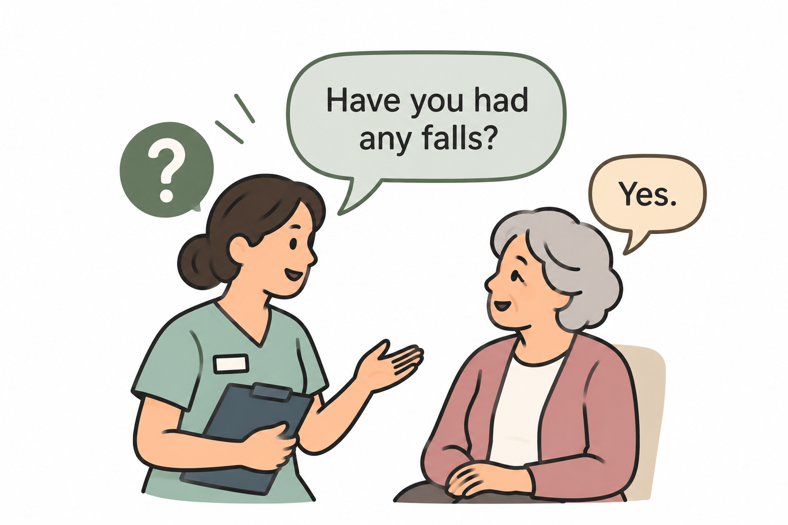
Meet Margaret
Margaret is 72 years old who is recovering from a stroke, she is receiving rehabilitation support to help her regain her confidence walking and her independence in which your role will be supporting her.
Margaret was active, independent, sociable and loved to talk up for herself.
She has become frustrated that others talk up on her behalf as it takes a while for her to process information and then say what she means.
She is frustrated she cannot go outside in her garden with a cup of tea unaided

Slide 14
Role play using linear model
Margaret 72 is recovering from a stroke 6 weeks ago and is preparing to continue her rehabilitation at home. A healthcare professional needs to give her information about using her walking aid safely.
You are to give clear information to Margaret on how she should use her walking aid around the house and how she should get up and down from her chair using it.
Margaret listens to the information but is not given an opportunity to ask questions or provide feedback.
Discuss what it is like to experience just giving clear instructions and what it is like to be Margaret experiencing not able to have the opportunity to ask questions.
Do you think effective communication has taken place?

Slide 15

15-MINUTE BREAK
Return ready to explore the Interactive Model

Slide 16

The Interactive Model
The interactive model recognises that communication as a two- way process.
The sender will send a message and waits for the feedback.
The health care professional can now determine whether the patient has heard, understood or misunderstood the information.

Slide 17
The Interactive Model
Communication becomes a two-way process through feedback.
MESSAGE
PERSON A
PERSON B
Healthcare professional
Patient / service user
FEEDBACK
Key feature
• Feedback allows clarification, questions and checking of understanding.
Notes:
The health care worker will send a message which could be in the form of closed or open questioning. Can be spoken or on a questionnaire. Example “have you taken your medication today?” person B “Yes.”
“What would you most like to be able to do independently again?” “I would like to make my own cup of tea and take it out and sit in the garden on my own”.

Slide 18
Interactive communication in healthcare
1. Medication
2. Procedure
3. Rehabilitation
• Professional gives dosage information.
• Patient asks when to take it.
• Understanding is checked.
• Professional explains fasting.
• Patient asks whether water is allowed.
• Information is clarified.
• Professional explains an exercise.
• Patient reports fear or discomfort.
• Communication can be adapted.
Notes:
The health care profession gives information, the patient responds, and the professional can then clarify, adapt or explain further. Example health care gives some exercises to do; Margaret responds,” she is worried to do them on her own in case she falls”. Health care professional checks out what part of these exercises make you worried the most. Margaret, “ When I stand up initially as I feel unsteady on my left side”.

Slide 19
Interactive model: strengths and limitations
Strengths
Limitations
• Allows feedback
• Supports clarification
• Identifies misunderstanding
• Encourages participation
• Helps check understanding
• Responsive to individual needs
• Can take longer
• Feedback can still be misunderstood
• Power differences may limit responses
• A patient may say yes without understanding
• Barriers can still remain

Slide 20
Activity 3: Repeat the drawing — now interact
• Repeat the task with a new image.
• Student B can now ask questions, clarify, repeat information and ask Student A to slow down.
• Compare the first and second drawings.
• What changed when feedback became possible?
• How could feedback improve safety and involvement in healthcare?

Slide 21

What are closed questions?
Require a short specific response
Yes/no
A number
A date
A factual answer.

Slide 22

Closed Questions
Do you use your walking aid at home?
Did you take your medication this morning?
Are you experiencing any pain right now?
Is the pain worse when you walk?
Can you walk independently to the bathroom?
Will someone be at home with you tonight when you return home?
Have you had any falls since returning home?
This Photo by Unknown Author is licensed under CC BY-SA

Slide 23

Why do we use open ended questions in health care
Gather
Gather more detailed information – “Tell me about the pain you have been experiencing?”
Explore
Explore feelings and concerns – “How are you feeling about going home?”
Identify
Identify what matters to the person most – “What is most important to you during your recovery?”
Identify
Identify individual needs and goal – useful in rehabilitation and care planning.
Encourage
Encourage patient participation rather than the professional controlling the conversation.
Build
Build rapport and trust- because the patient has space to explain their experience.

Slide 24
Open questions linking to the case study of Margaret
How have things been for you since your stroke?
What has been the biggest change in your life since coming home?
What would you most like to be able to do independently?
How do feel about other people helping you?
What worries you most about your recovery?
What would make you feel more confident at home?
What is the most important to you as you continue your rehabilitation

Slide 25
Overview of when would you use each type?
Closed: focused information
Open: understand the person
• Confirm medication or allergies
• Establish immediate safety or risk
• Clarify a detail
• Complete parts of an assessment
• Check a factual answer quickly
• Explore feelings or concerns
• Understand impact of illness
• Discover priorities
• Encourage participation
• Identify care or rehabilitation goals

Slide 26
Activity
Get into pairs or three’s
Read Margaret’s case study
Prepare questions to role play.
Think about what information the team you are working in need and write out some questions that will help you gather information.
There is no right or wrong it is your interpretation of gathering information that you agree in your pairs what you would like to get in order to help Margaret.

Slide 27
Case study: Margaret
Background
• Recovering following a stroke
• Team is considering mobility, safety and rehabilitation
• Family are concerned about independence
• Margaret wants her own voice to remain central.
“I don’t just want to recover from the stroke.
I want to feel like Margaret again.”
• What information does the team need?
• What questions would help them understand what ‘feeling like Margaret again’ means?

Slide 28
Consider some of these Questions to help Margaret
Closed: specific information
Open: experience and goals
• “Have you had any falls?”
• “Are you in pain today?”
• “Are you taking your medication?”
• “Do you need help getting dressed?”
• Useful — but these alone tell us little about her experience.
• “What has been the biggest change for you?”
• “What do you miss most?”
• “What would feeling like Margaret again look like?”
• “What would you most like to do independently?”
• “What should we focus on in rehabilitation?”

Slide 29
Quick check: Open or closed?
• 1. Are you in pain?
• 2. How would you describe your pain?
• 3. Did you sleep last night?
• 4. How have you been sleeping since coming home?
• 5. Can you walk to the bathroom independently?
• 6. What activities would you most like to become independent with again?
Then ask: Is one type always ‘better’?

Slide 30

15 mins
Next Role Play Margaret with Interactive model and closed and open questioning

Slide 31
Role-Play 2: Margaret — Interactive Model
Use both question types
Build the feedback loop
Aim
• Closed questions for specific information
• Open questions to explore experience
• Allow time for Margaret to respond
• Give information
• Ask a question
• Listen
• Clarify meaning
• Check understanding
• Adapt communication
• Discover what matters to Margaret
• Balance safety with autonomy
• Identify rehabilitation goals
• Make Margaret an active participant

Slide 32
Interactive example with Margaret
Professional: Have you been using your walking aid at home?
Margaret: Most of the time.
Professional: What tends to happen when you don’t use it?
Margaret: Sometimes I just want to do things myself. Everyone is watching me.
Professional: What would being more independent again look like for you?
Margaret: I’d like to make my own tea and go into my garden.

Slide 33
Linear vs Interactive: What changed?
Linear
Interactive
• One-way
• No built-in feedback
• Clarification is limited
• Patient may be more passive
• Useful for simple, clear information
• Risk: understanding may be assumed
• Two-way
• Feedback is central
• Clarification is encouraged
• Patient is an active participant
• Useful for consultation and care planning
• Feedback can still be misunderstood

Slide 34
Plenary: Exit ticket
Complete these three statements
• One difference between linear and interactive communication is…
• One barrier that could affect communication in healthcare is…
• One situation where I would use an open question with Margaret is…
Was the message SENT — or was the message UNDERSTOOD?

