Slide 1
GIT in practice
Dr Tim Bashford
Dr Mike Dacey

Slide 2
Repositories
Storing and managing source code.
  We store code in a “repository”
Tracking different versions of a code base.
Tracking bugs.
Sometimes fits into an entire ecosystem of code management.
  See: “build management”, “build automation” and “continuous integration”.
Useful for solo developers, almost mandatory for more than one.
  Lots of developers potentially working on the same files at the same time.

Slide 3
Managing code
At the most basic, you can think of repositories as creating “snapshots” of our code files.
  We can easily create a snapshot and revert to it if necessary.
  Useful if we want to try something we aren’t entirely sure about – we can revert to a working version of the code if needed.
  Possible to have lots of developers working simultaneously from the same snapshot – then merging all their code back together later.
    We should do this regularly to avoid any nasty surprises ☺.
Git is far from the only system for doing this, but it is presently the most popular by a significant margin.
  In this exercise, we’ll be talking about Git – but in practice could be referring to almost any version control/source code hosting system.

Slide 4
Using Git
We’ll start by using Git through the command line. There are lots of tools which can do at least some of the heavy lifting for us, but it’s worth getting an appreciation of what’s going on underneath.
We’ll need to install the CLI version of Git from:
https://git-scm.com/downloads

Slide 5
Navigating in the command line
Git uses a bash emulator in Windows, so provides a pseudo-Linux interface.
  Most of the basic Linux CLI commands work.
cd path Change directory to the path specified.
ls List structure – show the files and folders in this directory.
ls –l A more detailed version of the above.
mkdir name Create a directory with the name specified.
touch name Create a file with the name specified.
cat name Output contents of named file.
vi name Open the named file in a very basic, well-known but user unfriendly CLI test editor.
rm name Remove a file with the name specified.
rm –rf path Recursively remove a folder and all files and folders within at the path. Use
extreme caution!

Slide 6
Getting started
The first time we use git, we’ll need to specify who we are. This will become the name and e-mail attached to our config. We do this using:
  git config --global user.name “Username“
  git config --global user.email “Email“
Note that there’s no verification on this – you can say what you like. Actual user access to remote repositories is managed at a different level.

Slide 7
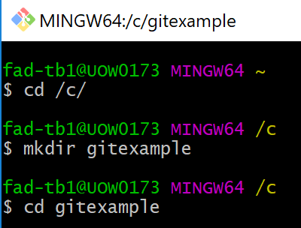
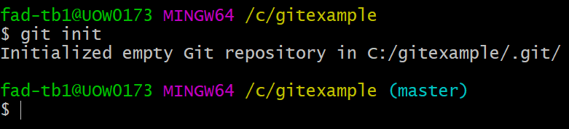
Getting started
To start working with Git, let’s make a dummy folder to work in. I’m going to create “gitexample” on the C drive.
To create a (local) git repo, use “git init”:
Note that now, the prompt says (master) – this is the name of the branch. More on this later.

Slide 8
Where is all this stuff going?
The eagle-eyed among you may notice that the previous message stated:
but navigating to the C:/gitexample folder may not show it. This is actually a hidden folder – in Unix, hidden folders start with a .
There are a few more hidden files/folders which git can use – we’ll talk about .gitignore later.
You can show these in the filesystem if you wish, but there’s generally no need to see the .git folder – we don’t really interact with it directly.

Slide 9
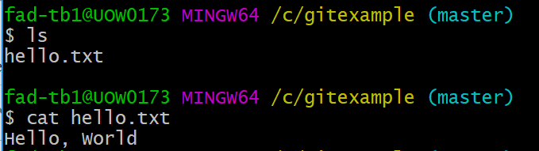
Working with files
For the sake of keeping this example reasonably simple, we’re going to be working with text files – but everything here is equally applicable to code files.
Let’s make a text file in this folder, which I’ll call “hello.txt”. I’ll also write “Hello, World” into this file.
  You can do this in or out of the CLI. Out is easier. ☺

Slide 10
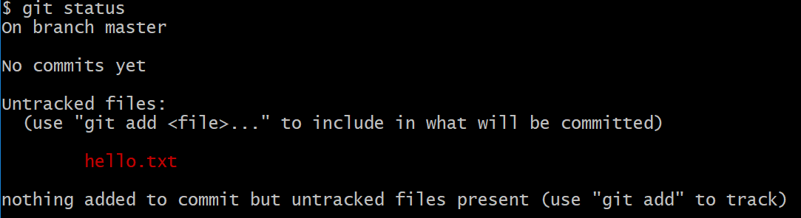
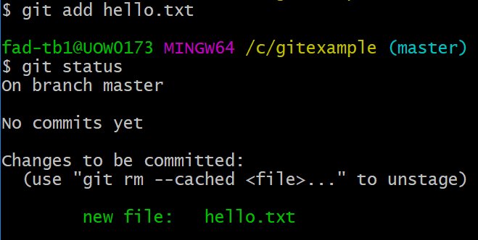
Adding a file to Git
We can use “git status” to view the current status of files in this folder:
This is reasonably easy to interpret – to have a file tracked by Git, we need to add it through “git add”. This is called staging.

Slide 11
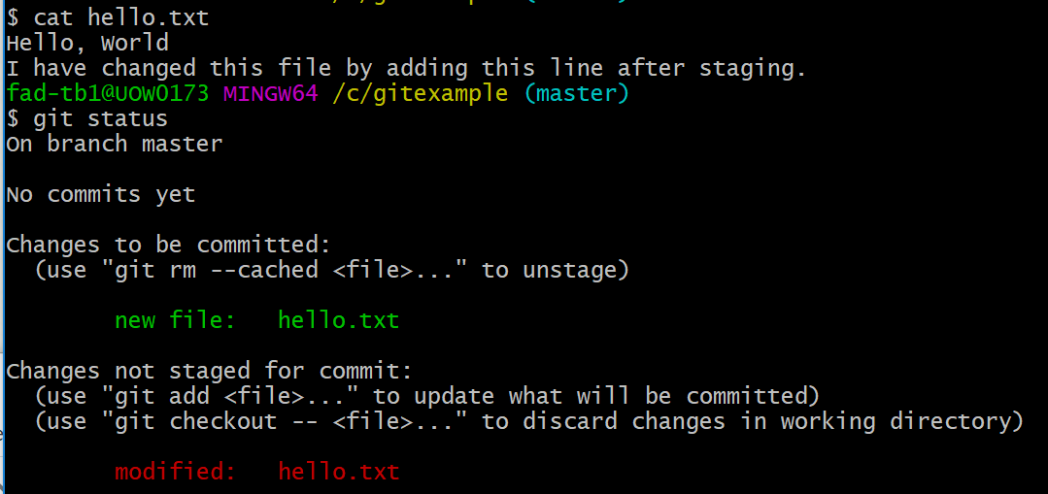
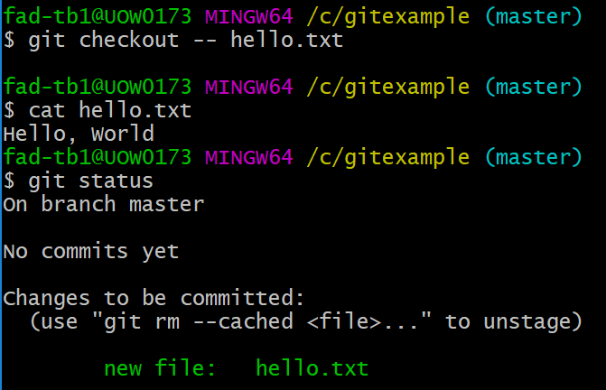
Staging
Staging creates a snapshot of the file at that exact moment. If you were to change the file, then check git status, you’ll see the staged file (in green) but also that it has unstaged changes (in red).
If you commit a file which has been modified after being staged, the staged version of the file will be committed. This can sometimes cause you problems, so be careful. It’s generally a good idea to stage your files, then immediately commit them (more on committing shortly).
Note: I then reverted this file to the staged version with
“git checkout -- hello.txt“
If I wanted to re-stage it, I would use
“git add hello.txt” again.

Slide 12
Committing
Once our “code” is at a point we’re happy with, we can commit it to Git. This creates a complete snapshot of all presently staged files.
You should commit to the local repository at any point you may later wish to come back to. This should be something you do often – certainly multiple times per day.
  Once you have some code functionality complete, such as a completed function that you’ve tested and are confident in.
  When you’re about to start doing something new in your code project, like implementing a new piece of functionality.
  If you’re about to try something small which may not work. You can trivially restore your files back to a previous commit.
    For something big which might not work, you’d use a branch – more on this later.

Slide 13
Committing
To create a commit, you can simply use “git commit”. You must always write a commit message with your commits, so the easiest way to do this is:
git commit –m ‘message’
Where message should be a meaningful message to help you remember what this commit was.
If you forget to add –m, you’ll end up in a vim interface. If you aren’t familiar with vim:
  Press the i key
  Type your message
  Press the escape key
  Type :wq and press return

Slide 14
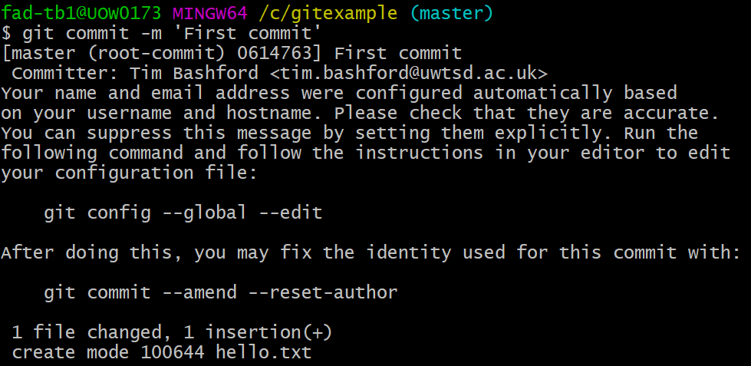
First commit
The final few lines state that we have inserted hello.txt to the repository.
This is a good reminder to explicitly set our name and e-mail using the commands listed. We need to do this, because we can use git to figure out who wrote a specific line of code – a very handy (if sometimes misused) tool.
We can navigate using the arrow keys, then use the x key to delete the hashes. :wq to write quit.

Slide 15
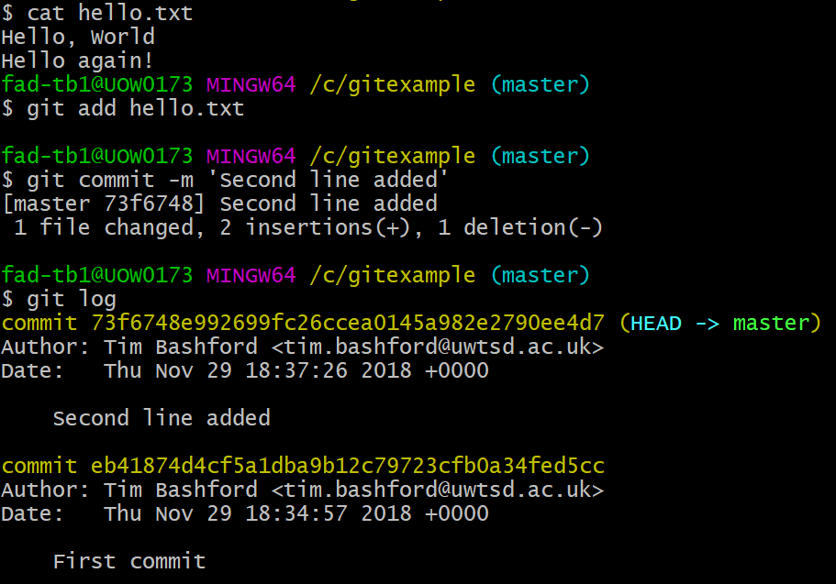
Second commit
Let’s make a change to our text file. I’ll add the line “Hello again!” below the first line.
We now need to re-stage the file with git add and perform a new commit.
git log shows us a log of all commits.

Slide 16
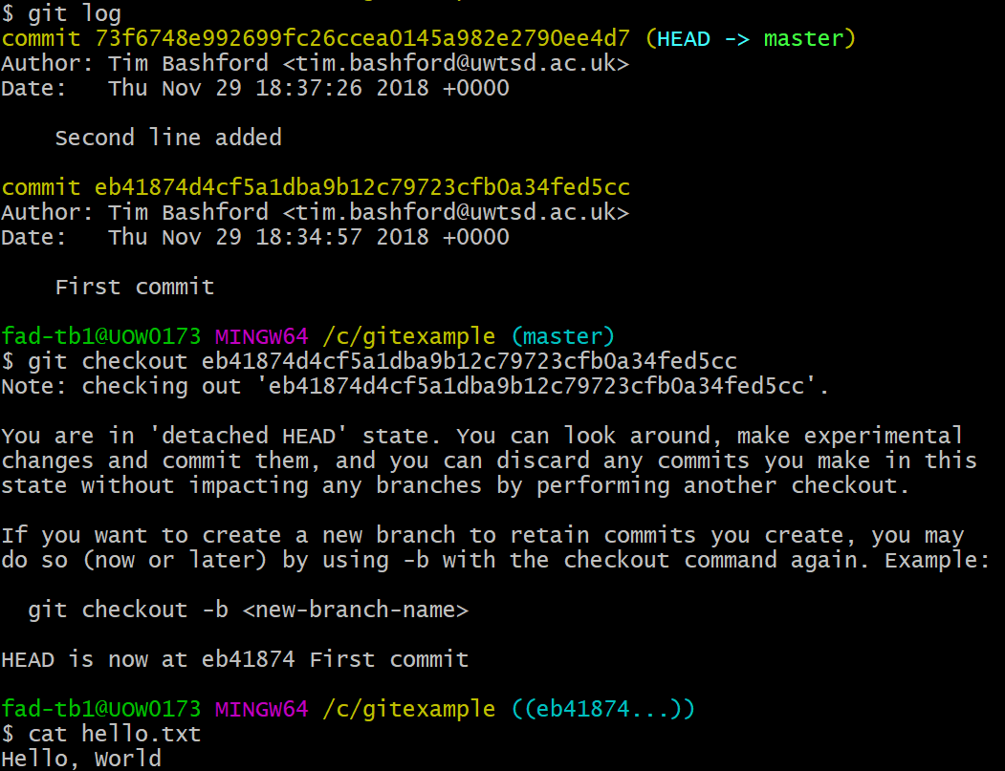
Going back in time…
Sometimes, we want to revisit a previous commit.
To go temporarily go back to an old commit, use “git checkout”:
“The HEAD”
Git has the concept of the HEAD – this points to the current commit. By default, Git has the HEAD commit at the tip of the branch, but using commands like checkout changes this such that the tip of the branch references an older commit.

Slide 17
Going back in time and rewriting history…
Or sometimes, if we’ve made a mess, we want to go back in time permanently. You can do this irretrievably by using
git reset --hard commitid
(though you can only do this if you haven’t published it to a remote repository yet)
Or retrievably using:
git revert commitid
This effectively performs the inverse of the commit and creates a new commit to the previous point, making that the new HEAD.
We don’t like people to know we’ve made mistakes, but we should pretty much always use revert. Often useful to be able to revisit our mistakes – especially if they later turn out not to’ve really been mistakes!
  We can revert reverts. ☺

Slide 18
Returning to the present
We can use:
git checkout –
To go back to wherever we were before the checkout
Or
git checkout branchname
To check out a particular branch. In this case, our only branch is called master, so we can use:
git checkout master
To go back to the latest commit in our main branch.
More on branches coming up…

Slide 19
Making life easier
Often you want to stage lots of files at once. Most of your code projects until now are probably made of one file, but believe me, as we enter OO in semester 2, this will swiftly change.
git add . Stage everything in the folder
git add *.py Stage all .py files. * is a wildcard
We can also create a special file called .gitignore
.gitignore is a list of files (or wildcard matches) stating which files we will never stage. This can be useful, because we can build a robust .gitignore file then git add . to stage everything else in one go.
Don’t add . to your gitignore file or you’ll never stage anything!

Slide 20
Branches
Branches in git are isolated copies of the development “trunk” (master).
By default, we create and work in the “master” branch – this is expected to be the working portion of the code.
  You can rename the master branch, but there’s no reason to so almost nobody does.
Branches allow us to try out something big and make commits to a completely separate area, without needing to worry about a big revert if things go wrong.
Most software development studios require new features to be developed in a separate branch.
  Reduces potential confusion among developers.
  Easy to go back if things to wrong.
There will usually be multiple simultaneous branches in existence – developers will work in their own branches from master.
  Sometimes a single developer will work on multiple features in different branches at the same time, but this gets very complicated very quickly, so isn’t recommended…

Slide 21
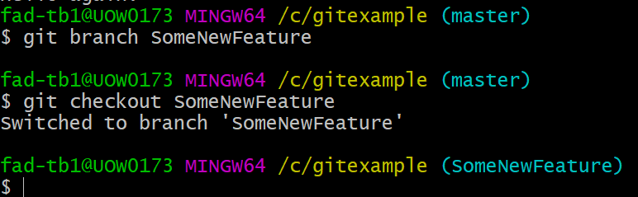
Creating a branch…
We can use:
git branch branchname
To create a new branch.
Important: you have to checkout your new branch!
git checkout branchname
Otherwise, you’ll still be working in master (or whichever branch you previously checked out).
Note the light blue text containing the branch name – after checking out the new branch, it changes.

Slide 22
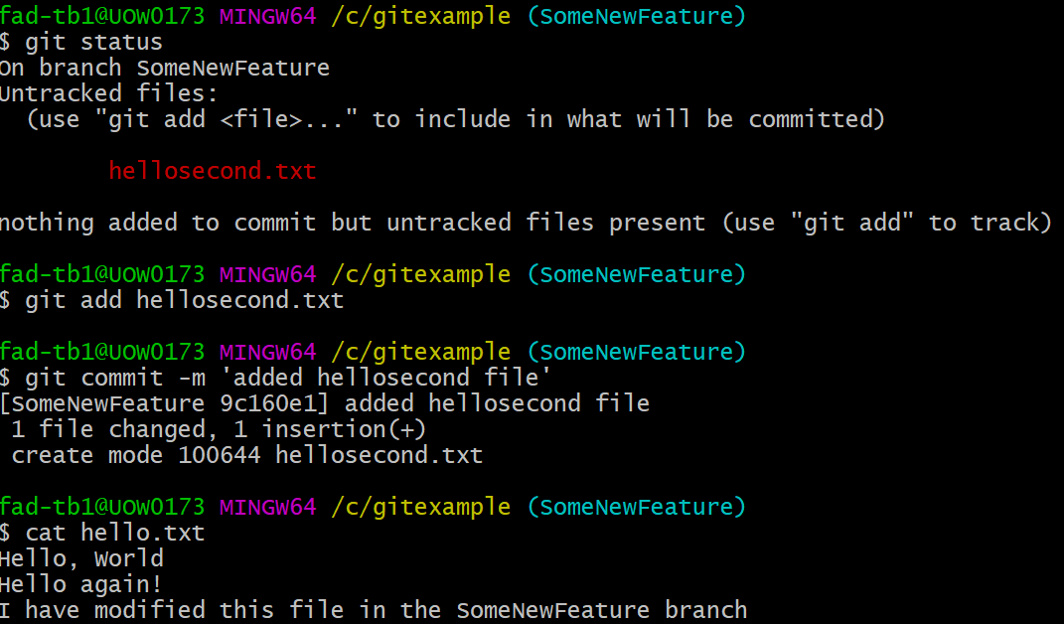
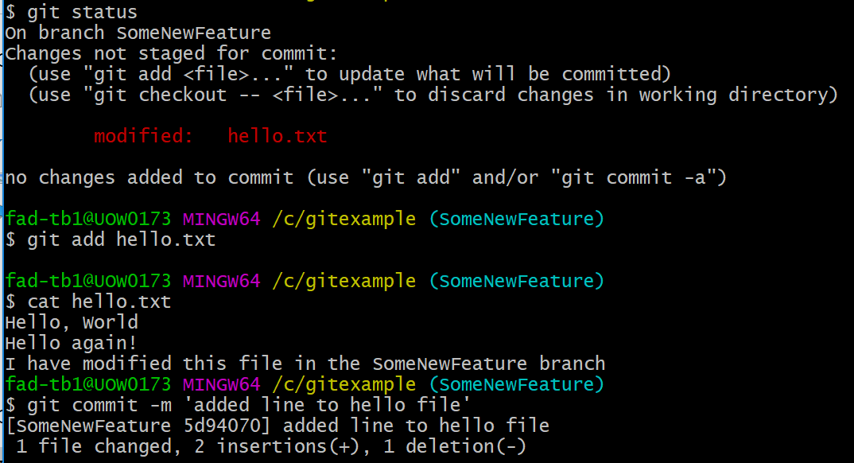
Working in a branch
Let’s make a few changes. I’m going to:
  Add a new file called “hellosecond.txt” with some text and then commit.
  And add a line to “hello.txt” then commit again.

Slide 23
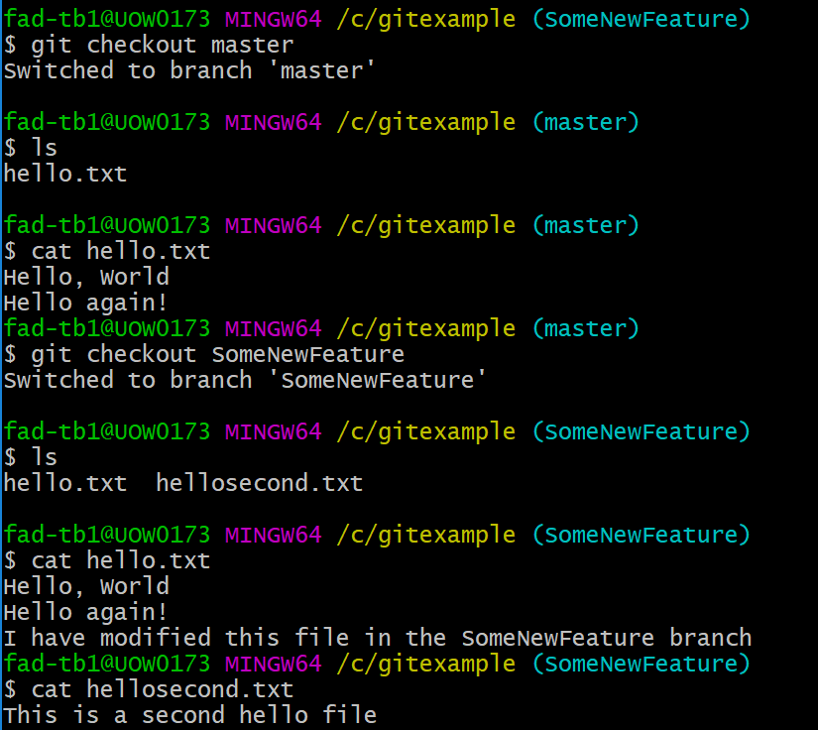
Moving between branches
I can easily jump between different branches using checkout. For example:

Slide 24
Merging branches
The end goal for every branch should always be merging it back into master.
  Usually once a feature or idea is successfully implemented.
In performing a merge, we need to be a little careful.
You must be on the branch you want to merge into (usually master). This is usually where people go wrong. I suggest you get used to checking (with git status) before performing a merge.
Use “git merge branchname” to merge that branch in to the current branch.
Resolve conflicts (more on this shortly).
Useful tip: list your branches with “git branch –a”

Slide 25
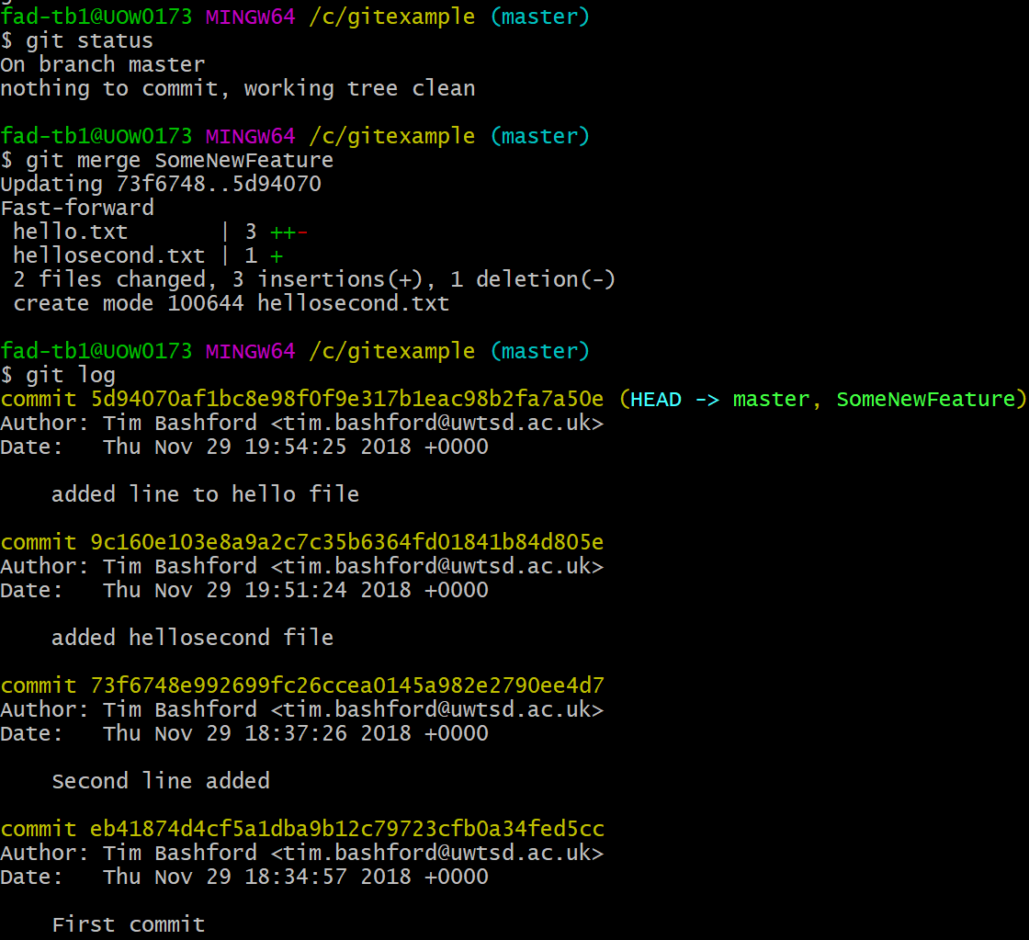
You might have noticed that the commits from the SomeNewFeature branch are now visible in the git log for the master branch. Next to the final commit, you’ll see HEAD -> master, SomeNewFeature which indicates that the branch was merged.

Slide 26
What happens to the branch?
Well, actually nothing. The branch continues to exist and you can continue to use it if you like – it’s still separate to master.
  You can continue to make changes on this branch and commit to it if you’d like.
  Sometimes you might like to perform a merge at a logical point part-way through development of a feature (when there’s enough code for it to make sense by itself). Note that breaking master is heavily frowned upon.
  Most people go with the branch, develop, merge once at the end approach, but there’s nothing terribly wrong with continuing to develop in a branch if it makes sense.
Alternatively, a branch can be deleted once you’re done with it.
git branch –d branchname deletes the branch.
git branch –D branchname force deletes the branch.
Force delete will work even if there are uncommitted/unmerged changes – so be a little careful with it.
Most development studios actually prefer branches to be left undeleted, or archived (additional reading: git tag).

Slide 27
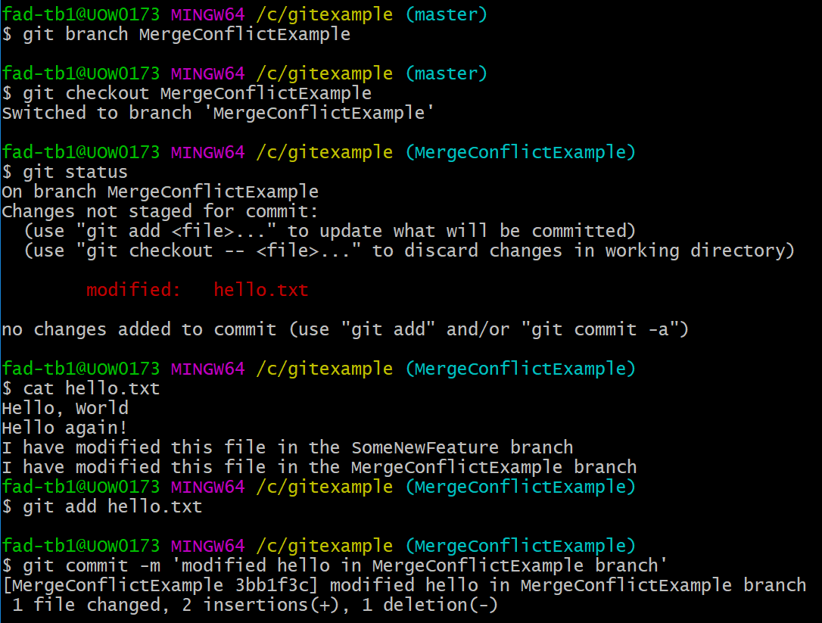
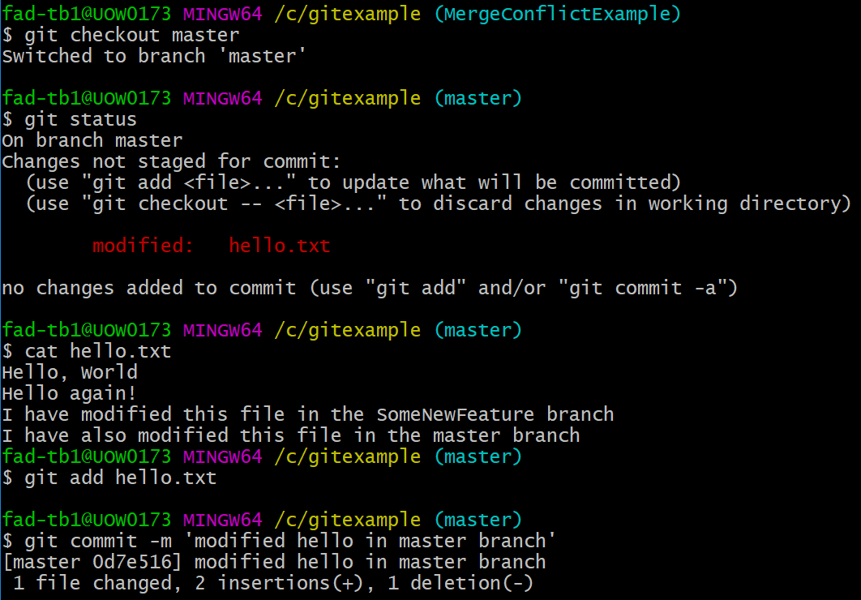
Dealing with conflict in the workplace
Merge conflict. Words that strike fear in the heart of every developer.
This usually happens when there’s a new commit on the branch you’d like to merge into. Let’s set up an example…

Slide 28
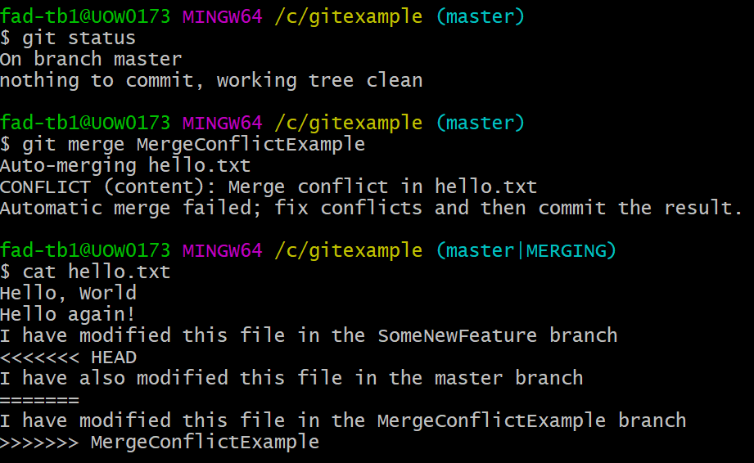
Resolving a merge conflict
You might have realised that I’ve now modified hello.txt on the MergeConflictExample branch and committed the change, then, before performing a merge, have simultaneously modified hello.txt on the master branch and committed that change.
Let’s try to merge…
Here, git is telling us about the conflict. I have printed the file so we can see that git has modified it, to give us some hints about what came from the master branch and what came from the MergeConflictExample branch.
We now have to resolve this conflict by manually editing the file… like barbarians.
There are also merge resolution tools available (outside the git suite). git mergetool for further reading. In my experience, these aren’t as helpful as you might hope.

Slide 29
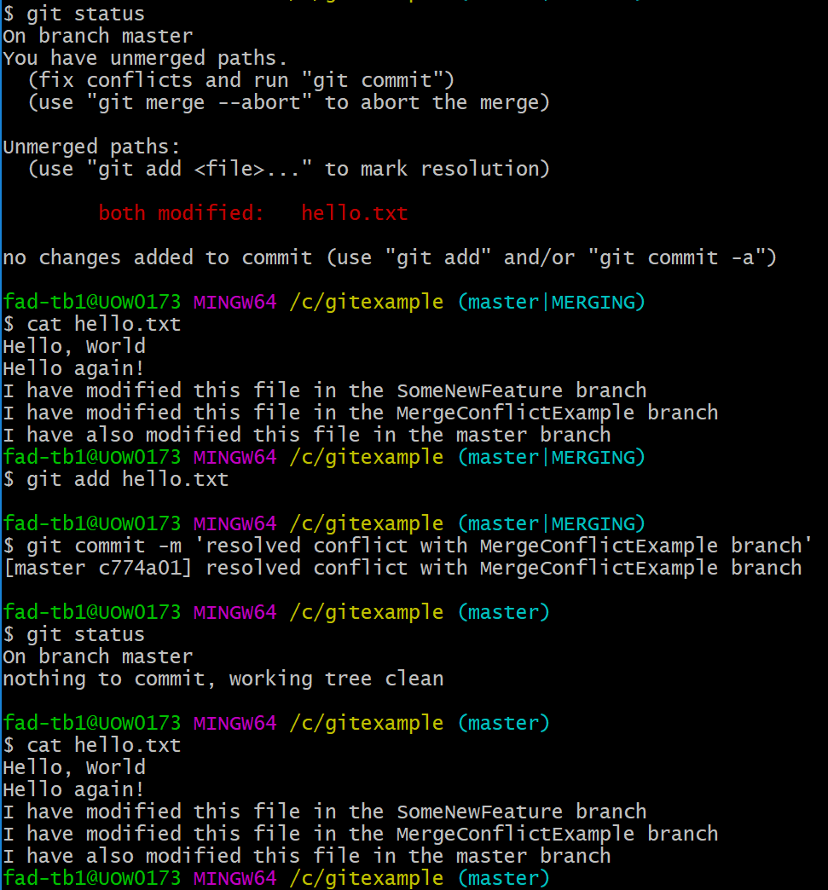
Conflict resolved!
I’ve modified the file manually to resolve the conflict. Check the branch and you’ll notice I’m in the master|MERGING branch, which means I either need to checkout a different branch or resolve the conflict to proceed.
To complete the resolution, I need to re-stage the file and commit the final changes.
Of course, this was a fairly trivial conflict. They can get very, very complex and unpleasant to unpick. This is why we commit often and early, and try not to leave branches unmerged for months.
Git will consider a conflict resolved no matter how you edit the file – but deleting a co-worker’s changes to “resolve” a conflict will both get you in trouble with your boss and inspire great antipathy and rage in your co-worker.

Slide 30
Working remotely
This is the big topic, which will make a lot of the previous stuff make a lot more sense.
Everything we’ve been doing up until now has involved a local repository – which exists on our computer and is almost certainly only used by us (or at least those with physical access).
Development studios work on remote repositories which exist on servers. Some large services exist for hosting Git repositories, including Github and Bitbucket (though many companies host their own).

Slide 31
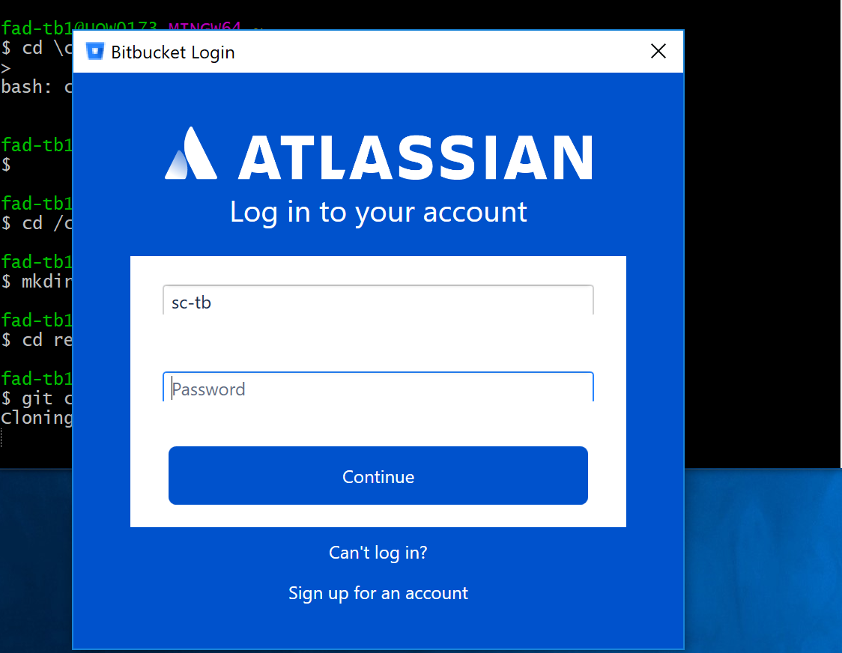
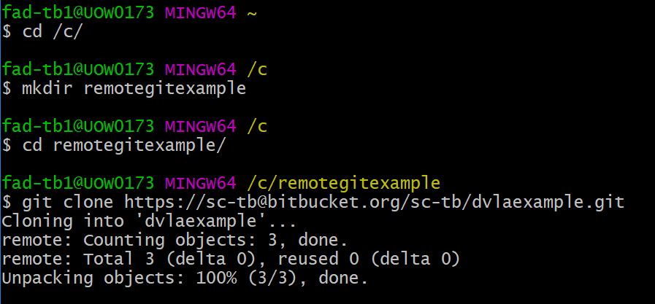
Working remotely
Thinking all the way back to the start, we, of course, ran the command “git init” to create a local repository. Instead, when working on a remote repo, we begin by issuing a command to clone it to our local filesystem and into our local repo.
git clone uri
Interestingly, Bitbucket repos throw up a flashy GUI to log in. Lesser-known repos will just ask you through the console.

Slide 32
Working remotely
When done, this will clone everything in the repo. There’s not much in this one because it’s newly created, but if there were code files, they would’ve been downloaded.
The file this repo does contain, README.md is a special git file which pretty much all repos have. It just contains information about the repo. It uses a fairly well-known format called “markdown”.

Slide 33
Working remotely
When we clone from a remote repo, git will retain where the URI, aliased with a name, which is, by default, “origin”. You can change this, but again, nobody really does. We can remind ourselves of where the remote repo is with
git remote gives us a list of remote aliases
git remote –v lists remote aliases with URIs.

Slide 34
Working remotely
There are three commands we mostly need to know about:
git fetch remotealias Re-downloads the latest data from the repo, but does not automatically merge, you’ll need to do this yourself.
git pull remotealias Re-downloads the latest data from the repo and automatically merges into the active branch.
git push remotealias branch Sends changes to remote repo known through remotealias and commits changes to the named branch.
You cannot git push unless the branch you are committing was up to date with the remote repo. This means you will have already resolved any merge conflicts on the local repo during the fetch and merge or pull.

Slide 35
The tip of the iceberg…
Git is a deep, complex topic. Nearly all developers use it and the workflows here will get you through most situations – but you will occasionally need to think on your feet and learn through experience.
Here are a few more useful commands with specific use cases:
git commit –a Commits, automatically staging all tracked files.
git blame Tells you who changed what in a file. As the name suggests, usually used to figure out who made a mess.
git diff Shows changes from previous commit (whether staged or not).
git rebase An alternative to merge. Take the changes you made and apply them to (usually) the latest commit. This helps you manage large merges with numerous changes, but should be used carefully and sparingly.

Slide 36
You mentioned something about tools…
Well, yes, I suppose I did. Visual Studio, VSCode, plus pretty much every popular IDE you’d care to name has some sort of git plugin or toolbar which does the work for you.
What plugins really do, however, is run the CLI command for you when you press a button. When we’re familiar with git, they’re a convenient timesaver, but they are not a panacea…
  We will, occasionally, encounter complex situations which the tool cannot resolve. This will require us to firstly understand the nuance of the problem and secondly delve into the CLI to fix it.
Start working with git for your solo projects too. Though it might not feel like it initially, it will save you time long-term.

Slide 37
Further learning
A fun game that can teach you git concepts visually:
https://learngitbranching.js.org/
It actually gets reasonably tricky towards the end and explores a few problems we haven’t studied here. A fun way to semi-productively kill a few hours.
A good list of things you can do wrong and how to fix them:
https://www.codementor.io/citizen428/git-tutorial-10-common-git-problems-and-how-to-fix-them-aajv0katd
Study the list to see if you can understand exactly what’s being done. You may need the reference manual: https://git-scm.com/docs (which is also excellent).

