Slide 1
GIS
B Holland
Longitude and Latitude

Slide 2
Introduction
The Geographical Information System provides only a computer representation of the read world.
This is a simplified view of reality, but hopefully containing the features important to your study.
The GIS should be populated with ideas about how these data interact and this can be termed a spatial model.
Chorley et al suggest that a spatial model places emphasis on reasoning about the real world by means of translations in space.
Thus we can solve geographical problems that would be otherwise difficult to model.

Slide 3
Topographic, Thematic etc..
There are many different types of maps. However (Robinson et al..) the following processes need to be considered:
Establish the purpose
Define the scale
Select the feature (spatial entities) from the real world that you want to portray
Choose a method to represent the features point line area
Generalize the feature to provide a two dimensional representation
Use a map projection
Apply a spatial referencing system to locate features relative to each other
Annotate your map with keys Legends and appropriate text.

Slide 4
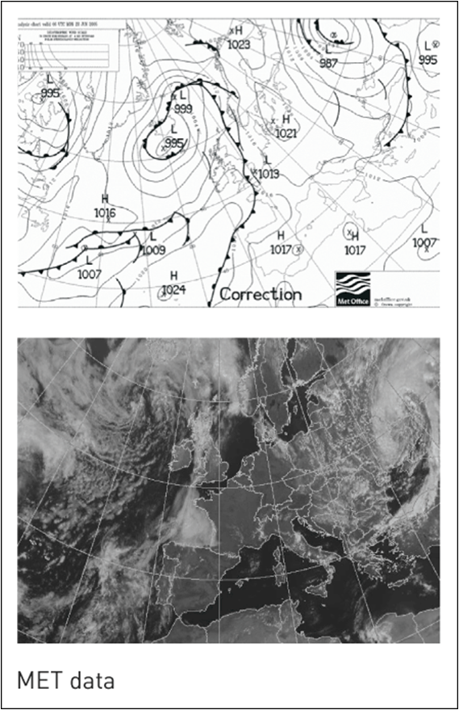
Data on the Earths Surface

Slide 5
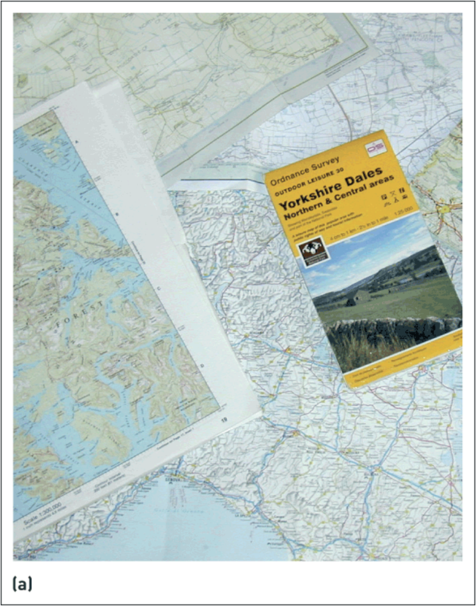
Examples of (a) paper maps
Source: (a) Maps reproduced by permission of Ordnance Survey on behalf of HMSO. © Crown Copyright 2006. All rights reserved. Ordnance Survey
License number 100030901; image shown on map brochure courtesy of Peter Baker / International Photobank

Slide 6
Scale
Virtually all maps and spatial data are smaller than the reality they represent.
Scale gives us an indication of their real size.
We could think of scale as an order of magnitude or the level of Generalisation applied to the objects.

Slide 7
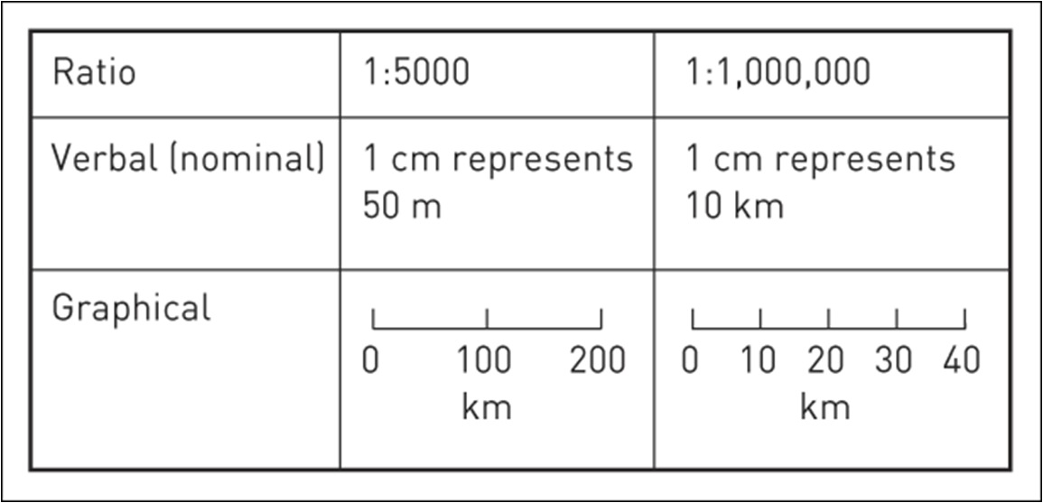
Expressions of scale

Slide 8
Spatial Entities
Usually represented by point line or area
This could depend on the scale of the mapped area you are trying to model
OS used different methods of representation depending on the scale

Slide 9
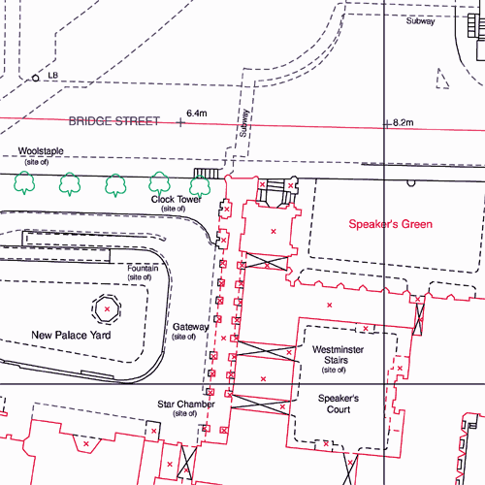
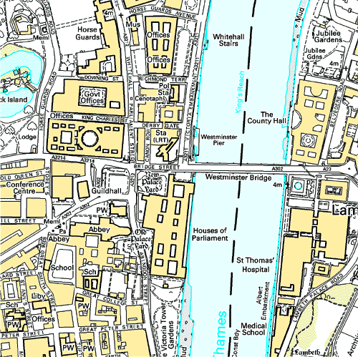
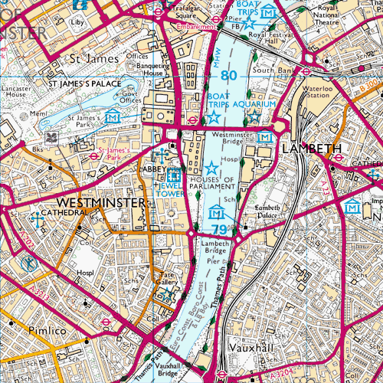
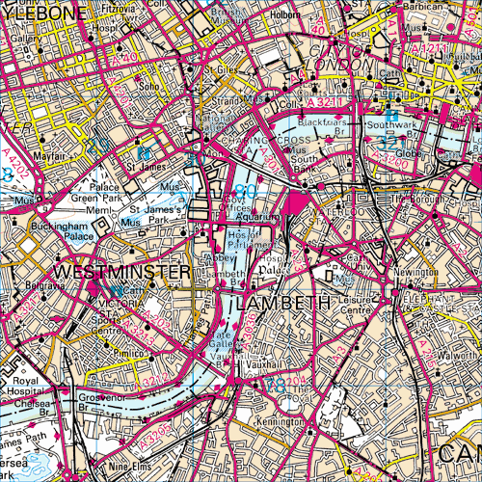
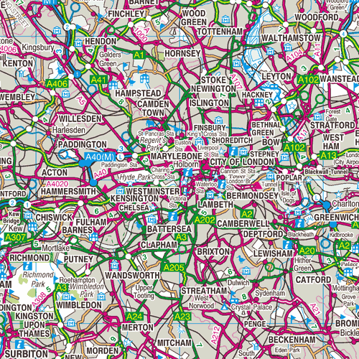
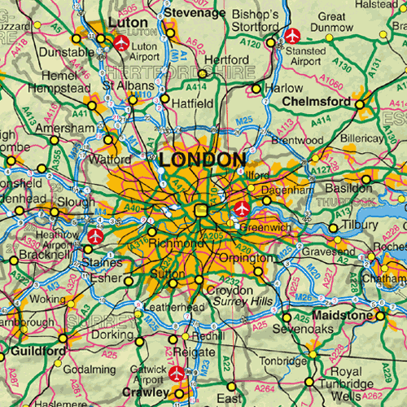
OS Superplan, Landplan, Explorer, Landranger, Tour, Route maps Crown copyright 2006

Slide 10
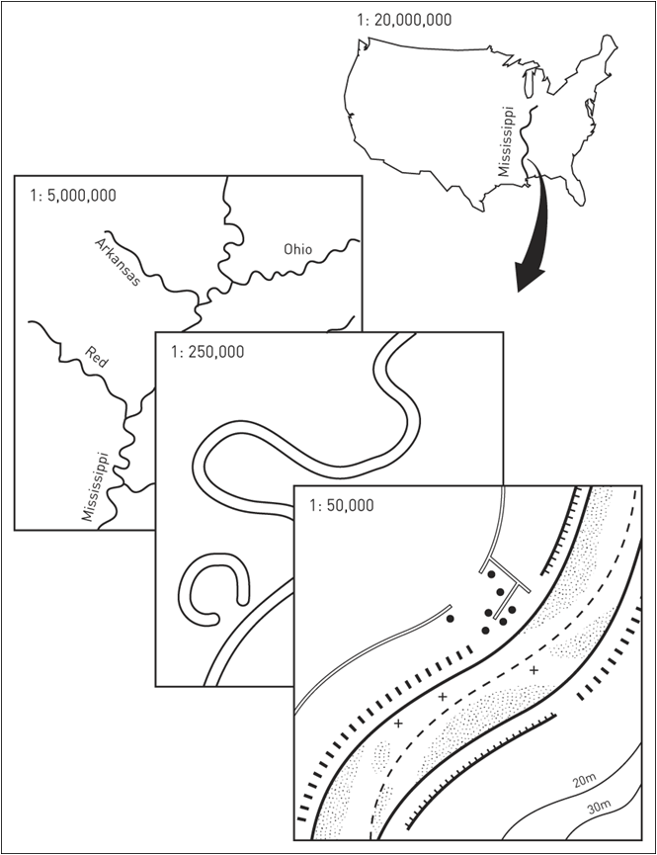
Scale-related generalization
the process of reducing detail on a map as a consequence of
reducing the map scale

Slide 11
Understand Longitude and Latitude Coordinates
& Map projections

Slide 12
X and Y
There are two major axes that separate the world. Vertical lines are called Longitude lines, and they refer to the X-coordinate. Horizontal lines are called Latitude lines, and they refer to the Y-coordinate .
The location of the Equator is identified by the X-axis at zero degrees Latitude (wrapping around the globe like a horizontal belt). The Location of the Prime Meridian is identified by the Y-axis at zero degrees Longitude (wrapping around the globe from top to bottom vertically).
The place where the Equator and Primer Meridian intersect creates four quadrants
The first quadrant has both positive X and Y coordinates, the 2nd quadrant has negative X and positive Y coordinates. The third quadrant has negative X and negative Y coordinates, and the 4th has positive X and negative Y.
These basic concepts will help you understand how to get your records with coordinate information on the map.

Slide 13
Create Points
Some of the data you use may contain X and Y coordinates for the location of that record. If this is the case, MapInfo can read those coordinates and create a point at that location using the “Create Points” command.
Before plotting the data on the map, you should have an understanding of the basics of longitude/ latitude coordinates and how they relate to the surface of the earth.

Slide 14
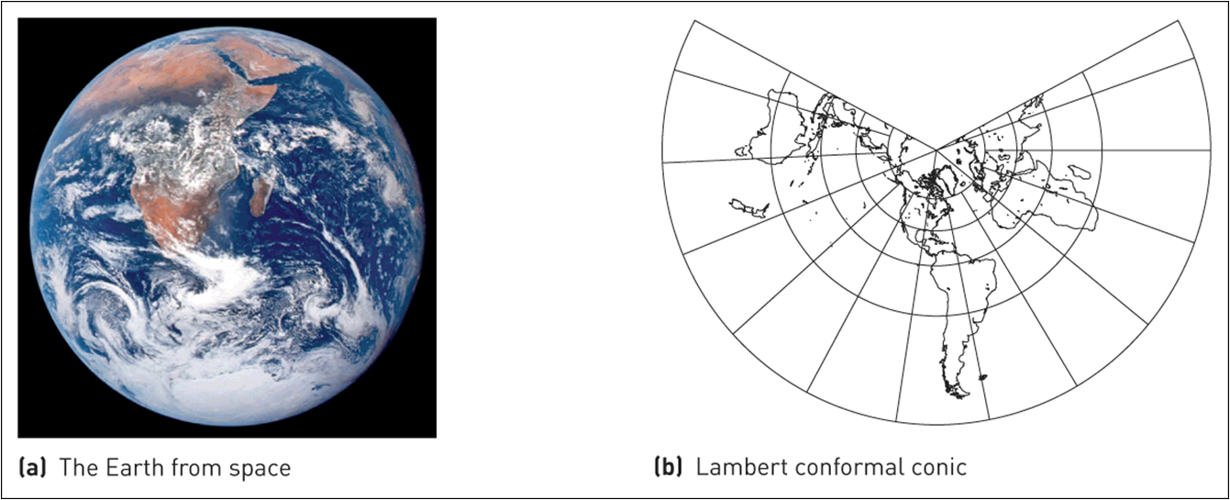
The Earth from space and some commonly used global map projections

Slide 15
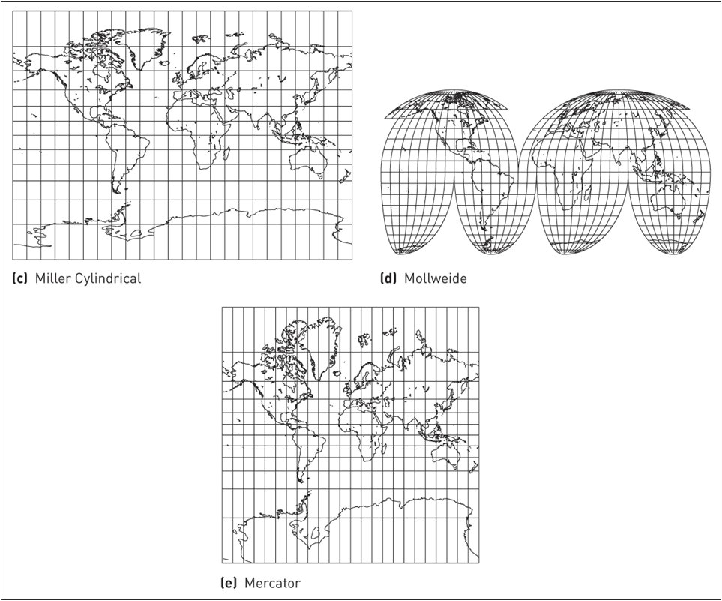

Slide 16
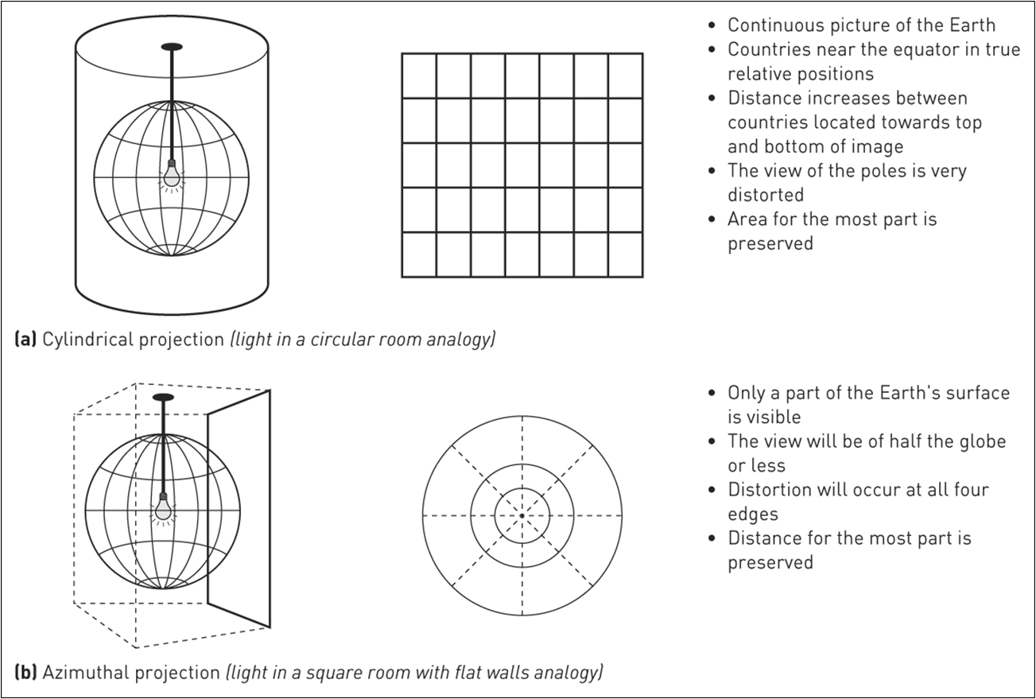
Projections: (a) cylindrical; (b) azimuthal

Slide 17
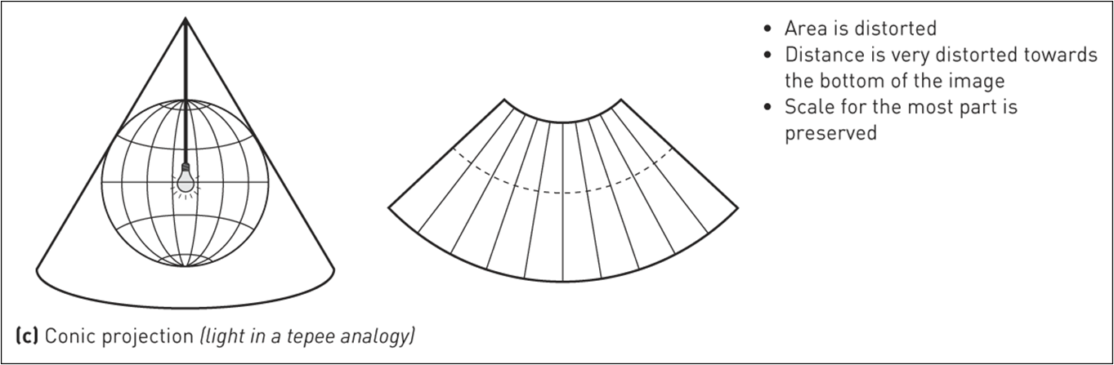
Projections: (c) conic (Continued)

Slide 18
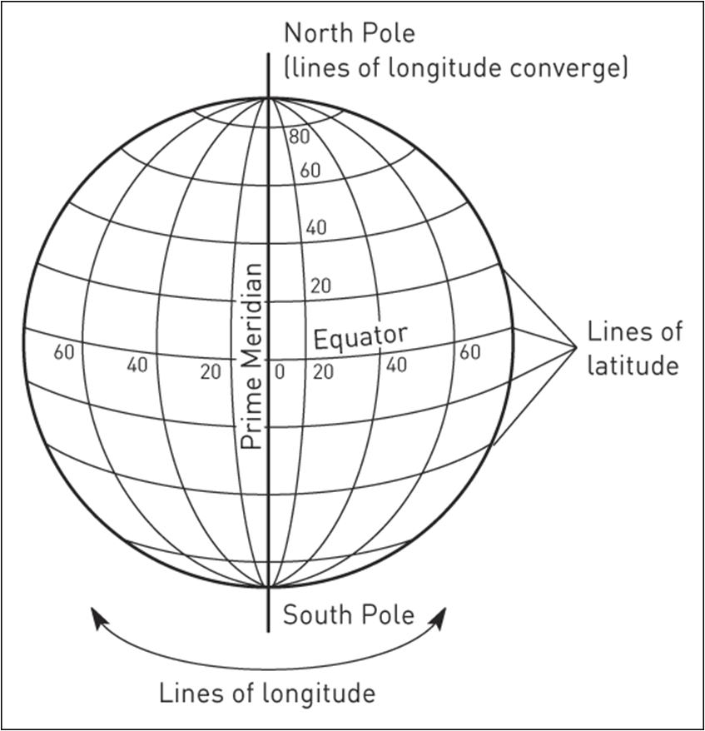
Latitude and longitude

Slide 19
The first quadrant has both positive X and Y coordinates, the 2nd quadrant has negative X and positive Y coordinates. The third quadrant has negative X and negative Y coordinates, and the 4th has positive X and negative Y.

Slide 20
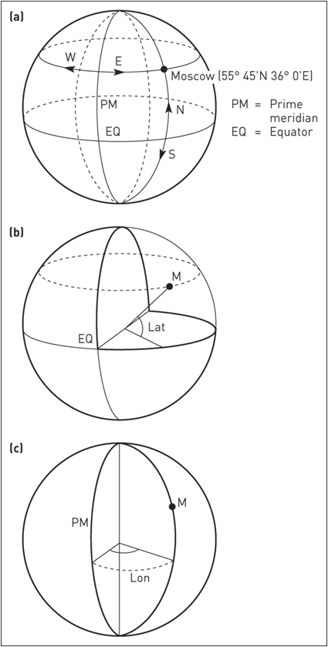
a) Latitude and longitude of Moscow; (b) calculating the latitude;
(c) calculating the longitude

Slide 21
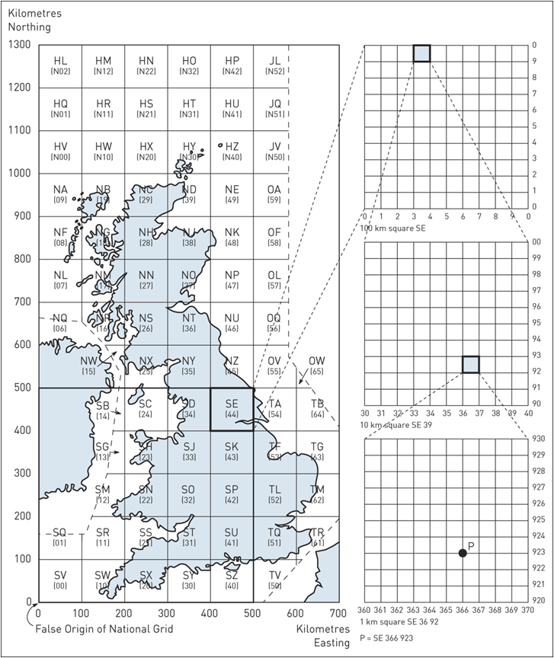
The Ordnance Survey National Grid system

Slide 22
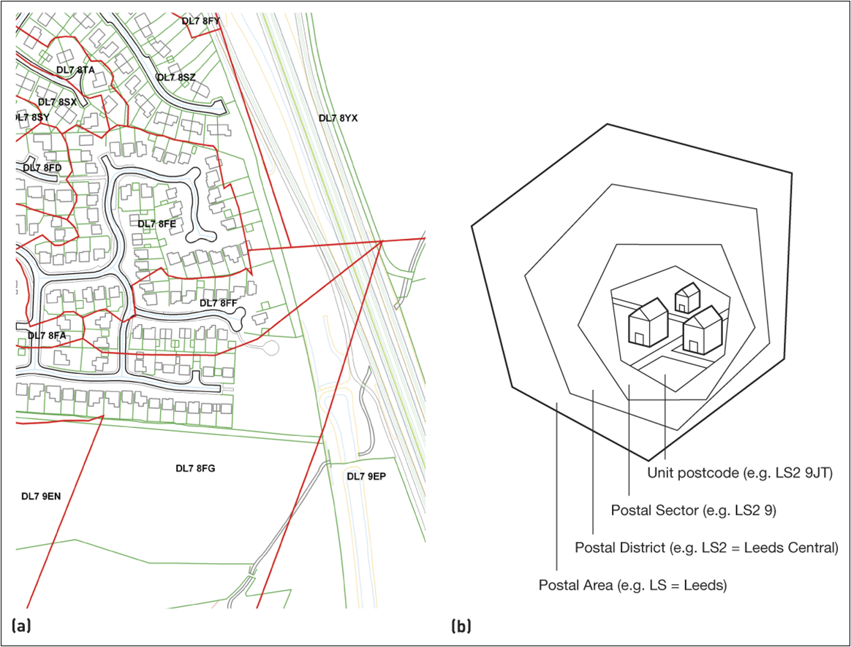
The UK postcode system

