Slide 1
MSC COMPUTING PORTFOLIO — VIVA PRESENTATION
By- Yash Deepakkumar Grawal
Student Id- 2511041
Assessing Machine Learning-Based
Cybersecurity Risk Models of IoT Devices
A quantitative, machine learning-based approach to assessing and prioritising cybersecurity risk in heterogeneous IoT environments
19bn → 32bn
CICIoT2023
2 ML models
connected IoT devices, 2024–2030
public IoT cybersecurity dataset
Logistic Regression & Random Forest

Slide 2



CHAPTER 1 · INTRODUCTION
The IoT Cybersecurity Challenge
The rapid growth of connected IoT devices has outpaced the ability of traditional, static methods to assess cybersecurity risk across diverse device populations.
GLOBAL IoT GROWTH
IoT devices are proliferating fast
~19 billion connected devices in 2024, projected to exceed 32 billion by 2030 (Lal et al., 2023).
Detection ≠ risk assessment
Most ML research classifies malicious vs benign traffic, but rarely produces a quantitative, prioritised risk score.
Traditional models fall short
Growth of this scale multiplies the number of devices, protocols and behaviours that must be risk-assessed simultaneously.
CVSS and NIST frameworks are structured but static, and struggle to reflect dynamic, heterogeneous IoT behaviour.
02

Slide 3




CHAPTER 1–2 · PROBLEM & GAP
Problem Statement & Research Gap
THIS STUDY ADDRESSES THE GAP BY:
THE PROBLEM
Vulnerability scores (e.g. CVSS) and frameworks (e.g. NIST CSF) are consistent, but static — they don't capture dynamic network exposure, device behaviour or interaction effects across heterogeneous IoT fleets.
Defining a measurable, binary cybersecurity risk outcome from network-flow data
Identifying relevant IoT risk indicators via mutual information analysis
THE LITERATURE GAP
Building & comparing two complementary ML models (Logistic Regression, Random Forest)
ML research on IoT security (UNSW-NB15, N-BaIoT, CICIoT2023) is dominated by attack detection & classification — not quantitative, prioritised, device-level risk scoring.
Benchmarking ML against a conventional threshold-based heuristic
03

Slide 4
CHAPTER 1 · AIM & OBJECTIVES
Aim, Objectives & Research Questions
AIM
Develop and evaluate a machine learning-based quantitative cybersecurity risk assessment model for heterogeneous IoT environments.
OBJECTIVES
RESEARCH QUESTIONS
1
Critically review existing risk assessment & ML-based security methodologies for IoT
RQ1
What gaps exist in IoT risk assessment, and what role can ML play?
2
Identify key IoT cybersecurity risk indicators (vulnerability, behavioural, network exposure)
RQ2
Which IoT-specific risk indicators are most relevant to cybersecurity risk?
3
Develop a ML-based quantitative risk assessment model for IoT devices
RQ3
How can a ML-based quantitative model be developed to assess IoT risk?
4
Evaluate model performance & reliability against traditional risk assessment approaches
RQ4
How accurately does the proposed ML model perform vs traditional approaches?
04

Slide 5



CHAPTER 2 · LITERATURE REVIEW
Positioning This Study in the Literature
IoT Threat Landscape
Traditional Models
ML for IoT Security
Predictive Risk Modelling
Heterogeneous devices, protocols and limited on-device security create diverse attack surfaces (Okolo 2023; Alfahaid et al. 2025).
CVSS & NIST CSF are consistent but static — they don't reflect dynamic network exposure or device behaviour.
Extensive work on intrusion/attack detection (Inayat et al. 2022; Khan et al. 2023) — mostly binary malicious/benign classification.
Emerging but limited: Barlybayev et al. (2024), Simanjuntak (2024) explore ML-based risk modelling, rarely device-level & quantitative.
RESEARCH GAP:
Existing IoT-ML studies rarely move beyond detection to a quantitative, prioritised, device-level cybersecurity risk score — the specific gap this dissertation addresses.
05

Slide 6
CHAPTER 3 · METHODOLOGY
Research Methodology
Positivist Philosophy
Deductive Approach
Design Science Research
Objective, measurable evaluation of numerical network-flow data; no participants or interviews.
Theory (Ch.2) → risk indicators → data → preprocessing → modelling → evaluation.
Overarching approach: design & evaluate a computational artefact — the risk assessment model.
CRISP-DM DATA SCIENCE PROCESS
1
2
3
4
5
6
Business
Understanding
›
Data
Understanding
›
Data
Preparation
›
Modelling
(LR & RF)
›
Evaluation
›
Deployment
(discussion)
Dataset: CICIoT2023 (public) · Fixed random seed = 42 for reproducibility · Ethics: low-risk — secondary, public, non-human-subjects data
06

Slide 7
CHAPTER 4 · DESIGN
Dataset & Risk Outcome Design
RISK OUTCOME OPERATIONALISATION
CICIoT2023 DATASET
Benign
Risk Level 0 — Low
Network traffic from 105 real IoT devices, spanning benign traffic and 7 attack categories: DDoS, DoS, Reconnaissance, Web-based, Brute Force, Spoofing, Mirai.
Reconnaissance, Brute Force, Spoofing
Risk Level 1 — Medium
10,000
observations
14
DoS, DDoS, Mirai
Risk Level 2 — High
variables (13 predictors + category)
80 / 20
train / test split, stratified
› binary collapse: risk_level ≥ 2 ›
Predictors include flow duration, protocol, packet rate/count, bytes sent/received, TCP flags, packet-size statistics, inter-arrival time, flow rate & ports.
LOW RISK
HIGH RISK
9,165 obs.
835 obs.
07

Slide 8
CHAPTER 4 · DESIGN
Feature Selection & Model Design
TWO COMPLEMENTARY MODELS
FEATURE SELECTION
Mutual information (SelectKBest, k='all') ranks the 13 predictors against the binary risk outcome. Variables are kept until cumulative importance reaches ~95%.
Logistic Regression — baseline
Linear, interpretable binary classifier. GridSearchCV (5-fold, F1-optimised) over C ∈ {0.01, 0.1, 1, 10, 100}, solvers {liblinear, lbfgs}, max_iter ∈ {1000, 2000}.
7 of 13
features selected: tcp_flags, flow_duration, packet_count, bytes_sent, packet_size_mean, packet_size_std, flow_rate
CLASS IMBALANCE
SMOTE applied to the training set only (never the test set) to upsample the minority high-risk class and avoid data leakage.
Random Forest — nonlinear
Tree-based ensemble capturing nonlinear relationships + feature importance. Grid search over 100/200 estimators, max depth 10/20, min split 2/5; 5-fold CV, F1-optimised.
REPRODUCIBILITY
Fixed random seed (42) throughout; StandardScaler fit on training data only, then applied to test data.
08

Slide 9
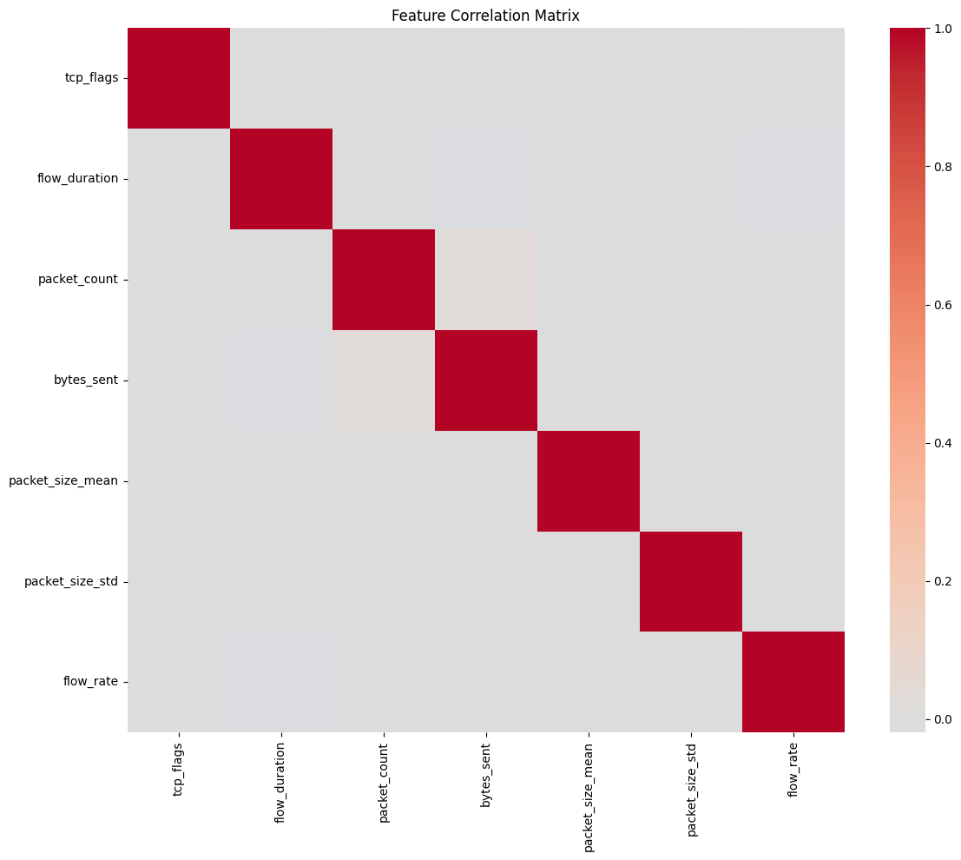
CHAPTER 6 · RESULTS 1 OF 3
Dataset Outcome & Feature Selection Results
10,000
total observations, 0 missing values
Figure 6.3 — Feature Correlation Matrix (selected predictors)
9,165 / 835
low-risk vs high-risk (91.65% / 8.35%)
14,664
training rows after SMOTE (7,332 / 7,332)
7
features retained at ~95% cumulative MI
tcp_flags ranked #1 by mutual information (0.00675) — TCP-control behaviour and connection duration carry the most signal, though absolute MI values remain low.
09

Slide 10
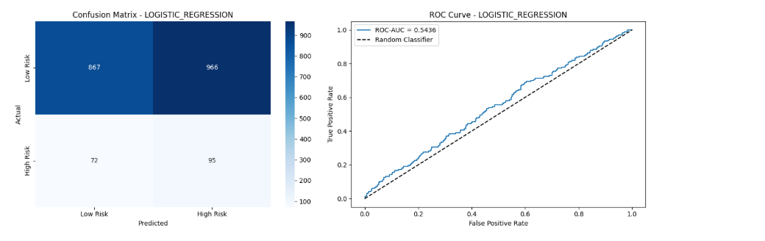
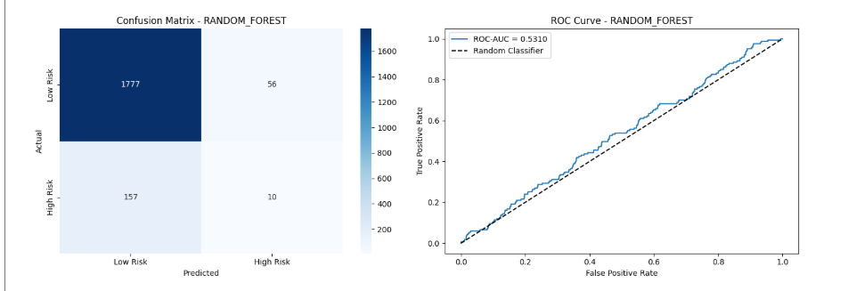
CHAPTER 6 · RESULTS 2 OF 3
Logistic Regression vs Random Forest
Metric | Logistic Regression | Random Forest
Accuracy | 48.10% | 89.30%
Precision | 8.95% | 14.93%
Recall | 56.89% | 5.99%
F1-score | 15.47% | 8.55%
ROC-AUC | 0.5436 | 0.5311
Confusion Matrix & ROC — Logistic Regression (Fig. 6.4)
Confusion Matrix & ROC — Random Forest (Fig. 6.5)
Recall & F1 matter most: they measure whether high-risk devices are actually caught.
Logistic Regression: safer, higher recall
Random Forest: higher accuracy, misses high-risk cases
10

Slide 11
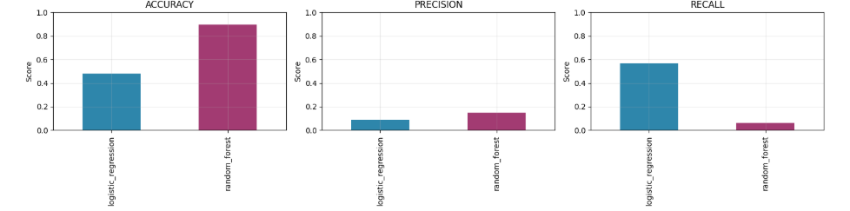
CHAPTER 6 · RESULTS 3 OF 3
Machine Learning vs Conventional Assessment
CONVENTIONAL HEURISTIC
Flags risk when packet rate, flow rate & packet count exceed test-set means
Accuracy
73.50%
Precision
6.89%
Recall
17.37%
F1-score
9.86%
Figure 6.7 — Accuracy, Precision & Recall: Logistic Regression vs Random Forest
KEY TAKEAWAY
No single method wins on every metric. Logistic Regression gives the largest relative gain in Recall (+227.6%) and F1 (+56.9%) over the conventional heuristic — the priority for cybersecurity risk detection. Random Forest achieves the highest Accuracy (+21.5%) and Precision (+116.7%), but at a substantial Recall cost (−65.5%). Both ML models show ROC-AUC close to 0.5, so results should be read cautiously.
11

Slide 12

CHAPTER 6 · DISCUSSION
Interpreting the Results
Accuracy can mislead
Recall is the safety metric
Random Forest's 89.30% accuracy comes largely from correctly classifying the low-risk majority — it caught only 10 of 167 high-risk cases.
In cybersecurity, a false negative (missed high-risk device) is more costly than a false positive. Logistic Regression's 56.89% Recall is the more defensible choice here.
Weak discrimination overall
Label construction matters
Both models' ROC-AUC (~0.53–0.54) sit close to 0.5, indicating limited discriminatory power — a caution against over-claiming predictive strength.
1,318 'Malicious' observations remain unmapped to the binary outcome; attack labels are largely independent of the network-flow features used.
12

Slide 13


CHAPTER 7 · CONCLUSIONS
Conclusions
The study demonstrates the methodological feasibility of combining network-flow indicators, feature selection, class balancing and ML for quantitative IoT cybersecurity risk assessment.
Objectives met: risk indicators identified, ML models built, and evaluated against a conventional baseline
Logistic Regression best serves the risk-detection priority (highest Recall & F1)
Random Forest best serves overall Accuracy & Precision, but under-detects high-risk cases
Accuracy alone is an insufficient evaluation criterion for cybersecurity risk models
Bottom line: choose the evaluation metric — and the model — to match the cybersecurity decision being made, not the other way around.
13

Slide 14

CHAPTER 7 · RECOMMENDATIONS
Recommendations & Future Work
Refine the risk mapping
Give the 1,318 unmapped 'Malicious' observations a clear, defensible risk classification before further model development.
Use richer, labelled real-world data
Broader IoT datasets with more devices, behaviours and attack types to improve discriminatory power (current ROC-AUC ≈ 0.5).
Engineer temporal & behavioural features
Capture patterns that individual flow variables cannot express alone.
Evaluate beyond Accuracy
Prioritise Recall, F1, ROC-AUC & confusion-matrix analysis; explore cost-sensitive learning & threshold optimisation.
Validate independently
Test the framework on further datasets under realistic deployment conditions before production use.
14

Slide 15
Thank You
Questions & Discussion
Assessing Machine Learning-Based Cybersecurity Risk Models of IoT Devices

