Slide 1
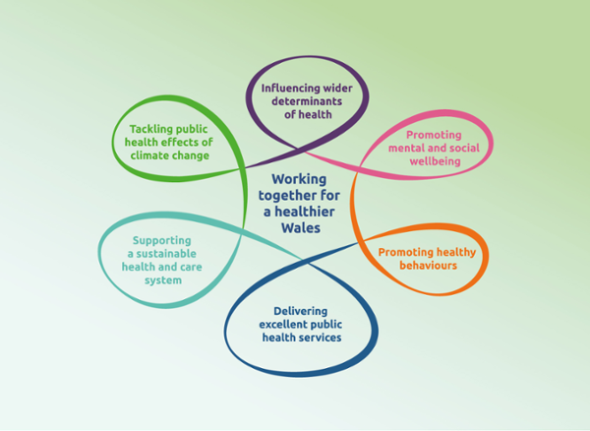
Health Promotion Initiatives in Wales to Improve Health and Wellbeing
Tobu Imran Ashraf (2206291)
Module: Public Health Promotion (BMNS5006)
University of Wales Trinity Saint David
8th March 2024
(Public Health Wales, 2023)

Slide 2
Area of Investigation: Whooping Cough (Pertussis)
Contents:
Introduction to the disease
Whooping Cough (Pertussis) Consequences
Symptoms
Who is at risk
The Prevalence of Whooping Cough in Wales and the United Kingdom (UK)
Whooping Cough Cases in Wales
Treatment
Disease Prevention and Control
Pregnancy and Vaccination
Vaccination and the side effects
Conclusion
Recommendation
2

Slide 3
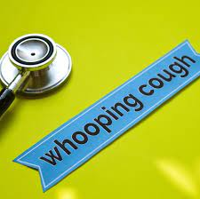
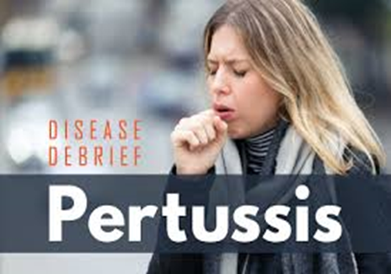
Introduction to the disease
Whooping cough, also known as pertussis
Pertussis is a bacterial infection that affects the lungs and airways.
It has a high tendency for spreading.
Can occasionally lead to severe complications.
All age groups can be affected with this illness.
Typically, babies and children experience severe symptoms (NHS, 2023).
Older children and adults with whooping cough typically experience less severe symptoms (Wiseman and Korsholm, 2020).
“100-day cough”
(Davis, 2023)
(NCCID, 2017)
3

Slide 4
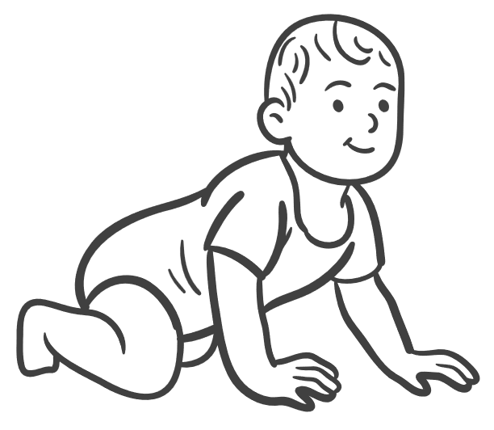
Whooping Cough (Pertussis) Consequences
Whooping Cough (Pertussis)
Transmissible Respiratory Infection
Severe Coughing Fits
Impact Individuals of All Age Groups
Highly dangerous for infants and young children
Pneumonia
Seizures
Brain Damage
Death
(Qaimkhani, 2024)
4

Slide 5
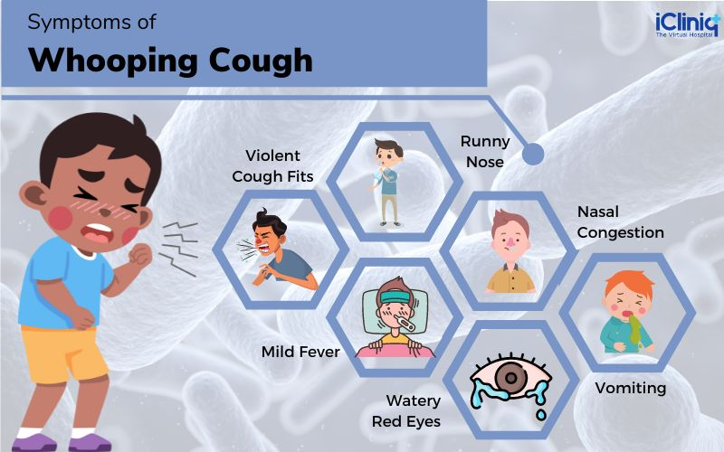
Symptoms
(Geethika and Viswanath, 2022)

Slide 6
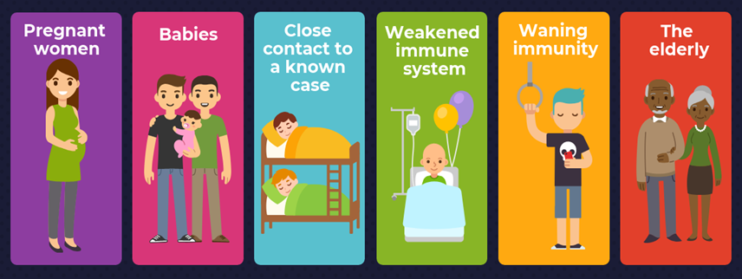
Who is at risk?
(Mt.gov., 2019)

Slide 7
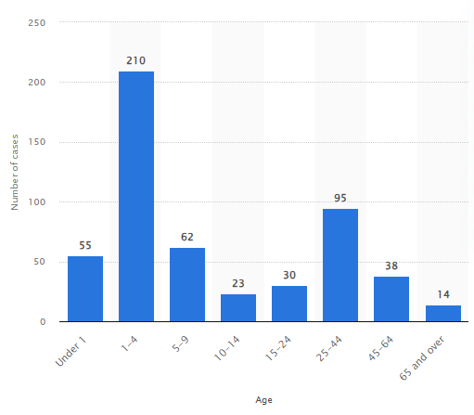
Whooping Cough (Pertussis) Cases in England and Wales in 2021
The Prevalence of Whooping Cough in Wales and the United Kingdom (UK)
Evidence it Impacts Infants and Young Children
This statistic shows the prevalence of pertussis (whooping cough) cases in England and Wales in 2021, categorised by age.
In the year 2021, 210 children aged between 1 and 4 years were infected with whooping cough, making it the most impacted age group in England and Wales (Gagliardi, 2023).
Source: Statista (Gagliardi, 2023)

Slide 8
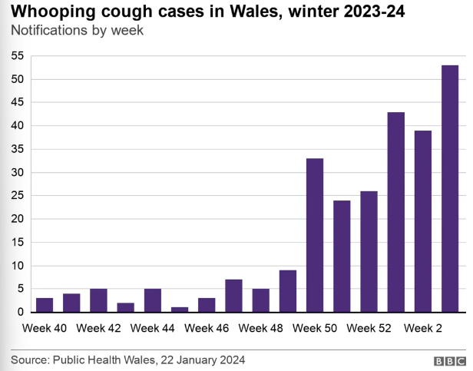
Whooping Cough Cases in Wales
Whooping cough cases in Wales have surged significantly in the early weeks of 2024.
135 incidents were reported in January 2024, compared to around 200 for the full year 2023.
Dr. Chris Johnson, an expert from Public Health Wales (PHW), indicated that reports from General Practitioners (GPs) suggest the start of a substantial wave.
(Duffy and Rees, 2024)
Source: BBC News (Duffy and Rees, 2024)

Slide 9


Treatment
Hospital Admission/Treatment
Antibiotic
Severe whooping cough
Baby under 6 months old and has whooping cough
Individuals with severe respiratory difficulties or pneumonia from whooping cough.
If diagnosed within 3 weeks
(UK Health Security Agency, 2023)

Slide 10
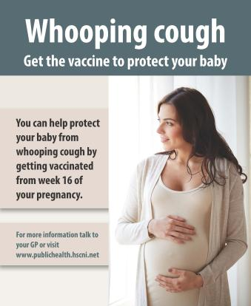
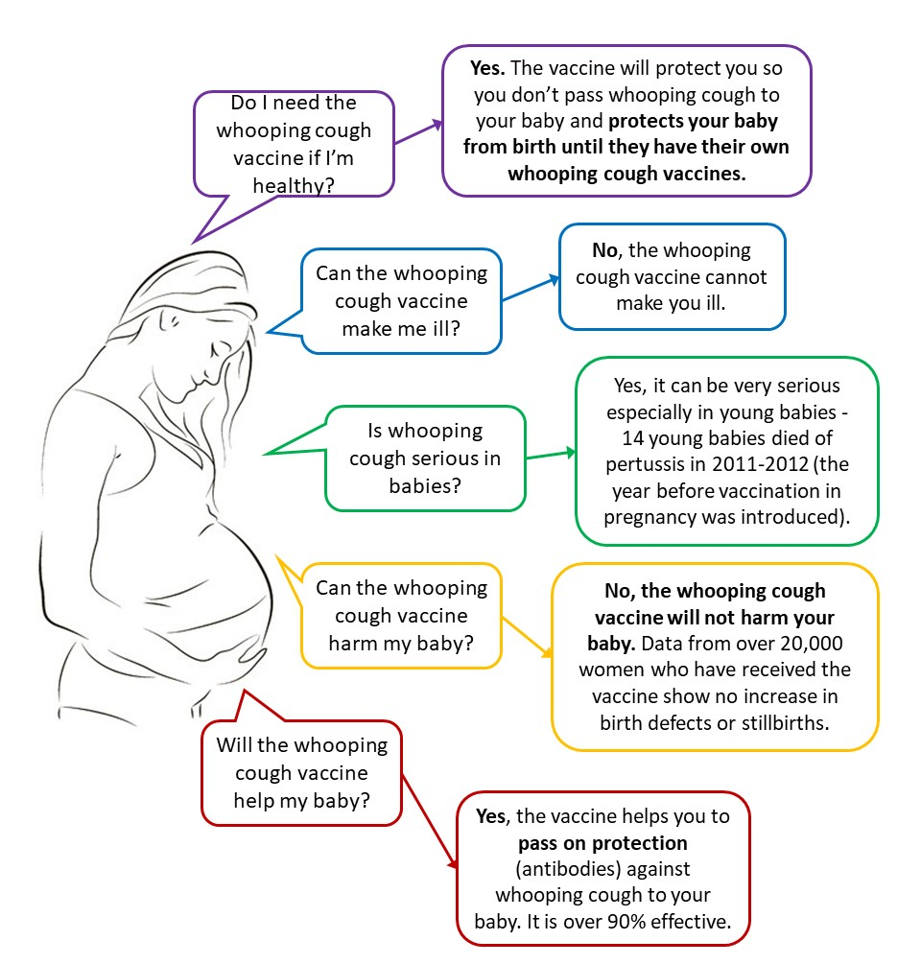
Treatment cont’d
In 2012, there was a significant rise in the incidence of whooping cough.
Since 2012, approximately 300 infants are hospitalised annually due to whooping cough.
Babies who die from whooping cough often get infected before they are old enough to be vaccinated.
400 Infant Infected
12 Death
(Public Health Agency, 2023)
(NHS Wales, 2024)
Since 2012, it has been advised that all pregnant women be offered the whooping cough vaccine to prevent additional fatalities and severe harm to infants.
(NHS Wales, 2024)

Slide 11
Disease Prevention and Control
Vaccination programs
The whooping cough vaccine
The whopping cough vaccine is commonly administered as part of the:
6-in-1 vaccine administered to infants at 8, 12, and 16 weeks.
4-in-1 pre-school booster for children aged 3 years 4 months
Pregnant individuals should receive the whooping cough vaccine between 16 and 32 weeks.
(NHS, 2023)
Promoting for whooping cough vaccine is a crucial public health effort. Vaccination can prevent infection and lessen illness intensity. Public health authorities frequently provide immunisations via healthcare professionals, schools, and community health clinics.
(Baïssas et al., 2021)

Slide 12
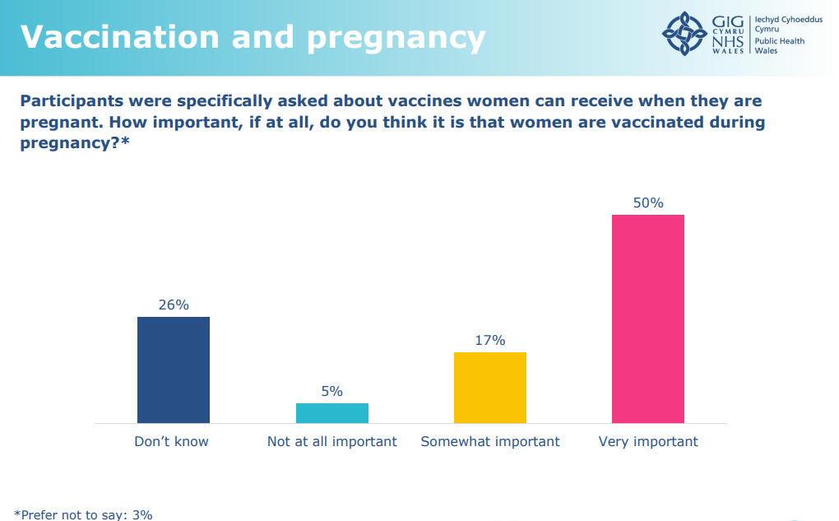
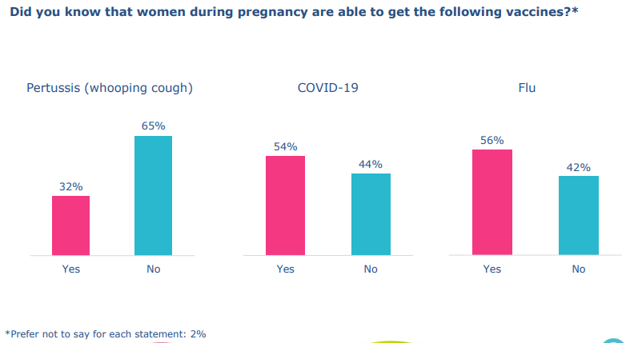
Pregnancy and Vaccination
Below finding from Time to Talk Public Health - December 2023 Panel Survey Findings (GVS, 2024)
65% did not know about the vaccine

Slide 13
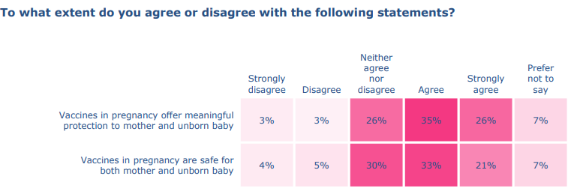
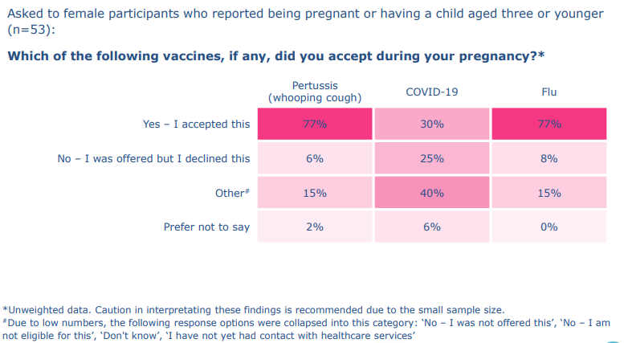
Pregnancy and Vaccination Cont’d
Vaccine Protection and Safe for baby and mother
77% Accepted the Vaccine
(GVS, 2024)

Slide 14
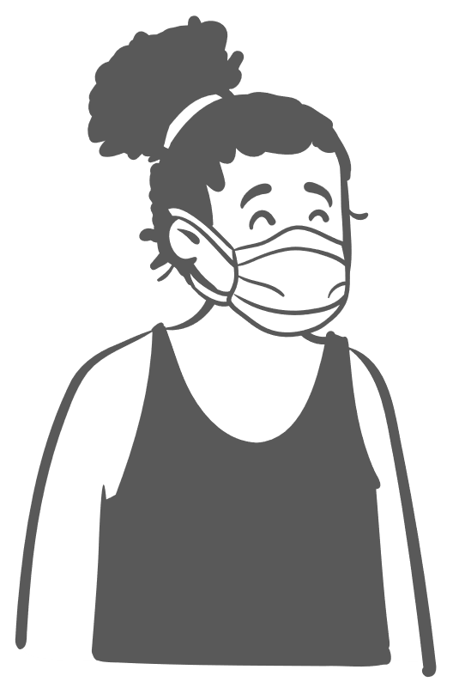

Vaccine and the Side Effects
side effects of the whooping cough vaccine
The pertussis vaccine administered during pregnancy is included in a combined vaccine known as diphtheria/tetanus/acellular pertussis/inactivated polio vaccine (dTaP/IPV) (Public Health Wales, 2024).
Vaccination rates in Wales for the 6 in 1 vaccine remain high, however rates of vaccination during pregnancy have decreased from over 80% to 70% in the past year 2023 (NHS Wales, 2024).
Mild side effects such as:
    swelling
    redness
    tenderness
Other side effects:
    high temperature
    irritation
    nausea
    loss of appetite
    tiredness
    headache
Severe side effects are very uncommon.
(NHS, 2020)

Slide 15
Conclusion
The presentation discusses health promotion initiatives in Wales to improve health and wellbeing, focusing on the whooping cough, also known as Pertussis.
Pertussis is a highly contagious respiratory infection affecting the lungs and airways, affecting all age groups, particularly babies and young children. It can lead to serious complications such as pneumonia, seizures, brain damage and even death.
NHS Wales (2024) reports that in 2021, 210 children aged between 1 and 4 years were infected with whooping cough, making it the most impacted age group in England and Wales.
Pregnant women are strongly advised to get the whooping cough vaccine due to a substantial increase in cases in 2012. The vaccine enables pregnant mothers to transfer antibodies against whooping cough to the infant, with an effectiveness rate above 90%.
Vaccination rates in Wales for the 6 in 1 vaccine remain high, but rates of vaccination during pregnancy have decreased from over 80% to 70% in 2023.
A Panel Survey Finding for Wales found 65% pregnant women did not know about the whooping cough vaccine (GVS, 2024).

Slide 16
Recommendation
Education and Awareness Campaigns:
    Campaigns to inform the public about the importance of vaccination,
    symptoms of whooping cough
    preventive measures such as practicing good hygiene and staying home when sick.
  Campaigning using such as brochures, posters and online resources to reach a wide audience.

Slide 17
References
Davis, N. (2023). What is whooping cough and why are cases rising in England and Wales? The Guardian. [online] 9 Dec. Available at: https://www.theguardian.com/society/2023/dec/09/what-is-whooping-cough-and-why-are-cases-rising-in-england-and-wales [Accessed 2 Mar. 2024].
Duffy , S. and Rees, J. (2024). Whooping cough cases in Wales show sharp increase. BBC News. [online] 23 Jan. Available at: https://www.bbc.co.uk/news/uk-wales-68067829 [Accessed 24 Feb. 2024].
Gagliardi, J. (2023). Cases of whooping cough in England and Wales 2021, by age. [online] Statista. Available at: https://www.statista.com/statistics/974146/cases-of-whooping-cough-by-age-england-and-wales-by-age/ [Accessed 24 Feb. 2024].
Geethika, B. and Viswanath, N.A. (2022). Pertussis - Causes | Symptoms | Diagnosis | Treatment | Prevention | Complications. [online] www.icliniq.com. Available at: https://www.icliniq.com/articles/infectious-diseases/pertussis [Accessed 25 Feb. 2024].
GVS. (2024). Two thirds of public unaware of life-saving whooping cough vaccine for pregnant women. [online] Available at: https://www.gvs.wales/news/two-thirds-of-public-unaware-of-life-saving-whooping-cough-vaccine-for-pregnant-women [Accessed 2 Mar. 2024].
Lind, S. (2024). Public Health Wales warns of rapid rise in whooping cough cases. [online] Pulse Today. Available at: https://www.pulsetoday.co.uk/news/clinical-areas/immunology-and-vaccines/public-health-wales-warns-of-rapid-rise-in-whooping-cough-cases/ [Accessed 25 Feb. 2024].
Mt.gov. (2019). Pertussis (Whooping Cough). [online] Available at: https://dphhs.mt.gov/publichealth/cdepi/diseases/pertussis [Accessed 25 Feb. 2024].
NCCID (2017). Pertussis. [online] National Collaborating Centre for Infectious Diseases. Available at: https://nccid.ca/debrief/pertussis/ [Accessed 1 Mar. 2024].
NHS (2020). Whooping cough vaccination in pregnancy. [online] nhs.uk. Available at: https://www.nhs.uk/pregnancy/keeping-well/whooping-cough-vaccination/ [Accessed 2 Mar. 2024].
NHS (2023). Whooping cough. [online] NHS. Available at: https://www.nhs.uk/conditions/Whooping-cough/ [Accessed 24 Feb. 2024].
NHS Wales (2024). Whooping Cough vaccination urged as cases rise rapidly in Wales. [online] Public Health Wales. Available at: https://phw.nhs.wales/news/whooping-cough-vaccination-urged-as-cases-rise-rapidly-in-wales/ [Accessed 2 Mar. 2024].
Public Health Wales. (2023). Working Together for a Healthier Wales. [online] Available at: https://phw.nhs.wales/about-us/working-together-for-a-healthier-wales/ [Accessed 2 Mar. 2024].
Public Health Wales. (2024). Pertussis (whooping cough) vaccination for pregnant women. [online] Available at: https://phw.nhs.wales/topics/immunisation-and-vaccines/vaccine-resources-for-health-and-social-care-professionals/pertussis-whooping-cough-vaccination-for-pregnant-women/ [Accessed 2 Mar. 2024].
Qaimkhani, R. (2024). Wales whooping cough figures rise, says public health body. [online] South Wales Argus. Available at: https://www.southwalesargus.co.uk/news/24082428.wales-whooping-cough-figures-rise-says-public-health-body/ [Accessed 25 Feb. 2024].
UK Health Security Agency (2023). Information for individuals diagnosed with whooping cough. [online] GOV.UK. Available at: https://www.gov.uk/government/publications/whooping-cough-diagnosis-information/information-for-individuals-diagnosed-with-whooping-cough [Accessed 25 Feb. 2024].
Wiseman, L. and Korsholm, H. (2020). Are you at risk of whooping cough? [online] Netdoctor. Available at: https://www.netdoctor.co.uk/conditions/pregnancy-and-family/a9091/whooping-cough-pertussis/ [Accessed 24 Feb. 2024].

Slide 18


Thank you for listening!

