Slide 1
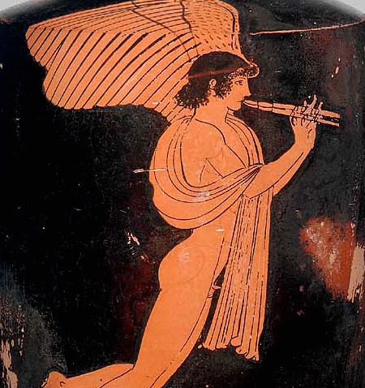
The Cult of Eros
Callum Fielding

Slide 2

Where was the Cult most popular

Slide 3
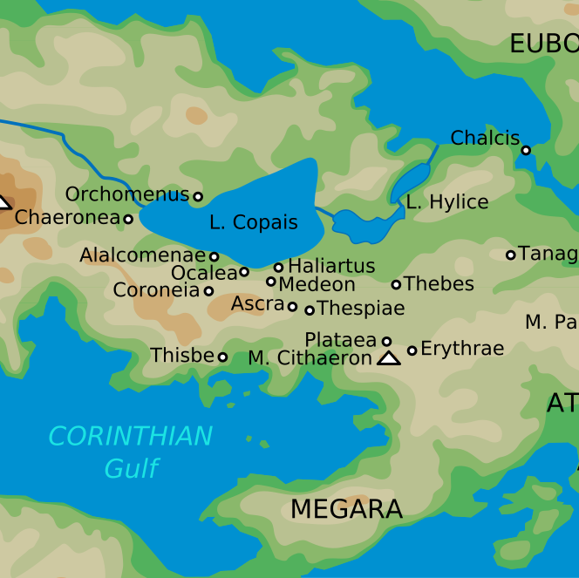
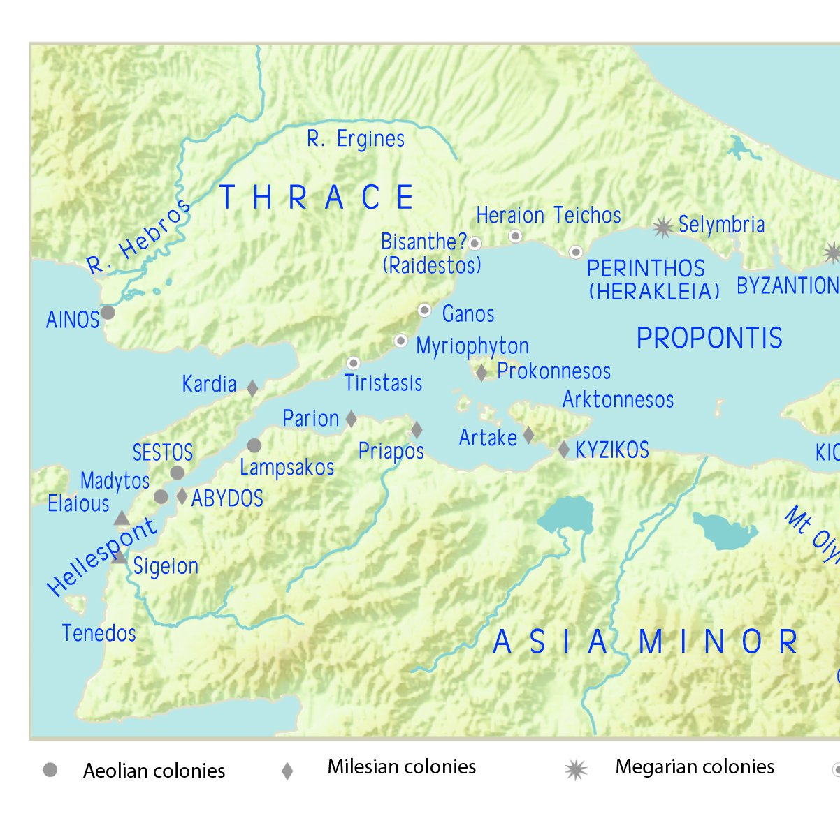
Prominent places related to the cult – Thespiae/Parion
Thespiae
Ancient Connection to the Cult of Eros
Features three statues
Uncertain origins of the worship
Parion
Is as devoted to Eros as Thespiae
Also features a prominent statue to the god

Slide 4
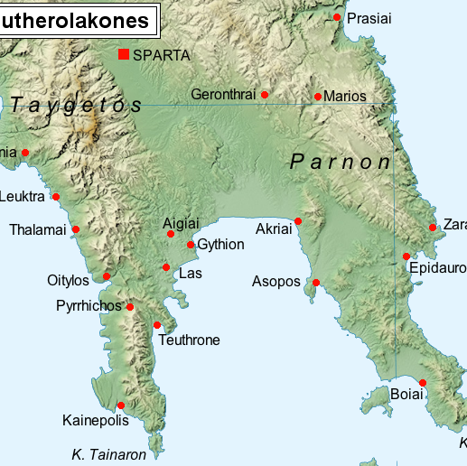
Pominent places related to the cult - Leuktra
"There is a temple and grove of Eros in Leuktra [in Lakedaimonia]. Water flows through the grove in winter-time, but the leaves which are shaken from the trees by the wind would not be carried away by the water even in flood."
Pausanias, Description of Greece 3. 26. 5 : text
Map of the Eleutherolakones according Pauanias
Date: 24 October 2014
Al-Qamar

Slide 5
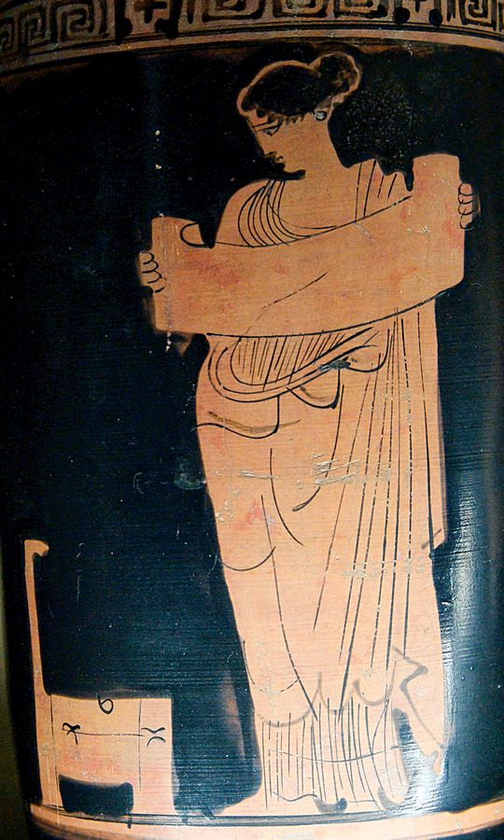
Mousai
Celebration of the muses
Prominence in Eros Story
Muse, perhaps Clio, reading a scroll (Attic red-figure lekythos, Boeotia, c. 430 BC)
Location: Department of Greek, Etruscan and Roman Antiquities, Sully, 1st floor, Campana Gallery, room 39
Accession number: CA 2220
Jastrow 2006

Slide 6
Erotideia
Dated to before the first Mithridatic war – under a different name
Statue Praxiteles was returned to Thespiae as a result of one
Theban attendance

Slide 7

The cult of Eros in Scholarship
Focus on Eros as a concept and a god
Mention of Cult is limited

Slide 8
Supporting the Scholarship
Could use the concept of Eros to understand the cult
Could use the celebrations to discover where the cult is popular
Broader understanding

Slide 9
Why Scholarship won't always be best
The focus on concept prevents using the sources as a form of informaiton on the cult
Inscriptions and ancient authors provide much more information on the cult
Independent analysis

Slide 10
That ends the presentation on the Cult of Eros
Bibliography:
ca. 130/120 B.C.; G.Nachtergael, Les Galates en Grèce et les Sotêria de Delphes, Brussels 1976, 365-366 and 488 no. 75
Pausanias, descriptions of Greece, 9. 27. 1 (Trans Jones)
Pausanias, descriptions of Greece, 9. 27. 11
Pausanias, descriptions of Greece, 9. 2. 25
Pausanias, descriptions of Greece, 3. 26. 5
SEG 36 469. — Lists of victors at the Mouseia and Erotideia, 3rd-1st cent. B.C.
SEG 47-518. — Thespiai. The festival of the Erotideia.

