Slide 1
Gen AI (Genetics + AI) in Health Care
Student Name: Mohammad Shoaib Tariq
Student ID: 2237655
Module: Digital Transformation In Care Professions
Lecturer name: Joanne Davis
Notes:
GenAI is a type of telemedicine which can transport specialised knowledge to underserved groups and diminish geographical inequalities in healthcare. It assists in making the community involved in the health management. However, the absence of digital infrastructure and distrust in AI technologies could be a hindrance. The digital infrastructure and community engagement programme must be an investment that would have a maximum benefit and low cost of inequality. Slide 9 GenAI has revolutionary benefits, yet a number of obstinate challenges need to be addressed, including the capability of the labour force to evolve, technological unification, confidentiality, and online inequalities. The systematic management of them using evidence-based interventions like protective training time, slow technological adoption, and greater access to digital will be used to implement AI innovations in healthcare with a lot of ease and safety. Slide 10: Conclusion GenAI results in high levels of efficiency of workforce, quality service delivery, and patient-centred care. The moderate view recognises the possibility of change and the difficulties of the process. Another investment that is required is training, infrastructure and ethical governance. GenAI has a sunny day of sustainable fair accurate healthcare. Slide notes: In conclusion, GenAI is a new solution that is revolutionising the UK health and social care through improving the workforce role, service delivery, and patient outcomes. However, the issues like digital illiteracy and system compatibility have to be addressed, and the evidence lies in the fact that it should continue to invest in the system in order to realise its full potential in a sustainable and equitable way. The future picture is optimistic since AI is on the way to the future in the sphere of healthcare.

Slide 2
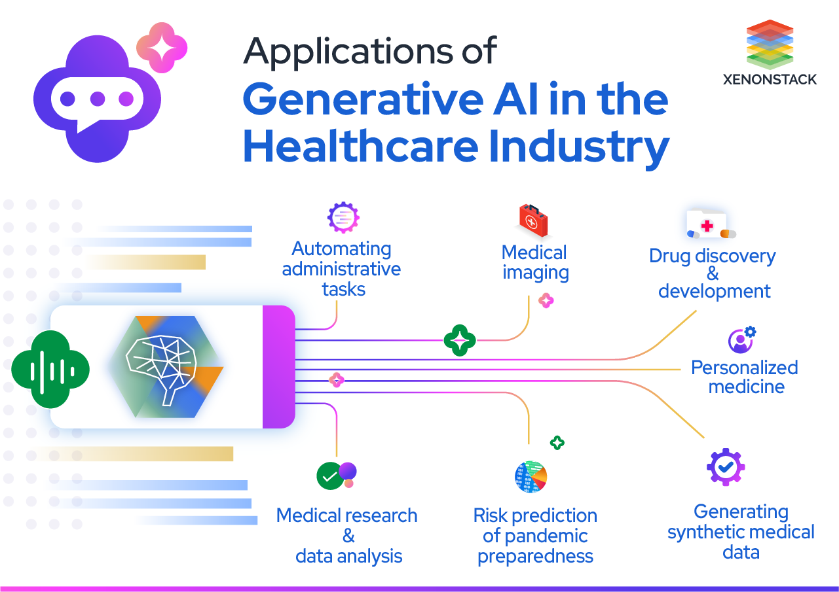
Introduction
GenAI is genetics combined with AI to process intricate genetic data to provide personalised care.
It is important since it leads to increased diagnostic accuracy and therapeutic effectiveness.
Areas of concern: workforce, service delivery, patients/community impact.
Notes:
GenAI is an important digital health transformation innovation. It is important as it enhances the quality, accuracy, and availability of healthcare services with data-driven insights. This presentation revolves around three primary areas, namely, the effect of GenAI on NHS labour supply, the way it transforms service delivery models, and patient and community experiences. A balanced perspective will lead to the positive as well as negative implications of the recent research and policy reports.

Slide 3
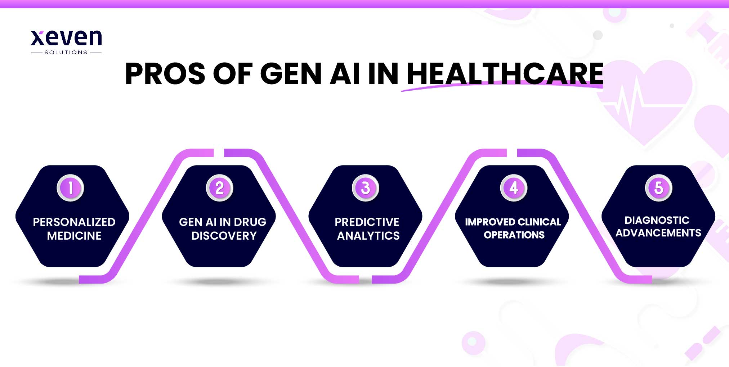
GenAI Overview: What and How
GenAI is used to integrate genetic information with AI diagnosis and individualised treatment.
Applied to NHS genomics services, hospitals, and research centers.
Functions: genomic data analysis, risk prediction, treatment planning.
Notes:
GenAI is a combination of genetic profiling and AI to enhance the clinical decision-making process through the analysis of big genomic data. It forecasts illnesses and is used to personalise treatment. In the UK, it is adopted in NHS genomics and digital health infrastructures, and is at the centre of managing precision medicine and population health. This technology makes work processes streamlined and provides more informed care.

Slide 4
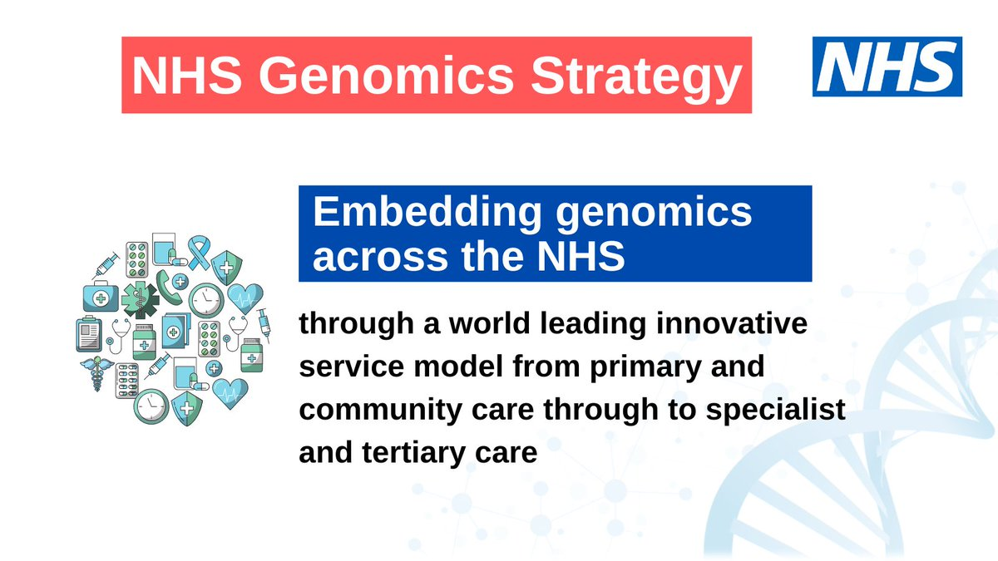
GenAI systems are a component of the NHS genomics services, hospitals, and research centers, which are intended to enhance the concept of precision medicine
Applications: AI that examines genetic data in order to deliver cancer treatment or identify a rare disease.
Notes:
The illustration shows how GenAI is used to work with patient genetic data in order to instruct clinicians on the best treatment options. As an illustration, AI can be used in cancer treatment by analysing the tumour genomics in order to discover targeted treatment. Examples of such applications include GenAI in clinical pathways, which allows the application to be more personalised and achieve better patient outcomes, and helps the NHS meet innovation objectives.

Slide 5
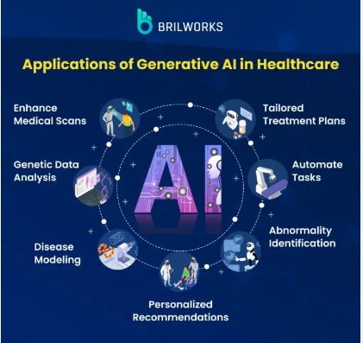
Infographic Style
New hybrid medical-AI jobs (e.g., clinical bioinformaticians). Less administration; improved clinical decision support.
Challenges: the adaptation of staff, lack of digital skills, the fear of job loss.
Barrier-solution: Reduced digital capability -guaranteed CPD time to train.
Notes:
GenAI changes the role of the healthcare workforce by designing new hybrid jobs that involve clinical knowledge and AI knowledge. It is able to automate the routine tasks and release clinicians to attend to patients. Although it has led to efficiency, the staff members experience difficulties adjusting to these new changes and overcoming the digital literacy gap. It is necessary to invest in continuing professional development (CPD) and ongoing training as a way of guaranteeing the readiness and acceptance of the workforce.

Slide 6
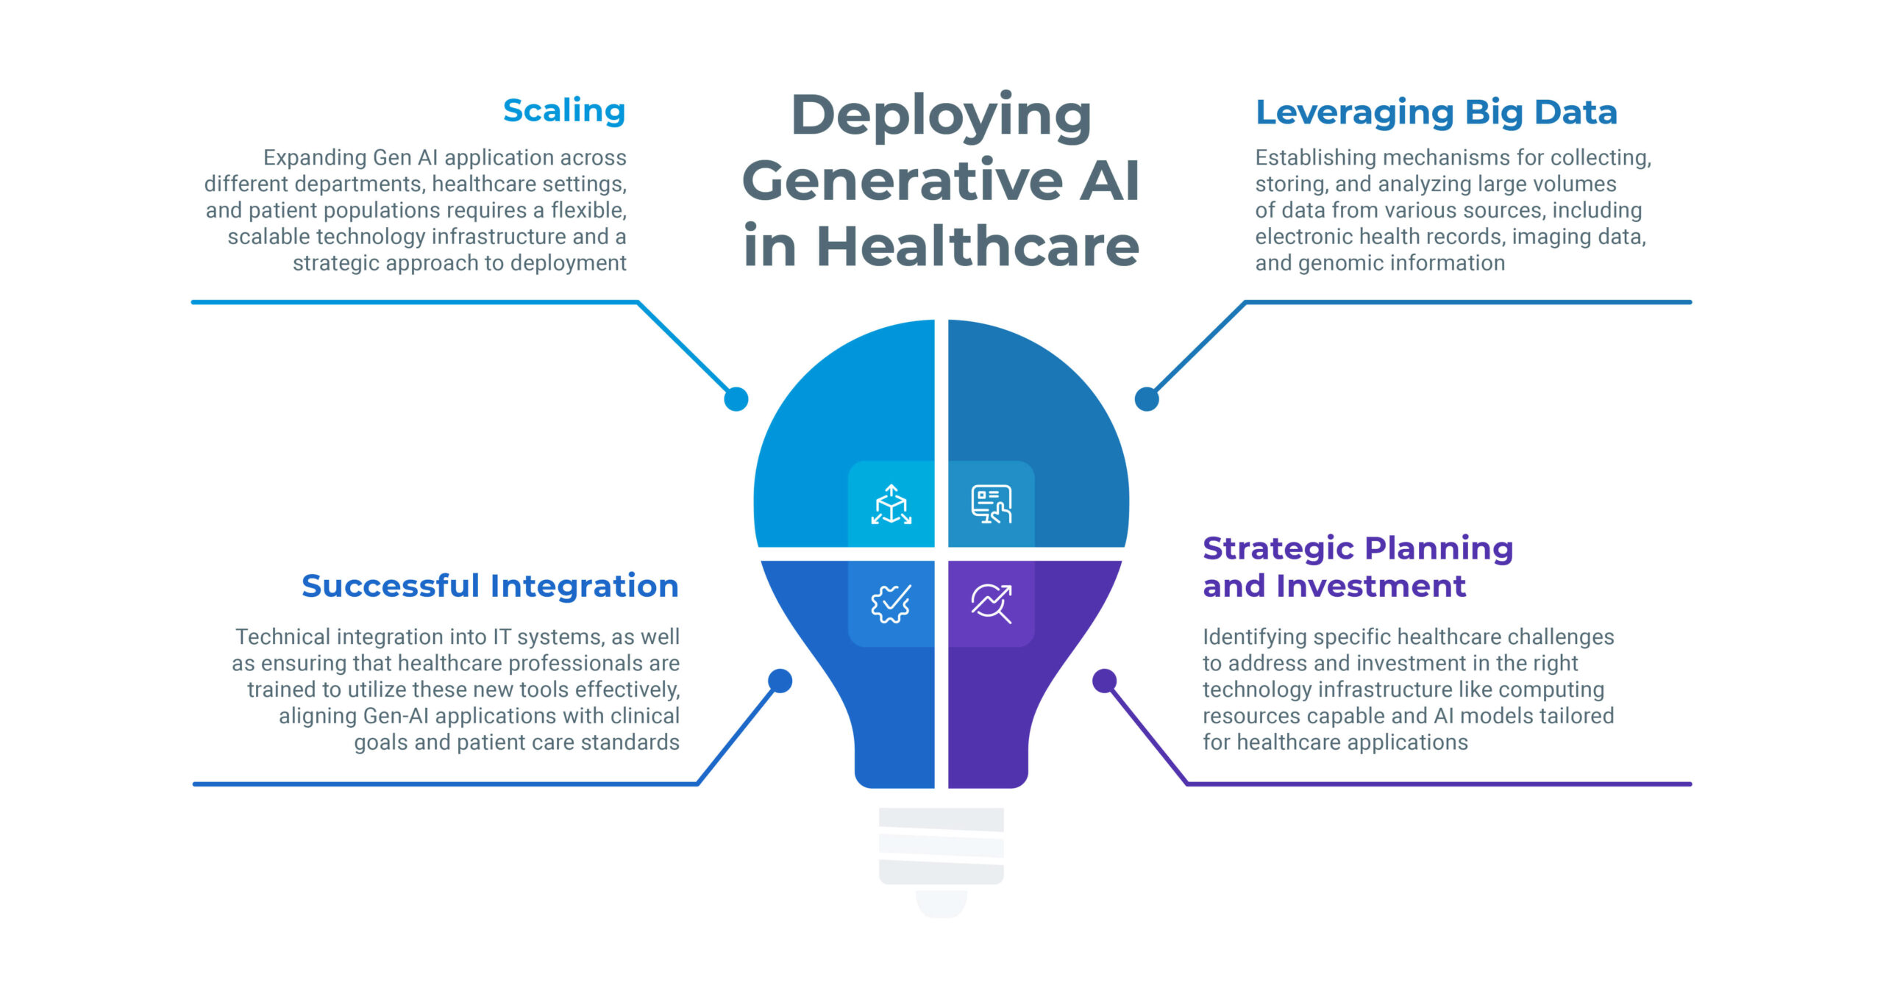
Impact on Service Delivery
Automates office work, enhances clinical processes. Improves treatment and diagnostics accuracy; facilitates remote patient monitoring.
Challenges:
Difficulties with connecting legacy systems; disrupted workflow during the implementation.
Barrier-solution: System compatibility problems phased integration with legacy support.
Notes:
GenAI has a positive influence over service delivery by automating routine operations, providing AI-based clinical decision support, and enhancing the quality, as well as the timeliness of care. It facilitates tele-patients and virtual care systems, which expand access. Nevertheless, technical difficulties with the introduction of AI into the current NHS IT systems may lead to delays and disruption, and it is important to introduce it step by step.

Slide 7
Effects on Patient Service Users
More individualised care using genomic profiling.
More empowered patients using AI-based portals and telehealth.
Barrier-solution: Digital exclusion - efforts to become more digital literate and digital accessible.
Challenges: privacy issues, digital inequality of vulnerable populations.
Notes:
AI-driven digital tools allow patients receiving care to have more personalised treatment plans and interact more with their health. Remote monitoring and telehealth enhance convenience, particularly in the case of chronic diseases. However, there are threats of privacy problems and digital gaps to fair access. These disparities need to be addressed by being educated and providing infrastructure to address inequities in healthcare delivery.

Slide 8
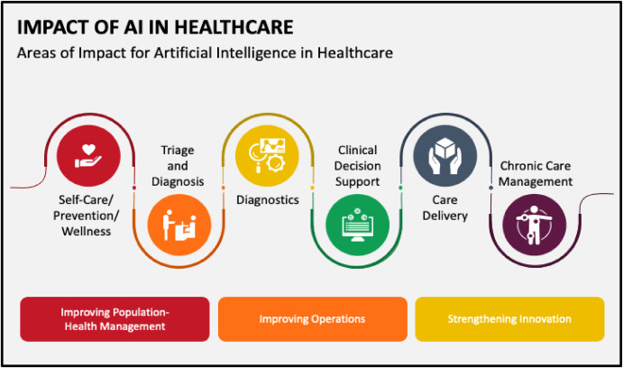
Impact on Community
Enhances rural/underserved health care access through telemedicine.
Facilitates community-based health co-production and proactive care with insights on community data.
Challenges: inequality based on the digital infrastructure gap; communal scepticism.
Barrier-solution: Infrastructure gaps- government spending in broadband and digital inclusion
.
Notes:
GenAI is a type of telemedicine that can transport specialised knowledge to underserved groups and diminish geographical inequalities in healthcare. It assists in making the community involved in the health management. However, the absence of digital infrastructure and distrust in AI technologies could be a hindrance. The digital infrastructure and community engagement programme must be an investment that would have a maximum benefit and low cost of inequality.

Slide 9
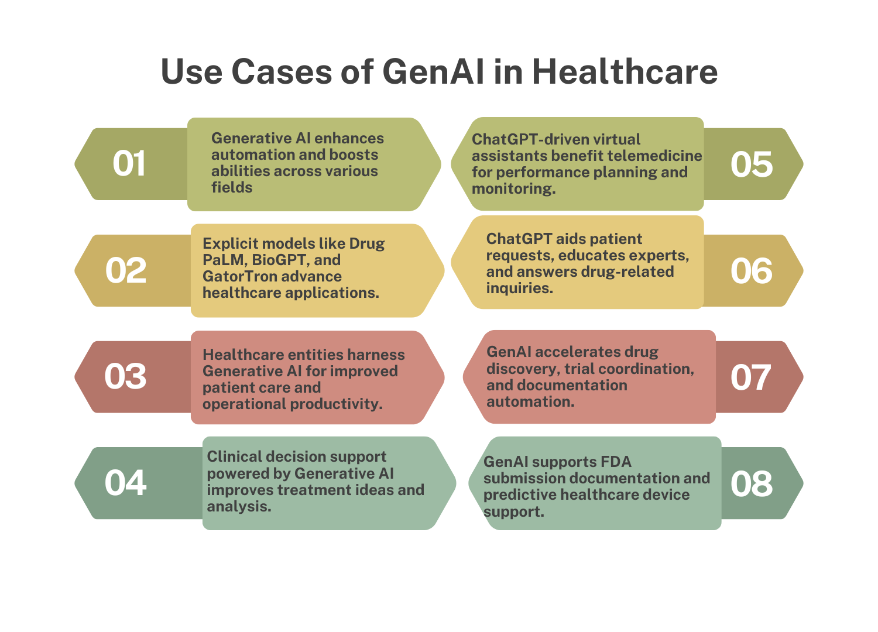
Challenges and Recommendations
Significant obstacles:
Employee orientation
System integration
Privacy
Digital exclusion.
Introduce the stages of integration of the AI-NHS system
Barrier: Legacy system compatibility
Solution: Gradual rollout
Enhance digital inclusion
Barrier: Access and skills
Solution: Broadband investment and education.
Research-Based evidencee solution
Notes:
GenAI has revolutionary benefits, yet several obstinate challenges need to be addressed, including the capability of the labour force to evolve, technological unification, confidentiality, and online inequalities. The systematic management of them using evidence-based interventions like protective training time, slow technological adoption, and greater access to digital will be used to implement AI innovations in healthcare with ease and safety.

Slide 10
Conclusion
GenAI leads to substantial workforce efficiency, the quality of service delivery, and patient-centred care.
The balanced perspective identifies the potential of transformation and the challenges of implementation.
A further investment in training, infrastructure and ethical governance is necessary.
GenAI has a bright future of sustainable equitable precision healthcare.
Notes:
GenAI results in high levels of efficiency of the workforce, quality service delivery, and patient-centred care. The moderate view recognises the possibility of change and the difficulties of the process. Another investment that is required is training, infrastructure, and ethical governance. GenAI has a sunny day of sustainable, fair accurate healthcare. Slide notes: In conclusion, GenAI is a new solution that is revolutionising the UK health and social care through improving the workforce role, service delivery, and patient outcomes. However, issues like digital illiteracy and system compatibility have to be addressed, and the evidence lies in the fact that it should continue to invest in the system in order to realise its full potential sustainably and equitably. The future picture is optimistic since AI is on the way to the future in the sphere of healthcare.

Slide 11
References
Alowais, S.A., Alghamdi, S.S., Alsuhebany, N., Alqahtani, T., Alshaya, A.I., Almohareb, S.N., Aldairem, A., Alrashed, M., Bin Saleh, K., Badreldin, H.A., and Al Yami, M.S., 2023. Revolutionizing healthcare: the role of artificial intelligence in clinical practice. BMC medical education, 23(1), p.689.
Bekbolatova, M., Mayer, J., Ong, C.W., and Toma, M., 2024, January. Transformative potential of AI in healthcare: definitions, applications, and navigating the ethical landscape and public perspectives. In Healthcare (Vol. 12, No. 2, p. 125). MDPI.
Bhuyan, S.S., Sateesh, V., Mukul, N., Galvankar, A., Mahmood, A., Nauman, M., Rai, A., Bordoloi, K., Basu, U., and Samuel, J., 2025. Generative artificial intelligence use in healthcare: opportunities for clinical excellence and administrative efficiency. Journal of Medical Systems, 49(1), p.10.
Ćwiklicki, M., Duplaga, M. and Klich, J. eds., 2021. The digital transformation of healthcare: Health 4.0. Routledge.
George, A.S., George, A.H., and Baskar, T., 2024. Artificial intelligence and the future of healthcare: Emerging jobs and skills in 2035. Partners Universal Multidisciplinary Research Journal, 1(1), pp.1-21.
Ghunaim, L., Agha, A.S.A., Al-Samydai, A. and Aburjai, T., 2024. The future of pediatric care: AI and ML as catalysts for change in genetic syndrome management. Jordan Medical Journal, 58(4).
Hussain, H.K., Tariq, A., Gill, A.Y. and Ahmad, A., 2022. Transforming healthcare: The rapid rise of artificial intelligence revolutionizing healthcare applications. BULLET: Jurnal Multidisiplin Ilmu, 1(02), p.592216.
Insidea. (2024, December 16). 10 Breakthrough Innovations in Generative AI-Powered Healthcare - XRHealth. XRHealth. https://www.xr.health/eu/blog/generative-ai-in-healthcare/
Lee, C.H., Wang, C., Fan, X., Li, F. and Chen, C.H., 2023. Artificial intelligence-enabled digital transformation in the elderly healthcare field: scoping review. Advanced engineering informatics, 55, p.101874.
Lin, B. and Wu, S., 2022. Digital transformation in personalized medicine with artificial intelligence and the internet of medical things. Omics: a journal of integrative biology, 26(2), pp.77-81.
Mahabub, S., Das, B.C., and Hossain, M.R., 2024. Advancing healthcare transformation: AI-driven precision medicine and scalable innovations through data analytics. Edelweiss Applied Science and Technology, 8(6), pp.8322-8332.
Mbunge, E., Muchemwa, B., Jiyane, S.E. and Batani, J., 2021. Sensors and healthcare 5.0: transformative shift in virtual care through emerging digital health technologies. Global Health Journal, 5(4), pp.169-177.
Patil, S. and Shankar, H., 2023. Transforming healthcare: harnessing the power of AI in the modern era. International Journal of Multidisciplinary Sciences and Arts, 2(2), pp.60-70.
Rangarajan, D., Rangarajan, A., Reddy, C.K.K., and Doss, S., 2025. Exploring the Next-Gen Transformations in Healthcare Through the Impact of AI and IoT. In Intelligent Systems and IoT Applications in Clinical Health (pp. 73-98). IGI Global Scientific Publishing.
Rashid, Z., Ahmed, H., Nadeem, N., Zafar, S.B. and Yousaf, M.Z., 2025. The paradigm of digital health: AI applications and transformative trends. Neural Computing and Applications, pp.1-32.
Reddy, S., 2024. Generative AI in healthcare: an implementation science-informed translational path on application, integration, and governance. Implementation Science, 19(1), p.27.
Sai, S., Gaur, A., Sai, R., Chamola, V., Guizani, M., and Rodrigues, J.J., 2024. Generative AI for transformative healthcare: a comprehensive study of emerging models, applications, case studies, and limitations. IEEE Access, 12, pp.31078-31106.
Tuncel, T., Aktan, M.E., Merih, Y.D. and Akdoğan, E., 2023. DIGITAL TRANSFORMATION IN HEALTHCARE: KEY TECHNOLOGIES AND APPLICATIONS. Akıllı Sistemler Dergisi, 2(1), pp.1-15.
Notes:
Alowais, S.A., Alghamdi, S.S., Alsuhebany, N., Alqahtani, T., Alshaya, A.I., Almohareb, S.N., Aldairem, A., Alrashed, M., Bin Saleh, K., Badreldin, H.A., and Al Yami, M.S., 2023. Revolutionizing healthcare: the role of artificial intelligence in clinical practice. BMC medical education, 23(1), p.689.
Bekbolatova, M., Mayer, J., Ong, C.W., and Toma, M., 2024, January. Transformative potential of AI in healthcare: definitions, applications, and navigating the ethical landscape and public perspectives. In Healthcare (Vol. 12, No. 2, p. 125). MDPI.
Bhuyan, S.S., Sateesh, V., Mukul, N., Galvankar, A., Mahmood, A., Nauman, M., Rai, A., Bordoloi, K., Basu, U., and Samuel, J., 2025. Generative artificial intelligence use in healthcare: opportunities for clinical excellence and administrative efficiency. Journal of Medical Systems, 49(1), p.10.
Ćwiklicki, M., Duplaga, M. and Klich, J. eds., 2021. The digital transformation of healthcare: Health 4.0. Routledge.
George, A.S., George, A.H., and Baskar, T., 2024. Artificial intelligence and the future of healthcare: Emerging jobs and skills in 2035. Partners Universal Multidisciplinary Research Journal, 1(1), pp.1-21.
Ghunaim, L., Agha, A.S.A., Al-Samydai, A. and Aburjai, T., 2024. The future of pediatric care: AI and ML as catalysts for change in genetic syndrome management. Jordan Medical Journal, 58(4).
Hussain, H.K., Tariq, A., Gill, A.Y. and Ahmad, A., 2022. Transforming healthcare: The rapid rise of artificial intelligence revolutionizing healthcare applications. BULLET: Jurnal Multidisiplin Ilmu, 1(02), p.592216.
Insidea. (2024, December 16). 10 Breakthrough Innovations in Generative AI-Powered Healthcare - XRHealth. XRHealth. https://www.xr.health/eu/blog/generative-ai-in-healthcare/
Lee, C.H., Wang, C., Fan, X., Li, F. and Chen, C.H., 2023. Artificial intelligence-enabled digital transformation in the elderly healthcare field: scoping review. Advanced engineering informatics, 55, p.101874.
Lin, B. and Wu, S., 2022. Digital transformation in personalized medicine with artificial intelligence and the internet of medical things. Omics: a journal of integrative biology, 26(2), pp.77-81.
Mahabub, S., Das, B.C., and Hossain, M.R., 2024. Advancing healthcare transformation: AI-driven precision medicine and scalable innovations through data analytics. Edelweiss Applied Science and Technology, 8(6), pp.8322-8332.
Mbunge, E., Muchemwa, B., Jiyane, S.E. and Batani, J., 2021. Sensors and healthcare 5.0: transformative shift in virtual care through emerging digital health technologies. Global Health Journal, 5(4), pp.169-177.
Patil, S. and Shankar, H., 2023. Transforming healthcare: harnessing the power of AI in the modern era. International Journal of Multidisciplinary Sciences and Arts, 2(2), pp.60-70.
Rangarajan, D., Rangarajan, A., Reddy, C.K.K., and Doss, S., 2025. Exploring the Next-Gen Transformations in Healthcare Through the Impact of AI and IoT. In Intelligent Systems and IoT Applications in Clinical Health (pp. 73-98). IGI Global Scientific Publishing.
Rashid, Z., Ahmed, H., Nadeem, N., Zafar, S.B. and Yousaf, M.Z., 2025. The paradigm of digital health: AI applications and transformative trends. Neural Computing and Applications, pp.1-32.
Reddy, S., 2024. Generative AI in healthcare: an implementation science-informed translational path on application, integration, and governance. Implementation Science, 19(1), p.27.
Sai, S., Gaur, A., Sai, R., Chamola, V., Guizani, M., and Rodrigues, J.J., 2024. Generative AI for transformative healthcare: a comprehensive study of emerging models, applications, case studies, and limitations. IEEE Access, 12, pp.31078-31106.
Tuncel, T., Aktan, M.E., Merih, Y.D. and Akdoğan, E., 2023. DIGITAL TRANSFORMATION IN HEALTHCARE: KEY TECHNOLOGIES AND APPLICATIONS. Akıllı Sistemler Dergisi, 2(1), pp.1-15.

Slide 12
THANK YOU
Insert the Subtitle of Your Presentation

