Slide 1
International Marketing: Principles and Practices
LCMB 7026
WEEK 5

Slide 2
Week Five
STP Strategies

Slide 3
Last Week
We have covered
Forms of organisational structures that international companies use.
Various modes of entry

Slide 4
In today’s session….
After reading and studying this session, you will be able to:
Understand what the STP strategy is and how international STP differs from domestic STP.
Understand the primary factors used to identify international consumer market segments.
Understand the steps and tactics used to establish positioning in international markets.

Slide 5
Learning Objective 1
Understand what the STP strategy is and how international STP differs from domestic STP.

Slide 6
The STP approach to markets
Segmentation consists of identifying all potential customer groups that are viable for the purposes of marketing products and services.
  Most companies not able to reach every available market segment
Targeting component of the STP approach involves selecting the market segments the firm intends to target or reach.
Positioning is creating perceptions in the minds of consumers about the nature of a company, its brands, and its products and services.

Slide 7
Markets and Market segmentation
A market consists of people with wants and needs, money to spend, and the willingness to spend money on those wants and needs.
Market segmentation consists of identifying all potential customer groups that are viable for the purposes of marketing products.

Slide 8
International Market Segmentation
The process of identifying specific segments – with homogeneous attributes across different countries,
Or within a single foreign market, that are likely to exhibit similar responses to a company’s marketing mix.
Country A
Country B
segment
Country C

Slide 9
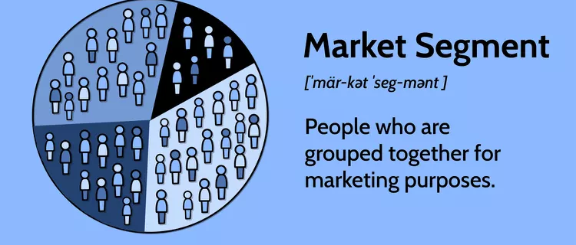
Market Segment `1 of 2
A market segment is a set of businesses or a group of individual consumers with distinct characteristics.
For a market segment to be viable in the eyes of the marketing team, it must pass four tests:
  Those within the segment should be homogeneous or have similar characteristics.
  The segment must differ from other groups and the population as a whole.

Slide 10
Market Segment 2 of 2
  Sufficient demand must be present to make the segment financially feasible.
  Methods to reach the market must exist, both in terms of physical delivery of the item and in terms of the marketing messages that would entice customers to make purchases.

Slide 11
International Market Segmentation
  International marketers spend time and money identifying viable market segments
  Country market will be selected based on assumptions:
    Degree of heterogeneity between countries. The greater the differences, the less likely a standardised approach can be featured
    Level of homogeneity within a country. It suggests an identifiable target market
    Marketers focus on macro-level cultural differences to understand how a good or service should be modified for a region

Slide 12
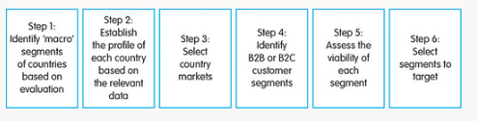
International Market Segmentation
  Steps in international market segmentation for a firm with an existing product/service
  Wind and Douglas, 1972

Slide 13
Learning Objective 2
What are the primary factors used to identify international consumer and business-to-business market segments?

Slide 14
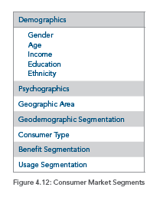
International Consumer Market Segments

Slide 15
Demographics
Demographics are population characteristics, and perceptions/consumption differences related to these characteristics may vary wildly internationally.
  Gender
  Age
  Income
  Education
  Ethnicity

Slide 16
Psychographics
Psychographic profiles emerge from a person’s activities, interests, and opinions.
  Vary widely by culture due to influence by divergent factors such as religious training, customs, language, and even the popularity of local sports
Psychographics are influenced by cultural differences.
  Cultures with individualistic tendencies offer opportunities to market personalized products and items that make a person stand out from the crowd.
Example:
  Red Bull targets adrenaline junkies and extreme sports
  Apple targets people who value innovation

Slide 17
Geographic Area
Marketing appeals can be made to people in a geographic area or region.
Many times differences exist in purchasing patterns in rural versus urban areas, creating unique target markets.
Germany can be divided into several distinct regions:
  Bavaria, the Black Forest, Germany’s East, the North and Baltic Sea area, the Rhine Valley, and Ruhrpott
Example: Zara collection in December is different in the northern part of the world (winter) and the southern part (summer).

Slide 18
Geodemographic Segmentation
A hybrid form of geographic segmentation allows companies to enrich geographic approaches to segmentation by adding demographic and psychographic information.
Geodemographic segmentation may also be useful when various regions feature differences.
Several companies focus specifically on geographic and geodemographic research.
  ESRI provides executives with cutting-edge technologies for utilizing data from around the world.
  ACORN (acorn.caci.co.uk) analyses data from hundreds of different sources and segments UK postcodes by common characteristics

Slide 19
Benefit Segmentation
Focuses on the advantages consumers receive from a product rather than the characteristics of consumers themselves.
A given product may feature one benefit in a given country and a separate benefit in another.
Example:
  Toothpaste: whitening seekers, sensitive teeth, gum disease
  Coffee: Low sugar, all-natural diet coke

Slide 20
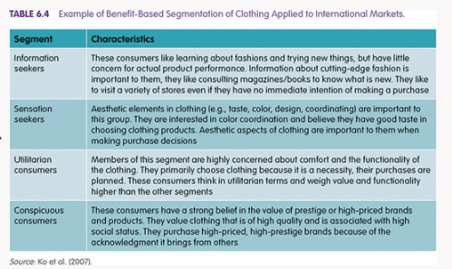
Benefit Segmentation

Slide 21
Targeting
The strategic process of identifying and focusing your resources on specific audience segments that are most likely to convert
Why Targeting?
Because it’s impossible to make everyone happy

Slide 22
How to target:
1. Assessing Market Potential
Marketers assess the potential of each segment to determine which ones are most viable and align with the company's goals.
Measurability: Can the segment be quantified and identified?
Accessibility: Can the segment be reached?
Profitability: Is the segment large enough to generate profits?
Actionability: Can a marketing program be designed to stimulate interest and behavioral responses (purchases)?

Slide 23
How to target:
2. Select the segment
The targeting decision is based on the segments most likely to respond positively to the marketing efforts and where the company can compete effectively.
Undifferentiated (Mass) Marketing: Treating the whole market as one segment and offering a single product to everyone. (e.g., Coca-Cola original).
Differentiated (Segmented) Marketing: Targeting multiple segments with custom products and marketing strategies tailored to each. (e.g., Coca-Cola diet, Coca-Cola Cherry).
Niche (Concentrated) Marketing: Focusing all efforts on a single, highly specialised market segment. (e.g., Red Bull for energy drinks).
Micromarketing: Tailoring products and marketing programs specifically to highly specific individuals or local customer locations

Slide 24
Group Activity – 30 Minutes
Choose two countries. Using the internet, collect as much information as you believe is needed to identify the potential market segments based on age, income, and product usage for the following product
    Bottled water
Assess the market potential using four criteria in slide 22 (measurability, accessibility, profitability, actionability)
What is your suggestion?

Slide 25
BREAK

Slide 26
Learning Objective 3
What steps and tactics are used to establish positioning in international markets?

Slide 27
The nature of International Product Positioning
Product position summarizes consumer opinions regarding the specific features of the product. Product position represents what currently exists.
Product positioning states the goal that marketers have in mind.
  Marketing activities can be designed to shape a product’s position over time.
Two key elements of product position:
  The way customers view the product
  The product’s standing relative to competitors’

Slide 28
Positioning Statements and Approaches
A one- or two-sentence summary of a company’s positioning strategy is its positioning statement.
  “Nike will provide authentic, innovative products that improve athletic performance.”

Slide 29
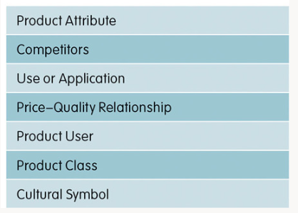
Product Positioning Approaches 1 of 3

Slide 30
Product Positioning Approaches 2 of 3
Product Attributes – The traits/ characteristics that distinguish one product from others (e.g., non-ironing needed; reduced fat)
Competitors – The firm directly (or implicitly) makes a comparison against a well-known competitor (e.g. Subway positions itself as a healthy choice compared to McDonald’s)
Use/ Application – Memorable set of product uses (e.g. Bleach is positioned as a cleaning product in country A, as a germ killer in country B)

Slide 31
Product Positioning Approaches 3 of 3
Price–quality relationship. The high–end products will emphasise quality, while the low-range products will emphasise price.
Product user – specify who will use this product (e.g. Credit card positioned for the traveller’s user)
Product class – Indicates a general category of items within which the good fits (e.g., skincare for men).
Cultural symbol – e.g., ‘British Asian restaurant’, Products endorse Pele in Brazil or Yao Ming in China.

Slide 32
Why does a marketer do
positioning?

Slide 33
International Positioning Objectives: Differentiation
Differentiation results from emphasising a unique benefit or component of a product that separates it from competitors.

Slide 34
International Positioning Objectives: Brand Equity
Brand equity is the unique benefits that a product enjoys due solely to its brand name.
  The sources of brand equity are the strong, favourable, and unique associations consumers have with the brand.
The benefits of brand equity include:
  The ability to charge a higher price
  Increased consumer loyalty
  Higher stock price
Brand parity exists when brands within one product category are viewed as similar or undifferentiated.

Slide 35
International Product Positioning Challenges
Changes in Technology
  The Digital Divide
  Consumer Reluctance
Country-of-Origin (COO) Effects
  The country-of-origin effect summarizes the response a consumer has to a product due to the country that is the source, in the consumer’s mind, of the product.
  The country-of-origin effect can drastically alter the position of the product in the minds of consumers.
Source of COO effect: Home country, Origin country, Made-in country, designed in country.

Slide 36
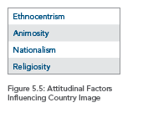
Country Image
Country-of-origin effects are often based on stereotyped conceptions consumers have about countries or the country’s image.
Country image consists of the attitudes and knowledge consumers have about a country.

Slide 37
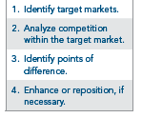
Steps for International Positioning

Slide 38
Different Types of Competition
Product versus Product
Product Line versus Product Line
  A product line consists of similar products within a particular category.
Brand versus Brand
Company versus Company
Industry versus Industry

Slide 39
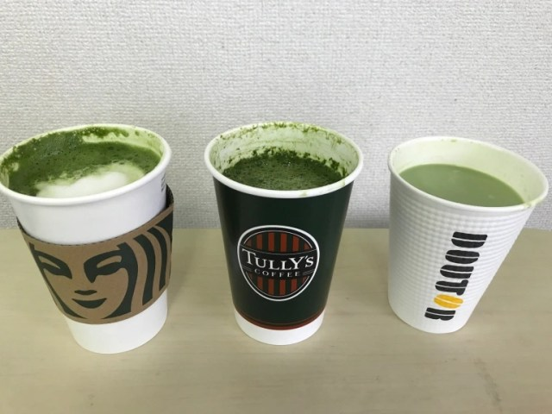
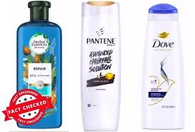
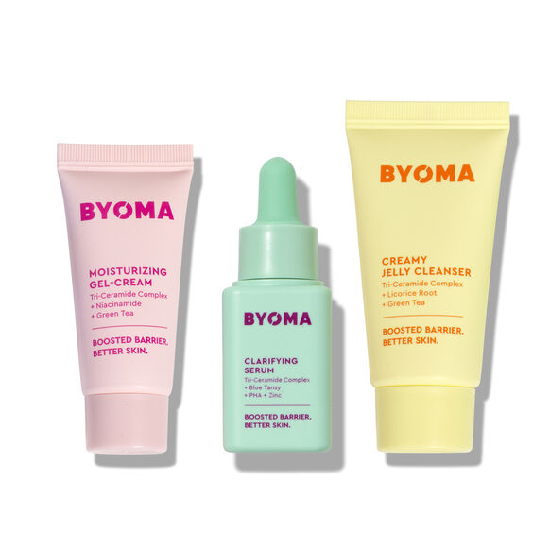

Product versus Product
Product line versus Product line

Slide 40
Identifying Points-of-Difference
Tangible product benefits are the value drawn from the physical components of the product.
Intangible product benefits are the value drawn from the social, emotional, and nonphysical aspects of consumption.
Positioning maps are tools used to map the company and its competitors in terms of consumer attitudes or perceptions.

Slide 41
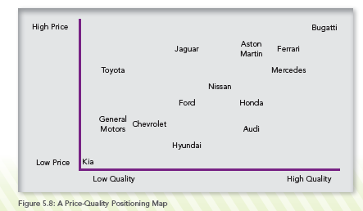
Example of Positioning Maps

Slide 42
Sustainability and International Positioning
Positioning a company, business practice, and product as being more environmentally conscious allows the organization to occupy a unique space in the minds of consumers.
  Sustainable business practices have become popular around the world.
The potential benefits have led to greenwashing, or the practice of exaggerating or even fabricating the degree of the sustainable or green activities taking place in the organization.

Slide 43
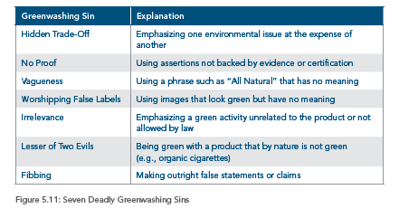
Greenwashing Sins

Slide 44
In Pair Activity – 30 Minutes
Ethnocentrism, animosity, nationalism, and religiosity influence consumer perceptions of products. Consider how these factors affect the positioning of the following brands:
  Starbucks, when entering France
  Royal Dutch Shell, when entering Saudi Arabia
Draw a Starbucks positioning map (price and quality) in France and the UK, using the perspective of a college student (you are the target customer). Is Starbucks' positioning similar in both countries?
Notes:
Royal Dutch Shell – the oil and gas company. Dutch and registered in the UK.
Saudi Arabia – Shell should be most concerned with ethnocentrism, nationality and animosity because they are an outside gas company – they should not position themselves against their competitors.
Starbucks - Could face ethnocentrism, animosity and nationalism in France. Starbucks
Could face ethnocentrism, animosity and nationalism in all three countries.
They should position themselves based on attributes.
Striking a balance between Starbucks’ global identity and the local nuance of French café culture.

Slide 45

Any Questions?
Next week we will study
Targeting
International Product Strategies and Branding

Slide 46
References
Baack, D. G. (2018). International marketing., 2nd edition. London: SAGE Publications.
Czinkota, M.R. (2011) International Marketing. Hampsire: Cengage Learning.
De Búrca, S., Fletcher, R. and Brown, L. (2004) International marketing : an SME perspective. 1st ed. Harlow, England: FT Prentice Hall.
Doole, I. and Lowe, R. (2012) International marketing strategy : analysis, development and implementation. Cengage Learning.
Keegan, W.J. and Green, M.C. (2013) Global marketing. 7th ed., global ed. Boston, Mass. ; London: Pearson.
Ko, E., Kim, E., Taylor, C. R., Kim, K. H., & Kang, I. J. (2007). Cross-national market segmentation in the fashion industry: A study of European, Korean, and US consumers. International Marketing Review, 24(5), 629–651.
Mathur, U. C. (2008). International marketing management : text and cases. SAGE.
Wind, Y., & Douglas, S. P. (1972). International market segmentation. European Journal of Marketing, 6(1), 17–25.

