Slide 1
Developing a Research Proposal

Slide 2
Student Name: Lavinia Neda
Module Name: Developing a Research Proposal
Research Title: Developing a Research Proposal
Student ID:2312753
Research Topic: A Critical Evaluation of how Managers Motivate Employees to Increase Productivity at Work in an Organisation

Slide 3
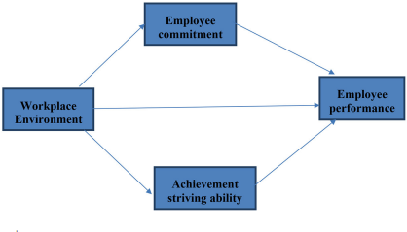
Introduction
Employee motivation becomes important for managers in this contemporary context to increase the overall productivity of a firm.
Identification of high-end employee notification factors becomes vital to maintain the competitiveness of Companies because, with proper motivation approaches, organisations can enhance their productivity levels.
Different academic theories and perspectives, along with real-time data, will utilise this project to identify employee motivation strategies in different organisational settings.
Employee Motivation Contexts
(Source: Zhenjing et al. 2022)
Notes:
Note: In dynamic work environments, employee motivation becomes important for organisations to maintain high productivity rates. To motivate employees for increasing productivity, managers consider different strategic practices to achieve success in a competitive environment.

Slide 4
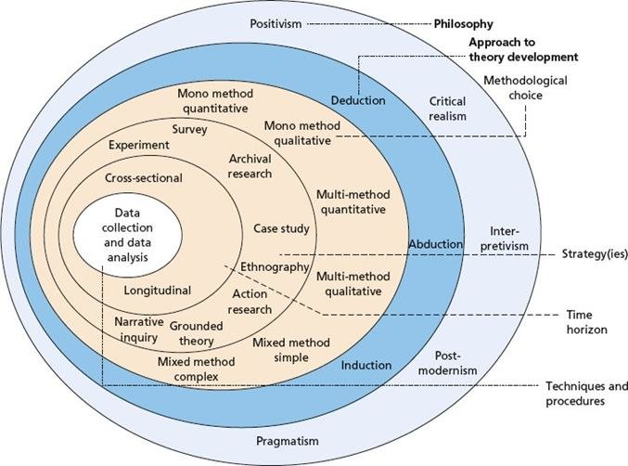
Methodology
This study will employ the Mixed Research Method.
The mixed research method combinations both qualitative and quantitative data identification strategies (Flick, 2023).
The study will use both statistical and theoretical data to conduct a critical analysis, based on the research topic.
Academic information and real-time market data will be utilised for the study.
This research style will help to avoid any type of bias within the project.
Layers of Research Methods
(Source: Melnikovas et al., 2018)
Notes:
Note: The study will intend to identify the roles of managers to increase the employee motivation level for enhanced productivity. So, the researcher will use the mixed method, where theoretical aspects and real-time data sets will be present. This mixed research method is justified for the study because it will help the researcher to make a critical analysis by comparing theoretical aspects with real-time responses.

Slide 5
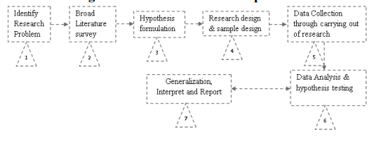
Methodology
Mixed Data Collection Method will be followed in this study.
Both primary and secondary resources will be used in this data collection method (Tashakkori and Teddlie, 2020).
The researcher will utilise a survey and an interview to collect primary data.
Different scholarly articles, journals, books and authentic websites will be used as secondary data resources.
By involving 30 participants, this study will use random sampling for the survey.
By maintaining data consistency and authenticity, the researcher will maintain research reliability.
For validity, the study will provide ethical consent forms from responses for the primary research
Flow Chart of Research Methods
(Source: Mishra and Alok, 2022)
Notes:
Notes: The study will use a mixed method, where the involvement of both primary and secondary data ensures reliability and advancement of the study. For primary research, the study will involve different participants, and for the secondary research, the study will use scholarly articles, journals, books and authentic websites. Here, the researcher will use a random sampling method involving 30 participants for the primary study. The study will also involve 05 managers to collect their perspectives, based on the research topic, through the interview process. It is anticipated that this combination will help the researcher to conduct a critical analysis and reach research findings efficiently.

Slide 6

Ethical Considerations
The study will collect informed consent from participants to ensure their prior permission.
The study will protect the confidentiality of responses by considering the Data Protection Act (2018) (Legislation, 2024).
The study will take prior permission from participants before utilising their responses.
Data Protection Act
(Source: Legislation, 2024)
Notes:
Note: In this research, the researcher will develop a clear constant form for participants by explaining, purpose, objectives and processes of this study to make the research more ethical. Addtionally, the researcher will protect participants’ responses confidentially and take their prior permission before utilising these responses. The main reason behind using these practices is securing the standard and making the study exclusive in front of others.

Slide 7
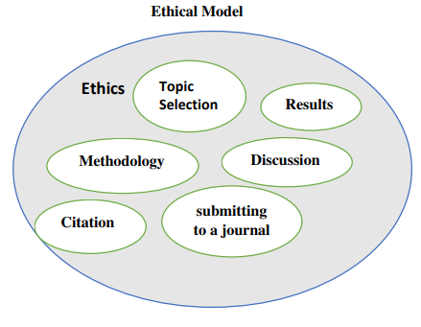
Ethical Considerations
The researcher will utilise effective measurements to protect participants from unwanted harms, including data leakage and the misuse of their responses.
The study will maintain academic integrity by acknowledging previous researchers through a detailed bibliography.
This study will be concerned with academic integrity and will refrain from any kind of academic misconduct.
The study will not use plagiarised content or use generative AI throughout the study.
Ethical Model for Study
(Source: Hasan et al., 2021)
Notes:
Note: To maintain the standard of the study, the researcher will protect participants' interests and academic integrity as per the university guidelines. Additionally, the study will maintain its standards by avoiding any kind of academic misconduct and falsification of data. Based on the university guidelines about research, the study will develop its methods and outline its research processes to make the study worthy.

Slide 8
Limitations and Recommendations
Potential Limitations
Generalised data finding patterns and utilisation of responses from limited candidates might create challenges for systematic explanation.
The allocated time is short for this study, which might not be sufficient for conducting and analysing large datasets.
Strict industrial protocols to reach managers and employees might create challenges for proper data collection techniques.
Recommendations
The Study may involve more participants to get wider responses.
The researcher can visit managers with proper formalities to avail of easy access.
Notes:
Note: During the time of analysis, the researcher might face multiple difficulties, including the presence of limited participants in the survey program, shortage of time and strict protocols to reach industrial people. To overcome such situations, the researcher might consider proper formalities to reach more industrial personnel and introduce more participants to get wider response ranges and conduct an in-depth analysis.

Slide 9

Conclusion
This initial study showed further development stages of the research.
This study will utilise a mixed data collection method in this study.
To maintain academic standards, the research will thoroughly employ ethical considerations.
Notes:
Note: From the initial analysis, it can be concluded that to make the study more efficient and what the researcher will employ both quantitative and qualitative strategies along with a mixed Data Collection method, where both primary and secondary data will be used. It is anticipated that the study will complete its overall findings within the deadline and maintain ethical standards.

Slide 10


