Slide 1
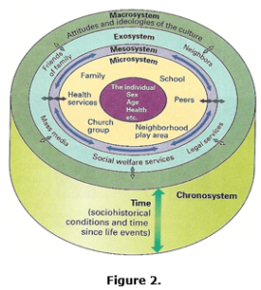
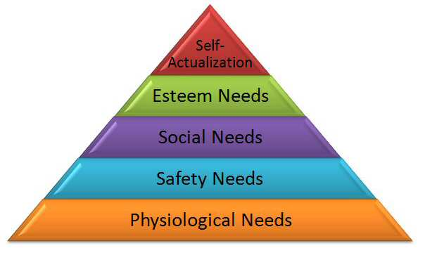
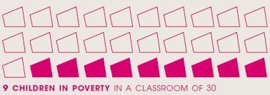
The Pupil Development Grant
Lack of home learning
Bronfenbrenner’s Ecological Systems Theory
Parental Attitudes
(Formally known as the Pupil Deprivation Grant)
Failure to engage
Who does it help?
Antisocial behavior
eFSM
LAC Children
Adopted Children
Maslow’s Hierarchy of Needs
www.researchleap.com/people-disabilities-representation-public-spaces-case-study-post-war. Accessed 1/8/20
What does it pay for?
Between 2016-17, 30% of children lived in poverty
Staff training and development
Interventions
Attendance Incentives
www.psychology.stackexchange.com/questions/169/does-evidence-sipport-maslows-hierarchy-of-needs. Accessed 1/8/20
Nurture Groups
Enhanced Curriculum
Article 28 – All children have the right to an education (UNCRC)
Resources
Elsa Provision
Does it work?
www.endchildpoverty.co.uk/keyfacts. Accessed 1/8/20
RED, MUD, SID
Levitas (1998)

Slide 2
Reference List:
Bronfenbrenner. U, Morris. P, (2007). The Bioecological Model of Human Development. Handbook of Child Psychology.
Dauncey. M, (2018). Next steps for the pupil development grant.
Estyn (2013). Working together to tackle the impact of poverty on educational achievement.
Goodman. A, Gregg. P, (2010). Poorer children’s educational attainment: how important are attitudes and behaviour?
Levitas. R, (1998). Social Exclusion and New Labour. Macmillan.
McLeod. S.A, (2020). Maslow’s Hierarchy of Needs. Simply Psychology.
National Assembly for Wales, (2018). Children, Young People and Education Committee. On the Money? Targeted funding to improve educational outcomes.
www.seneddresearch.blog/next-steps-for-the-pupil-development-grant. Accessed 2/8/20.
Welsh Government (2017). Evaluation of the Pupil Deprivation Grant: Final report.

