Slide 1

ROOM BOOKING
Module name and code: Foreign Languages and Cultural Awareness (BMIH5003)
Student number: 2025465
Student name: Judit Aniko Lengyel
Lecturer: Rodrigo F. Aguilera
10TH JUNE 2022

Slide 2
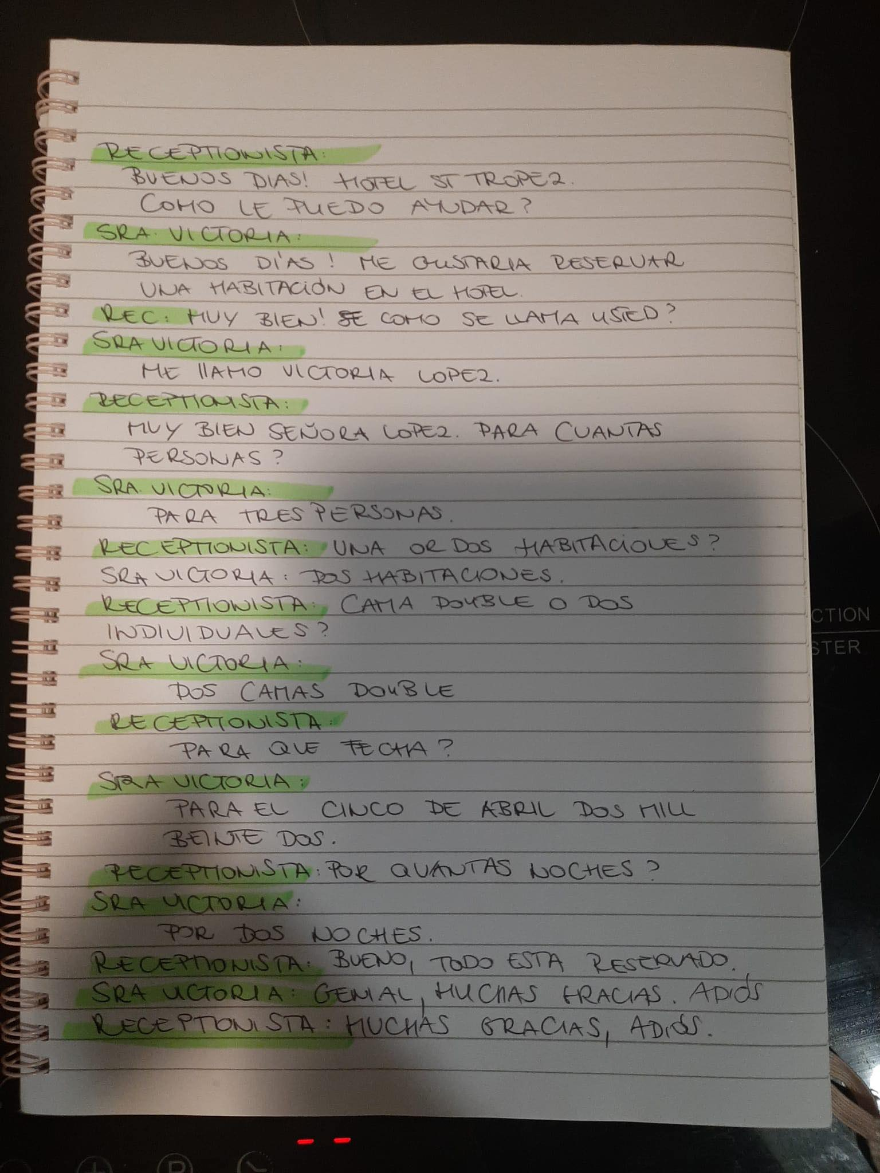

ROOM BOOKING
JUDIT LENGYEL
STUDENT ID: 2025465

