Slide 1

Name: Khushi Sangani
Student Id: 2520615
DIGITAL FORENSIC
INVESTIGATION REPORT

Slide 2
Investigation overview
  Quantum Tech's IT team detected unauthorised access to a confidential AI chip patent (QT-AI-2025). Senior engineer Emma is accused of stealing the material and attempting to sell it to competitor NexGen Circuits. She used Joe as an intermediary to find a buyer, and Norman (acting for NexGen) negotiated the purchase.
Emma
Role: Perpetrator
Senior engineer; obtained and offered patent for sale
Joe
Role: Intermediary
Brokered the deal; travelled to meet buyers
Norman
Role: Buyer
Acted for NexGen; negotiated terms & payment

Slide 3
Digital Evidence Inventory
Exhibit | Device | Owner | Status
EXH-01 | Huawei POT-LX1 | Emma | Hash Verified
EXH-02 | Samsung SM-A137F | Joe | Hash Verified
EXH-03 | Nokia C2 2nd Ed. | Norman | Hash Verified

Slide 4
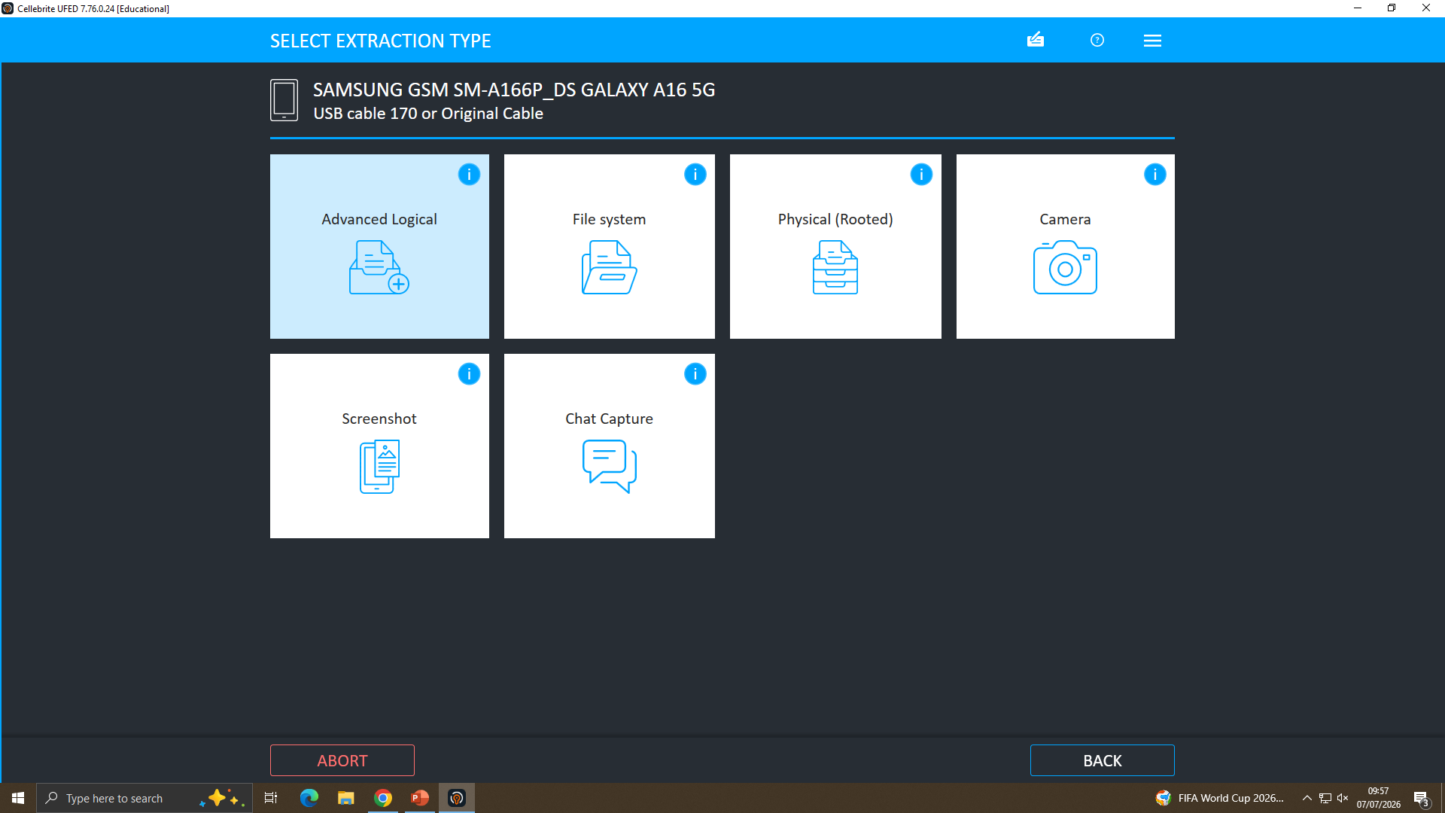
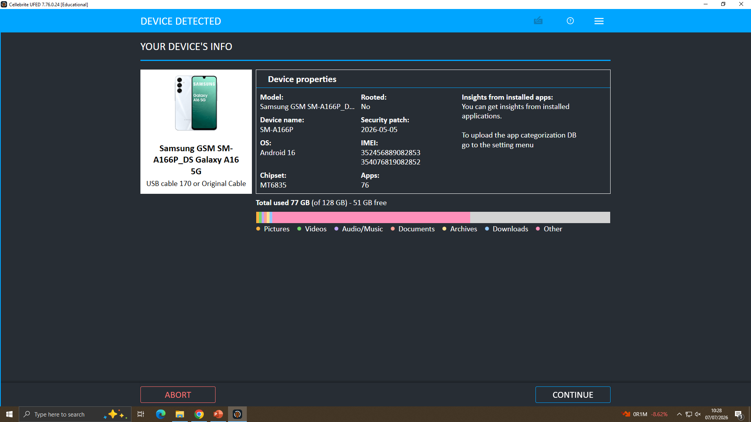
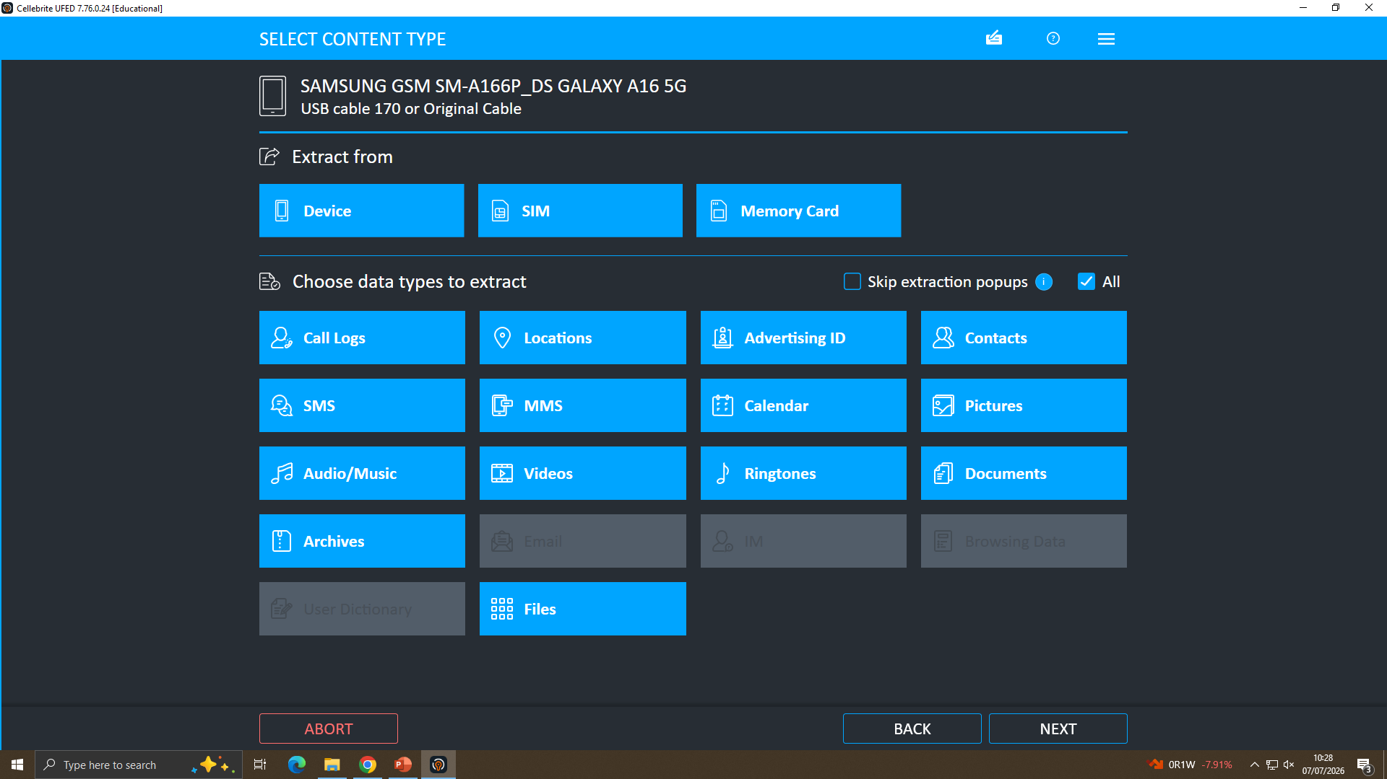
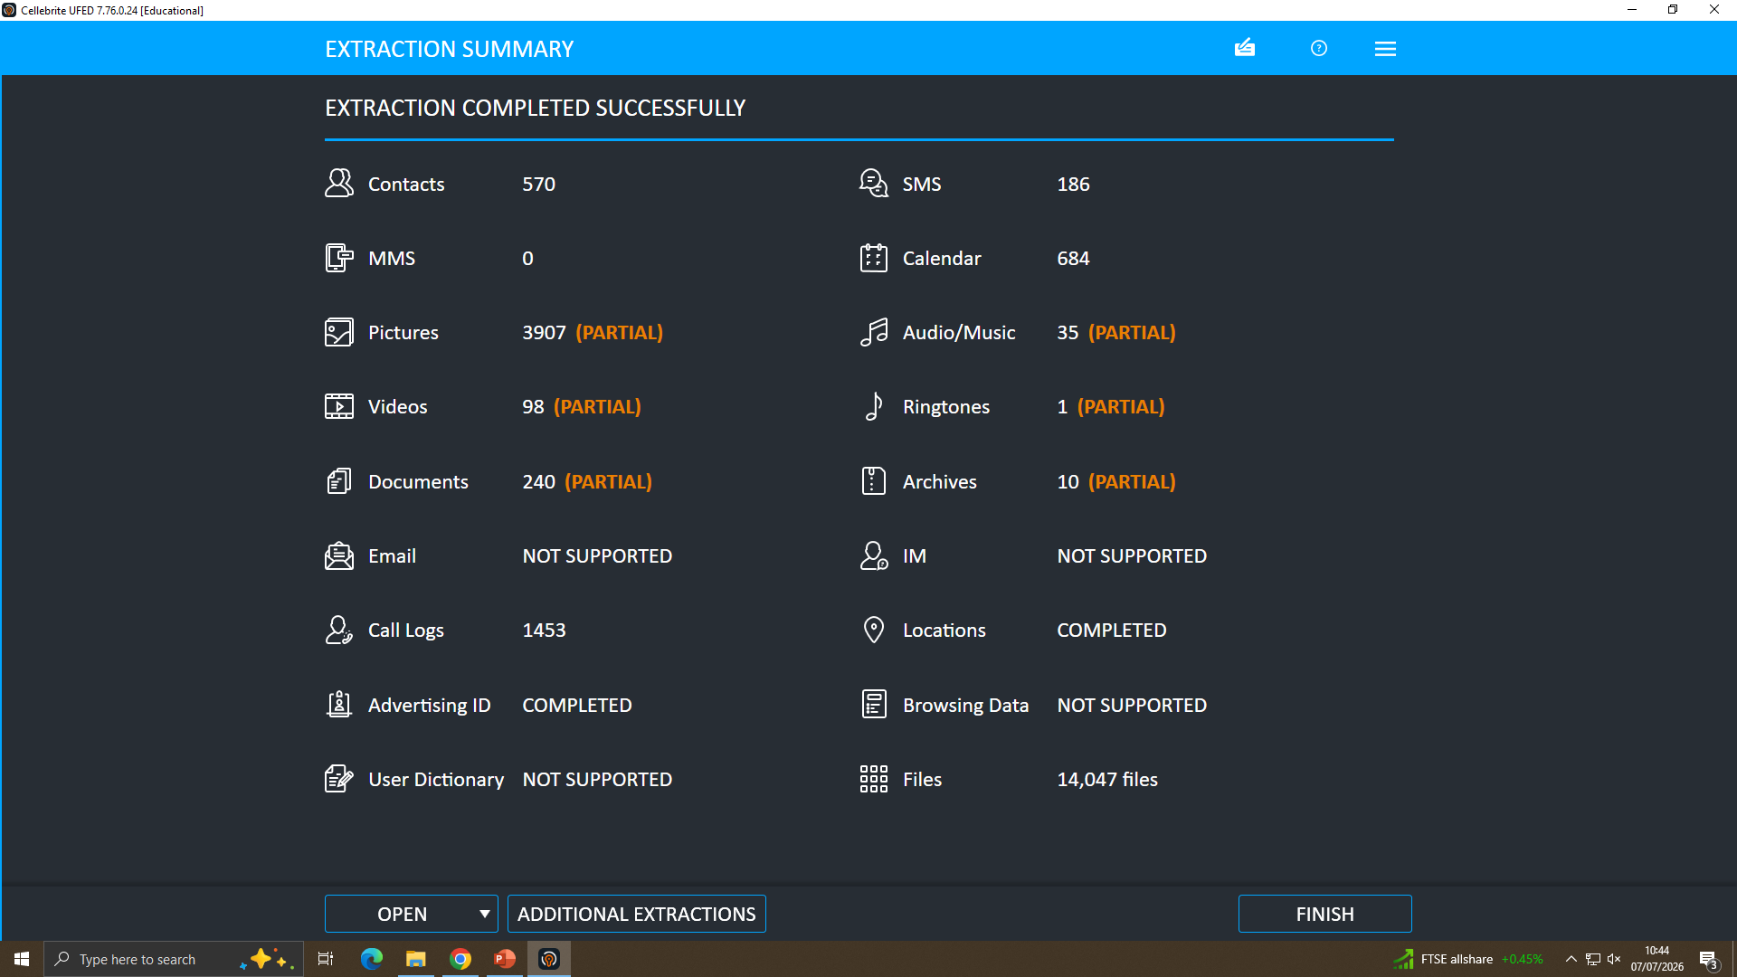
Forensic Imaging Process
Select acquisition source
Auto-detect device model
Select content types
Extraction completed

Slide 5
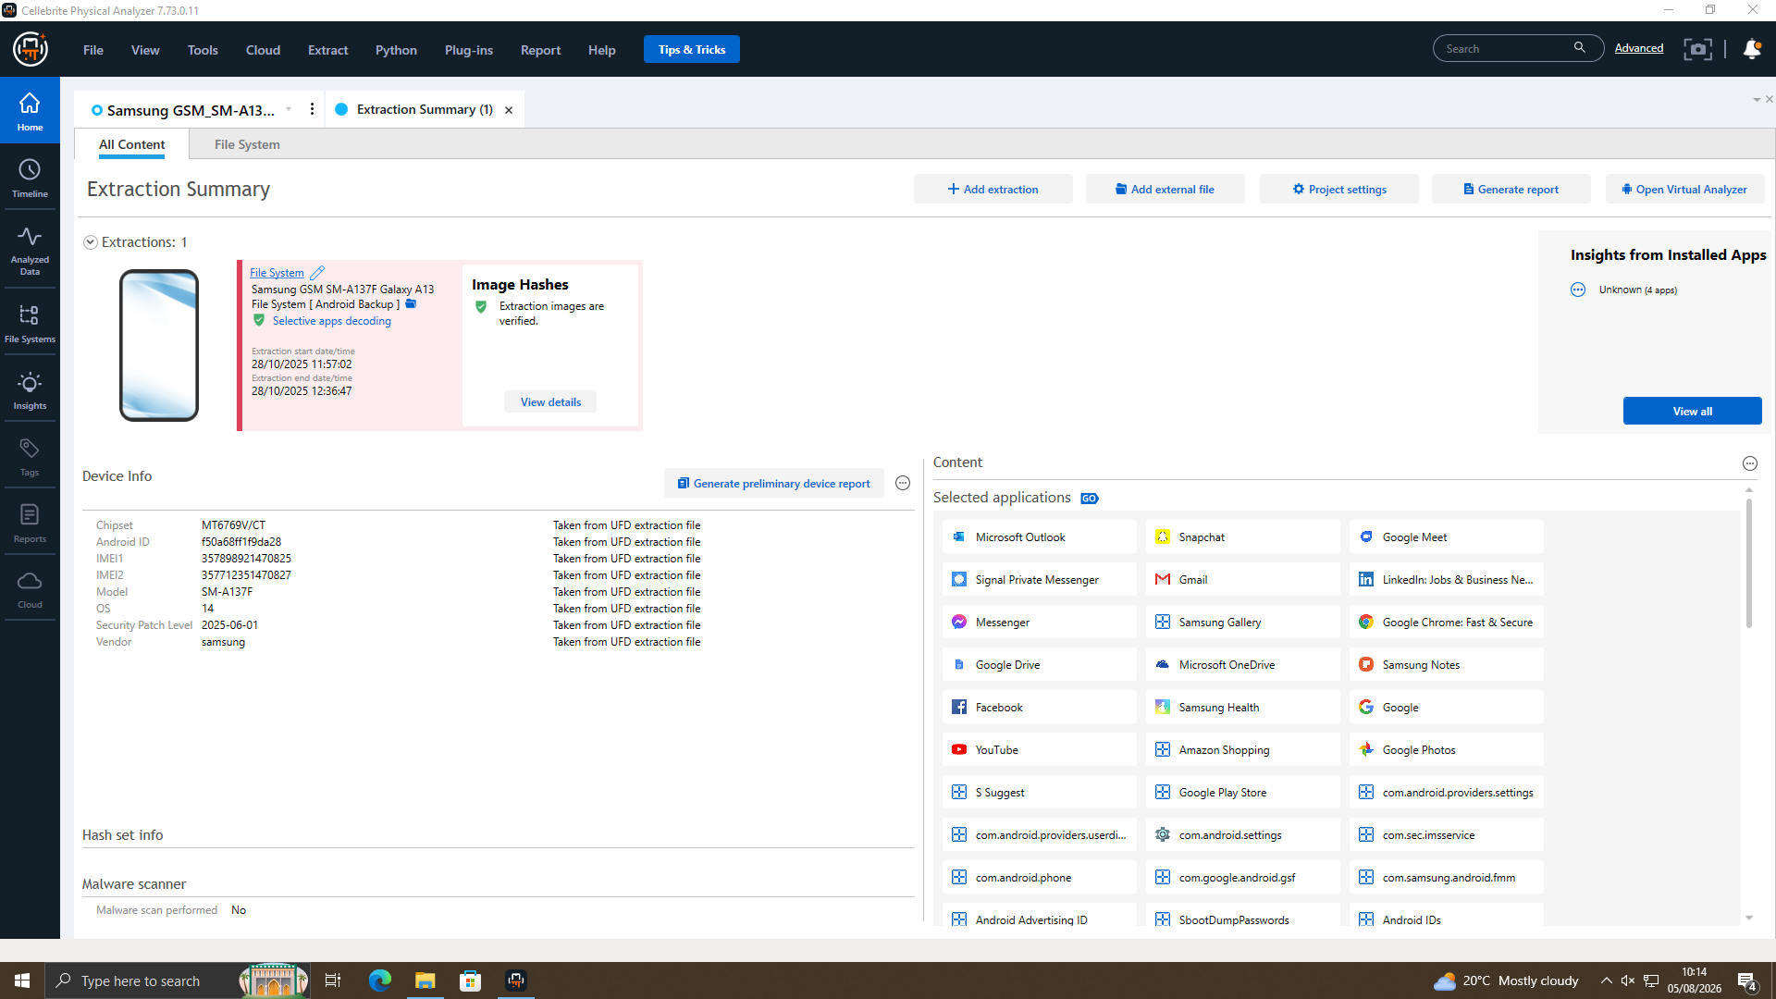
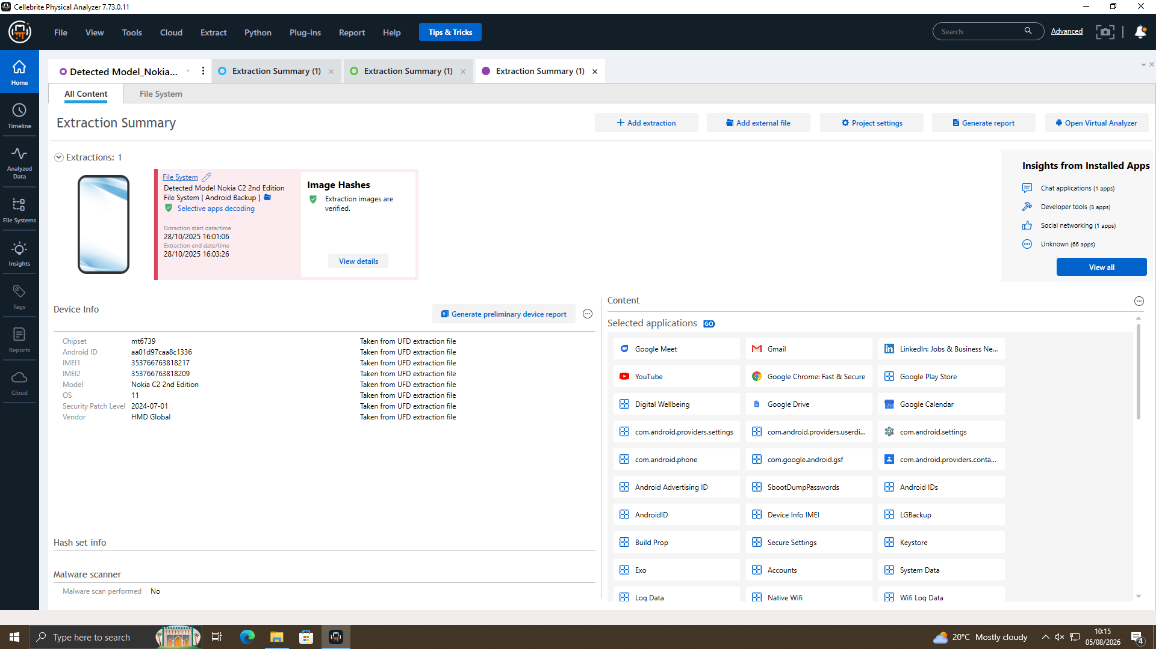
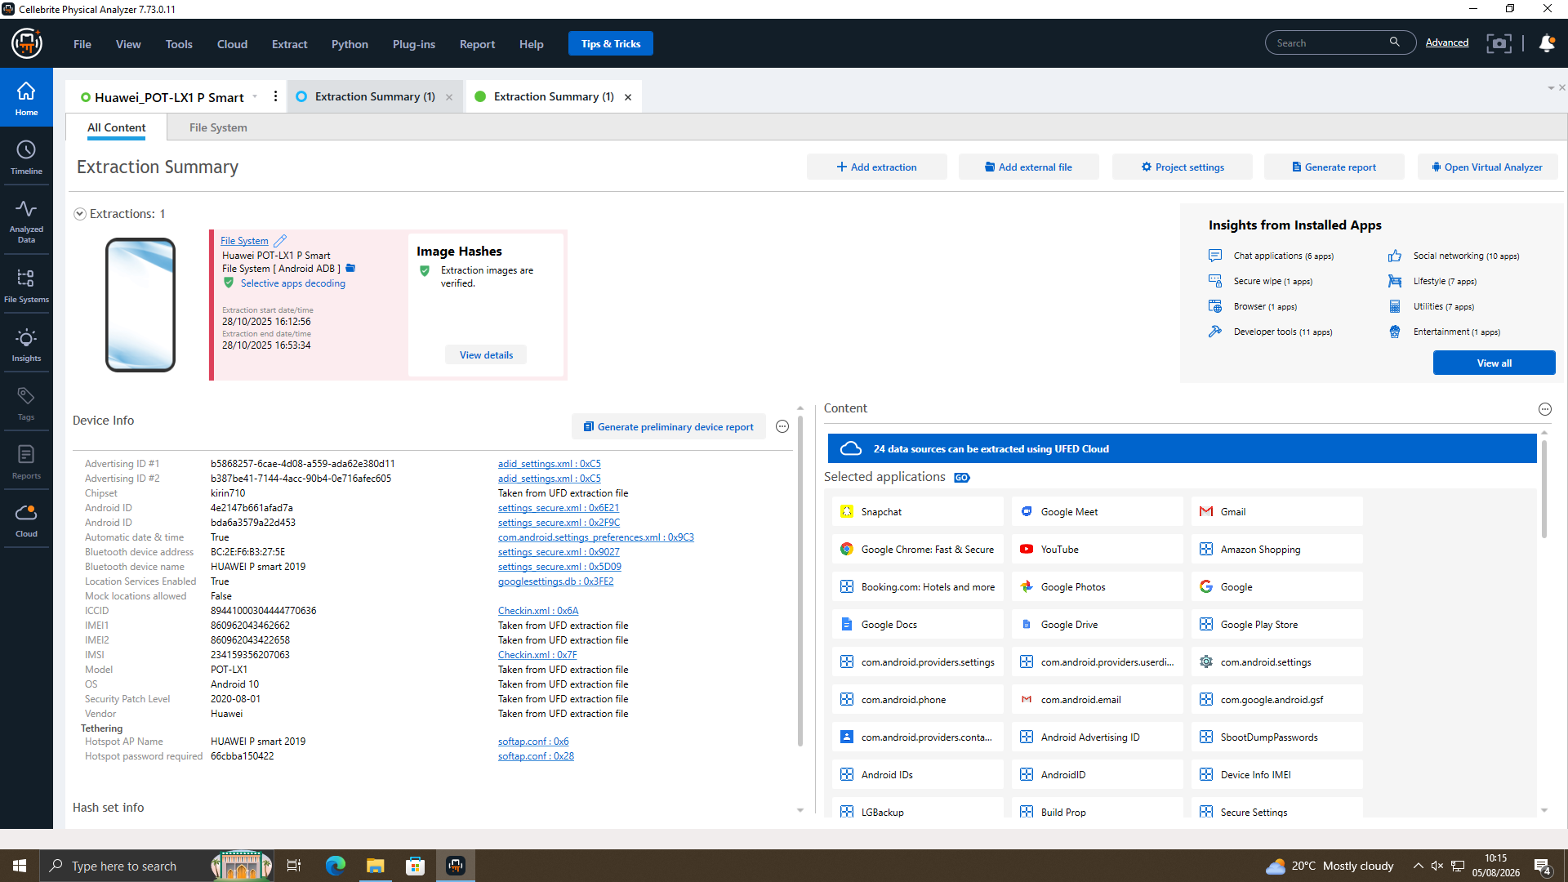
Data Integrity & Authentication
Samsung SM-A137F
very forensic image was hash-verified immediately after extraction. All three exhibits produced matching hashes, confirming the evidence remains unaltered and forensically sound.
Nokia C2 2nd Ed
Huawei POT-LX1

Slide 6
Investigation Timeline
21 Aug 2024 : WhatsApp chat with Joe and Emma
29 Aug 2024 : Joe travel Glasgow
4 Sep 2024 : Joe and Norman meet in Swansea
14 Oct 2024 : Joe in the Paris
20 Nov 2024 : Joe in the Manchester
31 Jan 2025 : Emma and Norman agree partial handover,£5M offshore, 48- hr window

Slide 7
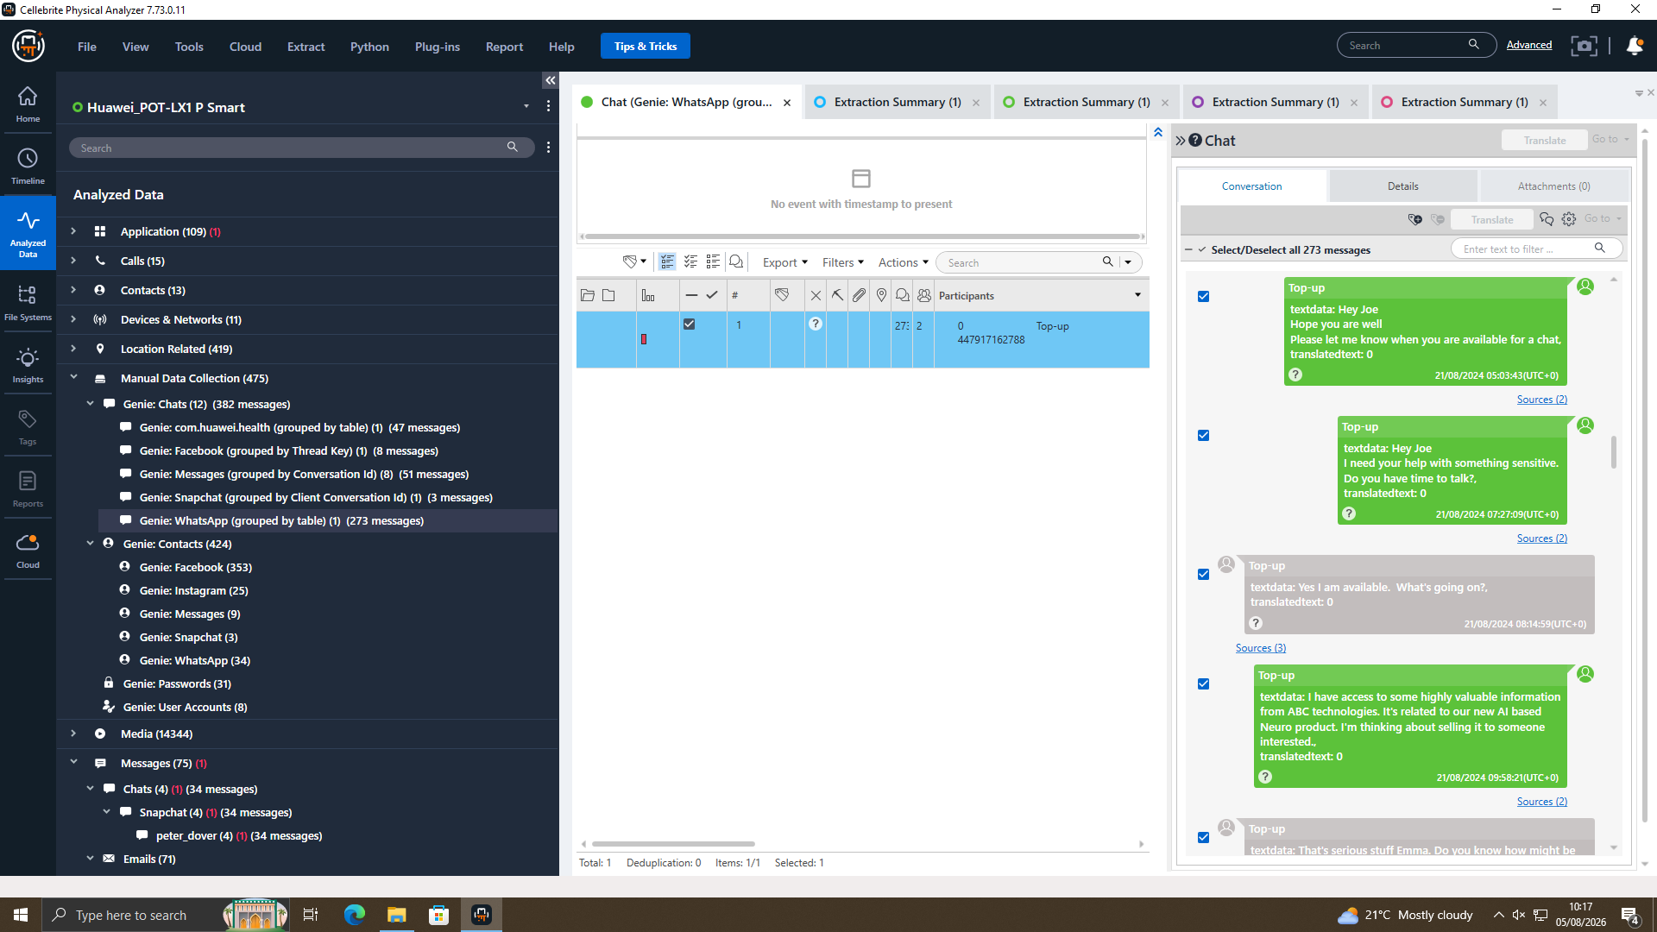
Emma and Joe communication in WhatsApp
Joe have Neuro-chip documents.
He want sell this chip
Joe reports travelling to Glasgow, Paris, and Manchester to meet buyers.
On 31 Jan 2025, Joe confirms around £5 million is almost secured.
Huawei POT-LX1 : chat with Joe and Emma

Slide 8
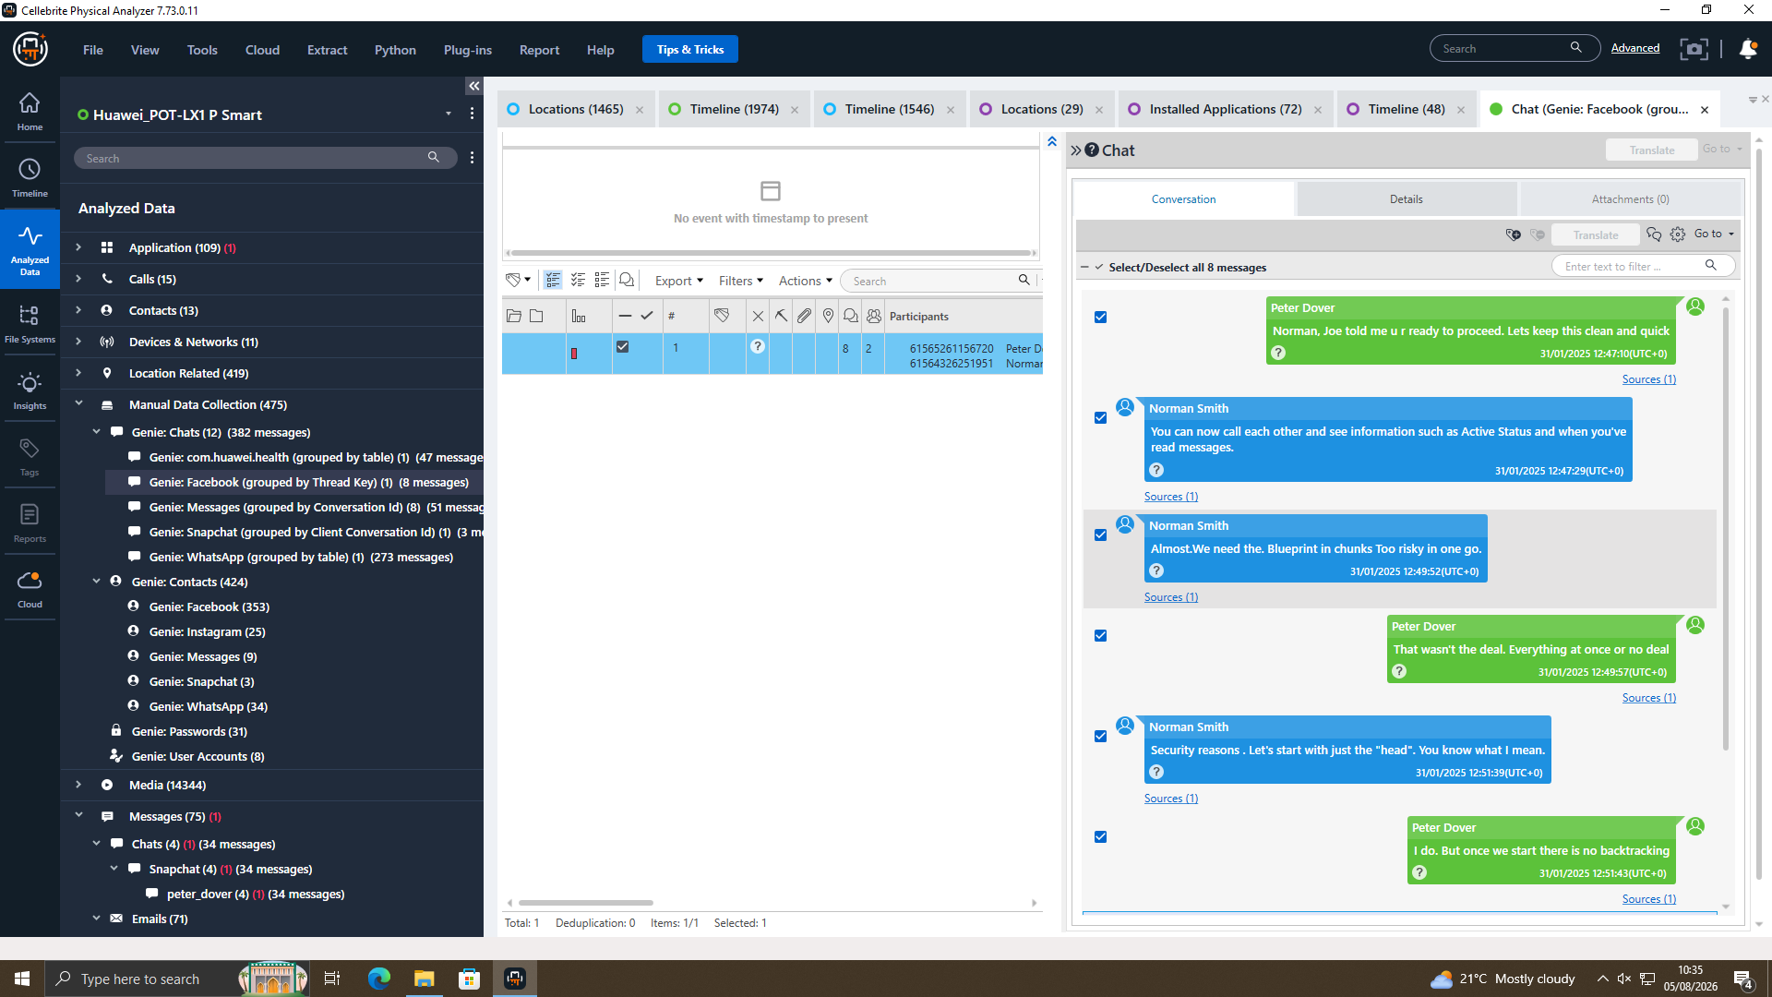
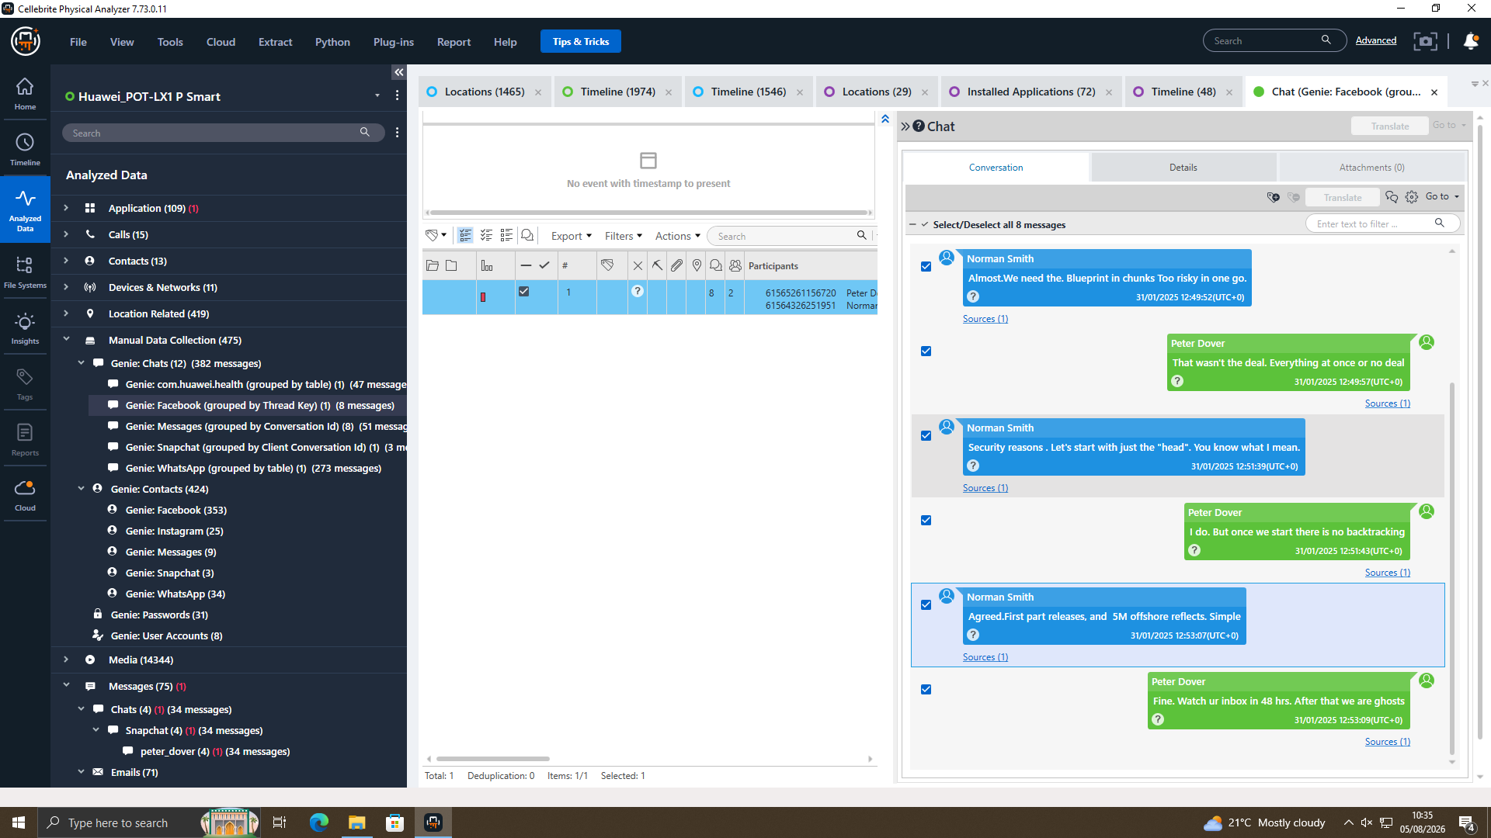
Peter Dover and Norman Smith communication on Facebook
Emma uses fake name "Peter Dover".
Norman suggests sending the document in parts.
Emma says all or nothing.
They agree: send the main part first.
Emma confirms 48-hour delivery.
Huawei POT-LX1: chat with Norman and Emma

Slide 9
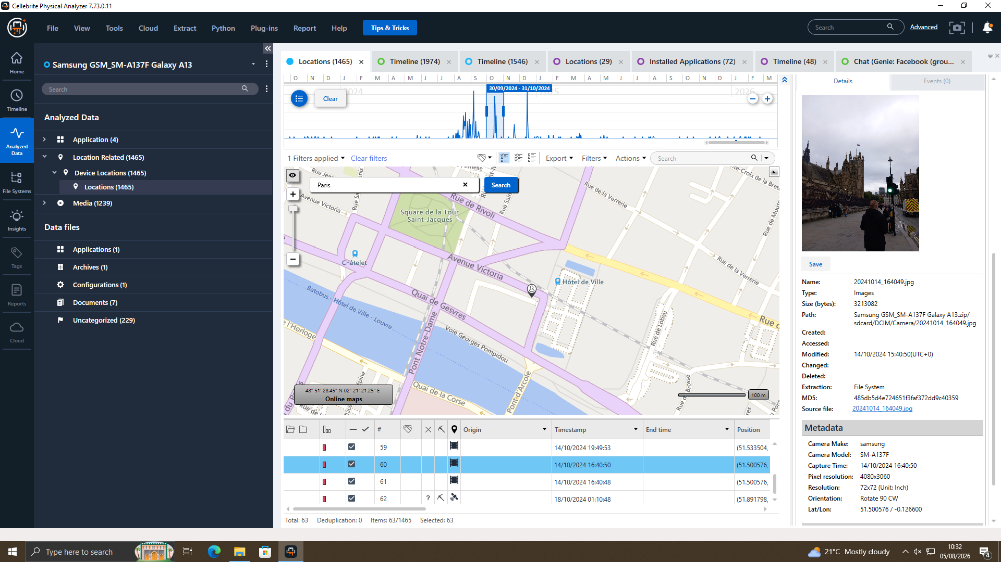
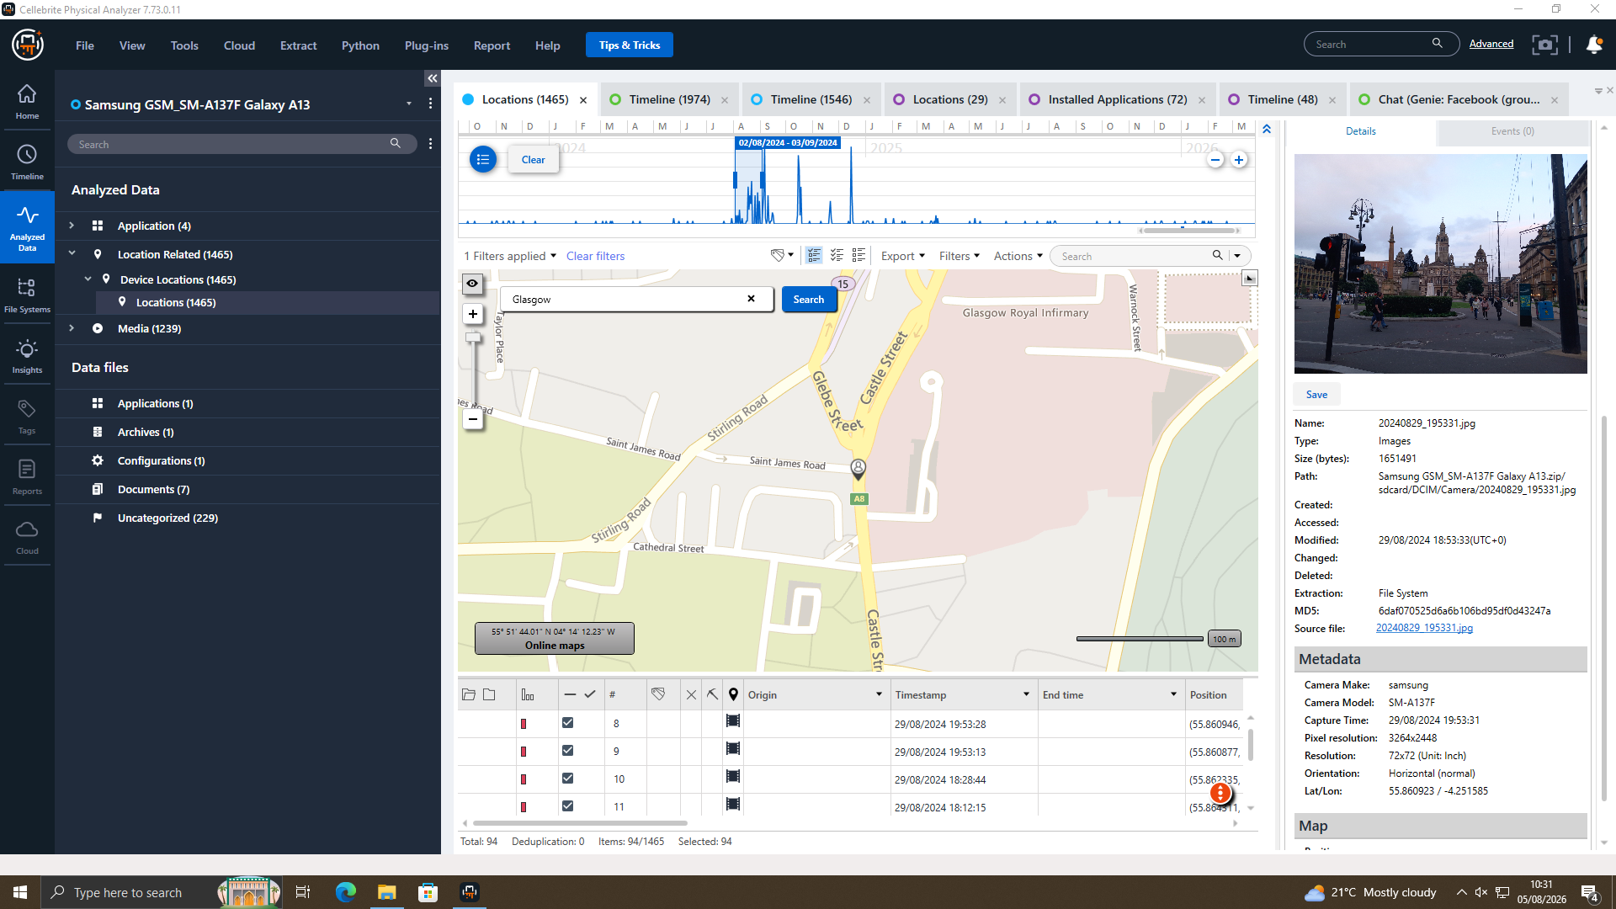
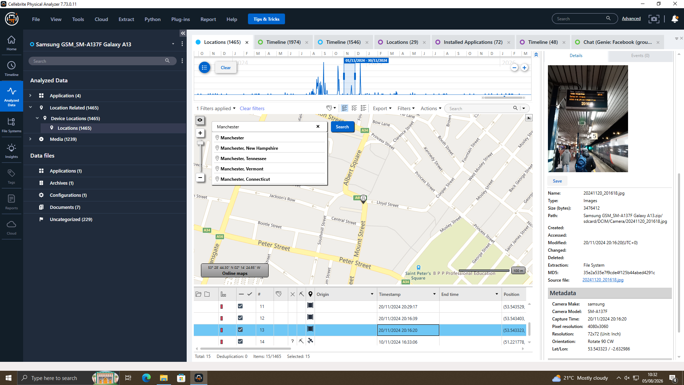
Joe’s travel – Glasgow,
Paris, Manchester
14 Oct : Joe’s travel in paris
29 Aug : Joe’s travel in Glasgow
20 Nov : Joe’s meeting in Manchester

Slide 10
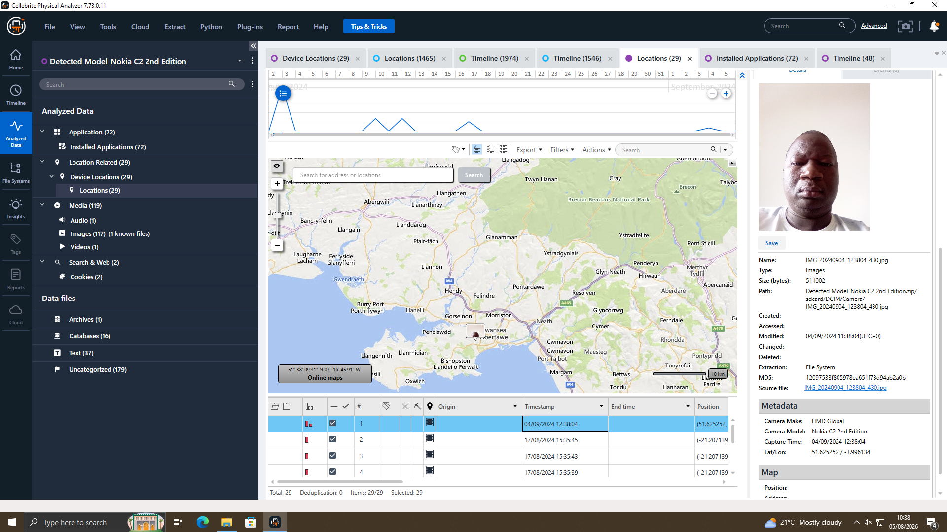
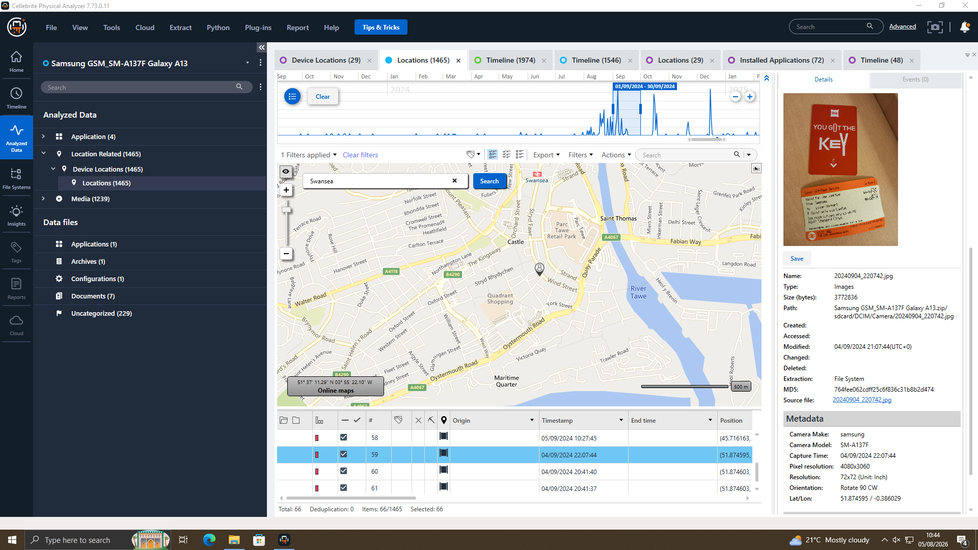
Joe Meets Norman — Swansea, 4 Sep 2024
A photo on Norman's phone showed he was in Swansea on 4 September 2024. Joe's phone location and travel tickets also placed him in Swansea on the same day. This proves Joe and Norman met in person.
Nokia (EXH-03) — Norman's device located in Swansea, 04/09/2024
Samsung (EXH-02) — Joe's matching location & travel-ticket evidence, same date

Slide 11
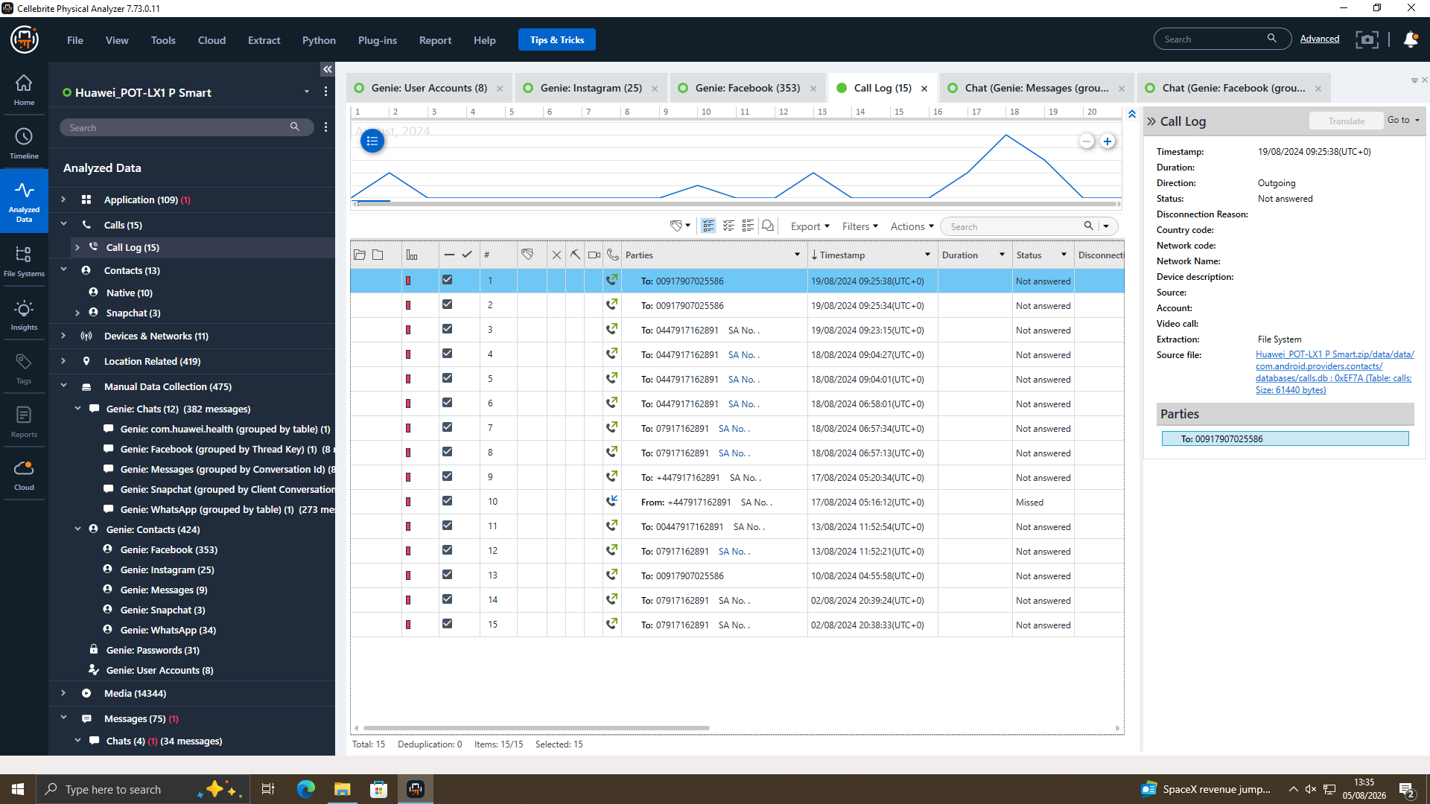
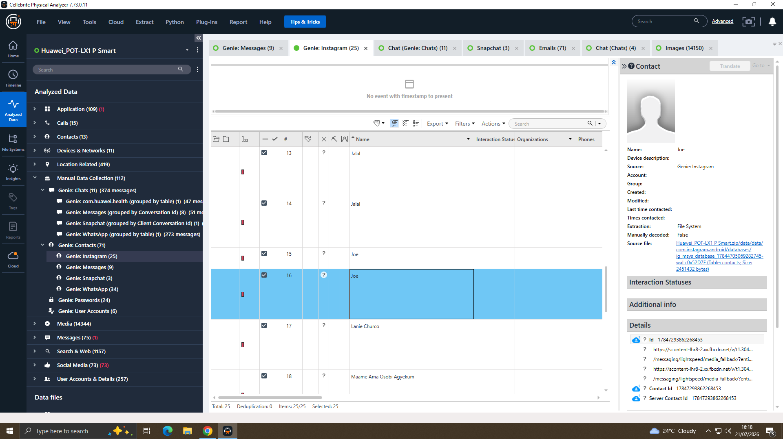
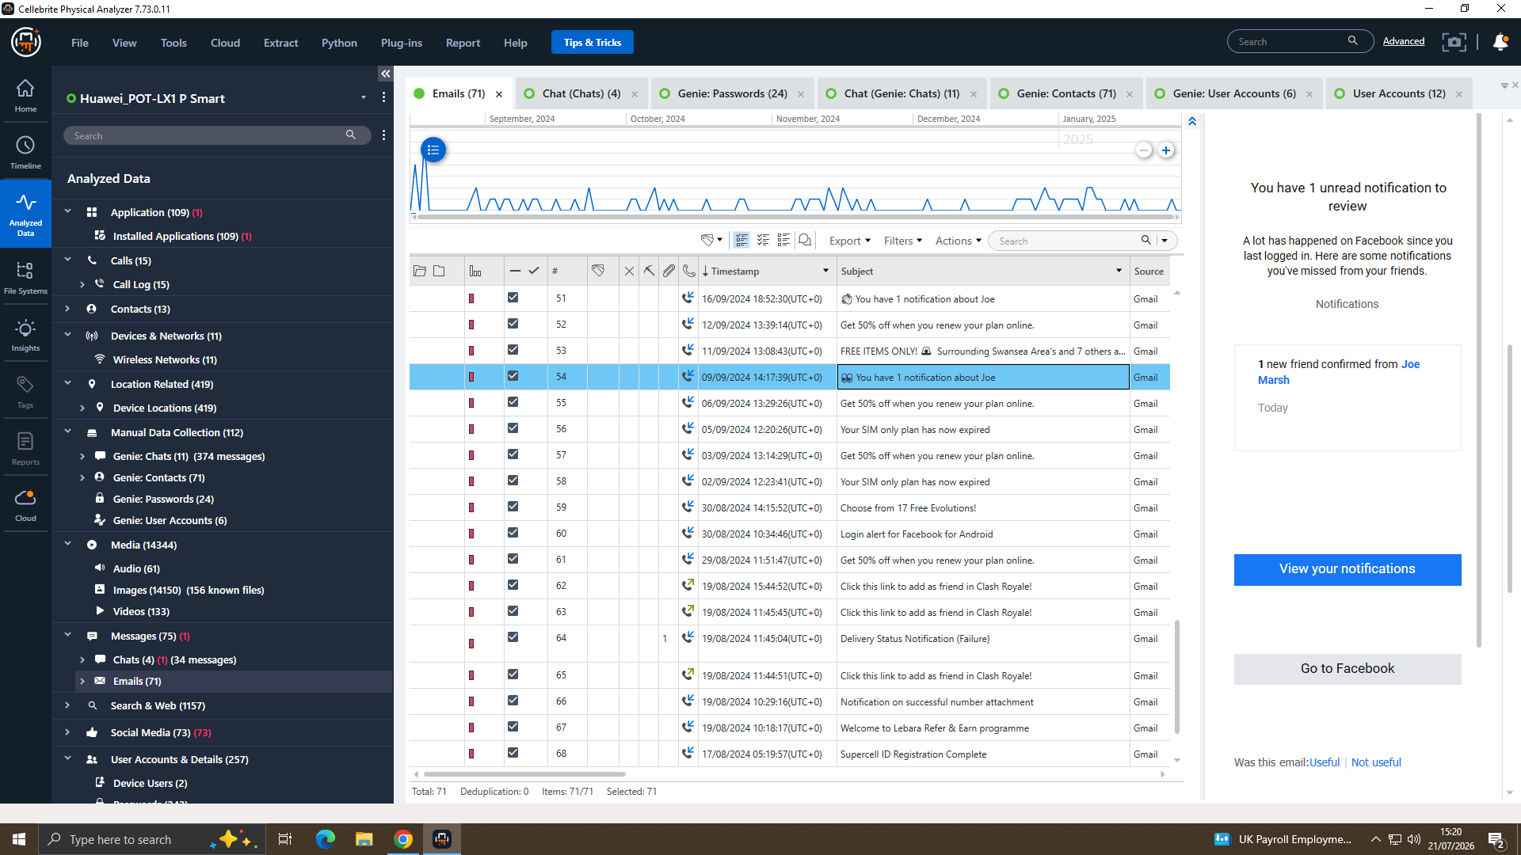
Additionally evidence : call logs, Email, and Instagram
This all are images like calls logs , Email, and Instagram . This is additionally evidence .
Call to Joe and Emma
Send the email to Joe
Emma send the request on the Instagram

Slide 12
Conclusion
Cross-corroborated chat, call-log, and GPS evidence from three separate handsets supports:
  Emma obtained and offered to sell the QT-AI-2025 material.
  Joe brokered a buyer.
  Norman negotiated purchase terms including ~£5M offshore payment.
All exhibits were hash-verified with an unbroken chain of custody.

