Slide 1
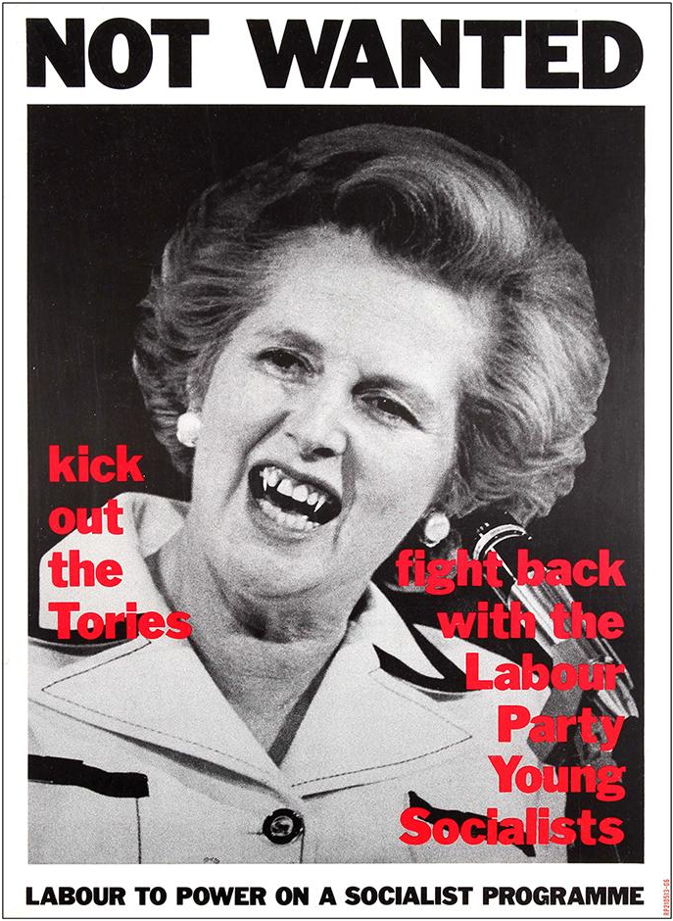
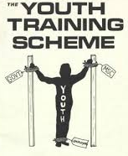
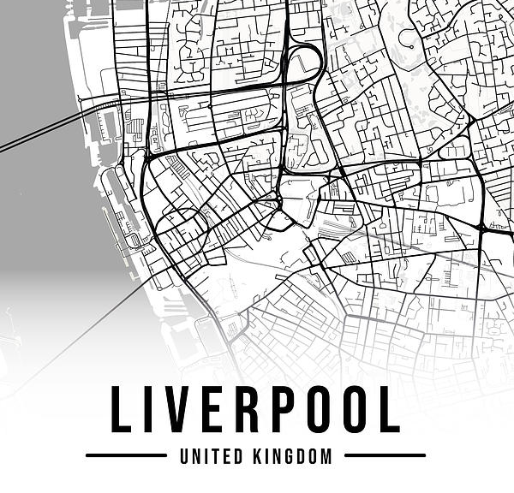
School students strike 23rd April 1985
Liverpool says NO to YTS conscription
Meeting Point:
St George’s Hall 10:30am
1 hour march through Liverpool town centre to rally point at Pier Head

Slide 2
Liverpool school students strike 23rd April 1985
What is YTS?
YTS, also known as the Youth Training Scheme, is an exploitative programme set up by the Conservative government for children 16-17 years old. In theory, the YTS aims for unemployed youth to gain work experience and basic training at firms, with the possibility of gaining full-time employment by the end of the year long programme.
On paper YTS seems like a perfect scheme to encourage young people to enter the workplace by providing them with relevant practical experience in the field. However, firms have been using YTS to TAKE ADVANTAGE of participating children. On-the-job training which is the essence of the programme has resulted in firms using young people as cheap full-time labour with no guarantee of a job at the end of the YTS programme. It is unfair for young people looking to better their futures to be exploited in this way by our capitalist society.
Organisation
On the day of the strike, we will meet outside ST GEORGE’S HALL at 10:30am and undergo an hour-long march through Liverpool city centre to PIERS HEAD for a rally where notable figures such as local Labour MP Terry Fields will be to greet our young protestors. The Labour Party Young Socialists have carefully planned the route of the march to avoid main roads to ensure the safety of our younger participants.
We encourage participants to bring their own signs, placards and banners to showcase the purpose of the march to the wider Liverpool public. Please avoid offensive language on your signs to keep the rally ‘child friendly’ as we expect young protestors to be present at the event.
Local photographer Dave Sinclair will be photographing this historic march through Liverpool city centre as protestors make their way to Piers Head. By taking part in this strike, you are consenting to your image being used in the press to further is campaign.
Why should YOU strike?
The school student strike against YTS is a national movement. Liverpool cannot be silent on issues which will affect an entire next generation of workers stepping into the workplace.
Furthermore, it has been suggested by parliament that YTS becomes compulsory under the threat that any unemployed youth opting not to take part in this exploitative system will have their unemployment benefits taken away. We cannot allow our youth to be forced into unfair employment.
We realise some schools in the area are not supportive of their students taking time out of education to use their voice to make an impact on this important protest which will directly impact current student’s futures. However, we believe the best form education comes from practical experience. By attending this march young children in Liverpool will be learning how to advocate for themselves against forces attempting to dictate their future.

Slide 3
References
BBC (2011) ‘Liverpool School Strike 1985 exhibition at The Bluecoat’, BBC, 5 October. Available at: Liverpool School Strike 1985 exhibition at The Bluecoat - BBC News (Accessed: 5 November 2024).
Dolton, P. J., Makepeace, G. H. and Treble, J. G. (1994) ‘The Youth Training Scheme and the School-to-Work Transition’, 46(4), p.629-657. Available at: The Youth Training Scheme and the School-to-Work Transition on JSTOR (Accessed: 5 November 2024).
John, S. (2015) The UK school students’ strike, 1985 – Steven Johns. Available at: The UK school students' strike, 1985 - Steven Johns | libcom.org (Accessed: 5 November 2024).
Socialist Party (2015) 30 years ago: 250,000 school students walked out. Available at: 30 years ago: 250,000 school students walked out. - Socialist Party (Accessed: 5 November 2024).
Sorene, P. (2019) Great Photos of the Liverpool School Strike of 1985. Available at: Great Photos of the Liverpool School Strike of 1985 – Flashbak (Accessed: 5 November 2024).

Slide 4
Images
Map of Liverpool - Liverpool Map United Kingdom Black and White Aesthetic Minimalistic Digital Art by Ricardo Pereira – Pixels
Youth Training Scheme - Youth Work? Employment Brokering and Business Networking – IN DEFENCE OF YOUTH WORK
Not wanted, Margret Thatcher - Not Wanted Thatcher Poster By Labour Party Young Socialists : Art Print £7.99 / Framed Print £22.99 / T-Shirt £12.99 / Shopping Bag £8.99

