Slide 1

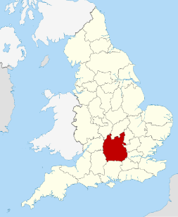
Organisational Adoption of Artificial Intelligence
Recommendation 1
Thames Valley Police
Peter Scott
Student No. :2307123
UWTSD
Image: map: thamesvalleypolice
Notes:
Good afternoon,
The purpose of this presentation is to bring forward one recommendation towards a holistic approach to AI adoption in the force.
A brief overview of the National Policing picture in terms of Police officer and staff levels, together with national leaving rates will assist in highlighting our first challenge of retention and attrition.
We will briefly capture the national picture of outcomes for police forces in terms of charges and summons, this outlook will provide the context of our second organisational challenge relating to skills and talent.
The data slides will conclude with a third presented challenge relating to the timeliness of bringing cases to conclusion, and the increasing demand on officers and staff, highlighting the bureaucratic systems and processes.
These three challenges relate to most police forces, including our own.
Attention is then drawn to our ability and capacity to achieve the Vison, Mission of TVP in achieving a public sector competitive advantage.
The strategic changes required towards a more competitive police service will rely upon adaption and the use of technologies to enhance our workforce skills and capability, our present movement towards this technology is highlighted with the successful contribution of AI Robotics.
Recommendation one focuses upon the preparation of the organisational structure to fully appreciate, adopt and implement holistic AI technologies in the future. The highlighted position of archaic structures of hierarchy provide a contrast to the adoption of more agile and flexible structures that can be used to steer, adopt and implement new technologies. The proposed outline for a Matrix structure to work separate to the organisational hierarchy will provide opportunity to work differently and create agile solutions to tackle the three identified strategic challenges.
An overview of the change process utilises McKinsey's 7s framework model to engage Strategy in both hard and soft environments. The use of a horizon strategy will provide an ambitious but planned engagement of AI technologies over five years.
We will conclude will general expected outcomes of AI implementation with the organisation – reinforcing the importance of stable foundations to engage this vison, leading with recommendation one.

Slide 2

Recommendation 1: Prior to the adoption and implementation of Artificial Intelligence within the organisation, the structure, platform should be reviewed with development towards a Matrix structure to harness workforce engagement with AI.
Notes:
The first recommendation brought forward for presentaion to day outlines the focus upon developing a unique but temporary Matrix structure to be able to engage the systemactic engagement of AI tecnologies. The engagement of AI technology is of urgent concern to remain competitive as a public sector organisation. Its ultimate aim to achieve an effective, efficient and engaged workforce that will provide value as a front facing public service.
It is suggested by (Mayer and Yee, 2025) that leaders should thrust forward with planned transformation and avoid being dissuaded, or face the potential of being uncompetitive tomorrow.

Slide 3
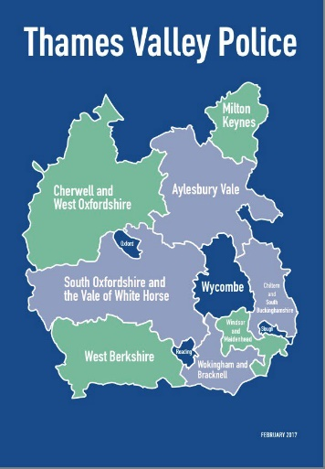
Comparable workforce size of top five forces
Police officer numbers 2025
Notes:
As an overview, for partners in the audience, according to Statista (2025) , Thames Valley Police (2025), Thames Valley Police is ranked in the top 5 of Forces in England and Wales. Highlighting the significance and importance of our workforce assets.

Slide 4
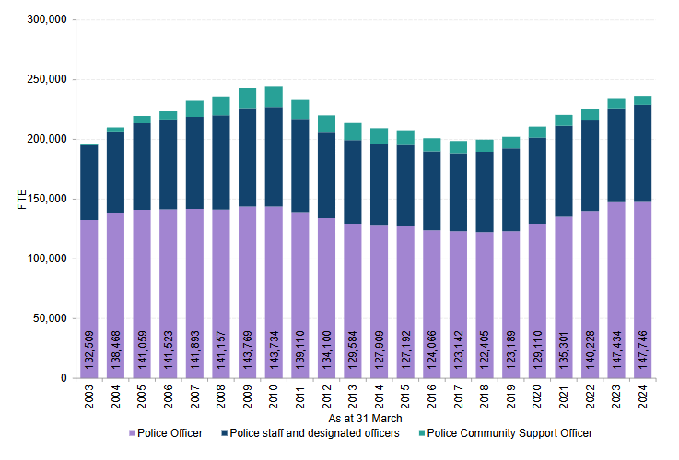
The National Picture
On 31 March 2024, there were 147,746 FTE Police officers in the 43 territorial police forces in England and Wales, a 0.2% increase from 147,434 FTE officers in 2023.
On 31 March 2024, there were 236,588 FTE workers (including officers, staff, designated officers and PCSOs) employed by the 43 territorial police forces in England and Wales
Image: Gov.uk police workforce
Notes:
The national overview of Police officer numbers in England and Wales is provided by Gov.uk (2024) provides the snapshot of current police officer numbers, whilst this appears healthy and increasing the next slide will present our first challenging workforce position.

Slide 5
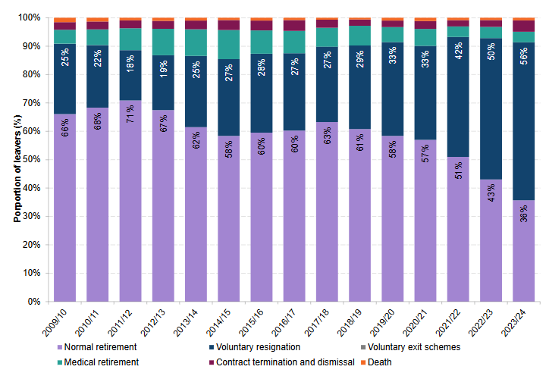
Police officer leavers national picture
Driven by an increase in voluntary resignations, up from 4,575 FTE in the year ending March 2023 (50%) to 5,058 FTE (56%) in March 2024.
Reflecting an increased number of newer officers with fewer years of service who are more likely to leave than experienced officers.
Image: Gov.uk police workforce
Notes:
The number of Voluntary resignations in the police service shows as of March 2023 to be approximately 56%. Gov.uk,(2024) This evidenced increase year by year provides a clear horizon challenge in the retention of trained workforce staff. The question of tackling increased attrition and retention is critical. The vison of high-quality data through AI provision of Human Resource management (HRM) is key in our understanding. Concentrations in this field and integration of HRM into the AI structures can benefit. According to Storey et al (2009), the significance of enhanced practices and policies have a direct relationship with behaviours and attitudes of the workforce, which in turn can reflect higher motivation and performance, increasing value.
Specifically in relation to Thames Valley Police the recent PEEL inspection completed by HMICFRS stated that there are challenges in terms of high demand and retaining officers and staff. The competitive job market provides a continued horizon challenge according to HMICFRS, (2025a)

Slide 6
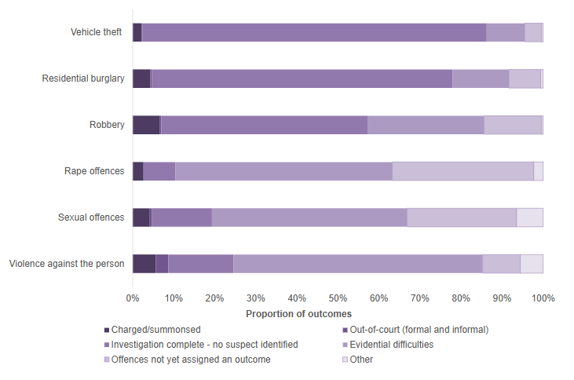
Proportion of national crime outcomes in year 2024
The charge and summons rates displayed show significantly low charge and summons outcomes being achieved.
There is a significant proportion of ‘no suspect identified’ - no positive outcome.
There is a significant percentage rise in filed investigations due to evidential difficulties.
Image: Gov.uk police workforce
Notes:
The Police is a public sector organisation, our value is the service upon which we provide to the public. The data captured and reflected by Gov.uk (2023) provides a data snap of charge and summons rates. The disproportionate poor results are reflected by HMICFRS reports, reflecting that this area requires improvements to be made, highly ineffective investigations, poor timeliness, HMIC, (2023)

Slide 7
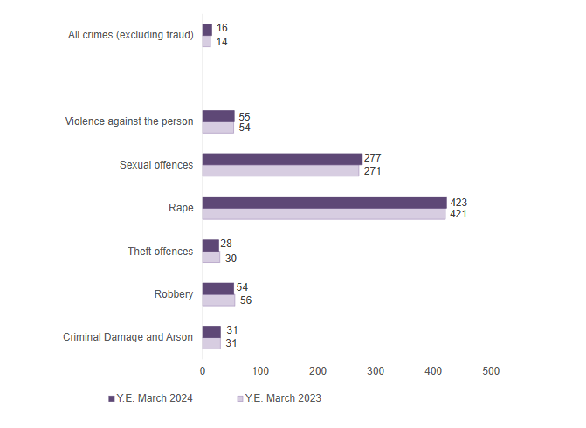
National Picture of time taken to conclude an investigation to a charge or summons outcome
The time taken (median days) for charge/summons outcomes to be assigned to offences, by offence group, year ending March 2024, England and Wales.
General increase in outcome time compared to 2023
Image: Gov.uk police workforce
Notes:
police lack the resources, time and experience to investigate crimes properly, leading to victim satisfaction and having an impact on public confidence according to The Guardian, (2025)
A report completed by the (His Majesties Inspectorate of Constabulary Fire and Rescue Service (HMICFRS) state that the police do not provide a good service to victims of crime, they are worried about the reduction in positive outcomes, with outcome rates decreasing below 11.3% from rates of 25.4% back in 2015. HMICFRS, (2025).

Slide 8
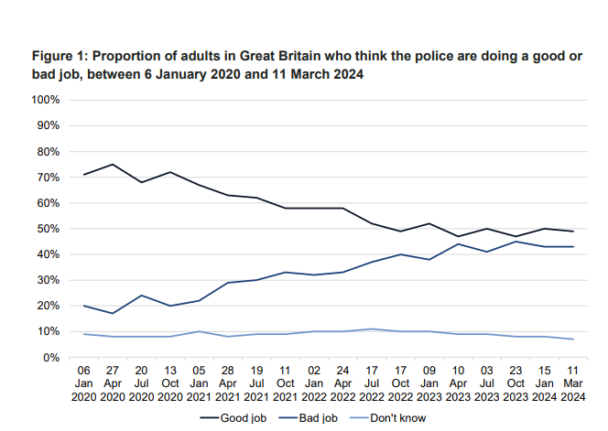
Rethinking our approach to change our mission outcomes ?
YouGov poll 2024, Are the police doing a good or bad job?
“preventing and thoroughly investigating crime, supporting victims and bringing offenders to justice. With our people, public and partners we will build stronger, more resilient communities and will provide a modern police force which meets the needs of the public we serve.”
(TVP,2025)
Notes:
The adaption of our service to integrate AI technologies is also led by our fundamental focus of Mission and Vision of Thames Valley Police, the demonstration of our commitment in providing value is clear states Thames Valley Police,(2025) The challenge with achieving public value can also be seen in recent you.gov polling, indicating that public confidence is near an all time low. This is also highlighted within the recent

Slide 9


Complexity of crime types require a fundamentally different set of skills…
The need to maintain a competitive advantage as a public sector organisation …
This Photo by Unknown Author is licensed under CC BY-SA-NC
Notes:
Complexity of crime types require a fundamentally different set of skills….
The national digital strategy for policing emphasises the growing speed in which technology is adapting and highlights the need for faster, proactive movement from police services to modernise in a digital era, or risk losing the opportunity. NPCC, (2020)
This recommendation of organisational change is an enabler of Pillar 3 in the National digital strategy, with focus on enabling officers and staff through digital transition and its use. NPCC, (2020)
This important aspect and focus on our people and skills is further recognised in the College of Policing (2020) within Pillar 4, this focuses on development and inspiration of our workforce, to evolve our culture.
The ineffective use of siloed procurement processes in the past have now led to outdated technologies now deemed unsuitable for the context and environment for policing, patch work setups are showing to be increasingly inefficient with increased spending according to CACI, (2020).
The need to maintain a competitive advantage as a public sector organisation is highted by the productivity review Gov.uk (2024b). despite the recent uplift of officers into policing the need for productive and effective policing services has never been so important in ensuring that the trust and confidence in policing is maintained.
Current efforts are smalls steps in the right areas, however considerable resourcing and leadership shift is required, this should include the replacement of old systems and embrace innovation. Gov.uk (2024b). The use of effective innovations according to Gov.uk (2025) estimates that there is a £7 return for every £1.00 spent towards digital innovation.

Slide 10

Current AI maturity levels of Thames Valley Police
RPA – Robotic Process Automation
14’000 tasks every month
390’000 hours a year
Image: MS Stock image
Notes:
Current maturity levels of Thames Valley Police
The use of AI and technology is a clearly recognised strategic position in the force, this is evidence from the use of AI and Robotics in recent MASH (Multi Agency safeguarding Hubs) through area process with Hampshire police.
recently engaging robotics in the MASH (Multi Agency Safeguarding Hub) according to Blueprism, (2025) Emergency calls for service are up over 23 percent in the last 12 months. The complexity and time taken to deal with an investigation has increased significantly, including investigation procedures. There are now over 14’000 tasks triggered every month in the MASH teams that required a different approach, the use of Robotic Process Automation (RPA ) has been utilised to optimise time and has created a time saving of over 390’000 hours a year that can be transferred to front line policing stated by Thames Valley Police, (2019).
This provides a tangible success of the use of AI in Robotics in one area, however as determined by the results forecast for changes and outcomes expected by our communities, these small successes are not enough.
The force has improved productivity and efficiency by using Robotic Process Automation, according to HMIC,(2023) they highlight RPA in use and reflect on this as promising practice; the report highlights the contribution of RPA use in other areas such as Firearms application process and bail management checks.

Slide 11
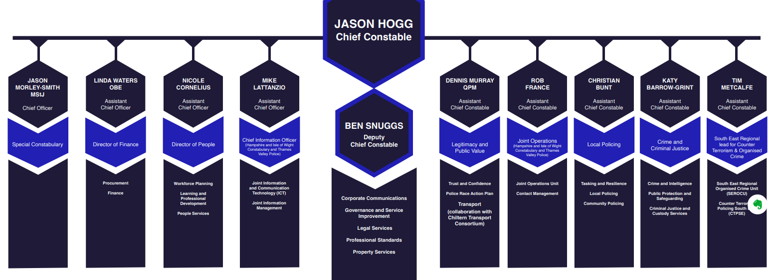
Current structure and position of Thames Valley Police.
Notes:
The police force is considered to operate with a formal hierarchy, according to Mullins, (2010), with a ‘line’ relationship format, early literature determined great importance of co-ordination and command and control, the structure often following the militaristic format.
The structure would be considered centralised and according to Mullins has advantages of operating common policies across the entire workforce much easier, together with a consistent strategy throughout the organisation.
However, this structure is considered Bureaucratic. According to Weber (1958) this bureaucracy is associated with precision and accuracy. However, Heckscher (1994) suggest that bureaucracy impacts on environmental agility and flexibility resulting in poor innovation.
As a traditional structure, this is also classed as a mechanistic organisation, a logical collection of departments and functions, organised to reduce duplication of tasks. This is different to the Organic organisation structure where concentration is upon its horizontal processes, eradicating boundaries between functions, reliant on fluidity and agility Armstrong (2023) Post-bureaucratic structures are now seen differently from Weber’s favourable bureaucracy structures, focused on diversity of skill and knowledge, greater informal standardisation of decisions and formation of workplace relationship and network structures according to Dischner (2015). The context of police bureaucracy and inefficiency are captured by Davis & Silvestri (2020) who cites Herrington and Colvin (2016) concerning the impact of hierarchy. The organised line structure of rank provides challenges to innovation, participatory and collaborative pathways to leadership.
The College of Policing recognised this fact suggesting the rigidity of the organisation structure can hamper decision making and create difficulties in communication. College of Policing (2015). The CoP have advocated a flattening of the structures that reflect private business setups. These changes are suggested to bring about agility, with a clearer transition for decision making. The greater the levels of structure in an organisation, the greater the risk of stifling communication and teamwork, leading to ineffective overlap and wastage. There should be an aim to reduce the number of layers according to Armstrong (2023).
To implement Recommendation One – The key consideration will be to adopt a format that can used to follow through the different aspects of configuration. Whilst considering the fundamental arrangement of Strategy, structure and systems to accommodate an AI effective organisation, the use of the McKinsey 7s model will frame how Style, Skills, and staff are included to promote greater effectiveness according to Whittington (2020).
This recommendation is primarily focused on adaption of organisational structure.

Slide 12
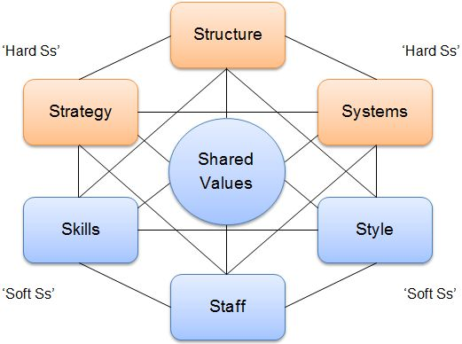
McKinsey's 7S Model
Image: Strategic Management Insight.com
Notes:
According to Strategic management insight (2025) there is an emphasis on softer skills within the Hurman resources contingent rather than total focus on tangibles such as infrastructure, equipment and capital. It helps demonstrate the shared values between all elements to achieve efficiency and effectiveness in the organisation. This is further highlighted by Whittington (2020) who suggests that all the elements should be in a configuration for the best outcomes, and this is not just about structure alone.
The 7s structure is also a structure that if not cognisant of all areas, changes in only a few may create inflexibility and performance decline, ensuring transition and adoption of all elements is important according to Whittington (2020).

Slide 13
Proposed Matrix structure for AI implementation
 | Legitimacy & Public Value | Finance | Learning & Development | Human Resources | IT | Legal Services | Procurement
Team Lead A | Responsibility A1 | Budget A1 | Training A1 | Recruitment A1 | Project IT A1 | Compliance A1 | Supplies A1
Team Lead B | Responsibility B1 | Budget B1 | Training B1 | Recruitment B1 | Project IT B1 | Compliance B1 | Supplies B1
Team Lead C | Responsibility C1 | Budget C1 | Training C1 | Recruitment C1 | Project IT C1 | Compliance C1 | Supplies C1
Image: author adapted with TVP structure information
Notes:
The factors of the matrix organisation is that this is a temporary setup, and it does not replace the main organisational structure or hierarchy. However, the Matrix is now able to focus and concentrate important aspects of project delivery for Artificial Intelligence within the organisation. Therefore, in line with contingency theory, Lawrence and Lorsch(1969) suggest there is no perfect structure, and importance should be given to best fit in line with circumstances and context of the organisation.
The Matrix design is considered a move to an Organic structure. Armstrong (2023) describes these exist with multidisciplinary teams that are positioned to achieve specific project tasks, the personnel being responsible to the function’s leadership. In this case they will focus upon the aspects of AI adoption and readying the organisations workforce. The concentration of effort according to Ghoshal and Bartlett (1995) is focus on working horizontally in collaboration with other functions and partners rather than on vertical tasks of the function unit. This would also require a different approach in Leadership style by its leadership team.

Slide 14
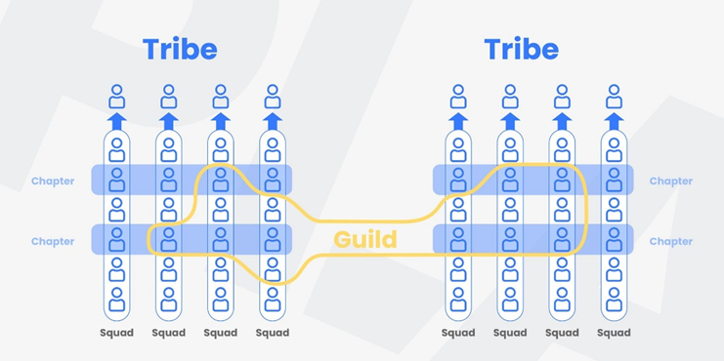
Spotify Matrix system
Image: product led Aliance.com
Notes:
One example of a successful Matrix structure, is that of Spotify.
According to Atlassian (2025) and tcgeni (2025) the Spotify model is built around scaling agility to reflect innovative and effective productivity. There are three key pillars that prioritise the organisation of work through communication, holding individuals and sectors to account, but moving away from the formal structure. The model relies upon the creation of Tribes, Chapters and Guilds – where the aim is promoting agility, flexibility that will enable fast and effective improvements through adaption.

Slide 15
The Change Process
 | Transformation | Realignment
Incremental | Evolution | Adaption
Rapid | Revolution | Reconstruction
Image: author adapted from Whittington (2020) Exploring strategy
Notes:
The change process that is considered is through Evolution, this is a transformational change but occurring gradually. This is considered a more challenging change as its necessity is not directed by a crisis states Whittington (2020).

Slide 16
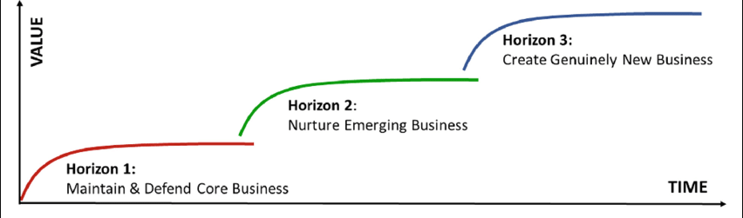
The strategy timeline
Image: McKinsey's horizon strategy Research gate.com
Horizon | Description | Timeline
Horizon 1 | Maintain & ensure core present functions remain stable to engage future projects and adaptions | 2025 - 2027
Horizon 2 | Clear plans of how new technology will work with existing systems and launch effectively with the human workforce. | 2027 - 2029
Horizon 3 | Identification of new models and systems that can be engaged and proactively planned for in advance, ensuring agility towards adaption through a structured approach and not a crisis response. | 2029 - 2030
Image: Authors data adapted from McKinsey timeline.
Notes:
The initial development of Horizon planning will focus upon a five-year trajectory. The priority base according to Farrow (2022) should be for the organisation to plan how Artificial Intelligence functions will engage and complement human activity and working practice.
The Horizon planning also considers the focus and attention of technology spending for police forces across the UK. The National policing digital strategy suggesting approximately 11% of funding remains directed for this purpose according to NPCC (2020).

Slide 17
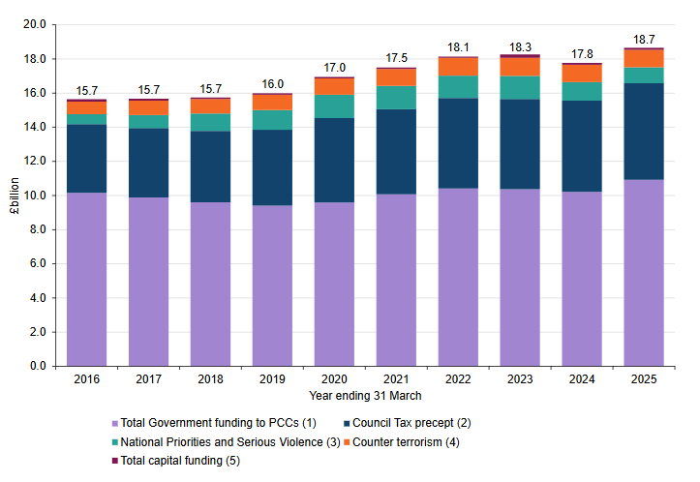
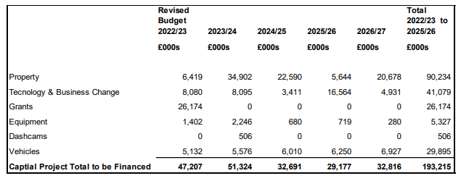
Finance Position for National police funding and Thames Valley Technology & business change budgets.
Notes:
Budget constraints and horizon show levels of increase funding from a national position, but locally the PCC office have published additional available budgets towards 2026. PCC (2023)

Slide 18

Conclusion
Image: MS stock image
Notes:
The adoption of Artificial Intelligence within Thames Valley Police presents a transformative opportunity to enhance operational efficiency, improve crime prevention, and support victims more effectively. By embracing an agile AI Matrix structure, we can harness workforce engagement and integrate appropriate AI technologies. Our horizon should maintain stability in our core functions whilst proactively planning for future advancements. Together, with our workforce, public, and partners, we will build a stronger, more resilient community, providing a modern police force that meets the needs of the public we serve.

Slide 19
References
Armstrong, M. and Taylor, S. (2023) Armstrong’s Handbook of Human Resource Management Practice. 16th edn. London: Kogan Page.
Atlassian.com (2025) Collaboration software for software, IT and business teams. Available at: https://www.atlassian.com (Accessed: 1 April 2025).
Blueprism (2025) Thames Valley Police: A Force for Automation. Available at: https://www.blueprism.com/resources/case-studies/thames-valley-police-a-force-for-automation (Accessed: 1 April 2025).
Caci (2020) Overcoming barriers to digital transformation in the police force. Available at: https://www.caci.co.uk/insights/opinions/overcoming-barriers-to-digital-transformation-in-the-police-force/ (Accessed: 13 March 2025).
College of Policing (2015) ‘Leadership Review’ Available at: https://assets.college.police.uk/s3fs-public/2021-03/cop-leadership-review-2015.pdf (Accessed: 22 March 2025).
College of Policing (2020) Policing in England & Wales Future Operating Environmental 2040. Available at: https://assets.college.police.uk/s3fs-public/2020-08/future-operating-environment-2040.pdf (Accessed: 20 March 2025).

Slide 20
Davis, C. and Silvestri, M. (2020) Critical Perspectives on Police Leadership. Bristol: Policy Press.
Dischner, S. (2015) ‘Organizational structure, organizational form, and counterproductive work behaviour: A competitive test of the bureaucratic and post-bureaucratic views’, Scandinavian Journal of Management, 31(4), pp. 501–514. Available at: https://doi.org/10.1016/J.SCAMAN.2015.10.002. (Accessed: 14th March 2025).
Farrow, E. (2022) ‘Determining the human to AI workforce ratio – Exploring future organisational scenarios and the implications for anticipatory workforce planning’, Technology in Society, 68, p. 101879. Available at: https://doi.org/10.1016/J.TECHSOC.2022.101879.
Ghoshal, S. and Bartlett, C. (1995) ‘Building the entrepreneurial corporation: New organizational processes, new managerial tasks’, European Management Journal, 13(2). Available at: https://doi.org/10.1016/0263-2373(95)00002-3. (Accessed: 15th March 2025).
Gov.uk (2023) Crime outcomes in England and Wales 2023 to 2024. Available at: https://www.gov.uk/government/statistics/crime-outcomes-in-england-and-wales-2023-to-2024/crime-outcomes-in-england-and-wales-2023-to-2024 (Accessed: 1 April 2025).
Gov.uk (2024) Police funding for England and Wales 2015 to 2025 - GOV.UK. Available at: https://www.gov.uk/government/statistics/police-funding-for-england-and-wales-2015-to-2025/police-funding-for-england-and-wales-2015-to-2025 (Accessed: 1 April 2025).

Slide 21
Gov.uk (2024b) Policing Productivity Review. Available at: https://www.gov.uk/government/publications/policing-productivity-review/policing-productivity-review-accessible (Accessed: 30 March 2025).
Gov.uk, (2024) Police workforce, England and Wales: 31 March 2024. Available at: https://www.gov.uk/government/statistics/police-workforce-england-and-wales-31-march-2024/police-workforce-england-and-wales-31-march-2024 (Accessed: 1 April 2025).
Gov.uk (2025) Government Office for Science. (Available at: https://www.gov.uk/government/organisations/government-office-for-science (Accessed: 21 March 2025).
Heckscher, C. (1994) ‘Defining the post bureaucratic type’.
Herrington, V. and Colvin, A. (2016) ‘Police Leadership for Complex Times’, Policing: A Journal of Policy and Practice, 10(1), pp. 7–16. Available at: https://doi.org/10.1093/POLICE/PAV047.
HMICFRS (2025) Crime investigations: An inspection into how effectively the police investigate crime. Available at (https://hmicfrs.justiceinspectorates.gov.uk/publications/how-effectively-police-investigate-crime/ (Accessed: 15 March 2025).

Slide 22
HMICFRS (2023) PEEL 2023–25: Police effectiveness, efficiency and legitimacy, an inspection of Thames Valley Police. Available at: https://hmicfrs.justiceinspectorates.gov.uk/publications/peel-assessment-2023-25-thames-valley (Accessed: 15 March 2025).
Lawrence, P.; and Lorsch, J. (1969) ‘Developing Organizations: Diagnosis and Action’. Addison-Wesley, USA.
Lawrence, P. and Lorsch, J (1967) ‘Differentiation and Integration in Complex Organizations’, Administrative Science Quarterly, 12(1), p. 1. Available at: https://doi.org/10.2307/2391211. (Accessed: 22 March 2025).
Mayer, H. and Yee, L. (2025) AI in the workplace: A report for 2025. Available at: https://www.mckinsey.com/capabilities/mckinsey-digital/our-insights/superagency-in-the-workplace-empowering-people-to-unlock-ais-full-potential-at-work (Accessed: 04 February 2025).
Mullins, L. (2019) Organisational Behaviour in the workplace. 12th Edition. London: Pearson.
NPCC (2020) NATIONAL POLICING DIGITAL STRATEGY. Available at: https://pds.police.uk/wp-content/uploads/2020/01/National-Policing-Digital-Strategy-2020-2030.pdf. (Accessed: 6 February 2025).
PCC (2023) Police and Crime Commissioner Statement of Accounts 2022/23. Available at: https://www.thamesvalley.police.uk/SysSiteAssets/foi-media/thames-valley-police/what_we_spend/2022-23/draft-pcc-and-group-statement-of-accounts-2022-23.pdf. (Accessed: 28 March 2025).

Slide 23
Statista (2025) UK largest police forces 2024. Available at: https://www.statista.com/statistics/877540/leading-police-forces-by-officer-numbers-in-the-uk/ (Accessed: 1 April 2025).
Storey, J. et al. (2009) ‘The Routledge Companion to Strategic Human Resource Management’. Routledge.
Strategic management Insight (2025) StrategicmanagementInsight.com. Available at: https://strategicmanagementinsight.com (Accessed: 1 April 2025).
Thames Valley Police (2019) ‘TVP Joint Digital Strategy’.
Thames Valley Police (2025) Our commitment: Thames Valley Police. Available at: https://www.thamesvalley.police.uk/police-forces/thames-valley-police/areas/au/about-us/our-commitment/ (Accessed: 1 April 2025).
Thames Valley Police (2025) Thames Valley police, Available at: https://www.thamesvalley.police.uk (Accessed: 26 March 2025).
The Guardian, (2025) Police in England, Wales and NI too overworked to investigate crimes properly. Available at: https://www.theguardian.com/uk-news/2025/mar/27/police-too-overworked-to-investigate-crimes-properly-england-wales-northern-ireland (Accessed: 1 April 2025).

Slide 24
Weber, M. (1958) ‘Essays in Sociology’.
Whittington, R. et al. (2020) ‘Exploring Strategy’ Twelfth Edition. London. Pearson.
YouGov (2025) Are the police doing a good job? (2025). Available at: https://yougov.co.uk/topics/politics/trackers/are-the-police-doing-a-good-job (Accessed: 1 April 2025).

