Slide 1
BA Business Management
Module: Managing People
Module Code: LCBB5004
STUDENT NAME: GEORGEL LAURENTIU OPREA
STUDENT ID: 2114879
NAME OF THE LECTURER: OLUSOYI ASHAYE
NAME OF THE UNIVERSITY: UNIVERSITY OF WALLES TRINITY SAINT DAVID
PRESENTATION DATE: 03/12/2022

Slide 2

Introduction
Flexibility in the organisation
Flexibility in relation to diversity and inclusion in the organisation
Diversity and inclusion connected to each others
Role of human resource manager in diversity
Role of human resource manage in the inclusion
Notes:
Introduction
There is going to be a discussion about bringing flexibility to the organisation by taking the position of human resource manager in the organisation. First to make elaboration on flexible working and then their relationship with diversity and inclusion. Furthermore, elaborate on the role of human resource management and the way to promote inclusion and diversity through flexibility.

Slide 3

flexible working
Describe the concept
Flexibility improve the performance of the organisation
Human resource managers play a crucial role in the organization to bring flexibility
It also increase the performance of managers and also of the employees
boost the efficiency of the employee
Notes:
Introduction to flexible working place
Flexible working refers to the decision to support working’s new way and it increases the performance of the managers and also of the employees. There are different aspects covered in this type of work. Human resource managers play a crucial role in the organisation to bring flexibility to the organisation. When the work culture is flexible then it aids to boost the efficiency of the employee and improve the culture of the company (api.warwickshire.gov.uk, n.d.).

Slide 4
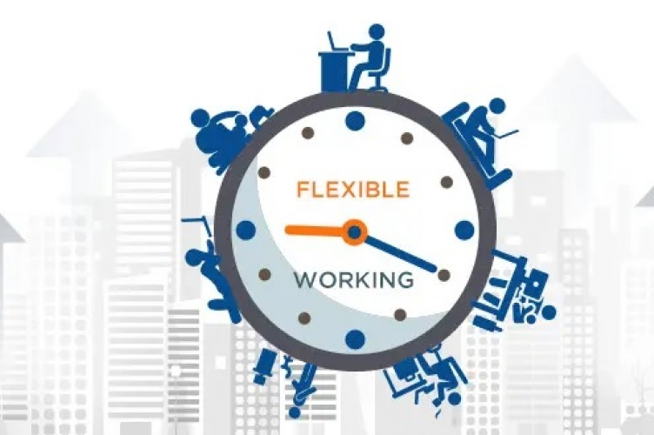
flexible working
Types of Flexible working
Job sharing: This is a kind of flexible working where two people do the same work and divided their time to perform their activity.
Work from home: In this way of working the people do some amount of task from home or full work form the home (Service, 2018).
Part time: Part time job comes under the flexible working where the people do the less hours working as compared to full time.
Compressed hours: In this way of working the people do full time working but perform their work only few days.
Notes:
Type of Flexible working
Flexible working in very essential for the employees to promote their efficeicncy and in this way it can be seen various types of flexible working.
Job sharing: This is a kind of flexible workimg where two people do the same work and divided their time to perfrom their activity.
Work from home: In this way of working the people do some amont of task from home or full work form the home (Service, 2018).
Part time: Part time job comes under the flexible working where the people do the less hours working as compared to full time.
Compressed hours: In this way of working the people do full time working but perfiorm their work only few days.
In additon to this there are many type of flexible working is also.

Slide 5

Explanation of diversity and inclusion
Diversity and inclusion
Diversion and inclusion both are interconnected with each other
Inclusion refers to the contribution of the employees and manager and other subordinates
Flexibility promotes inclusion and diversity and there are many benefits of it (Daley, 2022).
Having inclusion and diversity aids in a better understanding of the customer and it also helps to improve the overall reputation
Notes:
Explanation of diversity and inclusion at work
Diversion and inclusion both are interconnected with each other and diversity refers to representation in the organisation. Inclusion refers to the contribution of the employees and manager and other subordinates in the company so that the company accomplishes success. So, flexibility helps to bring more involvement in the activity of the company so that it leads to an increase in the performance of the company through making potential efforts of all the members in the company. Flexibility promotes inclusion and diversity and there are many benefits of it (Daley, 2022). It aids in the better performance of the organisation and it also assists in the problem-solving of the company in a faster and better way. In the organisation, having inclusion and diversity aids in a better understanding of the customer and it also helps to improve the overall reputation of the company and this is possible through the support of top managers in the organisation.

Slide 6

Diversity and inclusion
Flexible working in relation to diversity and inclusion
Diversity and flexibility which help to create an eco-friendly environment within the organisation
Flexibility improves diversity and inclusion in various ways
Enhance the experience of the previous employees
Flexibility in the workplace, the organisation leads to bringing diversity and this ultimately helps in innovation in the company
Flexibility working also helps in inclusion which allows the employees to work in a way that could meet their wants
Notes:
Flexible working in relation to diversity and inclusion
There are close relations between diversity and flexibility which help to create an eco-friendly environment within the organisation of the company. Flexibility improves diversity and inclusion in various ways as it allows the organisation to widen their perspective and also enhance the experience of the previous employees. In the retail organisation of the UK, flexibility boosts the retention of employees and also improves the culture of the company. It is not possible to imagine the success of the company without having a flexible culture and it leads to increased diversity in the organisation. Flexibility in the workplace, the organisation leads to bringing diversity and this ultimately helps in innovation in the company and better options for decision-making. Flexibility working also helps in inclusion which allows the employees to work in a way that could meet their wants and also meet the desire of the company. Having flexibility in the organisation assists in adaptability (Cole, 2022).

Slide 7
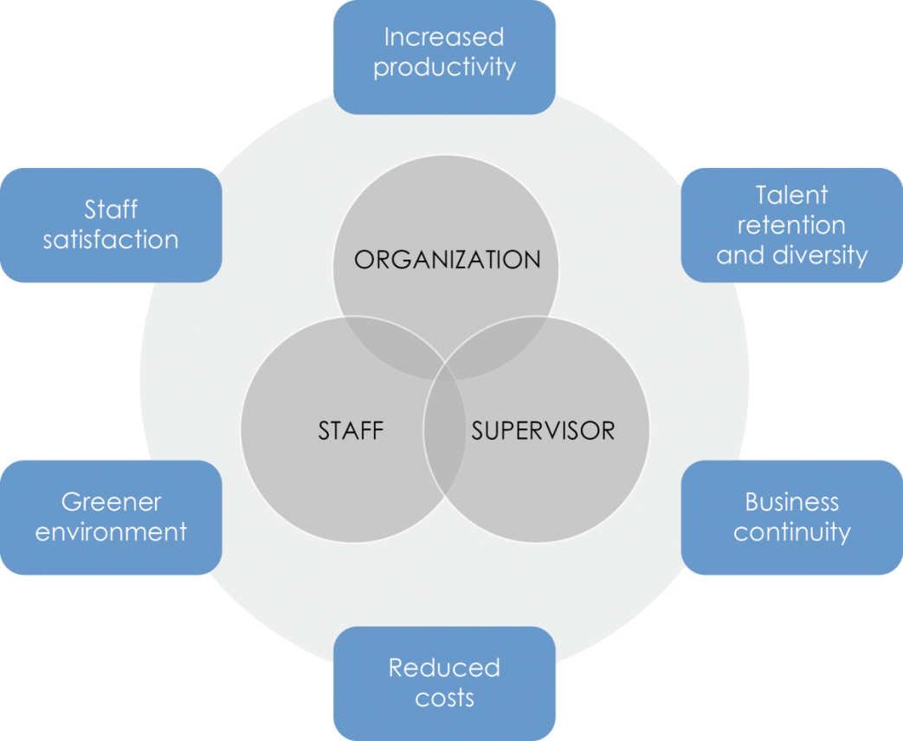
The role of Human Resources in promoting diversity through flexibility
Diversity and flexibility is the crucial strategy for the organisation.
Hr leaders are dealing with the enormous complexity.
HR helping to emerge the workplace environment in effective ways (Midgie and Yolande, 2022).
Hybrid workplace options can create an expanded vision that helps to access advancement opportunities for career advancement.
This can promote equal importance and create an effective working environment that is accessible to a wide range of employees.
Notes:
Diversity and flexibility is the crucial strategy for the organisation and Hr leaders are dealing with the enormous complexity and helping to emerge the workplace environment in effective ways. Flexibility within the working place helps to create effective working opportunities for individuals because employees face physical disabilities for reasons they could not attain work. Therefore, the use of the virtual collaboration tool increases accessibility among employees (Midgie and Yolande, 2022). This kind of flexibility creates a new opportunity because the company can hire employees from different working perspectives in different locations. This way promotes beneficial working requirements for the employees and they will share different working schedules and help to retain family responsibility among employees. This way provides progress to an effective career path also retains personal life and impacts the employees they feel more comfortable with their co-workers and increases flexibility in the career path.

Slide 8

Role of Human resources
The organisation can promote advanced equity for the perspectives of career advancement that help to retain employees.
The company can provide training to female executives for business and finance purposes.
A productive culture in the workplace for that all team members can access new workplace technologies and help to increase career opportunities (Gayeski, 2022).
Notes:
Hybrid workplace options can create an expanded vision that helps to access advancement opportunities for career advancement. This can promote equal importance and create an effective working environment that is accessible to a wide range of employees. For that organisations can increase the working opportunity among the employees. The organisation can promote advanced equity for the perspectives of career advancement that help to retain employees for that the company can provide training to female executives for business and finance purposes. There it helps to create a productive culture in the workplace for that all team members can access new workplace technologies and help to increase career opportunities (Gayeski, 2022).

Slide 9

The role of Human Resources in promoting diversity through flexibility
Human resources will promote workplace flexibility and that is an effective strategy for the employees engagement.
Flexible workplace provides efforts to the employees on the specific needs on perspectives of the employees for that flexibility has a strong relation with productivity and flexibility.
The organisation can promote remote working facilities for the employees that helps in promoting the proper areas of the work (HR and Symonds, 2022).
Notes:
Human resources will promote workplace flexibility and that is an effective strategy for the employees because it helps to modify the different approaches and tasks for the required assignments. This flexible workplace provides efforts to the employees on the specific needs on perspectives of the employees for that flexibility has a strong relation with productivity and flexibility. Therefore, organizations promote new ideas and strategies to optimize that flexibility and promote an effective role in the career path of the employees.
The organisation should promote flexitime policies to the workers that are baes on staggered arrival and departure time as needed. For that employees can start their work at 7:00 am and finish the work at 3:00 pm and this help to help the multitasking opportunity for the employees. The organisation can compress work weeks for that em[ployees can do the same number of work within the shooter working week. For that, employees work for 10 hours instead of 8 hours per day. The organisation can promote remote working facilities for the employees so that employees can do their work from the outside and this way helps to maintain the working schedule and help to balance the work-life balance of the employees (HR and Symonds, 2022).

Slide 10

Strategy for flexible working at work place
HR professionals will cultivate mutual respect and trust.
HR will provide rigid goals that help to manage a flexible workforce.
HR promotes effective strategy that will manage flexible workforces to priorities regular communication through the online.
HR should treat employees equally to the employees that provide effective flexible workforces (HR and Symonds, 2022).
Notes:
HRs need to trust employees and team members and the manager plays an important role that helps to develop the personal relation with the team members to cultivate mutual respect and that also helps to boost the working performances among the employees.
Organisation can promote rigid goals and that manages the flexible working forces and that manages the goal setting within the working forces and the HR should enforce a short structure and that provides short goals among the employees.
HR should promote effective strategy to clear an effective workforce through the emphasizing the regular online communication with video call with the team members and the encourage the collaboration and the strategy build the company culture through the flexible working forces.
Organisation should treat the employees equally to the employees and that occurs through its effective management for that the manet has to avoid the blanket policies and the company needs to revise processes and that help to standardise the interaction among the team members. This helps to create equal experiences and eliminates side conversation and creates conversation among the employees (HR and Symonds, 2022).

Slide 11

Conclusion
Flexibility boosts diversity and inclusion
Both things are associated with each other.
Human resource manager in the organization promotes diversity through flexibility
It help to make the smooth operation in the organization
Notes:
Conclusion
Summing up all the mentioned points with a clear understanding of the flexibility in the retail organisation. Flexibility boosts diversity and inclusion in the workplace and both things are associated with each other. After that, the role of the human resource manager in the organisation promotes diversity and inclusion by increasing flexibility in the organisation.

Slide 12
References
Cole, B.M. (2022) 8 reasons why diversity and inclusion are essential to business success, Forbes. Forbes Magazine. Available at: https://www.forbes.com/sites/biancamillercole/2020/09/15/8-reasons-why-diversity-and-inclusion-are-essential-to-business-success/?sh=5cf7772e1824 (Accessed: November 14, 2022).
Daley, S. (2022) Diversity + inclusion., BuiltIn. Available at: https://builtin.com/diversity-inclusion (Accessed: November 14, 2022).
Gayeski, D, (2022). Flexible work can help expand diversity and inclusion efforts: Robin, RSS. Available at: https://robinpowered.com/flexible-work-improvements-diversity-and-inclusion (Accessed: November 14, 2022).
HR, F. and Symonds, C, (2022). How to boost your workplace flexibility in 2022, Factorial Blog. Available at: https://factorialhr.com/workplace-flexibility-2/#:~:text=Make%20sure%20your%20employees%20are,freelancers%20as%20a%20flexible%20workforce. (Accessed: November 14, 2022).
Introduction to flexible working v0.6 - api.warwickshire.gov.uk. (2022). Available at: https://api.warwickshire.gov.uk/documents/WCCC-575-3195 (Accessed: November 14, 2022).
Midgie and Yolande, (2022). How to be flexible in the workplace: Responding to change quickly and positively, How to Be Flexible at Work - Career Skills From MindTools.com. Available at: https://www.mindtools.com/pages/article/flexibility-at-work.htm (Accessed: November 14, 2022).
Service, G.D. (2018) Flexible working, GOV.UK. GOV.UK. Available at: https://www.gov.uk/flexible-working/types-of-flexible-working (Accessed: December 1, 2022).

Slide 13

Appendix

