Slide 1
BA International Hotel Management
Marketing Essentials
Session 13
M4X01916

Slide 2
Session 13
Digital and Social Media Marketing in Hospitality & Tourism Industry

Slide 3
Learning Objectives
At the end of this session students should be able to:
Understand the change in the H & T industry through digital and social media outlets.
Identify several era emerging in H & T industry through the influence of advancement in technology.

Slide 4
Digital and Social Media Marketing in Hospitality & Tourism Industry
  The Internet has significantly reshaped the tourism landscape, forcing hospitality firms to extend their established marketing strategies.

Slide 5
Digital and Social Media Marketing in Hospitality & Tourism Industry
  Four major era have emerged in the H & T industry influencing established or traditional marketing strategies.

Slide 6
Digital and Social Media Marketing in Hospitality & Tourism Industry
  These four era are:
  The Global Distribution System (GDS) Era
  (i.e. the Intermediation Stage)
  Internet Era
  (i.e. the disintermediation)
  SoLoMo Era
  (i.e. the disintermediation Matures)
  Hybrid Era
  (i.e. Going Back to The Start)

Slide 7
Digital and Social Media Marketing in Hospitality & Tourism Industry
  The Global Distribution System (GDS) Era
  The GDS era in the 1960s was the first major step in the development of digital distribution channels for an industry that was relying on the telephone, teletype, and even mail for room reservations. In this era, flights and hotels rooms were sold in real time via travel agents.

Slide 8
Digital and Social Media Marketing in Hospitality & Tourism Industry
  The Global Distribution System (GDS) Era
  GDSs significantly increased the reach of individual hotels, airlines, and car rental and cruise firms across borders and boosted the global travel and tourism industry.
  In this era, travel agencies grew all across the world, and by 2008, nearly half a million travel agents sold travel products worldwide.

Slide 9
Digital and Social Media Marketing in Hospitality & Tourism Industry
  The Global Distribution System (GDS) Era
  GDS significantly increased competition among hospitality firms and also added “middle men” or intermediaries within the distribution system.
  The balance of power shifted away from the suppliers (hoteliers) to the distribution channel intermediaries.

Slide 10
Digital and Social Media Marketing in Hospitality & Tourism Industry
  The Global Distribution System (GDS) Era
  In this era, the hospitality guest was not the firms’ customer as much as the agents themselves were.
  The chains’ focus was not on customer information and details, but on offering the lowest rate and maintaining their relationship with the travel agency.

Slide 11
Digital and Social Media Marketing in Hospitality & Tourism Industry
  The Internet Era
  The growth of the worldwide web in 1990s changed the online distribution game.
  The internet era offered the first cost-effective tool for direct marketing by travel and hospitality suppliers.

Slide 12
Digital and Social Media Marketing in Hospitality & Tourism Industry
  The Internet Era
  The web helped to erase the differences in the geographical reach between the global brands and the small or local independent hotel chains and airlines.
  The intermediation game started changing as suppliers started investing in brand websites and booking engines rather than depending as heavily on the GDSs and travel agents.

Slide 13
Digital and Social Media Marketing in Hospitality & Tourism Industry
  The Internet Era
  The change was rapid, with the launch of search engines, such as Google in 1994 and Yahoo in 1998, brought a new form of intermediation.
  As the internet gained popularity, by 2001, many thirdparty websites had entered the distribution space. This opened another door for marketing the product to end users, but also had another effect.

Slide 14
Digital and Social Media Marketing in Hospitality & Tourism Industry
  The Internet Era
  The growth of third-party intermediaries such as Expedia and Travelocity across the globe once again kept the suppliers heavily dependent on the distribution channel intermediaries.

Slide 15
Digital and Social Media Marketing in Hospitality & Tourism Industry
  The Internet Era
  While the growth started driving up the profits of online travel agencies, hotel operators started experiencing a loss of control over the pricing of rooms and a potential transfer of pricing authority to third-party internet-based companies.

Slide 16
Digital and Social Media Marketing in Hospitality & Tourism Industry
  The Internet Era
  While the growth started driving up the profits of online travel agencies, hotel operators started experiencing a loss of control over the pricing of rooms and a potential transfer of pricing authority to third-party internet-based companies.

Slide 17
Digital and Social Media Marketing in Hospitality & Tourism Industry
  The Internet Era
  The popularity of such services stemmed from consumers’ desire to obtain the lowest rate within their desired market segment, coupled with the price transparency on the internet.

Slide 18
Digital and Social Media Marketing in Hospitality & Tourism Industry
  The SoLoMo Era
  The social-, location-, and mobile-based applications era.
  With the emergence of SoLoMo, the trend toward intermediation has again been disrupted by new technology.
  Primarily, this era help to simplify the booking process for the customers (Kim and Connolly 2012).

Slide 19
Digital and Social Media Marketing in Hospitality & Tourism Industry
  The SoLoMo Era
  Social
  The beginning of the SoLoMo era was marked by the growth and popularity of the social and travel community sites such as TripAdvisor, Facebook, and MySpace.

Slide 20
Digital and Social Media Marketing in Hospitality & Tourism Industry
  The SoLoMo Era
  As the decade of the 2000s became the 2010s, social media became the buzzword in the industry, and travel community sites such as TripAdvisor dramatically shifted the traditional one-way supplier-to-consumer communication to an open consumer-to-consumer communication.
  The word-of-mouth revolution changed the way consumers collaborated and shared information with each other.

Slide 21
Digital and Social Media Marketing in Hospitality & Tourism Industry
  The SoLoMo Era
  Social media traffic is astonishingly heavy. By one estimate three years ago, on each day, more than three million photos were uploaded to Flickr, there were five million tweets, and a million new blog entries were posted on Twitter and other blog sites (Bodnar 2010).

Slide 22
Digital and Social Media Marketing in Hospitality & Tourism Industry
  The SoLoMo Era
  Companies in the H & T industry are experiencing direct link between the online review scores and the return on investment.
  However, social media in today’s world is not a point of differentiation, but rather, it is a point of parity for the travel and tourism suppliers.

Slide 23
Digital and Social Media Marketing in Hospitality & Tourism Industry
  The SoLoMo Era
  It has become critical to maintain a strong presence on social channels along with maintaining consistency in the messages.
  This is vital as social networking has been reported as the third most popular activity among mobile users.

Slide 24
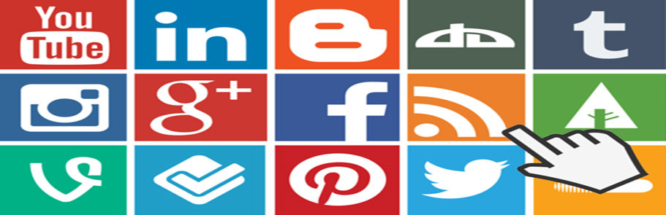
Digital and Social Media Marketing in Hospitality & Tourism Industry
  The SoLoMo Era
  More than three-fourths of travellers turn to social networks to find some type of shopping-related deal, and 30 percent specifically seek out travel-related deals (PhoCusWright 2012).

Slide 25
Digital and Social Media Marketing in Hospitality & Tourism Industry
  The SoLoMo Era
  Mobile
  According to the internet usage statistics report by UN’s telecommunications agency, by 2020, connected devices would outnumber connected individuals by a ratio of six devices to every person online.

Slide 26
Digital and Social Media Marketing in Hospitality & Tourism Industry
  The SoLoMo Era
  Mobile
  Overall, the market is moving from the first- to the third-generation experience and cutting out the “middle men.”
  The number of smartphone users continues to grow at such a fast pace that there are approximately six billion mobile subscribers globally—equal to 87 percent of the world’s population.

Slide 27
Digital and Social Media Marketing in Hospitality & Tourism Industry
  The SoLoMo Era
  Mobile
  This implies that mobile marketing has also become a popular tool for travel suppliers to reach their customers on the go and has also given birth to the local marketing trend, in which promotions are context sensitive according to the user’s location.

Slide 28
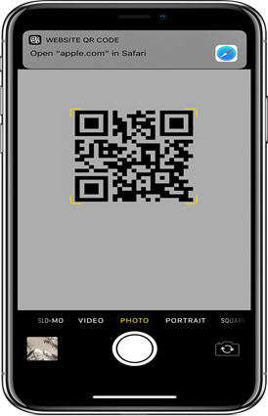
Digital and Social Media Marketing in Hospitality & Tourism Industry
  The SoLoMo Era
  Mobile
  In addition, for example, many travel suppliers/marketers have already taken the advantage of SMS marketing and QR code technology by investing in mobile websites.

Slide 29
Digital and Social Media Marketing in Hospitality & Tourism Industry
  The SoLoMo Era
  The customer in today’s SoLoMo era has completely different expectations from the customers in the GDS or the internet era.
  The SoLoMo customers want easy access to information and appropriate messages customized to their needs.

Slide 30
Digital and Social Media Marketing in Hospitality & Tourism Industry
  The SoLoMo Era
  Also the SoLoMo customers are able to be much more spontaneous in their actions, and they are often occupying two different stages of the booking process at the same time.
  For instance, a SoLoMo customer may be checking out of the hotel and posting the photos on social media along with looking at a friend’s recent experience with an airline.

Slide 31
Digital and Social Media Marketing in Hospitality & Tourism Industry
  The SoLoMo Era
  Therefore, it essential for the marketers in H & T industry to keep the customers engaged through social, local, and mobile channels for a long-term sustainable relationship.
  Investing the marketing Pound Sterling in internet and mobile marketing is becoming vital to retain customers and maintain loyalty.

Slide 32
Digital and Social Media Marketing in Hospitality & Tourism Industry
  The Hybrid Era – Going Back to The Start Era
  According to some researchers, marketers in H & T industry are now in hybrid era - computers, tablets, and smartphones.
  A hybrid era where the customers are increasingly depending on online search using multiple screens at different times of the day as they search for the supplier information that they want.

Slide 33
Digital and Social Media Marketing in Hospitality & Tourism Industry
  The Hybrid Era – Going Back to The Start Era
  In this era, marketers in H & T industry are investing in direct channels and trying to provide customized and high quality experience to the customer.
  The industry is slowly moving back toward the disintermediation phase.
  However, the existing intermediaries, including GDS-supported travel agents, and search engines, co-exist and remain an important part of the industry’s distribution channels.

Slide 34
Digital and Social Media Marketing in Hospitality & Tourism Industry
  Class exercise
  In group, discuss which device (computer, tablet, mobile) you use most for your holiday or flight bookings and why?
  How has contributing to social networking affected your booking experience(s)

