Slide 1

Robotic Assisted Surgery:
Innovating and Transforming the HealthCare System
Student name: Ana Ferraz
Student number: 2321715
Lecturer’s name: Laila Surani
Digital Transformation in the Health and Care Professions (BMHP6026)

Slide 2
Aim of Presentation
Explore RAS as a healthcare innovation
Evaluate:
Benefits
Limitations
Ethical implications
Assess the impact on the workforce, patient care and community.

Slide 3
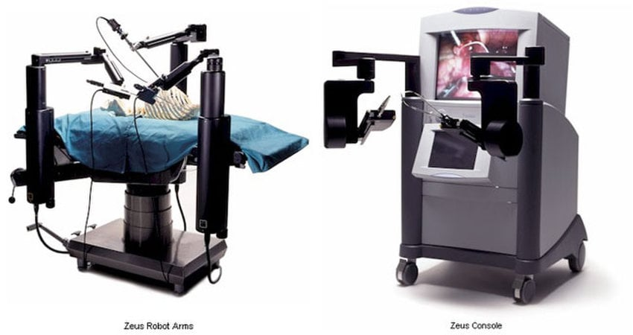
Introduction
Robotic-Assisted Surgery (RAS) transformed modern healthcare (Connel, 2025).
Increased use across the NHS and private sectors (Connel, 2025).
Driven by the demand for an efficient healthcare service (Connel, 2025).
Late 1990s: Aesop system (camera control) (Kraft et al., 2004).
The Zeus system was first used for cardiac surgery (RCS England, 2025).
The first transatlantic robotic surgery happened in 2001 (BBC, 2001).
Expanded into multiple surgical specialities (Ferrarese et al., 2016).
(ResearchGate 2026b).

Slide 4

Growth of RAS
17 million robotic procedures globally carried out as of 2024 (RCS England, 2025).
2.68 million procedures in 2024 alone (RCS England, 2025).
NHS projections: 70,000 → 500,000 surgeries by 2035 (NHS, 2025)
90% of keyhole surgeries may be robotic (NHS, 2025).

Slide 5
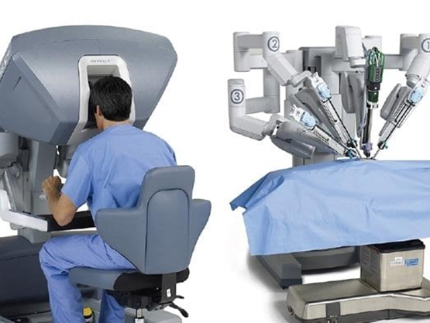
Impact on Workforce
Changing Professional Roles:
Surgeons operate via consoles (NICE, 2025).
Technicians manage robotic systems (NICE, 2025).
Nurses require new post-operative skills (Schouten et al., 2025).
(ResearchGate 2026a).

Slide 6
Impact on Service Delivery
Improved surgical precision and control
Reduced complications
Faster procedures
Used in:
Urology (e.g. tumor resection).
Cardiology (e.g. coronary artery bypass).
Orthopedics (e.g. placement of implants)
Gynaecology (e.g. fine dissection in delicate organs)
General surgery (e.g. gallbladder removal)
(RCS England, 2025)
(RCS England, 2025).

Slide 7
Clinical Benefits
25% reduction in operating time
30% reduction in complications
40% increase in precision
15% faster recovery time
20% improvement in workflow efficiency
(Wah, 2025)

Slide 8
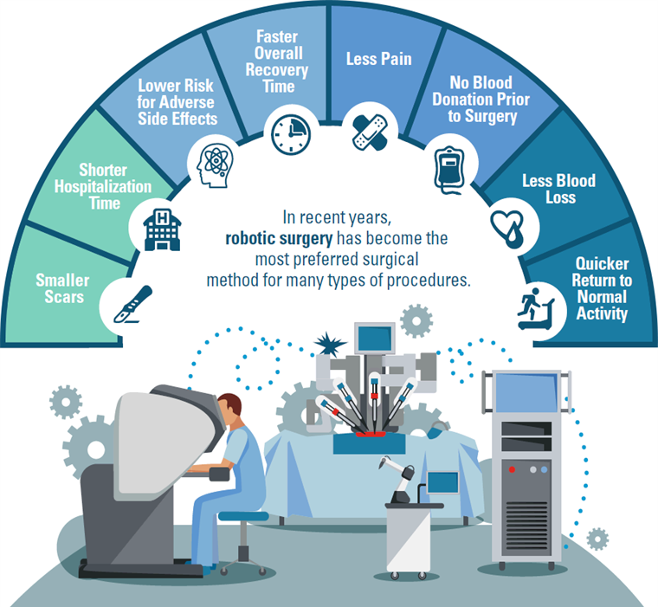
Impact on Patients
Less pain and scarring (NICE, 2025)
Faster recovery and discharge (Connell, 2025)
Shorter hospital stays (Connell, 2025)
Higher patient satisfaction (Connell, 2025)
Increased confidence in care (Xi MN et al., 2026).
Reduce patient anxiety (Xi MN et al., 2026).
(Lluh.org, n.d)

Slide 9
Impact on Community
Reduced hospital pressure (Connell, 2025)
Shorter waiting times (Connell, 2025)
Increased access to minimally invasive care (Connell, 2025)
Faster return to normal life (Connell, 2025)
Improved public trust in healthcare
(NICE, 2025)

Slide 10
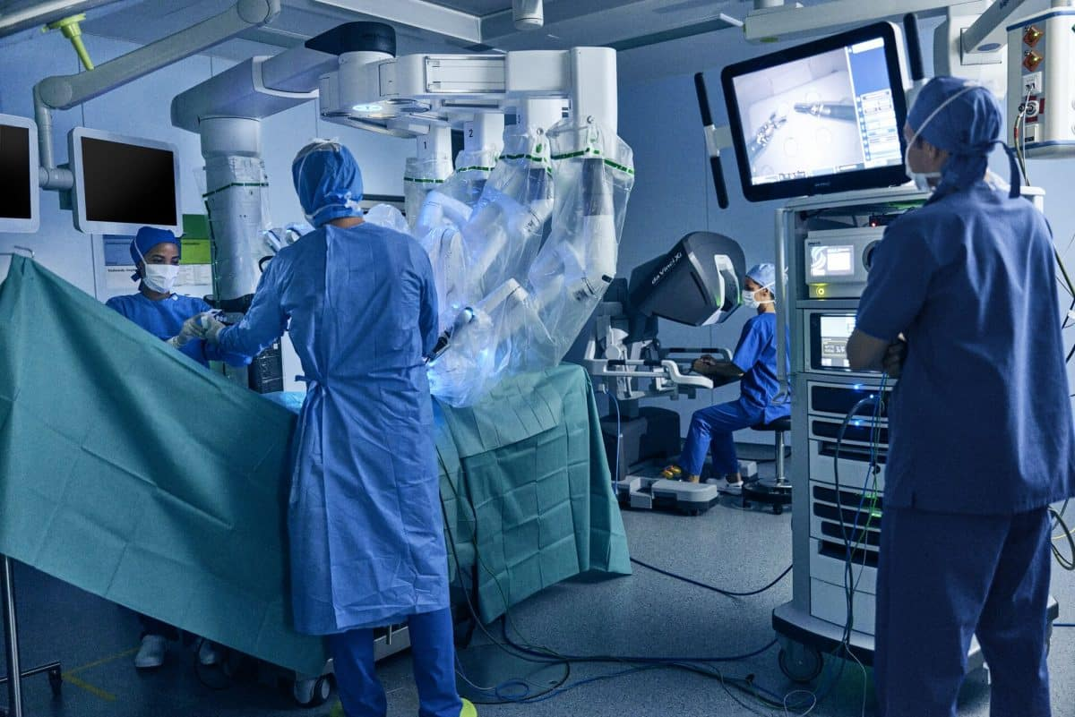
Challenges of the Innovation
Increased complexity of procedures (RCS England, 2025).
High training demands (RCS England, 2025).
Changes to theatre infrastructure (RCS England, 2025).
Increased stress and workload for staff (Schouten et al., 2025).
Reduced job satisfaction in some cases (Schouten et al., 2025).
(Healthcare Radius, 2024)

Slide 11
Advantages
Strong benefits in complex procedures
Limitations
High costs (£500,000–£1.5 million) (NICE, 2025).
Ongoing maintenance and training expenses (NICE, 2025).
Unequal access between hospitals (Pietrabissa et al., 2013).
Limited long-term data availability (Wah, 2025).
Benefits may be overstated (Pietrabissa et al., 2013).
Improves Patient confidence (Xi MN et al., 2026).
System efficiency improvements (NICE, 2025)
Increased precision in procedures (NHS, 2025).
Reduced hospital pressure (Connell, 2025).

Slide 12
Ethical Issues
Accountability for surgical errors unclear
Challenges in informed consent
Transparency in AI decision-making
Data limitations and bias concerns
(Wah, 2025; NICE, 2025)

Slide 13
Recommendations
New training and new competencies for staff (NICE, 2025).
Team restructuring, establishing comfortable operating rooms (Schouten et al., 2025).
Improve communication between staff (RCS England, 2025).
The creation of national registers (Donald et al., 2026)
It is necessary to create new datasets to find patterns in different surgical operations (Donald et al., 2026)

Slide 14
Conclusion
RAS is transforming modern healthcare
Key benefits:
Increased precision
Faster recovery
Improved efficiency
However:
High costs
Training demands
Ethical concerns
Future success depends on:
Evidence
Equity
Workforce development

Slide 15
References
Connell A (2025). Surgical Robots: Revolutionising Healthcare in the NHS. Available at: https://www.sbs.nhs.uk/news/surgical-robots-revolutionising-healthcare-in-the-nhs/. (Accessed: 3 March 2026).
BBC (2026). BBC News | Doctors claim world first in telesurgery. Available at: http://news.bbc.co.uk/1/hi/sci/tech/1552211.stm
Donald, N., Sebastian, J. and Preziosi, G. (2026). Adoption and expansion of robotic surgery across General Surgery in the United Kingdom: a 10-year procedure-specific analysis (2015–2024). Journal of Robotic Surgery, 20(1). Doi: https://doi.org/10.1007/s11701-025-03073-y.
Ferrarese, A., Pozzi, G., Borghi, F., Marano, A., Delbon, P., Amato, B., Santangelo, M., Buccelli, C., Niola, M., Martino, V. and Capasso, E. (2016). Malfunctions of robotic system in surgery: role and responsibility of surgeon in legal point of view. Open Medicine, 11(1). Doi: https://doi.org/10.1515/med-2016-0055.
National Health Service, England (2025). Millions to benefit from NHS robot drive. Available at: https://www.england.nhs.uk/2025/06/millions-to-benefit-from-nhs-robot-drive/ (Accessed: 3 March 2026).
National Institute for Health and Care Excellence (2025). Cutting-edge robotic surgery gets green light as 11 systems are recommended. Available at: https://www.nice.org.uk/news/articles/cutting-edge-robotic-surgery-gets-green-light-as-11-systems-are-recommended. (Accessed 29 March 2026).
Pietrabissa, A., Vinci, A., Pugliese, L. and Peri, A. (2013). Robotic Surgery: Current Controversies and Future Expectations. Cirugía Española (English Edition), 91(2), pp.67–71. Doi: https://doi.org/10.1016/j.cireng.2012.07.002.

Slide 16
References
Schouten, A.M., Butler, R.M., Vrins, C.E., Flipse, S.M., Jansen, F.W., van der Eijk, A.C. and van den Dobbelsteen, J.J. (2025). Impact of operating room technology on intra-operative nurses’ workload and job satisfaction: An observational study. International Journal of Nursing Studies Advances, 8, p.100341. Doi: https://doi.org/10.1016/j.ijnsa.2025.100341.
Wah, J. (2025). The rise of robotics and AI-assisted surgery in modern healthcare. Journal of Robotic Surgery,19(1). Doi: https://doi.org/10.1007/s11701-025-02485-0.
Xi MN, Y., Li M, Guo X, Gao B, and Zhao Y. (2026). Efficacy of the IDEAS Model Combined With Supportive Psychotherapy Visiting in Da Vinci Robot–assisted Radical Cancer Surgery. Journal of Peri Anaesthesia Nursing. Doi: https://doi.org/10.1016/j.jopan.2025.12.009.
.
Images:
ResearchGate (2026a). daVinci-Surgical-System-19_fig4_327561755 Available at: https://www.researchgate.net/figure/daVinci-Surgical-System-19_fig4_327561755 (Accessed 29 Mar. 2026).
ResearchGate (2026b). Zeus-Robotic-Surgical-System. Available at: https://www.researchgate.net/figure/Zeus-Robotic-Surgical-System-1_fig3_327561755 (Accessed 29 Mar. 2026).
Loma Linda University Health (n.d). Available at: https://lluh.org/sites/lluh.org/files/robotic-surgery-infographic.png (Accessed 29 March 2026).
Healthcare Radius. (2024). Patient with complex kidney cancer treated using advanced robotic-assisted surgery. Available at: https://www.healthcareradius.in/features/surgery/patient-with-complex-kidney-cancer-treated-using-advanced-robotic-assisted-surgery (Accessed 29 March 2026).
Kraft, B.M., Jäger, C., Kraft, K., Leibl,

