Slide 1
ECEY6005
Regaining Paradise:
Sustainability in the early years
Lecture 2

Slide 2
Content
Values
Pedagogy, Theory and Philosophy
Curriculum and legislation
Practical examples

Slide 3
Resources
PP for the lecture
Research
Leganto
Moodle
Library
Google Scholar

Slide 4
Early Years Theory, ESD and GCE
Ideas?
While England doesn’t use the exact term ESDGC, it covers similar ground under the broader umbrella of:
Education for Sustainable Development (ESD) and Global Citizenship Education (GCE)
Notes:
Does early years theory link to the ideals of ESD?
Drawing together previous week discussion

Slide 5
Pedagogy- a way of learning
Problem solving
Child-led
Creative thinking
Reflective
Practical
Active
Outdoor learning and engaging with nature
Notes:
Note the close ties between FP and ESD

Slide 6
Young children as empowered citizens
Heft and Chawla, 2005
Elliott and Davis, 2014
‘honouring the young child’s right to know about social and environmental issues; to be part of conversations and possible solutions; to have their ideas and contributions valued’ Mackay, 2012: 1
Notes:
Might this resonate with UNCRC?
Competent child Reggio Emilia?
Agency?

Slide 7
Values Based
Opinions and values
Personal responsibility
Doing the right ‘thing’
Caring for local and further away
Caring for each other and the rest of nature
Acting responsibly
Notes:
This is the same as PSE education
Society think some things are inherently wrong or good.
Respect is an important issue

Slide 8
English Context – ESD
Education for Sustainable Development (ESD) is not a specific piece of legislation
A broad concept and framework that aims to empower individuals with the knowledge, skills, attitudes, and values needed to contribute to a more sustainable future.
Key part of the UN's Sustainable Development Goals, particularly SDG 4.7, which calls for ensuring all learners acquire the knowledge and skills for sustainable development.
While not a single law, it's embedded within broader legislative frameworks like the UK's Climate Change Act and National Adaptation Programme, which include action for education in adapting to climate change.

Slide 9
ESD (2)
1970s–1980s: The Roots
The concept of environmental education gained traction.
UNESCO began pushing for more environmental awareness in schools.
1992: Earth Summit (Rio de Janeiro)
Marked a key moment: Agenda 21 emphasized the importance of education in achieving sustainable development.
2002–2014: UN Decade of ESD
Declared by the United Nations.
Focused on integrating sustainable development into all forms of education.
UNESCO took the lead.
2015: Launch of the Sustainable Development Goals (SDGs)
SDG 4.7 specifically includes ESD:
“By 2030, ensure that all learners acquire the knowledge and skills needed to promote sustainable development…”
2020–2030: ESD for 2030 (UNESCO)
A new framework focusing on action-oriented learning.
Promotes transformative education that leads to real-world sustainability action.
Notes:
Have they heard of it. If not why not? Give backdrop of ESD policy in England.

Slide 10
ESD (3) - implementation
1. National Curriculum (England):
Sustainability is embedded within subjects like Geography, Science, Citizenship, and PSHE (Personal, Social, Health and Economic education).
Topics include climate change, resource use, diversity, global interdependence, and responsible citizenship.
2. Eco-Schools Programme:
A UK-wide initiative that promotes environmental awareness in schools.
Many English schools follow this as part of their sustainability education.
3. Global Learning Programme (GLP) (until 2018):
Previously funded by the UK government to support global citizenship education in England.
Although funding ended, many schools still use its resources.
4. UNESCO ESD 2030 Framework:
England aligns with international efforts through this framework, which promotes sustainable development education at all levels.

Slide 11
Common Areas of ESD
Climate action
Global citizenship
Peace and human rights
Cultural diversity
Sustainable consumption and production
Health and well-being
Gender equality
Notes:
Discuss common areas link to theory such as Sterling and Julia Davis
Champions strong leadership
Community participation
Partnerships for example Forest School, BTCV Amnesty, Oxfam etc.
Active learning
Reflection
Child led
Whole school approach. Must be seen to be sustainable as well as being part of the ‘formal curriculum’
Cross curricular
Interdisciplinary
Research and Monitoring essential to ensure joined up approach
Link to Ecoschool
Healthy School programmes
Fair Trade
Need to all interact
2014 Estyn report suggest that often awards such as Healthy schools, Fair Trade schools become ‘bitty’ and not enough cross links to holistic approach to ESDGC made.

Slide 12
Whole School
Everyone is involved
Foundation learning children are not too young
Engage all school staff
Engage the local community
Engage local businesses
Engage people and places far away from our own community
Young children must be part of school decisions- school councils, Eco-committees
Notes:
Is this the case. I know of schools where young children not in Eco committee or School council. Why? How is their voice heard? Also noted by Merriman et al, 2014
Does system need to change?
LINK to UNCRC- right to voice Article 12

Slide 13
Foundation Learning?
Symons, 1996 (old but one of the first books to consider Education for Sustainability
Young children?
Emphasise feelings of self worth, communication and cooperation
Suggestion that children with high self regard are likely to be more altruistic, generous and sharing
More positive attitudes if they are able to express their own thoughts clearly and listen to others
In / Yn:-Symons, G. (1996) The Primary Years in Education for Sustainability London: Earthscan Publication Ltd.
Notes:
Starting the important values when children are young. Empathy, supporting them express themselves , have a voice. Is this not the core of early years values? Old source but significant as the book it is from was one of the frst key texts in this area

Slide 14
Ideas for the Curriculum? Discuss
Cooking
Gardening
Shopping

Slide 15
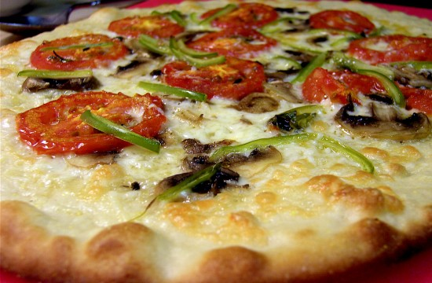
Discussion 1
Making pizza / cooking activities
Choices and decisions
Consumption and waste
Climate Change
Health
Identity and culture
Wealth and poverty
The natural environment
Notes:
Think of the issues that can come out of a cooking exercise, how can adults ensure ESDGC is also a focus.
Waster- where does unused food go?
Fair trade olives?
How far have the ingredients travelled etc?
What about take away pizza- packaging etc ?
Get students to think and discuss

Slide 16
Watch the first and second clip: Discuss
Clip 1
https://www.bing.com/videos/search?q=The+point+preschool+video+sustainability&&view=detail&mid=F045EBBC3CFE68917FFCF045EBBC3CFE68917FFC&&FORM=VDRVRV
Clip 2
https://www.youtube.com/watch?v=i51jHKF1_SQ
http://thepointpreschool.com.au/wp-content/uploads/2015/02/PDF_Information-Sheet_Sustainability.pdf
The Point Preschool, Sydney
Notes:
Clip one is very good
Although Australian are there parallels with Welsh context
How can we lead for sustainability?
Are there links here to catalytic leadership?

Slide 17
Other Useful clips
https://www.bing.com/videos/search?q=The+point+preschool+video+sustainability&&view=detail&mid=01DE1DCF42B91F3BFE8401DE1DCF42B91F3BFE84&&FORM=VDRVSR
C and K Redlands Community Kindergarten, Brisbane

Slide 18
Leading and making sustainability a key focus
https://gecco.org.uk/contact/
https://leyf.org.uk/green-leyf/
https://connectchildcare.com/blog/customer-success-story-leyf-launches-new-level-4-sustainability-qualification-for-early-childhood-education/
Sustainability is becoming a focus in many early years settings and organisations
LEYF in London could be considered catalytic leaders here- change agents in making sustainability a key an integral art of the business.

Slide 19
Discussion 2
Outdoor learning and sustainability
Space
Problem solving
Looking after nature?
Being part of nature?
Creative thinking
Exploration
Asking questions
Sense of place?
Notes:
Links to ESDGC
Problem solving and creative thinking skills to answer the world’s big problems in future?
Think about gardening? Links to Froebel

Slide 20
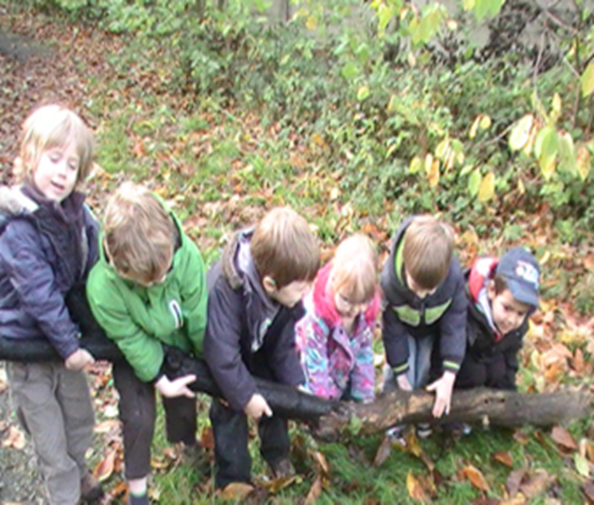
ESD- Themes and pedagogy?
From: http://www.cherubinsdaynursery.co.uk/forest-school/

Slide 21
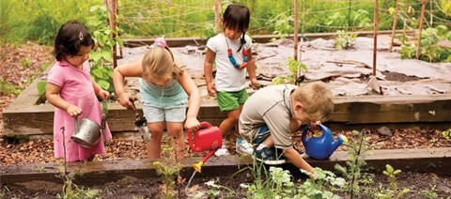
ESD- Themes and pedagogy?
From: https://www.communityplaythings.com/resources/articles/2014/gardening-with-children

Slide 22
Learning Outdoors?
Significant life experiences
Chawla, 1998
Biophilia
Wilson, 1993
Biophobia
Nature deficit disorder
Last Child in the Wood, Louv, 2008
Ecopedagogy
https://learningdiscourses.com/discourse/ecopedagogy/
Ecoliteracy
Notes:
Interesting document from WAG linking Outdoors to ESDGC, highlights significant life experiences
Reference
DCELLS (2007) Cardiff : Wales Out of classroom learning
Making the most of first hand experiences of the natural environment.
Cardiff: WAG.
Consider these ideas
Could we be moving to posthumanims – new materialism where humans decentred?
Or are we looking after the non-human world for our own wellbeing.
Should understanding ecology / cycles of life be part of pedagogy and working in harmony be core to early years?
Biophilia- hypothesis that humans have a evolutionarily and genetic love of nature.
Biophobia / ecophobia- also a fer of nature (sometimes well founded – in terms of predators etc.) However some argue that this may be separating us from other living things or fearing connecting with them or renfcred by living a more urbansied, digital age.

Slide 23
Sense of Place
‘… a ditch somewhere – or a creek, meadow, woodlot, or marsh …These are places of initiation, where the borders between ourselves and other creatures break down, where the earth gets under our nails and a sense of place gets under our skin.’
Pyle, 2011
‘Some environments encourage children "to pause, play, and stay awhile" (Olds, 1989, p. 9), while others do not. Some environments foster a "sense of place" in young children; others do not’
Wilson, 1997

Slide 24
Harmony
Watch headteacher Richard Dunne’s TED talk
https://www.youtube.com/watch?v=58l3O5y2UgE
Discuss the possibilities / challenges.
In your own time some of the podcasts from the Harmony project may be of interest. https://www.theharmonyproject.org.uk/tag/podcast/

Slide 25
Partnerships / Support
Ecoschools
Fair Trade Schools
Healthy Schools
Green Schools
British Council
RSPB
Oxfam
Centre for Alternative Technology
Save the Children
Amnesty
Notes:
Estyn , 2014 note that there needs to be a database of organisations that can support settings and schools to take ESDGC forward.

Slide 26
Evaluating John Muir
Discuss
https://www.youtube.com/watch?v=jCulXPYPP4U
Notes:
Possibility students might want to think how to link some of the discussion to evaluating their John Muir experience.

Slide 27
Bibliography
Wilson, E.O (1993) Biophilia Cambridge, Massachusetts: Harvard Univeresity Press.
Bronfenbrenner , B. (1979). The Ecology of Human Development: Experiments by Nature and Design. Cambridge, MA: Harvard University Press
Bruner, J. (1990) Acts of Meaning. USA: Harvard University Press
Chawla, L. (1998) Significant Life Experiences Revisited: a review of research on sources of environmental sensitivity. Environmental Education Research, 4, 4, pp. 369-382.
DCELLS (2008a) Framework for Children’s Learning for 3 to 7-year-olds in Wales . Cardiff: Welsh Assembly Government.
DCELLS (2008b) Education for Sustainable Development and Global Citizenship: A Strategy for Action (Updates) January 2008. Cardiff: Welch Assembly Government.
Dewey, J. (1998) Experiences and Education The 60th Anniversary Edition Indiana, USA: Kappa Delta Pi.

Slide 28
Bibliography
Ingrid Engdahl I. and Rabušicová M. (2010) Children’s Voices about
the State of the Earth and Sustainable DevelopmentA report for the OMEP World Assembly and World Congress on the OMEP World Project on Education for Sustainable Development 2009-2010
Elliott and Davis (2014) Research in Early Childhood Education for Sustainability: International Perspectives and Provocations. London: Taylor and Francis Ltd.
Froebel, F. (1826, 2005) The Education of Man. USA: Dover Publications Inc.
Heft, H. & Chawla, L. (2005). Children as agents in sustainable development: Conditions for competence. In M. Blades & C. Spencer (Eds.), Children and Their Environments. Cambridge, UK: Cambridge University Press.
Louv, R. (2008) Last Child in the Woods: Saving Our Children from Nature-deficit Disorder. USA: Atlantic Books.
Mackay (2012) ‘To know, to decide, to act: the young child’s right to participate in action for the environment’. Environmental Education Research, 18, 4, pp. 473-484.
Piaget, J. and Inhelder, B. (1972) The Psychology of the Child. USA: Basic Books.
Pyle, R.M. (2011) The Thunder Tree: Lessons from an Urban Wildland. Oregon: Oregon State University Press, 2011
Vygotsky, L. (1978) Mind in Society: Development of Higher Psychological Processes. USA: Harvard University Press.

