Slide 1
What is the learning Experience of Children with Dyslexia in a one-to-one singing lesson
A UK based Qualitative Analysis of Questionnaires and Case study
Jessica Bray (Sanchez)
24/02/2025

Slide 2
Introduction
Purpose of Study: Examine the learning experience of children with dyslexia in one-to-one singing lessons.
Research Question: What is the learning experience of children with dyslexia in a one-to-one singing lesson? A UK based Qualitative Analysis of Questionnaires and Case study

Slide 3
Key Terms
Dyslexia: Learning difficulty affecting pathways, memory, and phonological skills. (Ott. P 2007)
Neurodiversity: Variations in brain function and behaviour within the human population.

Slide 4
Person First Language
Language is an important part of the Social Model of Disability because language reflects the cultural assumptions and thinking of the society around us. Language is never purely descriptive - it shapes how we see each other, the value we place on different identities, and sometimes how we behave.
- Disability Rights UK, 2024
Notes:
.(Abramo, 2012; Flink, 2021 & Linton 199 British Dyslexic Association, 2024
https://www.disabilityrightsuk.org/social-model-disability-language?srsltid=AfmBOoryjoGL1wZhoTq2uQMeqiFgy7Q2iLNPTQUZIKB3S-JF28Xs4Ryu

Slide 5
Why this research? Why Now?
Estimated 10% of the UK population are thought to be affected by Dyslexia (British Dyslexic Association, 2024)
1985 publication of “Dyslexia and Music” brought about an increased awareness of potential barriers specific to Music lessons within this community (Oglethorpe, 2002). This has been met with publications in Music and instruments- but the lack of research specific to singing reveals a knowledge gap
Between the intakes of 2024/15 to 2021/22 students enrolling in higher education in the UK has risen from 12.22% to 20.30% (Department for Education, 2022)
Notes:
Possible transition from medical to social models (tang at Al)

Slide 6
Two key Pieces of Literature
Nelson and Hourigan (2016) examined the learning strategies and challenges of five professional musicians with dyslexia. Their study primarily focused on individuals' perceptions of their dyslexia-related challenges and recommendations through questionnaires. However, this approach may limit the scope of data, as participants could have excluded relevant experiences that they did not directly associate with their dyslexia, potentially skewing the findings.
O’Byrne et al. (2019) conducted qualitative case studies on dyslexic students transitioning to university. Using semi-structured interviews, they employed a constructive, open-ended approach that allowed participants to reflect on their experiences without making direct connections between dyslexia and their challenges

Slide 7
Methodology
Research Methods: Online questionnaires and case study sessions. Based on the methods of Nelson and Hourigan (2016) & O’Byrne et al. (2019)
Participants: Case Study children aged 7-11 with dyslexia and questionnaire people with dyslexia who identify as a singer
Data Collection: Quantitative data from questionnaires and qualitative data from semi-structured interviews and observations.
Data Analysis: Inductive process of thematic Analysis- Data Driven (Braun, V. and Clarke, V., 2006)

Slide 8
Philosophical Stance
Ontological Position: Recognizes multiple realities, reflecting diverse interpretations of individual experiences.
Epistemological Position: Knowledge is subjective, shaped by participants' perspectives and the researcher's interpretation.
Axiological Position: Emphasizes ongoing self-reflection to minimize personal biases.
Interpretivist Paradigm: Experiences are socially constructed based on unique perspectives.

Slide 9
Reflexive Approach
Insider Researcher: Dual “insider role” with Personal experience with dyslexia which led my motivation
Mitigating Bias: Active reflection on the researcher's role and experiences and will be data led (inductive)
Ensuring Integrity: Transparency in the analysis process to maintain research validity.

Slide 10
Questionnaire
Recruited from self-volunteered sample who fulfilled the eligibility criteria answering recruitment call outs on social media targeted posts
Information sheet, consent and questionnaires was available by self-serve links

Slide 11
Questionnaire Eligibility
Declared a Singer
Self-declared as Dyslexic
Appropriate consent to particpate

Slide 12
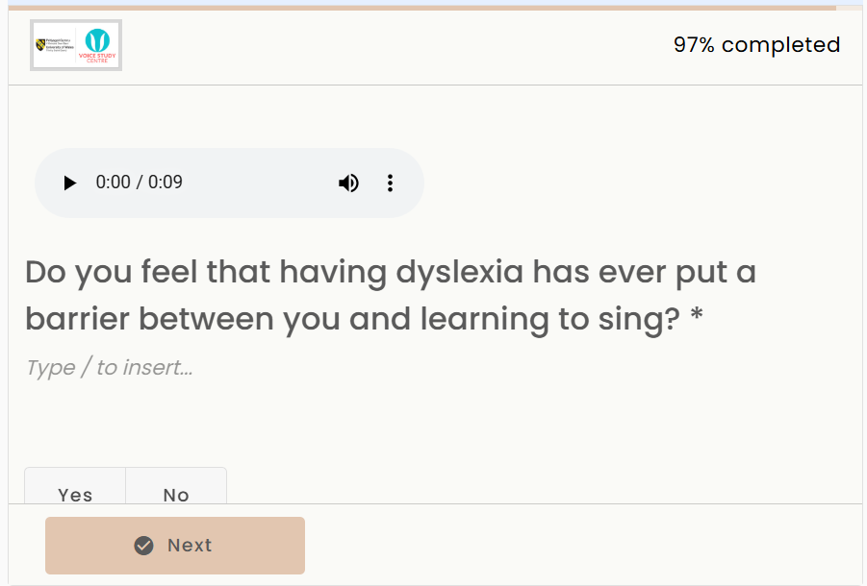
Questionnaire

Slide 13
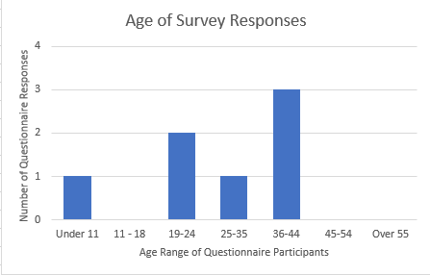
Questionnaire Age Demographic
(Mo) of participant age was “36-44 years old” (N=7) with the response of “ 25-35 years old” was the median value of this range of data.

Slide 14
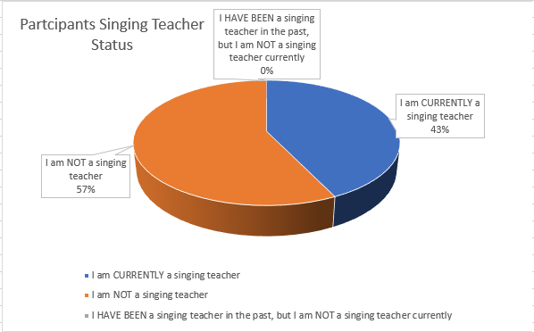
Questionnaire Singing Teacher Status

Slide 15
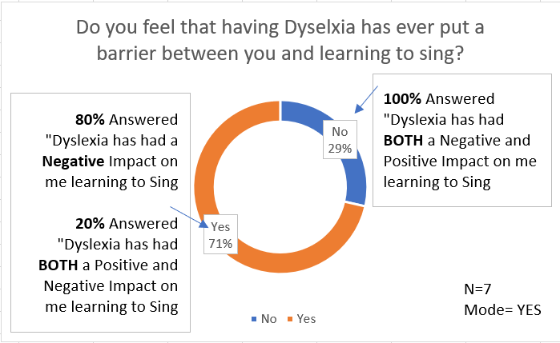
Questionnaire Responses

Slide 16
Case Study Eligibility and Recruitment
Aged between 7-11 years Old
Self-identifying as Dyslexic
Has experienced or currently has one-to-one singing lesssons

Slide 17
Case Study Insights
Participant: 10-year-old female with dyslexia.
Key Observations: Mirrored broader trends, highlighting common challenges and preferences.

Slide 18
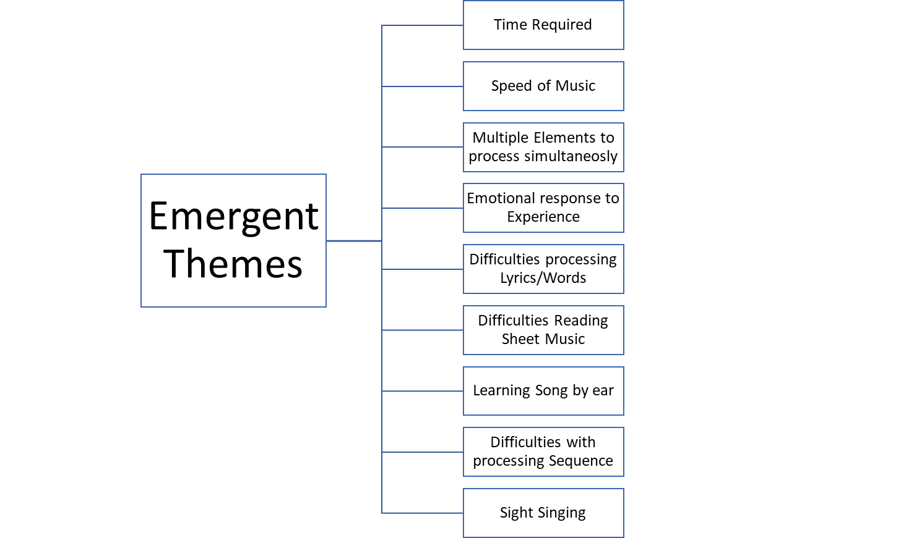
Themes of Findings

Slide 19
Findings - Processing Words/Lyrics
Key Theme: Difficulties with reading and processing lyrics.
Examples: Preference for activities not involving reading lyrics.

Slide 20
Findings - Emotional Responses
Key Theme: Range of emotional responses, from enjoyment to frustration.
Examples: Positive self-expression vs. anxiety under time pressure.

Slide 21
Findings - Time Required
Key Theme: Need for additional time to process new information.
Examples: Repetition and familiarity with songs improve learning outcomes.

Slide 22
Findings - Multiple Elements
Key Theme: Challenges in processing multiple types of information simultaneously.
Examples: Difficulty with tasks requiring reading music and lyrics together.

Slide 23
Findings - Reading Sheet Music
Key Theme: Significant challenges with reading sheet music.
Examples: Preference for visual aids and alternative formats.

Slide 24
Conclusion
Summary: Dyslexic children face specific challenges in singing lessons, particularly with reading, TIME required and processing multiple elements.
Recommendations: Tailored support and flexible teaching methods can enhance learning experiences. Which could form the basis of further research exploration to prove

Slide 25
Future Research
Larger cohort studies
comparison with non-dyslexic learners, and exploration of alternative teaching methods between control groups
Exploration of processing time within a singing lesson in wider cohorts and across control groups
the use of musical notation specific to singers, not just within the music lesson with additional element of lyrics

Slide 26
Individual Learning Outcome 1
To develop my ability to write succinctly within my academic writing
I felt although I improved in part with this, I still found it difficult to write succinctly whilst being able to hit the key learning objectives set out in the assessment frameworks. I feel this is something that will grow with confidence in my academic writing and therefore likely to be a continued goal moving through this course.

Slide 27
Individual Learning Outcome 2
To improve my time management skills in relation to academic work
On reflection this was something that was aided with the use of a GANT chart within my project proposal. However I need to take more time to consider that I am taking this course alongside a full time job, running a small singing tuition business and family commitments. The additional impact my neurodiversity and general health mean I should allow for longer than I often anticipate tasks will take. I will work aim to work more closely with my tutor in the next module

Slide 28
Individual Learning Outcome 3
To gain a more objective insight in to the impact dyslexia has on others in comparison to my own experiences both as a learner and a teacher
I feel this objective has definitely been achieved throughout this process. The need for me to explore deeper into the research within this field has given me insights I would not have been likely to have come across exposing me to more literature. The reflexive nature of the process does ask you to at yourself and your own teaching experiences too.

Slide 29
Individual Learning Outcome 4
To improve my time management skills in relation to academic work
On reflection this was something that was aided with the use of a GANT chart within my project proposal. However I need to take more time to consider that I am taking this course alongside a full time job, running a small singing tuition business and family commitments. The additional impact my neurodiversity and general health mean I should allow for longer than I often anticipate tasks will take. I will work aim to work more closely with my tutor in the next module

Slide 30

Questions

Slide 31
References
Braun, V. and Clarke, V. (2006) ‘Using thematic analysis in psychology’, Qualitative research in psychology, 3(2), pp. 77–101.
Disability Rights, Social Model Disability Language Available from https://www.disabilityrightsuk.org/social-model-disability-language?srsltid=AfmBOoryjoGL1wZhoTq2uQMeqiFgy7Q2iLNPTQUZIKB3S-JF28Xs4Ryu Accessed 1st December 2024
Flink, P. (2021) ‘Person-First & Identity-First Language: Supporting Students with Disabilities on Campus’, Community college journal of research and practice, 45(2), pp. 79–85.
Higher Education Statistics Agency, https://www.hesa.ac.uk/data-and-analysis/students/what-study#characteristics Accessed the 23th January 2025
Nelson, Kent & Hourigan, Ryan. (2015). A Comparative Case Study of Learning Strategies and Recommendations of Five Professional Musicians With Dyslexia. Update: Applications of Research in Music Education. 35. Oglethorpe,S 2002, Instrumental Music for Dyslexies: A Teaching Handbook
Ott, P. (2007) Teaching children with dyslexia : a practical guide. London: Routledge
O’Byrne, C., Jagoe, C. and Lawler, M. (2019) ‘Experiences of dyslexia and the transition to university: a case study of five students at different stages of study’, Higher education research and development, 38(5), pp. 1031–1045.
Questionnaire Website https://app.voiceform.com/

