Slide 1

TIME MANAGEMENT AND
SETTING GOALS
Academic Survival Skills, Block 1 Week 2

Slide 2
In this session, we’ll discuss:
Planning and prioritising
Study goals
Distractions and procrastination
Time management tips
(What follows is adapted from the Open University)

Slide 3
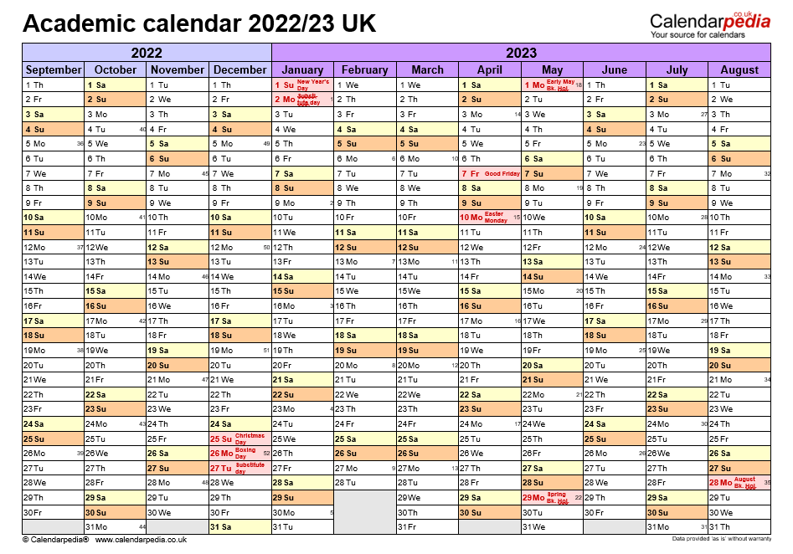
Planning and Prioritising

Slide 4
TO START
Make sure you are very familiar with the modules you are taking.
What are the module learning aims and outcomes?
What is required to pass the module?
When are the assignment deadlines?
How much time do you need to allocate to study?

Slide 5
HPFY3001 Academic Survival Skills
AIM(S)
To introduce the student to study and learning skills as a foundation for higher education.
LEARNING OUTCOMES
Upon the successful completion of this module, the student should be able to:
Apply learning strategies to the content of subject modules
Follow instructions, analyse questions and plan answers for course assignments

Slide 6
HPFY3001 Academic Survival Skills
Less formally …
This module is designed to provide a continuous point of contact and support throughout your Foundation year. We meet as a group weekly on Mondays at 10am.
The module will cover key themes and issues that will enable you to build your confidence, develop your skills and become familiar with the physical and intellectual structures of University life.

Slide 7
HPFY3001 Academic Survival Skills
What is required to pass the module?

Slide 8

HPFY3001 Academic Survival Skills
What is required to pass the module?
An overall mean average mark of 40% or over
And make sure you attempt every assessment

Slide 9
HPFY3001 Academic Survival Skills
PORTFOLIO
6 x 350 word reflective pieces of writing on each Block that you are taking for credit:
Due dates:
Friday 20 October
Friday 24 November
Friday 12 January
Friday 16 February
Friday 15 March
Friday 24 May
PRESENTATION
Deadline Friday 24 May*
*Presentations will take place during weeks begging 13 & 20 May

Slide 10
DEADLINE not a TARGET

Slide 11
How much time do you need to allocate to study?

Slide 12
How much time do you need to allocate to study?
Activity type | Hours | Percentage
Scheduled learning | 20 credits = 30 10 credits = 15 | 15%
Independent learning | 20 credits = 170 10 credits = 85 | 85%
TOTAL | 20 credits = 200 10 credits = 100 | 100%

Slide 13
Planning your time
Plan ahead – anticipate pressure points in your timetable when you might not be able to dedicate yourself 100% to your studies
Create a schedule
Set aside time for studying
Try and organise competing priorities

Slide 14
Planning your time
GIVE YOURSELF A BREAK (or many breaks!)
Find time for family, friends, hobbies, etc.
Listen to your mind and body – when do you work well? When is your concentration strongest?

Slide 15
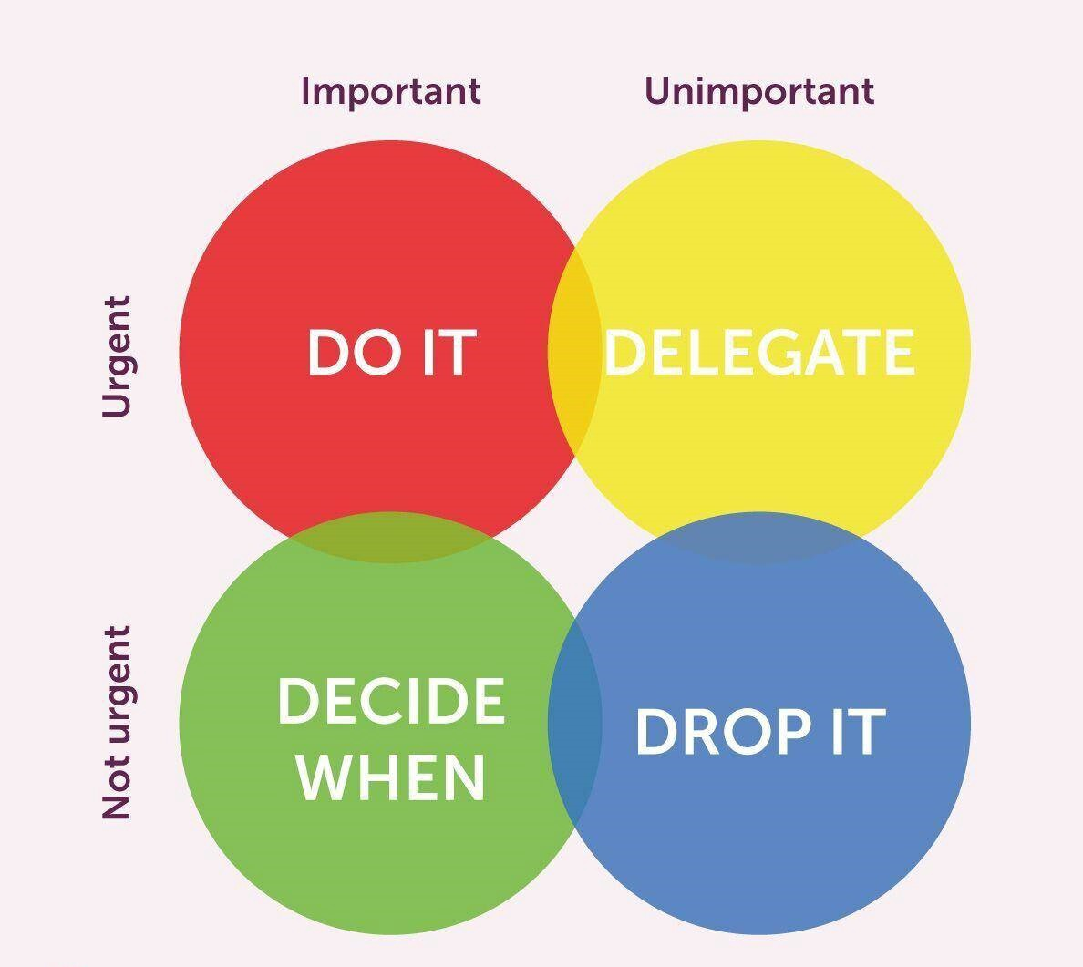
Planning your time

Slide 16
Find a place to study …
Whatever suits your learning style and strategies is the right approach.
Find a place to study:
Where you can work comfortably and without distraction.
Working in a comfortable temperature with adequate light and ventilation.
Your desk and chair should be complementary in height so that you are not sitting in a crouched position.
Don’t be ‘too comfortable’, otherwise it is easy to snooze.
McMillan, Kathleen, and Weyers, Jonathan, The Study Skills Book, 4th edn. (Pearson Education Limited: Harlow, 2021), p. 40.

Slide 17
Study Goals

Slide 18
Study Goals
Decide BA degree
Take part in social and extracurricular activities
Improve IT skills
Improve writing
Gain confidence
Gain knowledge/skills for career plans (or not)
See if academia is ‘for you’
Good physical, emotional & mental health
Improve vocabulary

Slide 19
Action Plans
What do I need to do to achieve it?
How can I achieve it?
What resources will I need?
When can I take action?

Slide 20
Obstacles

Slide 21
Dealing with distractions
Set realistic goals for your study session (e.g. 'I'll read this section, or work for 40 minutes before I make that coffee')
Aim to minimise interruptions (e.g. switch off your phone)
Short-term, realistic deadlines
Try not to feel that you need to produce the perfect assignment or project
Avoid taking on too many commitments - learn to politely say 'no'
Do a deal with yourself - 'Okay, I'll binge-watch TV tonight, but this means that I'll need to get up early on Sunday to study instead'.
Just do it! You may find that the task doesn't take as long as you expected and you'll feel much better for getting it out of the way.

Slide 22
OU’s tips for time management
Completing an assignment or receiving good feedback and marks can be a real buzz, but if things don't go to plan don't get discouraged. Instead, consider ways of using your limited time to the best advantage.
Pareto's Principle, or the 80/20 rule, says that 80% of the result can usually be gained by concentrating on the most important 20% of the task.
Check your study calendar - be aware of approaching deadlines so there are no surprises.
Mark or highlight parts of your reading which are holding you up and move on past them - return to them when you have read more, because generally it will make more sense.
Attend class - learning with fellow students and being guided by the tutor adds depth to your study, and it helps you to see that you are not alone.

Slide 23
OU’s tips for time management
Write out the next assignment question - use it as a bookmark and keep it in front of you while you're reading, so your notes are focused and relevant.
Highlight and make a note of references you'll need in an assignment as you go along - this can really save time later.
Tell your tutor or student support team of any difficulties you are experiencing - they will be pleased to offer help and guidance.

Slide 24
Study Skills support @ UWTSD
Personal organisation
Time management
Concentration
Reading
Doing presentations
IT skills
Practicing presentations
Planning coursework
Essay-writing skills
AOB
https://www.uwtsd.ac.uk/study-skills/
Email: studyskillsdistance@uwtsd.ac.uk
Appointments available throughout the week via Teams.
Email with an issue and indicated preferred time out of those listed.

Slide 25
Student Support Services @UWTSD
Did you get learning support ‘screening’ in induction week?
Have you had a follow-up email from Student Support?

