Slide 1


Individual presentations powerpoint with voice over
Andreea Cristina Velisaru
Student id 2323535
Module code BMHP6027
Lecture Robert Nartowski

Slide 2
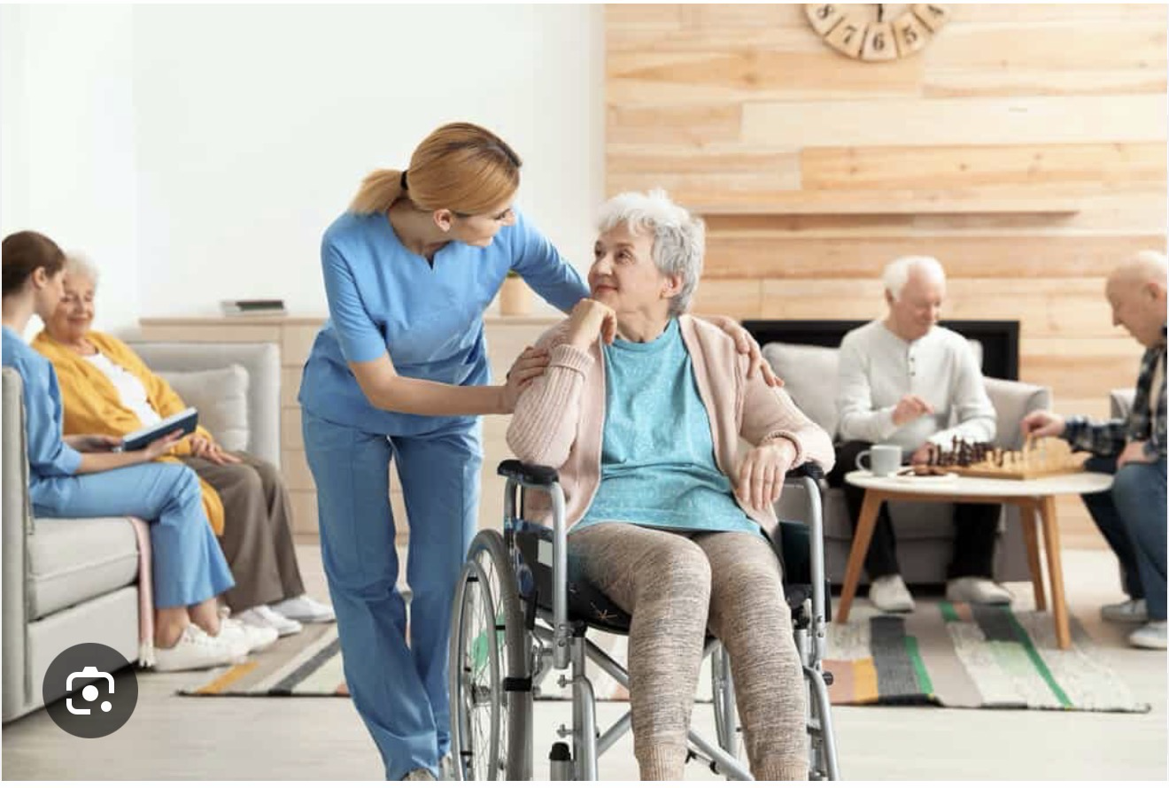
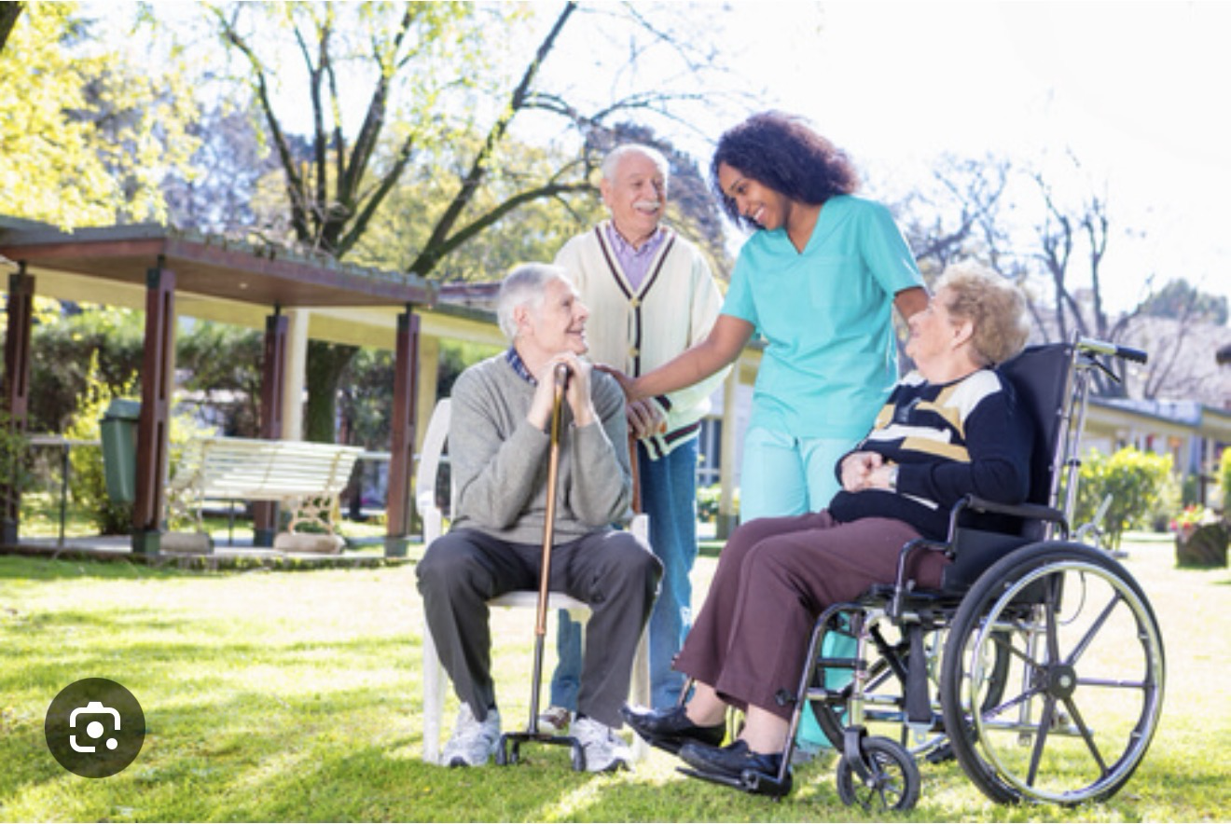
Introduction
The presentation's objective
Analyse the assistance and care requirements of senior citizens.
Analyse care places and services in the UK.
Examine how technology promotes wellbeing and independence.
Talk about suggestions for future development.
What is meant by "ageing"?
The slow biological, psychological, and social process that comes with growing older is called ageing.
According to WHO (2024), elderly persons in the UK are often defined as those who are 65 years of age or older.

Slide 3

Why ageing matters
Ageing is important because there are more older persons worldwide as a result of longer lifespans. Healthcare, social services, housing, and the economy are all significantly impacted by this. Understanding ageing enables us to support healthy ageing, preserve independence, enhance quality of life, and guarantee that services are tailored to the needs of senior citizens. In order to provide person-centred care, future healthcare practitioners must acknowledge the social, psychological, and physical components of ageing.

Slide 4
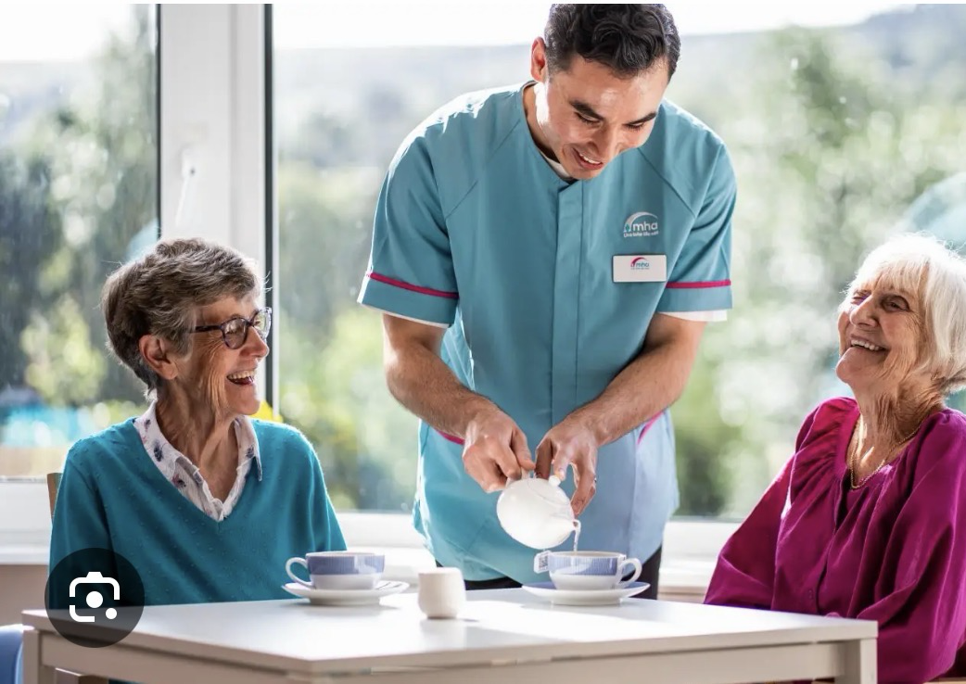
Care and support needs of older people
Physical:
Mobility assistance
Individual care
Management of medications
Psychological
Support for mental health
Care for dementia
Social
decreasing loneliness
Participation of the community
Financial:
Security of finances
Availability of services and advantages according to Victor (2010)

Slide 5

Framework
Theory of Activity (Havighurst, 1961)
Maintaining an active and socially active lifestyle is essential for successful ageing.
promotes wellbeing and independence.
Advantages
promotes involvement.
encourages healthy ageing.
Limitations Due to illness, some elderly persons are unable to continue being active.
Critical Assessment
helpful in comprehending empowerment, yet it could ignore physical constraints.

Slide 6
An Alternative Perspective
Theory of Continuity (Atchley, 1989)Elderly people continue their current lifestyles, values, and routines.
Instead of change, adaptation happens through continuity.
Assessment
acknowledges uniqueness.
aids in the explanation of various assistance requirements.
little focus on how societal injustices impact ageing.

Slide 7

Uk legislation and policy key framework
The Care Act of 2014
enhances wellbeing.
person-centred treatment.
assessments of care needs.
The 2010 Equality Act
prevents discrimination based on age.
Integrated care under the NHS Long Term Plan.
community support and prevention.
Critical Point: Although there is a robust legal framework, its application differs.

Slide 8
Recommendation /framework
Problems with Policy Implementation
* Person-centred care is encouraged by laws like the Care Act of 2014, however local governments implement them differently.
* Service access and quality may be impacted by disparities in resources.
Lack of Funding
* There are constant budgetary strains on social care services.
* Insufficient financing may result in higher wait times and less service availability.
Hiring and Retaining Employees
* In the health and social care sectors, staff shortages continue to be a significant problem.
* Care continuity and quality may be impacted by high workloads and turnover.
Digital Isolation
* A large number of elderly people lack access to technology and digital skills.
* The advantages of telehealth and other digital services may be diminished as a result.
Regional Disparities
* In the UK, access to care and support services varies.
* There may be fewer services and greater travel lengths in rural locations. Critical Assessment
* Despite the fact that laws offer a robust framework for assisting senior citizens, these obstacles may restrict the efficiency of care and reduce access equality. (NHS England, 2019; Age UK, 2024; ONS, 2024; Care Act, 2014)

Slide 9

Current care
An Overview of Services in the UK
Residential care facilities
Domiciliary (home) care nursing homes
Services for community support
NHS medical services
Organisations in the voluntary sector
Aim
Encourage self-reliance and a high standard of living.

Slide 10

Evaluation of home care
Benefits of Domiciliary Care
Stay in comfortable surroundings.
keeps its independence.
more affordable than residential care.
Obstacles
lack of workers.
Quality varies.
little social engagement.
Critical Assessment
encourages empowerment, but the availability of services determines how effective it is.

Slide 11
Evaluation of residential care home
Benefits
24-hour assistance.environment that is structured.
specialised services for dementia.
Obstacles
loss of autonomy.high prices.issues with institutionalisation.
Critical evaluation may diminish autonomy, although it is necessary for complicated demands.

Slide 12

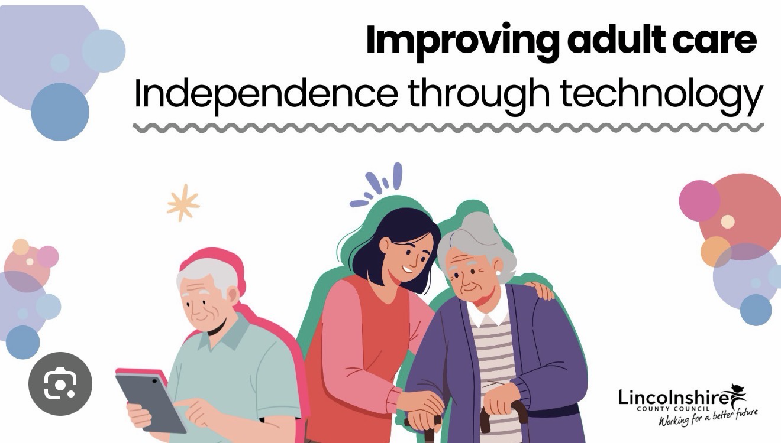
Technology in older adult care
Examples of Technology's Growing RoleSmart home systems for telehealth
Wearable technology
Reminders for digital medications
Advantages
encourages self-sufficiency.
enhances safety and monitoring.
And keeps them actively.
And less lonely because they can have social contact with others through online.

Slide 13

Innovation
Telehealth
Telehealth: What is it?
remote monitoring and consulting.
decreases hospital stays.
Benefits
easy access.
helps manage chronic illnesses.
Restrictions
digital marginalisation.
challenges with confidence in technology.
Critical Discussion: Not always available, yet useful for many senior citizens.

Slide 14
Innovation
Examples of Assistive Technologies
Detectors for falls
Intelligent sensors
GPS monitoring for dementia
Benefits
enhanced security.
encourages independence.
gives families comfort.
Restrictions
privacy issues.
financial obstacles.
dependence on technology.

Slide 15
Case study Mrs Smith 82 years old
Context:
lives by themselves.
early-stage dementia and arthritis.experienced a tumble.
Assistance Given:
visits for home care.
sensor for detecting falls.
monitoring via telehealth.
attendance at the community day center.
Results:
increased security.
fewer hospital admissions.
greater self-reliance.
Utilising Theory
Through community involvement, Activity Theory promotes social engagement.

Slide 16
Recommendation
Needed Improvements
1. Increase financing for social care.
2. Increase hiring and employee retention.
3. Enhance training on digital inclusion.
4. Increased NHS and social care integration.
5. Make assistive technology more accessible.
Hindrances
Funding limitations.
Lack of personnel.
Problems with digital literacy.
Disparities by region.
Critical Examination
Person-centred care cannot be replaced solely by technology.

Slide 17
Conclusion
Important Lessons
The demand for care services rises as the UK's population ages.
The physical, psychological, and social demands of older persons are varied.
Laws support equality and well-being.
Both residential care and home care have advantages and disadvantages.
Although technology increases independence, accessibility problems still exist. Investment and integrated care techniques are necessary for future improvements.

Slide 18
References
Atchley, R.C. (1989)
Care Act (2014)
Equality Act (2010)
Havighurst, R.J. (1961)
NHS England (2019) NHS Long Term Plan
Office for National Statistics (2024)
World Health Organization (2024)
Age UK (2024)
Sixsmith, A. (2021)
Wiles, J. et al. (2012)
Victor, C. (2018)
Nolan, M. et al. (2020)
Department of Health and Social Care (2023)
Glasby, J. (2017)
Lloyd-Sherlock, P. (2022) .
Victor, C.R. (2010) Social Gerontology. 6th edn. London: Routledge.

Slide 19
References
Lincolnshire County Council (n.d.) Improving adult care: Independence through technology. Available at: https://www.lincolnshire.gov.uk (Accessed: 25 June 2026).
Getty Images. (n.d.). Caregiver assisting elderly woman in wheelchair in nursing home [Photograph]. Getty Images. Retrieved June 25, 2026, from https://www.gettyimages.com/

