Slide 1
Title Slide
Module: LCHS4010 Psychology in Health and Social Care
Assignment: Assessment 1: Individual Presentation
Title: A Lifespan Development Analysis: Community Support Plan for Jenny
Student Name: Kiran Zatoon
Student ID: 2129822
Date: Week beginning February 16, 2026

Slide 2
Case Study Overview: Jenny
Profile: 16-year-old female.
History: Young carer for 5 years following her father’s death.
Current Situation: Provides practical help (cooking, cleaning) and administrative support (memory/mood issues) for her mother.
Needs: Support for her own development and well-being.

Slide 3
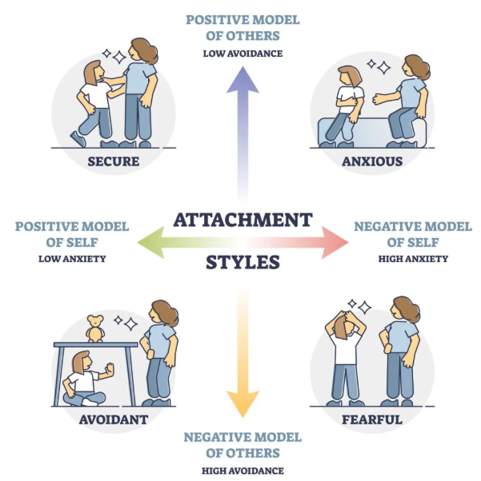
Chosen Theory: Bowlby’s Attachment Theory
Core Concept: Focuses on the importance of a secure base and the impact of early emotional bonds on future development.
Relevance: Directly addresses the impact of paternal loss and the shifting "caregiving" role Jenny has assumed.
Key Principle: Internal Working Model how Jenny’s early attachments shape her current view of relationships and self-worth.

Slide 4
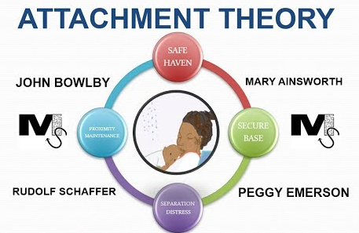
Key Concepts of Attachment Theory
Monotropy: The significance of the primary attachment bond.
Separation Distress: The psychological impact of losing a primary caregiver (her father).
Safe Haven: The child’s need to return to the caregiver for comfort.

Slide 5
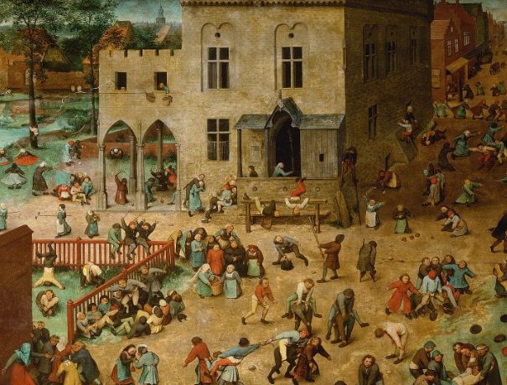
Historical Impact on Jenny’s Development
The Loss: Death of her father 5 years ago (at age 11) interrupted a key developmental stage.
Role Reversal: "Parentification“ Jenny became the caregiver rather than the cared-for.
Impact: Possible insecure attachment or "anxious-avoidant" traits due to the unavailability of her mother’s emotional support.

Slide 6
Biological Influences (Nature)
Stress Response: Impact of long-term caregiving on cortisol levels and brain development during adolescence.
Temperament: Jenny’s innate resilience or vulnerability to mood disorders (linked to her mother’s low mood).

Slide 7
Environmental Influences (Nurture)
Socio-Economic Stress: Practical burdens of cleaning, cooking, and shopping at age 16.
Social Isolation: Lack of peer interaction due to 5 years of intensive home-based care.
Grief Context: The family environment changed from stable to one of chronic illness and bereavement.

Slide 8
Proposed Support Plan (Practical Strategies)
Strategy 1: Respite Care: Professional home-help for the mother to return the "caregiver" role to professionals.
Strategy 2: Therapeutic Support: Counseling for Jenny focused on "earned security" to process the loss of her father.
Strategy 3: Social Integration: Young Carers support groups to rebuild peer-to-peer "environmental" nurture.

Slide 9


Critical Evaluation: Usefulness of the Theory
Strengths: Effectively explains why the loss of her father and her mother's memory problems are so psychologically damaging.
Application: Provides a clear roadmap for rebuilding Jenny’s emotional "secure base".

Slide 10
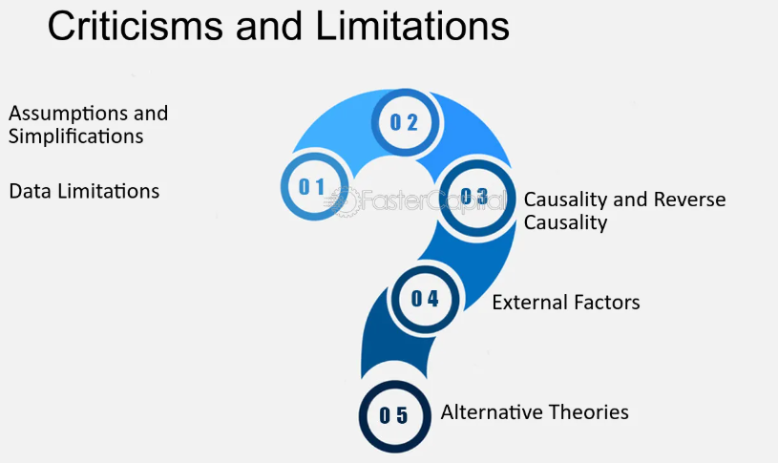
Critical Evaluation: Limitations of the Theory
Deterministic: Can over-emphasize early childhood, potentially overlooking Jenny’s current agency and resilience.
Cultural Context: Bowlby’s original work is often criticized for a narrow view of family structures.

Slide 11
Conclusion
Jenny’s development has been heavily influenced by early bereavement and parentification.
Attachment theory highlights the need for a support plan that prioritizes her emotional security alongside practical aid.

Slide 12
Reference
Bowlby, J. (1979) The making and breaking of affectional bonds. London: Tavistock.
Duschinsky, R. (2025) 'Attachment theory and research: what should be on the core curriculum for child and family social workers?', Social Work Education, 44(1).
Forslund, T. et al. (2022) 'Attachment goes to court: child protection and custody issues', Attachment & Human Development, 24(1), pp. 1-52.
Johnson, S. (2019) Attachment theory in practice: emotionally focused therapy (EFT) with individuals, couples, and families. New York: Guilford Press.
Li, X. et al. (2024) 'Association between adult attachment and mental health states among health care workers: the mediating role of social support', Frontiers in Psychology, 15.
Nolan, M. and Gore, S. (2023) Contemporary issues in perinatal education. London: Routledge.

Slide 13
Thank You!!

