Slide 1

PowerPoint Presentations:
Some ‘Dos’ and ‘Don’ts’

Slide 2

PowerPoint general principles
To send a clear, informative message confidently
To engage your audience
To present info accurately and memorably

Slide 3

Presentation Basics
PowerPoint is a tool that y augments what you are talking about.
The slides should not just be a verbatim version of notes that you read out.

Slide 4
Presentation Basics
PowerPoint slides -
  add a visual dimension
  enable the audience to ‘see’ info
  provide atmosphere/scene setting
  convey key information

Slide 5

ABC of PowerPoint presentations
Accuracy
  Spelling, content etc
Brevity
  Slides’ points should be brief - bare minimum
Clarity
  Neat, simple, uncluttered
Notes:
Why should your slides be brief? Because people tend to read the slides before they listen to you. If you put up lots of info and talk, they will be conflicted about what to concentrate on. Help the audience by giving them some time to absorb the slide before going over the points. The points should be in brief – you can add to them as you go along.
Dates, names refs etc should be accurate.
Each slide should deal with one concept or one idea, only the essential details as points should be included; cardinal sin of too much on one slide to be avoided
Visibly obvious and clear – try to avoid clutter or unnecessary info – this is a bit personal/subjective but try and keep the background simple and the font clear – Arial or Calibri are considered the best

Slide 6

Tips for slide design
Use consistent format
Size and place text/images to maximise readability
Limit text (except when using quotations to illustrate points)
Make sure colour scheme and contrast is easily read
Make sure font and its size is easily read

Slide 7

Tips for effective slides
Theme your slides; consistency = calming
Amount of text : think T shirt
Contrast colours background/text
Size and clarity of font

Slide 8

Poor slides
Text written over the picture so that you can’t see it
Background colour not contrasted enough with text’s colour
Text too small
Font too florid

Slide 9
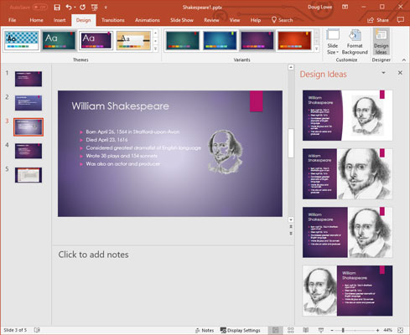
Tip:
Use ‘Design Ideas’ function to help with layout https://support.microsoft.com/en-us/office/create-professional-slide-layouts-with-powerpoint-designer-53c77d7b-dc40-45c2-b684-81415eac0617

Slide 10

Making your PowerPoint
Follow the ABC rule
Remember visibility – you are sending a message
Plan the sequence. There should be a
  Title slide
  Intro slide (like an essay)
  Slides of topics (1 topic/1 slide)
  Concluding slide (+ reference slide)
Notes:
Visibility - font size, contrast etc ; highlight the salient info if you want
Remember about visual impairments – colour blind for instance; remember contrast
Background should not be cluttered; consistency is good, use images to highlight the main idea or to bring in some humour.
Structure – quite like an essay = Title slide, intro slide, slide of topics (each one could be likened to a paragraph of an essay), concluding slide and refs’ slide as necessary.

Slide 11

During the presentation
Breathe
Take your time
Try not to just read from the slides
Try not to be monotone – vary vocal emphasis; try to use energy and enthusiasm

