Slide 1
Health Promotion and Social Cognition Models.
Dr Stuart Jones

Slide 2
Aims of the Session.
Provide a definition of Health and Health Psychology.
Discuss why Health Psychology is important and the rise of the Health Psychologists.
To examine approaches to research in Health Psychology.
To explore Health Promotion and the types of Health Promotion Strategies.
To discuss the applicability of Social Cognition Models to changing health related behaviour.

Slide 3
What connects Psychology to Health?
People have beliefs about Health.
Can become very emotional.
People have a behavioural role to play in maintaining their health and coping.
Individual Differences.
WHY do some people react well emotionally to ill-health.
WHY do some people get ill all the time?

Slide 4
Health Psychology.
Concerned with how biology, behaviour, personality, and social context can influence health, illness and well-being.
More than just physical illness!
Health Psychology can address key questions relating health, illness and well-being.

Slide 5
Health Psychology.
Matarazzo (1982).
The promotion and maintenance of health.
Improving Healthcare systems and health policy.
The prevention and treatment of illness.
The cause of illness: e.g. Risk factors / Vulnerability.

Slide 6
HCPC (Health Care and Professionals Council)
Health Care and Professionals Council
Is a statutory regulator of over 280,000 professionals from 15 health and care professions in the United Kingdom.
Including all Practitioner Psychologists.
Clinical psychologist, Counselling psychologist, Educational psychologist, Forensic psychologist, Health psychologist, Occupational psychologist, Practitioner psychologist, Registered psychologist, Sport and exercise psychologist
http://www.hcpc-uk.org/

Slide 7
Why is Health Psychology Important?
How people manage and cope with illness.
Experiences of health and illnesses.
Promote General Well Being.
Behavioural Change.
  Health Psychology seen to make an “actual” difference.
Employment Opportunities.
  Working with a variety of people.
  NHS, Carers, Communities, Schools, Universities.
Links with other branches of Psychology.
  E.g. Social Psychology.
  Use of Qualitative and Quantitative Research Methods.

Slide 8
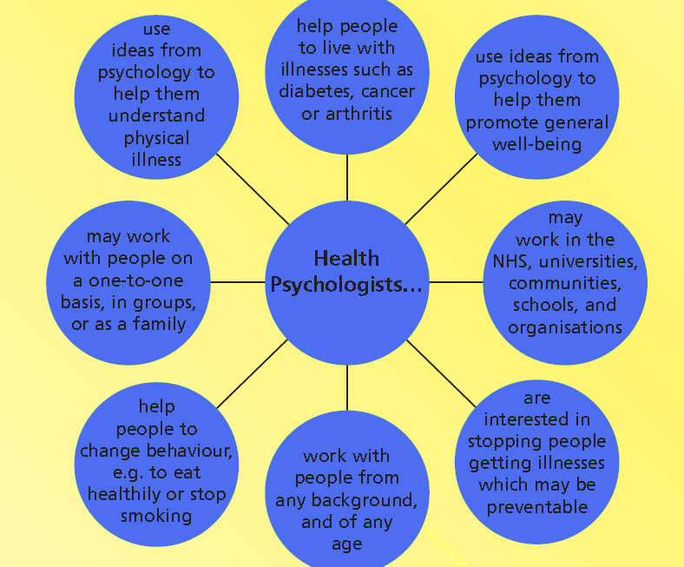


Slide 9
About Health Psychology
Major rise in popularity in the 1980’s – 1990’s.
By 2005 – over 1,000 members in the BPS.
Largest sub division in the APA.
Why?

Slide 10

Why?
1) Increase awareness of causes of death in 1970 – 1980’s.
  Leading causes of Death ALL Behavioural.
  E.g. Potentially preventable.

Slide 11
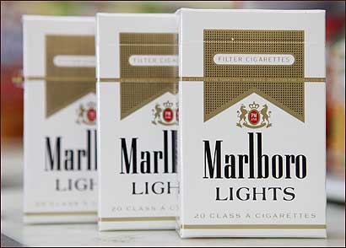
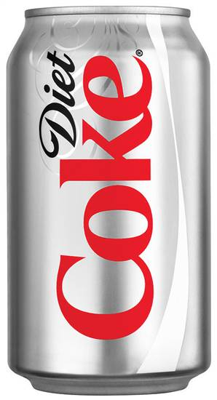
Why?
2) Ideology that individuals are responsible for their own health.
People can look after themselves.
No such thing as a community – don’t need help.

Slide 12
2).
Where this view is the strongest – shown the biggest increase in Health Psychology.
Need for policy interventions designed to support and promote health.
Individual ALONE may be unable to make improvements in health related behaviour – as a consequence of economic or political factors.

Slide 13
Why?
3) Disenchantment with health care among patients and practitioners.
Improving services – alternatives.
Patients views.
Growing awareness of Psychological and Social influences of Well being.

Slide 14
What is Health?
Have a few minutes to write your own definition of health.
Group discussion.

Slide 15
What is Health?
HEALTH
Illness
Signs
Symptoms
Cognitions
Behaviours
Emotions

Slide 16
What is Health?
Defined as “Wholeness”.
World Health Organisation (1948) “a state of complete physical, mental and social well-being and…. not merely the absence of disease or infirmity”.
Is this a good definition?

Slide 17
A Definition of Health.
Marks et al (2006).
Health is a state of well-being with physical, cultural, psychosocial, economic and spiritual attributes, not just the absence of illness.

Slide 18
Natural Science vs Human Science.
Two primary sources of knowledge for studying human behaviour and experience
Natural Science
Human Science.

Slide 19
Natural Science.
The principle objective of natural science is to identify causes.
  Does Alcohol intake elevate depression?
Attempts to generate predictive models.
  Medical Model.
Quantitative in its approach.
Physical treatments.

Slide 20
Human Science.
Objectives is to Identify meanings.
  What does X mean to Y?
Represented by research on discourse, narratives and social representations.
IPA (Case Studies).
Social Constructivism.

Slide 21
Theory in Health Psychology.
3 Broad Types based on their level of generality.
Frameworks
Theories
Models.

Slide 22
Frameworks.
Complete system of thinking about a field of inquiry…. Looser and less developed in nature, intended for general application. (Marks et al, 2006).

Slide 23
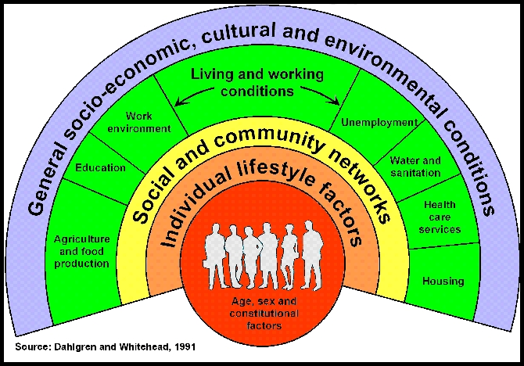
Example of a Framework
Determinants of Health Framework

Slide 24
Determinants of Health Framework
6 Characteristics.
  1) Concerned with all determinants of health.
  2) Individual at the Core.
  3) Reflect the whole situation.
  4) Interdisciplinary (not just medical).
  5) DOESN’T STRESS WHICH ASPECT IS MORE IMPORTANT.
  6) Complex nature of Health determinants.

Slide 25
Four Approaches to Health Psychology.
Clinical Health Psychology.
Public Health Psychology.
Community Health Psychology.
Critical Health Psychology.

Slide 26
Clinical Health Psychology.
Relates Psychological variables to Biomedical conditions.
Quantitative assessments.
Interventions.
Randomised Controlled Studies.

Slide 27
Clinical Health Psychology.
Researched Based.
Work alongside health services to assess and improve care of patients.

Slide 28

Public Health Psychology.
Allied to epidemiology and health promotion.
Manipulate psychological variables predicting health and healthy behaviours.
Large Scale Surveys.
Interventions.

Slide 29
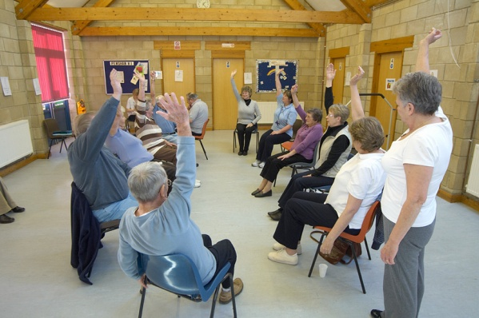
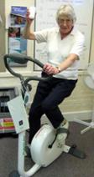
Community Based Health Psychology.
Empower communities to have a great control over health and health care.
Case Studies and Action Research.
Vulnerable people.

Slide 30
Critical Health Psychology.
Analyse how power, economics and society influence health, health care.
Political in Nature.
Society as a whole.

Slide 31
What is Health Promotion?
Event, process or activity that facilitates the protection or improvement of the health status of individuals, groups, communities or populations (Marks et al, 2007).
Environmental Interventions.
Behavioural Interventions.

Slide 32
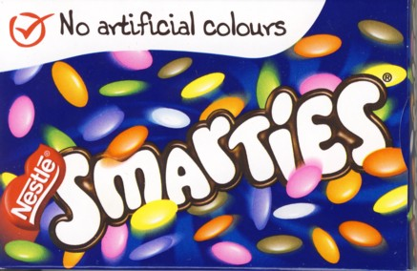

Health Promotion.
Environmental Interventions.
Legislative
Productions of Goods.
  E.g. Beef.
  E.g. E numbers.
Safeguard our Natural Environment.
  Beach flag system.

Slide 33
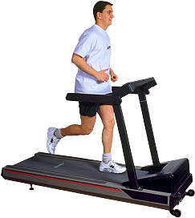

Health Promotion.
Behavioural Intentions.
Individual.
Empowerment.

Slide 34
Behaviour Change Approach in Health Promotion.
Changing individuals Cognitions.
Decision Makers.
Need the Information.
Health Education.

Slide 35
Social Cognition Models.
Health Belief Model (Becker, 1974).
Theory of Reasoned Action (Fishbein and Ajzen, 1975).
Theory of Planned Behaviour (Ajzen, 1985).
Transtheoretical Model (Prochaska and DiClemente, 1983).

Slide 36
Models of Behavioural Change.
Health Belief Model.
Initially developed by Rosenstock (1966).
Becker and colleagues (70’s and 80’s).
Predict preventative health behaviours and also behavioural response to treatment in acute or chonically ill patients.

Slide 37
Models of Behavioural Change
Health Belief Model
The Likelihood of changing behaviour depends on the person’s perceptions of the severity of the health risks and appraisals of the costs and benefits of taking action.
  Becker and Maiman, 1975 (cited in Weinberg and Gould, 2001).

Slide 38
Components of HBM.
Behaviour is a result of a set of core beliefs.
  Susceptibility to illness.
  Severity to illness
  Costs involved in carrying out behaviour.
  Benefits.
  Cues to action.
    Internal (e.g. Physical Symptom).
    External (e.g. Health Promotion Leaflet).

Slide 39
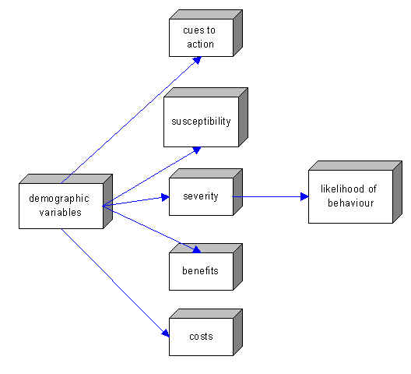

Slide 40
HBM Model and Smoking.
Consider how the issue of smoking is dealt with by the HBM.

Slide 42
HBM and Smoking.
How susceptible they are to lung cancer and other smoking related conditions.
How serious these conditions are.
The extent and Value of the benefits of giving up smoking.
The potential negative consequences of giving up smoking.

Slide 43
HBM.
Applied to a wide range of health behaviours.
Successful in predicting health behaviours (Sheeran and Abraham, 1995).
Each variable correlates with the behaviour and behaviour change (Marks et al, 2007).

Slide 44
Contradictory findings.
Other studies have shown that LOW perceived severity are related to healthy behavioural intentions.
What are the best predictors – differing results.
  Beker and Rosenstock – Costs, benefits, severity.
  Janz and Beker – Susceptibility.

Slide 45
Criticisms of HBM.
All focused on conscious processing – Do we consciously process EVERYTHING?
What about the role of social and economic environment?
What is the relationship between the beliefs?

Slide 46
Criticism of HBM
What about fear or denial?
What about outcome expectancy?
Individual Differences – is it flexible?

Slide 47
HBM
Other beliefs added in response to criticisms.
  Health Motivation – Readiness to be concerned.
  Perceived Control – e.g. Confidence, within capabilities.

Slide 48
Theory of Planned Behaviour.
(Azjen and Madden, 1986)
Progression from Theory of Reasoned Action.
Behavioural Intensions are the outcome of a combination of several beliefs.
Intentions “plan of action in pursuit of goals”.

Slide 49
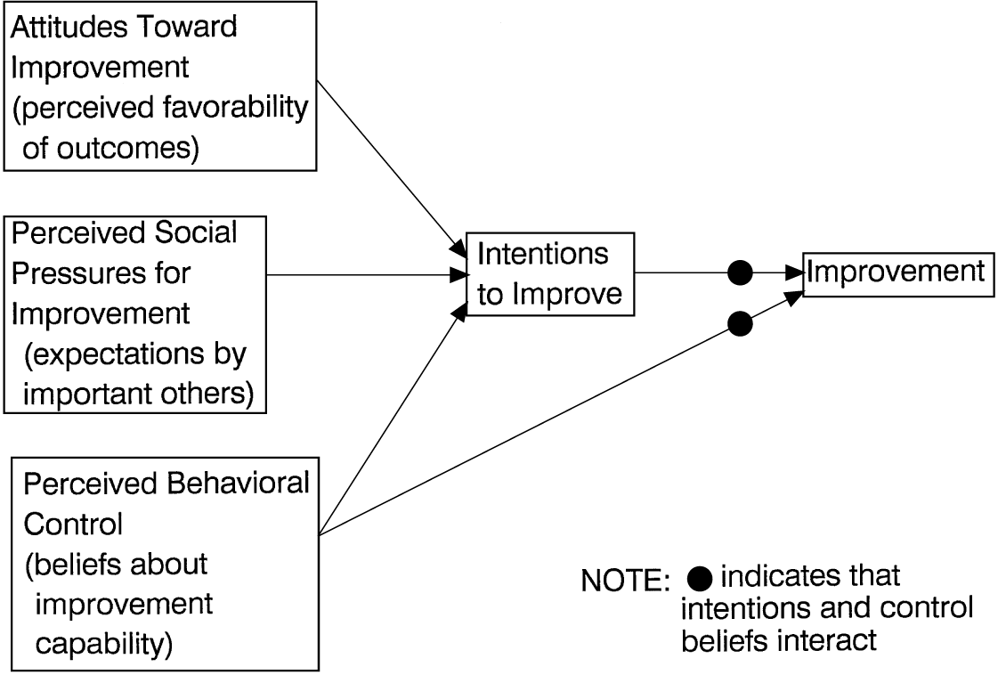

Slide 50
Components of TPB.
Attitude towards the Behaviour.
  Positive and Negative Evaluation.
  Beliefs about Benefits and Outcomes.
Subjective Norms.
  Peer Pressure (people will want).
  I want to do this so people can be proud.
Behavioural Control.
  Internal (e.g. skills, ability) and External factors (obstacles, opportunities).

Slide 52
Theory of Planned Behaviour
Case Study.
Clinically obese individual warned by the doctors that he must diet AND exercise immediately or suffer serious health failure.
He is currently ignoring all advice from the Doctor.
Use the factors associated with the Theory of Planned Behaviour as the basis of an intervention strategy / strategies in an attempt to get him to change his behaviour.

Slide 54
Support for TPB.
Brubaker and Wickersham – testicular self-examination – showed correlations with.
  Attitude towards Behaviour.
  Subjective Norm.
  Behavioural Control

Slide 55
Transtheoretical Model.
Prochaska & DiClemente (1983).
Used in Several Areas of Health Psychology.
  Alcoholism
  Smoking Cessation.
  Exercise Adherence.
  Treatment of Anorexia Nervosa
Behaviour is Changed via 5 cyclic stages.
  Pre-contemplation.
  Contemplation.
  Preparation.
  Action.
  Maintenance.

Slide 56
TTM
An individual progresses through five cyclic stages.
1. Pre-contemplation Stage – (does not have any desire to change behaviour).
2. Contemplation Stage – (has “fleeting” thoughts of changing behaviour – but doesn’t make any changes).

Slide 57
TTM
3. Preperation Stage (makes some behavioural adjustments…. E.g. enquires about local gymnasiums).
4. Action Stage – (Has changed behaviour but for less than six months).
5. Maintanence – (Has changed behaviour for more than six months).

Slide 58
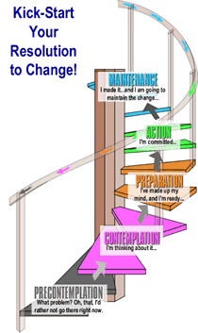

Slide 59
Transtheoretical Model.
Factors that influence an individuals progress through these stages.
Self Efficacy.
  Self Efficacy = Positively Correlated with Behavioural Change.
Decisional Balance.
  Pro’s and Cons of changing behaviour.
10 processes of change.
  5 Cognitive Processes.
  5 Behavioural Processes.

Slide 60
Process of Change.
5 Cognitive Processes.
Consciousness Raising.
Dramatic Relief.
Environmental Re-evaluation.
Self Re-evaluation.
Social Liberation.

Slide 61
Processes of Change.
5 Behavioural Processes.
Counter-Conditioning.
Helping Relationships.
Reinforcement Management
Self-Liberation.
Stimulus Control.

Slide 62
Improving and Maintaining Adherence.
Based on the Processes of Change.
Education (Gudas et al, 1991).
  Increase awareness of the Benefits of Exercise.
  Increase awareness of the problems associated with non-exercise.
Changing Routine.
  Increasing every day physical activity first (Prasad & Cerny, 2002) .
Making it easier to exercise.
  Community Based Programmes (Prasad & Cerny, 2002) .
    Practical issues (Prasad & Cerny, 2002) .

Slide 63
Improving and Maintaining Adherence
Social Support.
  Friends demonstrate commitment
    Lifts to the Exercise Centre
    Training Partners.
  Health Care team demonstrate commitment/enthusiasm.
    Provide education and social support = Schneiderman et al (2000).
    Positive Attitude to Exercise (Prasad & Cerny, 2002)

Slide 64
Improving and Maintaining Adherence.
Increasing Motivation.
Applying Goals (Cobb et al, 2000).
  Short term Goals.
  Long term Goals.
  Performance/Outcome Goals.
Rewards.
  E.g. Trainer of the Week.
Enjoyable Activities.
  ↑ Self Esteem = ↑ Motivation ↑ = Adherence.

Slide 65
Improving and Maintaining Adherence.
Stimulus Control.
  Use of Reminders, diaries etc (Prasad & Cerny, 2002)
Re-evaluating the Pro’s and Con’s.
  Individualised.
↑ Self-Esteem.
  Cognitive Behavioural Therapy (CBT’s = Whelan et al, 2007).
  Interventions based on Self-Efficacy Theory.
    Performance Accomplishments – Harter, 1987.
    Vicarious Experiences
    Verbal Persuasion
    Emotional Arousal
    Physiological Arousal.
    Imagery.

Slide 66
Criticisms of the TTM
Stage based intervention.
  Mixed results – more recent studies have highlighted that stage based interventions are not effective (Biddle et al, 2005).
  Is Stage Based intervention successful for all health behaviour – maybe not so much Alcohol (Orford, 1992).
  Is Stage progression the only thing that counts? (Campbell et al, 1994).

Slide 67
Criticisms of the TTM
What about regression and stage skipping, does this take place?
It could be considered a “framework” in that it doesn’t state which processes of change are most significant.
Decisional Balance – pro’s and con’s – is it the number of pro’s and con’s or the significance of each one?

Slide 68
Implications for Health Practice.
Little discussion of EXACTLY how the insights of these social cognition models could inform the design of health promotion interventions.
Divide between academics and practitioners.

Slide 69
Does Social Cognition Models tell us anything about how beliefs, attitudes, perceptions and values can be altered?

Slide 70
Well TTM does sort of (ish) with the processes of change, but researchers didn’t give clear examples.

