Slide 1
Happiness
Realistic or Selfish?

Slide 2
Cantril’s Ladder

Slide 3
Some Fundamental Questions on Happiness
Is greater happiness realistically possible?
If so, to what extent is that in our own hands?
How can we get happier?
What things should be considered in the choices we make?
How does the pursuit of happiness fit with other things we value?

Slide 4

Barriers to Happiness..
What are your personal barriers to happiness?
  Age?
  Relationship?
  Friendships?
  Children?
  Genetics?
  Social exclusion?
  Loneliness
  ACEs?
  Mood?
  Health?

Slide 5
A Life on Autopilot
Our brains work in two ways, consciously and unconsciously, this activity takes up about 25% of our physical energy. The brain takes a lot of feeding!
The conscious brain is used for processes involving logic, rationality and higher levels of cognitive processing (very tiring).
The subconscious is a more efficient mechanism. It is good at looking for patterns and similarities in what we are experiencing and how this compares to what we have experienced previously.
We cannot consciously deal with every detail of our lives. The snag is that the subconscious can tend to take over, not easy to switch it off.

Slide 6
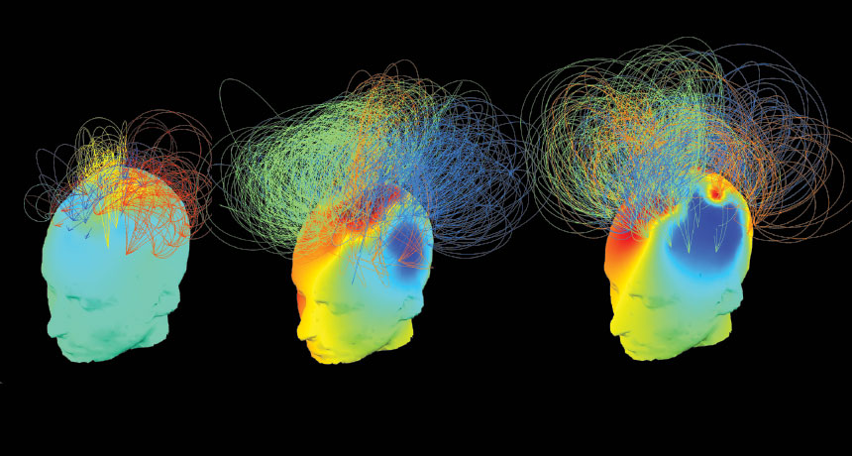
Result

Slide 7
Subconscious Mind
When we are on autopilot, our subconscious is in control. This means that we tend to be very reactive to the world around us.
When we are in autopilot we make snap decisions which are often bad ones. Think being tired, soft drinks, pizza.
Autopilot feels a little bit numb. It’s passive. It’s disconnected. When it kicks in it often feels like we are on our own and we are in a fight for survival.
When in this state we either busy ourselves with thoughts, plans, actions, or often we enter a twilight zone in which our brains are drip fed by digital devices, social media, gaming, television.

Slide 8
Being Conscious
The opposite end of the spectrum is where we wake up.
This is a truly connected and conscious state, think of a moment when you have experienced a moment of crystal clarity. A fleeting glimpse of how wonderful life can be.
When conscious, think about the difference between reacting and responding.
What sparks this consciousness?
Walking in the countryside on a stunning day, or hearing a piece of music that strikes a chord with us, or as we hold a loved one close to us. Bereavement can also act to make us conscious.

Slide 9
How to become more Conscious?
Action: close your eyes, remember a time when you have been fully awake, alert. Take a deep breath and remind yourself how it felt to be fully awake, to be aware and in the moment.
What was your mind like in that moment?
What emotions bubbled at that time?
What was the sense of connection like to yourself, to others and to the planet?
What was it about this moment that felt different from how you feel when you are on autopilot?

Slide 10
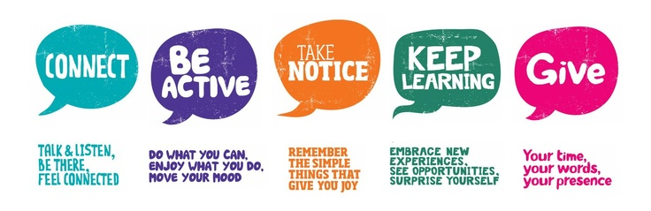
Five Ways to Well-Being

Slide 11
Evidence
Reminiscence groups reported greater increases in the percent of time they felt happy over the past week than the control group; and happiness increased more in the cognitive imagery group (Bryant et al, 2005, p. 227).

Slide 12
Bryant, FB, Smart, CM, and King, SP. (2005) Using the Past to Enhance the Present: Boosting Happiness Through Positive Reminiscence. Journal of Happiness Studies, Vol. 6 (3), pp. 227-260.
Veenhoven, R. (2015) Informed Pursuit of Happiness: What we should know, do know and can get to know. Journal of Happiness Studies. Vol. 16 (4) pp. 1035-1071.

