Slide 1
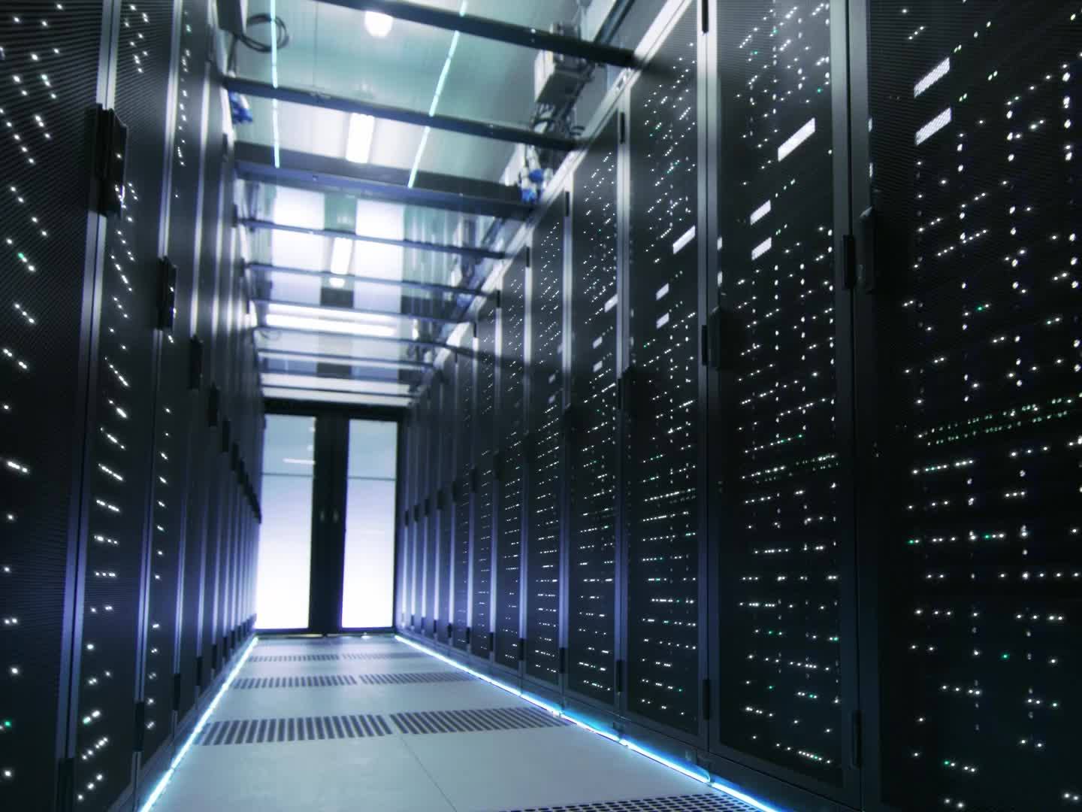
Strengthening Cybersecurity at FinSecure Ltd
Leo Richards
Networks and Cyber Security Essentials

Slide 2

Agenda
• Introduction
• Threat Landscape
• Security Policies
• Mitigation Measures
• Incident Response & Monitoring
• Training Program
• Conclusion

Slide 3
Introduction
FinSecure Ltd has recently experienced phishing attacks and unauthorized access.
This presentation outlines:
• Identified threats
• Recommended security policies
• Mitigation strategies
• Monitoring & training approaches

Slide 4
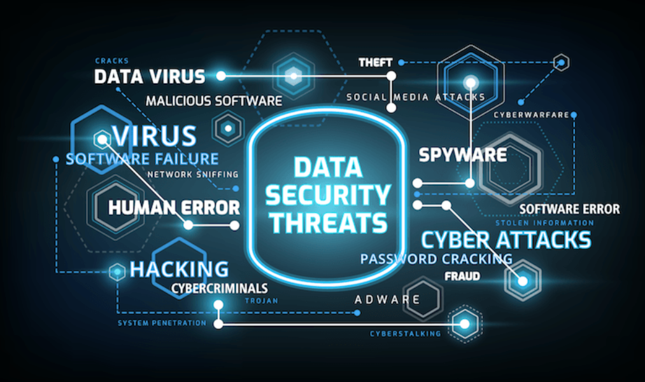
Cybersecurity Threat Landscape
• External threats: Phishing, malware, credential theft
• Internal threats: Malicious insiders, human error
• Increased risk from remote work and mobile device usage

Slide 5
Core Security Policies
• Data Protection & Privacy
• Access Control & Network Security
• Remote Work Policy
• Mobile/BYOD Policy
• Acceptable Use Policy

Slide 6
Key Mitigation Measures
• Email security: SPF, DKIM, DMARC, filtering
• Endpoint protection & patch management
• VPN + MFA for remote access
• Network Access Control (NAC)
• Zero Trust Architecture

Slide 7
Incident Response & Continuous Monitoring
• Follows NIST IR Framework:
- Preparation
- Detection & Analysis
- Containment & Eradication
- Recovery
- Lessons Learned
• Tools: SIEM, UEBA, SOC, on-call teams

Slide 8
Employee Training & Awareness
• Regular phishing simulations
• Secure remote work practices
• Data protection and compliance
• Clear reporting procedures
• Role-based, gamified learning

Slide 9

Conclusion
• Threats will continue to evolve
• FSL must adapt with policy, technology, and awareness
• A culture of cybersecurity resilience is essential

Slide 10
References
[1] keepnetlabs.com, 2025
[2] CISA, 2024
[3] DataGuard, 2024
[4] usecure.io
[5] bitsight.com
[6] threatcop.com

