Slide 1
Religions in Africa
Prof Bettina E. Schmidt

Slide 2
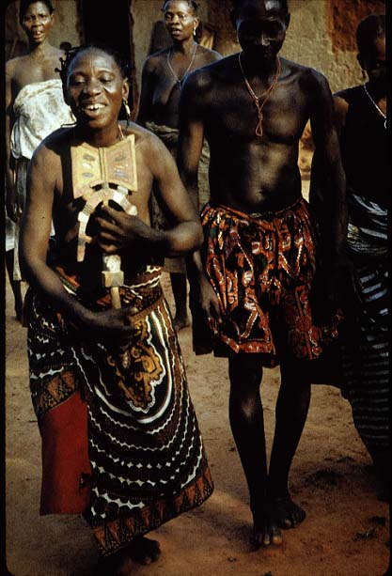
Topic
African Traditional Religions:
  Beliefs and Practices

Slide 3
Core Reading
Olupona, J. K., African Religions: A Very Short Introduction (Oxford: Oxford University Press, 2014).

Slide 4
Prelim
Diversity of religions in Africa
In addition to a range of traditional religions also Islam and Christianity (or better Christianities) as well as Hinduism and even Judaism (the latter both due to immigration to Africa)

Slide 5
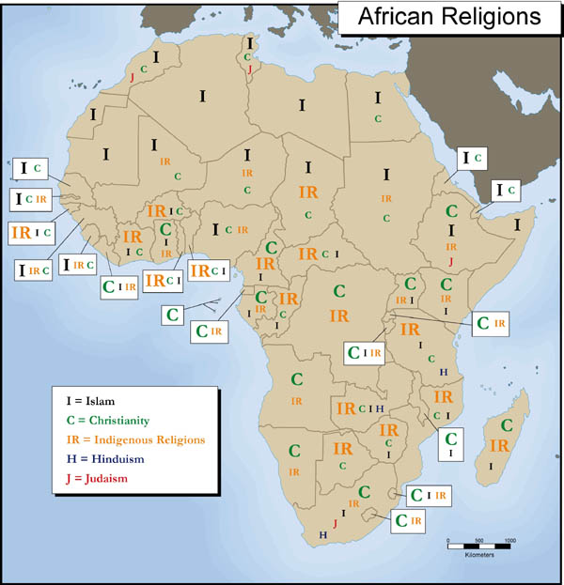
African religious landscape

Slide 6
Focus today on traditional (indigenous) religions
Often described as “African Traditional Religion” (ATR)
Better: African traditional religions as these religions are very diverse

Slide 7
Structure today
Worldview, cosmology, and myths of origin
  Gods, ancestors, and spirit beings
Sacred authority: Divine kingship, priests, and diviners
Ceremonies, festivals, and rituals

Slide 8
1. Worldview
“Religious worldviews, often distinct to ethnic groups, reflect people’s identities and lie at the heart of how they relate to one another, to other people, and to the world at large.” (Jacob Olupona 2014, p. 1)

Slide 9
Worldviews encode and influence ethical practices, taboos and the knowledge particular to each group
Key feature: religious worldviews permeate all parts of society such as economics and politics
=> different from church-state dichotomy in Euro-American societies
  remember: debate about the definition of religion last year

Slide 10
Religion is not a separate entity
Religious beliefs inform every aspect of life in Africa, including birth and death, marriage, family, even diet, dress, grooming and health care, interaction with friends and neighbours, and governance

Slide 11
Three-tiered worldview
human world is between sky and earth
Porous border between the human realm and the sky which belongs to the gods
Porous border between the human realm and the earth where ancestors dwell

Slide 12
Integrated cosmology
Universe is fluid with agents from each realm interact with one another
=> gods and ancestors influence human space
=> visible and invisible are intertwined

Slide 13
Oral tradition
Worldview and cosmology embedded in oral narratives
=> flexibility as feature of African religions
“African traditional religions are communally maintained and routinely changed in response to people’s lived experiences and needs.” (Olupona,p. 5)

Slide 14
Core beliefs
Ancestors
Deities
Divination (= communication between human and sacred realms)
Sacred myths, e.g. about creation of the universe and its nature and structure

Slide 15
Example
Documentary on YouTube
Africa: Paper Gods

Slide 16
Pantheon 1: Deities
Gods and goddesses (=deities) inhabit a world primarily created for humans
  Extraordinary influence over day-to-day human affairs
Supreme God as the highest and most powerful being
  Often perceived as distant creator

Slide 17
Pantheon 2: Ancestors
Veneration of deceased parents and forebears = key feature of many religions
  Sometimes even perceived as equal important than the worship of deities

Slide 18
Pantheon 3: Spirits
Less powerful than deities and ancestors but also important
Often linked to place of family group
  Inherited from one’s family and place of birth

Slide 19
Example
Documentary on YouTube
The Bridge of the Spirits

Slide 20
2. Sacred authority
African chiefs, monarchs and elders fulfil political and religious roles
-> custodians and guardians of religious centres such as shrines, temples and even sacred forests
  comparison with role of Queen of England as head of Church of England?

Slide 21
Sacred (divine) kingship
Sometimes kings possess mystical, life-sustaining powers
-> their well-being is intertwined with well-being of community
-> subject to strict taboos
  e.g. It is not possible to address the king directly

Slide 22
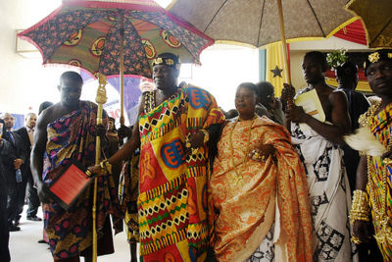

Slide 23
Example: Asante
The Queen mother of the Asante took over when the King was imprisoned by the British Army and continued the war against the British Empire

Slide 24
Divination
Divination = oracle reading, communication between the human world and the spirit world (gods, ancestors and spirits) in order to access secret knowledge to clients
Requires specifically trained and able people such as priests, diviners or traditional healers

Slide 25
Diviners can identify cause of problem and remedy
Different systems, e.g. numerology, spirit possession
  Often requires someone to translate message

Slide 26
“Sacred power is typically viewed in Africa as a morally neutral force than can be used for good and evil.” (Olupuna, p.55)
  Witchcraft and sorcery

Slide 27
3. Ceremonies
Ceremonies embody, enact and reinforce the sacred values communicated in myths
Often in calendrical cycles
  > dictate when communities have to honour a particular god or spirit or when a specific taboo has to be observed

Slide 28
Function
“Such events reinforces the bonds between humanity, ancestors, God and other deities. They function as modes of communication between humans and spirits. Most significantly, rituals enable supernatural beings to bless individuals and the community with longevity, children and sustenance.” (p. 56)

Slide 29
Rites of Passage
Mark personal transition from one social status to another
Coincide with birth and naming, circumcision or coming-of-age initiations, marriage, old age and death

Slide 30
Calendrical rites
Renew the community’s connection to the sacred
Marking important transitions such as change of seasons, the first harvest, or planting time

Slide 31
Burial rites
Linked to ancestor worship
Guarantee transition of deceased to life as an ancestor
And ensure that new ancestor is pleased with display of love from the family -> future favours for the living

Slide 32
Other festivals
in honour of deities or cultural heroes
“Festivals not only renew the bonds between ancestors and their progeny but also emphasis cyclical time as well as keeping track of the community’s legacy and orientation by carrying forward its predecessors’ memories.” (p. 71)

Slide 33
YouTube clip
Pilgrimage to African Gods

