Slide 1
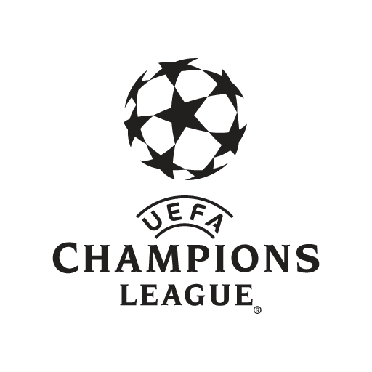
The champions League Final 2017
Marketing strategies

Slide 2

What is UEFA?
Union of European Football Associations – The governing body of European football.
An association of ‘associations’, a representative democracy and the umbrella of 55 national football associations of Europe.
Headquarters located in Nyon, Switzerland.
UEFA acts through its organs, which include; UEFA congress, the UEFA executive committee, the UEFA president and the organs for administration of justice.
(UEFA, 2017).

Slide 3
The champions League Final
“The eyes of the World will be on Cardiff – for 2017 Final” (Hamer, 2016).
Saturday 3rd June, 2017.
Real Madrid Vs Juventus.
At the Principality Stadium, central Cardiff.
Staging this large event would be a challenge for Cardiff due to the City’s size, in comparison to previous host cities, such as Madrid, London and Berlin (Hamer, 2016).
Transport could also be a potential issue. But officials were certain this wouldn’t affect UEFA final like it had affected Rugby World Cup the previous year (Hamer, 2016).

Slide 4
UEFA & Marketing
In 1992 the European Cup was altered into the Champions League (UCL) which sparked a revamp in terms of a new marketing strategy and brand identity.
For transformation of European club competition, UEFA formed an alliance with two former executives of ISL (international sport & leisure). Recognising growth potential, Klaus Hempel and Jurgen Lenz formed TEAM (television event and media marketing).
After guidance from UEFA, TEAM desired to apply a blueprint for sports marketing success, by comprising the synergetic qualities of football, sponsorship and television.
(Desbordes, 2007).

Slide 5
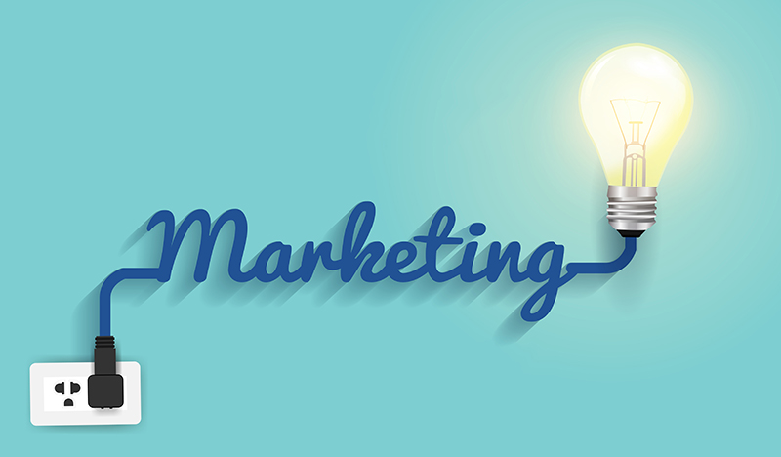
Marketing strategies
Sports events marketing.
Mass Marketing.
Social media marketing.
Brand marketing.
Partnerships / Sponsorships.
Notes:
What is strategy?
Utilising an appropriate marketing strategy is a crucial component for business accomplishment. Selecting the most relevant strategy requires knowledge of various other alternative marketing strategies and understanding how they operate under varying environmental and organisational conditions (Shaw, 2012).

Slide 6
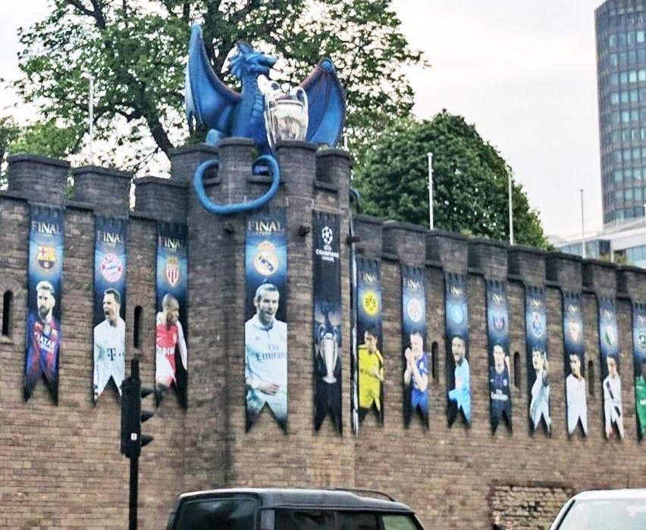
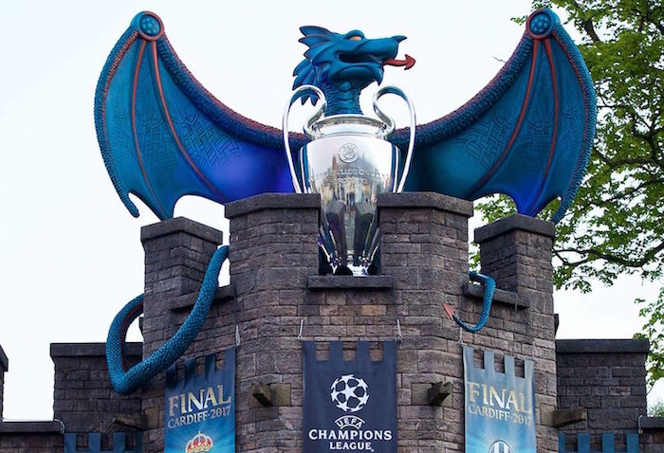
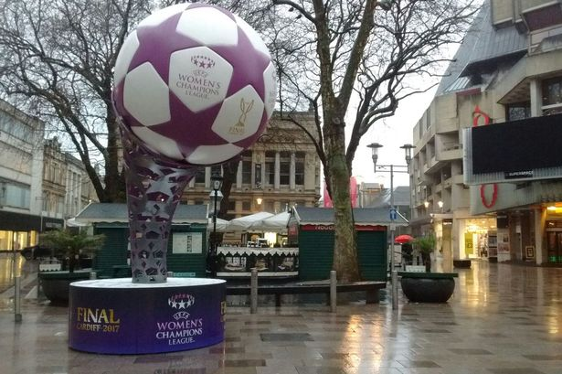
Mass marketing
UEFA Dragon and flags at Cardiff Castle.
Big football, city centre near shops, restaurants / bars.
Fan zone at Cardiff Bay with floating football pitch.
Notes:
Mass marketing implies that the same price, product, promotion and distribution system is correct for everyone involved. Whether that be the company, suppliers, consumers etc. And even though it has been a dominant marketing technique, technology advancements has meant that mass marketing is on the decline and companies are now introducing other differentiated methods to reach their target audience (Doyle, 2011).
UEFA’s mass marketing campaign may be demonstrated by the pop up spectacles throughout the city. This demonstrates mass marketing as the objects did not only grab the attention of fans that visited the city but also other visitors, including: shoppers, workers and people who originally live in the city. In that sense these objects targeted ‘everyones’ attention.

Slide 7
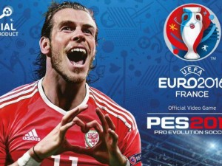
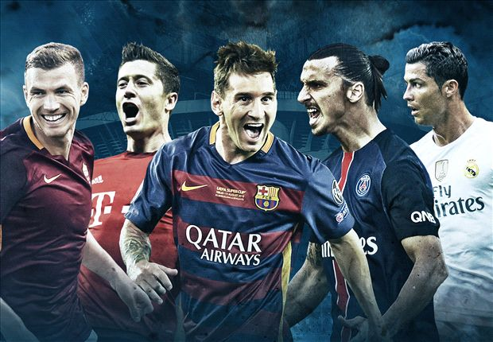
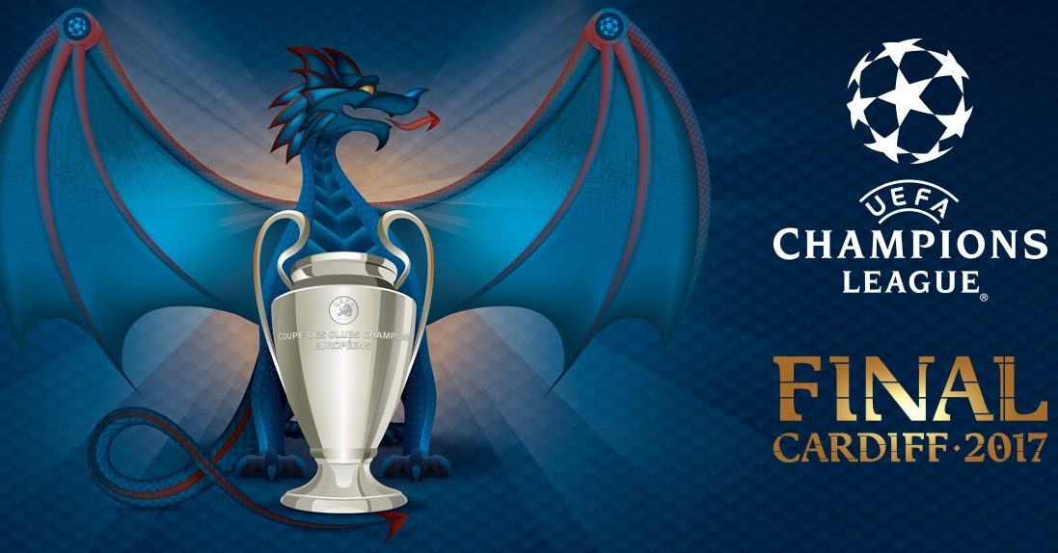
Sports events marketing
A subdivision of marketing. It focuses upon the promotion of sports events and teams, as well as the promotion of other products/services via the events and teams. For Example, Heineken (a beer brand) at the UEFA champions League final 2017.
There are 3 sectors of sports marketing, including;
Advertising sport and its associations.
Promotion of the event, team & individual athlete.
Promotion of sport participation amongst the public.
Notes:
UEFA uses sports events marketing to promote its global sports events such as the champions league and Europa league etc.
Sports events marketing - Sports marketing uses sports, in any form, to help sell goods and services. This particular style of marketing is less about using a single strategy and more about using the content of sports to assist marketing efforts (Marketing-schools, 2012).
1a) Benefits to sports event marketing – It allows marketers to target fans who are solely devoted to a specific team or player. A marketer who uses player endorsements instantaneously portrays credibility in the fan’s mind (marketing-schools, 2012). I.E UEFA using Gareth Bale in their marketing campaign for past event, Euro 2016.
1b) Drawbacks to sports event marketing – The industry is so vast that it can sometimes be difficult to stand out from the crowd. (I.e A fan who watches a football match may be subject to hundreds of differentiated marketing messages). Marketers need to advertise to a wide range of customers, this can be expensive and time consuming and sometimes may not grab the attention of spectators (marketing-schools, 2012). This could be demonstrated at UEFA’s Champions League Final, whereby the match had a vast amount of sponsors, via banners, adverts etc.

Slide 8




Social media marketing
A key element when planning a marketing strategy (Hutchingson, 2017).
Facebook
Instagram
Twitter
snapchat

Slide 9
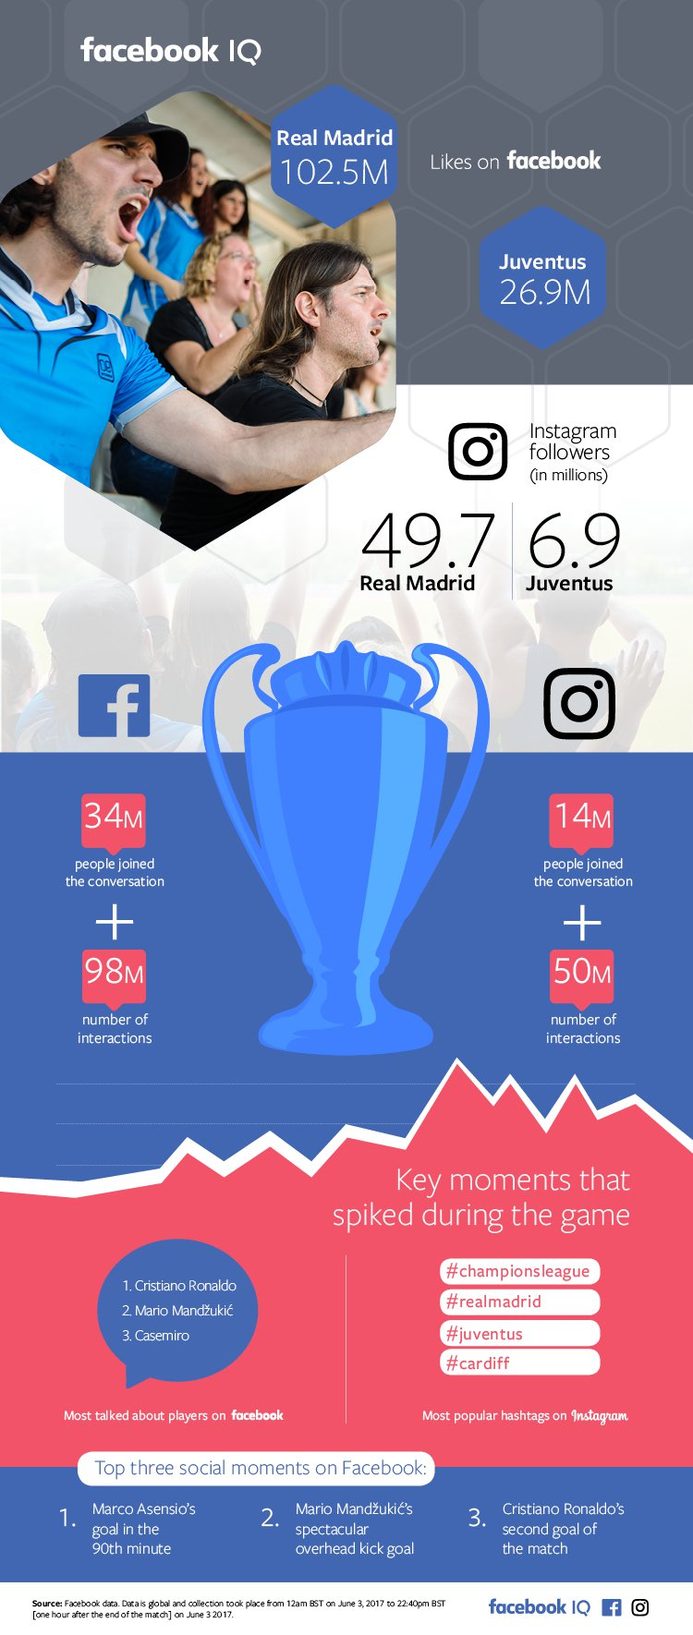
Facebook
(Facebook, 2017).
Notes:
According to Facebook, “football is the most watched sport” on the platform. The sport’s conversation on the social network was substantial.
“Across the globe on Facebook, 34 million people had 98 million interactions related to the Champions League Final, and on Instagram, 14 million people had 50 million interactions related to the match.“ (Facebook, 2017).
The most hash tagged topics on Instagram – ‘ChampionsLeague’ ‘RealMadrid’ ‘Juventus’ ‘Cardiff’ (Facebook, 2017).
The top five countries talking about the event on june 3rd, include:
Indonesia
Brazil
Mexico
Italy
Colombia
This demonstrates the power of UEFA as a recognised sporting association, and also creates huge destination promotion of Wales on a global scale.

Slide 10
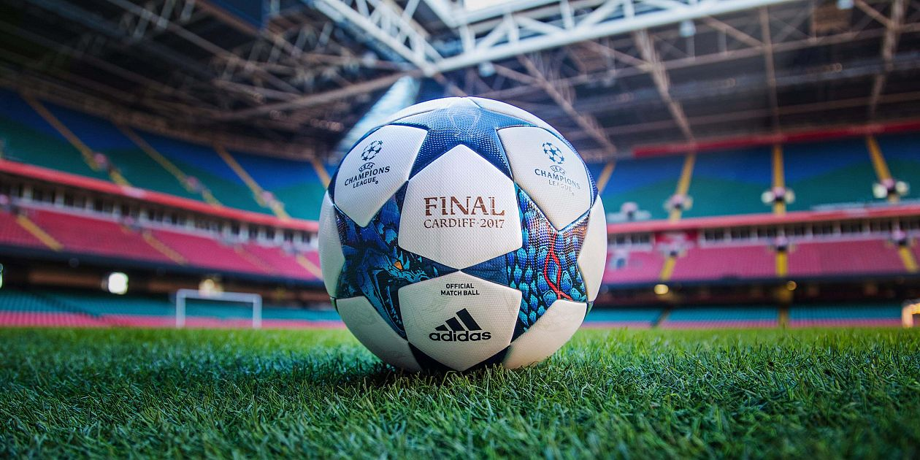
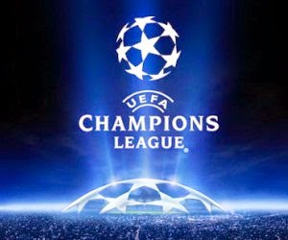
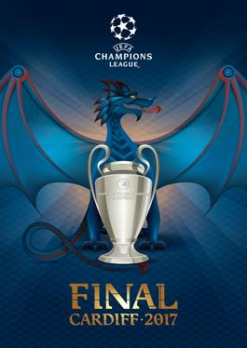
Brand Marketing
TEAM introduced the UEFA logo & ‘Starball’.
Replicas of ‘match’ balls are made and sold in shops, promoting the final and inevitably the Brand of UEFA.
Includes the location of the final and the year. ‘Final. Cardiff. 2017’
Addidas official ‘matchball’ sponsor of 2017.
Consistent and uniform, UEFA promotional banners around the city & stadium. ‘Principality’ taken off stadium and renamed as ‘Cardiff international stadium’. Allowing Cardiff to be recognised as an international destination.
UEFA placed flags and banners around the city, promoting themselves and the teams, Real Madrid and Juventus.

Slide 11
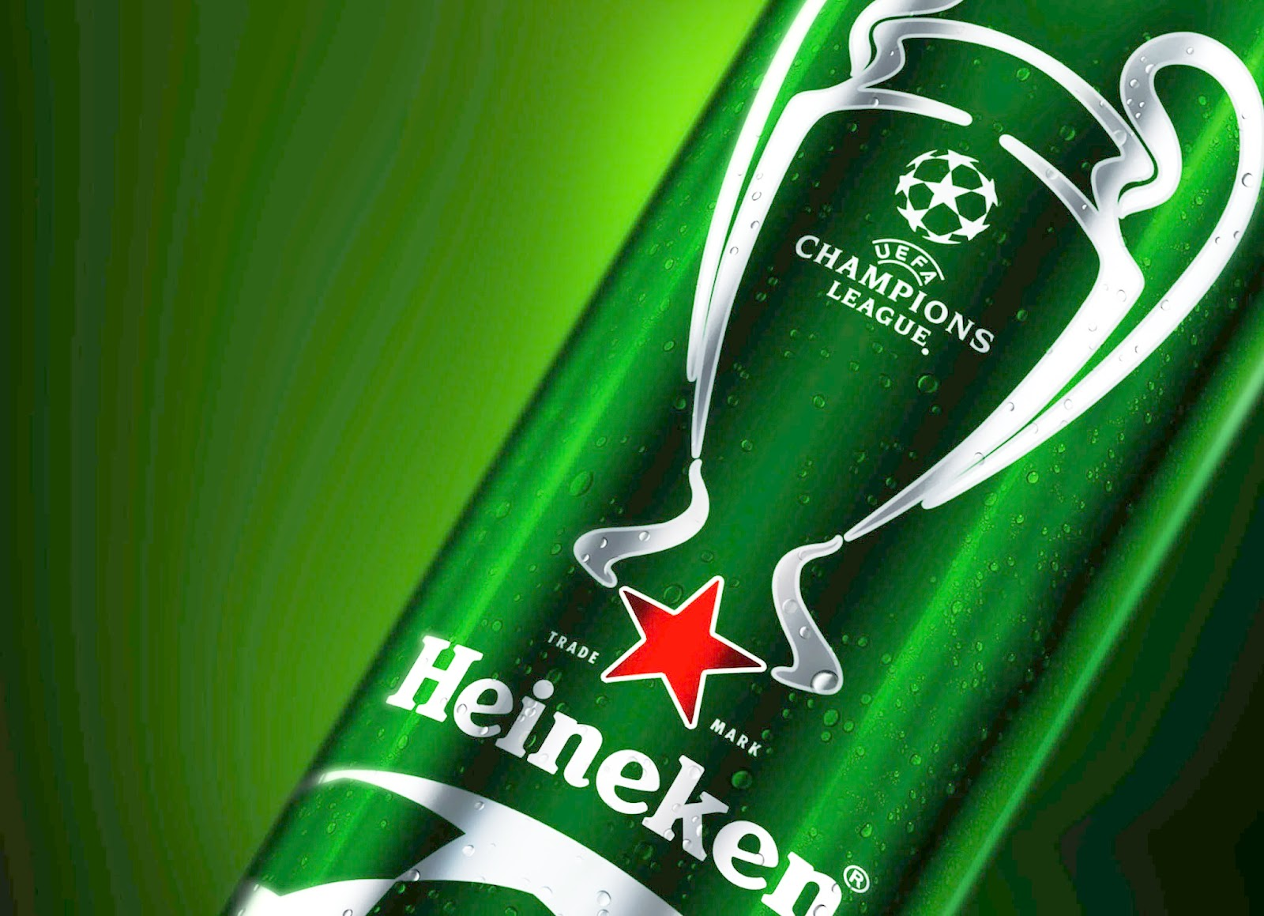
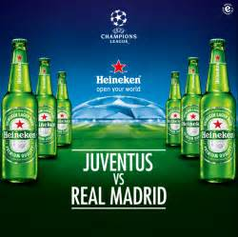

Partnerships / Sponsorships
Heineken international
Champions the match
VisitWales
2017 – The Year of the Legend
Bilingual marketing material in 6 languages: Spanish, German, Italian, French, Welsh and English (Lamb, 2017).
Notes:
Heineken’s partnership dates back to 1994 and is the longest-running supporter of UEFA. The Beer company ‘Heineken International’ has been a vital role in the promotion of UEFA Champions League Final 2017. They have promoted the event on a global scale (Targeted News Service, 2017)
It is also important to note that Heineken supports the continued success of UEFA’s international flagship competition and places the football association at the heart of their ‘award-winning’ and innovative marketing campaigns (Targeted News Service, 2017).
According to Epstein (2017) (UEFA’s events marketing director) “Having such an experienced partner, such as Heineken is an invaluable asset to us and reinforces our efforts to continuously improve and promote our club competition on a global stage”.
UEFA’s global ‘Champion the match’ campaign was live in over 100 markets in 2017. Via this marketing campaign, which showcased UEFA’s league trophy tour, it also created further fan engagement experiences which took the ‘buzz’ beyond the 90 minute match (Epstein, 2017).
Similarly, Visit Wales partnered with UEFA to integrate into ‘The Year of the Legend, 2017’ marketing campaign. Prior to the event, Visit Wales attended the ITB travel trade show as a means of promoting the event in Wales. The show links an estimated 120,000 media and trade representatives and 26,000 potential consumers. During the last two days, all efforts were made to promote WALES to the potential consumers (MENA Report, 2017).
Visitors to the stand at the show had the opportunity to be pictured with the UEFA Champion’s League trophies and Visit Wales also hosted a prize draw to win a ‘legendary’ week stay in Wales during June with tickets to spectate the women’s & Men’s Final.
Attendance to ITB travel trade show is one element which demonstrates a working partnership between Visit Wales and UEFA in an attempt to inspire visitors to come to Wales during 2017 and post event. ITB gives an excellent platform to raise awareness of the event and promote Wales as a destination and drive further long term visitor benefits to the region (Skates, 2017).

Slide 12
Champions League final 2017
&
Rugby World Cup 1999
Comparing marketing strategies of the Champions League Final to the Rugby World Cup 1999....
Rugby world Cup promotional ad 1999
https://www.youtube.com/watch?v=U9TgZc91WUE
UEFA Champions League Final promotional ad 2017
https://www.youtube.com/watch?v=nUatfj91ekM
Notes:
“The promotional video to promote Cardiff as a destination for the Rugby World Cup 1999” (Davies, 2012). There are clear differences between both marketing adverts, RWC 1999 promotional advert is lengthy in time and appears to be crowded with a substantial amount of visuals in regard to well-known places in Wales.
The Rugby World Cup 1999 ad video represents welsh culture with the promotion of welsh landmarks such as our castles and well-known places such as Tenby.
The advert demonstrates a mass marketing campaign where marketers have attempted to include everything which Wales offered at the time, in an attempt to grab ‘everyone’s’ attention.
UEFA Champions League Final 2017:
Clear of the location from the outset. ‘Cardiff 2017’. There is also a clear visual of UEFA branding and consistent music anthem played across all of UEFA’s competitions. However, there is a lacking of any further association with Wales and Cardiff as the host destination (Nelszon, 2017).

Slide 13
Champions League Final Vs Superbowl
In terms Advertising.....
According to Shaik (2017) The UEFA Champions League does not follow in the footsteps of American marketing.
UEFA’s advertising is recognised as strong, but by no means highly anticipated and consequently not deemed as valuable as the commercial marketing strategies which the Superbowl possessed.
American super Sunday V’s European super Saturday (Shaik, 2017).
Notes:
American super Sunday V’s European super Saturday
By allocating the Champions League final to a Saturday creates greater opportunity for a larger audience to be reached, whether that’s direct bums on seats at the stadium, fans watching via fan zone or people watching from home on televisions (Shaik, 2017).

Slide 14

In conclusion...
It is evident to see how global UEFA’s marketing campaign for the 2017 finals were during the event days.
The impact of the event had huge platform recognition across social media.
The extension of Heineken’s sponsorship.
UEFA Champions League final 2017 and Visit Wales partnership.
Notes:
Global marketing campaign.
Demonstrated by the consistent brand marketing throughout the city centre and bay area. UEFA transformed the city and branded it completely under its brand umbrella.
2) Social media marketing.
Facebook is just one example of a social media advent which experienced huge conversation and coverage of the final, highlighting further, that UEFA is a powerful association in which its marketing strategies can be experienced world wide.
3) Heineken extend sponsorship.
The international company extended its sponsor for 2018-2021 seasons due to its success during 2017 final. This demonstrates a cohesion of excellent partnership, whereby UEFA continues to be recognised as a global association and Heineken can continue to operate a integrated marketed campaign with UEFA.
4) Visit Wales partnership.
Again another successful aspect. The champions league final fitted retrospectively with Visit Wales own marketing campaign ‘The Year of the Legend’.

Slide 15

Recommendations
Visit Wales should continue to liaise with major events, as not only does it allow them to reach new audiences on a potential global scale BUT also promotes the region to domestic residents, further promoting the ‘Staycation’.
UEFA should consider incorporating an increased coverage of local culture within its marketing adverts, like the Rugby world Cup advert.
UEFA should also consider improving the social media link between snapchat users and event spectators, this may create better movement of people through the city if a major event was to occur again.

Slide 16
References
Beacham, R. (2017). the biggest single sporting event in the UK after the Olympics. Available: http://www.bbc.co.uk/news/uk-wales-south-east-wales-39530585. Last accessed 20.11.17.
Davies, G. (2012). Rugby World cup 1999 Cardiff Promo video. Available: https://www.youtube.com/watch?v=U9TgZc91WUE. Last accessed 30.11.17.
Desbordes, M (2007). Marketing and football: An international perspective. London: Routledge. p17-53.
Doyle, C (2011). Mass Marketing - Dictionary of marketing. London: Oxford university press. p1-188.
Epstein, G.L (2017). In Heineken Extends UEFA Club Competition Sponsorship. Available: https://search.proquest.com/docview/1863845469?accountid=130472. Last accessed 30.11.17.
Facebook. (2017). 2017 UEFA Champions League Final on Facebook and Instagram. Available: https://www.facebook.com/iq/articles/2017-uefa-champions-league-final-on-facebook-and-instagram. Last accessed 01.12.17.
Hamer, A (2016). In BBC News. (2016). Champions League: 'Eyes of world will be on Cardiff' for 2017 final. Available: http://www.bbc.co.uk/sport/football/36404999. Last accessed 20.11.17.
Hutchinson, A. (2017). How Users Engaged with the 2017 UEFA Champions League Final on Facebook and Instagram. Available: https://www.socialmediatoday.com/social-networks/how-users-engaged-2017-uefa-champions-league-final-facebook-and-instagram. Last accessed 24.11.17

Slide 17
Lamb, C. (2017). Marketing Wales to the world - The 2017 UEFA Champions League Final. Available: http://chcymru.org.uk/comms/CHC-Cartref/2017/10/23/marketing-wales-to-the-world-the-2017-uefa-champions-league-final/. Last accessed 01.12.17.
Marketing-schools. (2012). Sports marketing: explore the strategy of sports marketing. Available: http://www.marketing-schools.org/types-of-marketing/sports-marketing.html. Last accessed 23.11.17.
MENA report. (2017). United Kingdom: Jahr der Legenden 2017 at the world’s largest travel show. Available: https://search-proquest-com.ezproxy.uwtsd.ac.uk/docview/1890929410/abstract/57F45942D784E98PQ/1?accountid=130472. Last accessed 30.11.17.
Nelszon. (2017). UEFA Champions League Final Cardiff Intro, Mastercard and Pepsi. Available: https://www.youtube.com/watch?v=nUatfj91ekM. Last accessed 03.12.17.
Schaik, T. (2017). Superbowl vs UEFA champions League. Available: http://www.sportsnetworker.com/2011/05/25/super-bowl-vs-uefa-champions-league/. Last accessed 10.11.2017
Shaw, E. (2012). Marketing strategy. Historical research in marketing. 4 (1), p30-55.
Skates, K (2017). In United Kingdom: Jahr der Legenden 2017 at the world’s largest travel show. Available: https://search-proquest-com.ezproxy.uwtsd.ac.uk/docview/1890929410/abstract/57F45942D784E98PQ/1?accountid=130472. Last accessed 30.11.17.
Targeted News Service. (2017). Heineken Extends UEFA Club Competition Sponsorship. Available: https://search.proquest.com/docview/1863845469?accountid=130472. Last accessed 30.11.17.
UEFA. (2017). About UEFA. Available: http://www.uefa.com/insideuefa/about-uefa/index.html. Last accessed 22.11.17.

