Slide 1

Policing Terrorism and Human Rights
Wynne Jones

Slide 2
The Dilemma
For Governments to provide Safety and Security whilst protecting Human Rights.

Slide 3
Wilkinson (2007)
Spoke of the dangers of:
Overreaction,
Over reliance on military force
Measures that involve curtailment of democracy,
Abuses of Human rights and the Rule of law and the threat that these pose to democracy.

Slide 4
Northern Ireland- Discrimination
1966 : Catholic minority population discriminated against-politically, socially and economically.
Many had no vote as they were not ratepayers,
Electoral wards were ‘gerrymandered’ so that even where there was a Catholic majority there was still a Protestant council,

Slide 5
Northern Ireland- Discrimination
Allocation of Housing,
Employment: A West Belfast woman:
“ When I went for jobs, I found out I was asked if I was Catholic, not whether I had the qualifications. If I said I was Catholic, I was told the job was not available”

Slide 6
Northern Ireland- Discrimination
Harland and Wolff shipbuilders had a workforce of 100,000 only 400 were Catholic!
The Catholic Community described itself as “an oppressed minority”-they had plenty to be angry about.

Slide 7
Northern Ireland – Civil Rights
The Catholic minority demanded Civil Rights, the Protestant majority resisted, and many Catholics were persecuted, their homes burned down and many were driven from the areas in which they lived.
The Catholic community blamed the Police, who were largely Protestant for not taking action when this Sectarian violence took place.

Slide 8
Enter the Troops
The British Army were requested by Senior RUC officers as the rioting went beyond the control of the Police and were temporarily deployed to NI in 1969.
On their arrival they were welcomed by the Catholic community who saw the army as ‘protectors’ they were the ‘Good Guys’.
However, the arrival of troops saw the birth of the Provisional IRA.

Slide 9
Good Guys
The sight of heavily armed troops on the civilian streets of NI didn’t go down well on both sides perspectives, three events took place during early 1970 that shifted the mood of the Communities of NI.

Slide 10
Overreaction – A Recruitment Tool
‘Operation Motorman’ saw the deployment of 31000 troops tasked with tearing down barricades protecting Catholic ‘no go’ areas,
Internment without trial (almost entirely against Catholics),
Bloody Sunday (30th Jan 1972 British Soldiers shoot dead 13 during a Civil Rights march)

Slide 11

Remember Wilkinson
Overreaction?
Over reliance on military force?
Curtailment of democracy, Human rights and the Rule of law?

Slide 12
Community Effects
Stigmatisation of Community,
Fuel Resentment,
Bolster support for Terrorist movements,
‘Suspect Community’

Slide 13
The ‘Troubles’
Whilst the combined Military/Police approach failed to deal with the PIRA there were arguably some successes:
Numbers of those killed as result of terrorist attack reduced significantly:
1972 – 467 deaths
the late 1980's - 90’s less than 100 per year
Prevented escalation of troubles to civil war and made the peace process possible

Slide 14

the UK’s CT Network

Slide 15
Scotland Yards Anti Terrorist Branch (SO13)
The main burden of containing and defeating terrorists lies with the Police as the methods use to detect and prosecute persons for terrorism are similar to those used to detect and prosecute criminality.
To this end prior to the events of 7th July 2005 the National responsibility for the Investigation of terrorism lied with Scotland Yards Anti Terrorist Branch, a section of the Metropolitan Police Service,

Slide 16
Scotland Yards Anti Terrorist Branch
The partnership forged between the ATB and MI5 (supported by MPSB) had reaped rewards as the combination of the intelligence agencies together with the specialist knowledge relating to the terrorists modus operandi, weapons, tactics, bomb disposal and bomb scene management skills possessed by the specialist resources within the ATB paid off.

Slide 17
PIRA on the back Foot!
Arguably it was the successes of this partnership and the successful prosecution of a number of key PIRA players that brought about the ‘ceasefire’ called in 1994 and ultimately led to the ‘Peace Process’ following the election of the Labour government in 1997.

Slide 18

NI terrorist campaigns of the 1970's 1980's and 1990's
Lessons learned:
Police
Criminal justice system
Community leaders
Intelligence officers
politicians

Slide 19
MI5 and Crime
Following it’s success in gathering intelligence against PIRA there were calls for the Service to be used to tackle Serious Crime most significantly the illicit drug trade.
However, whilst MI5 focussed upon serious crime, PIRA and more latterly RIRA, as a result they neglected to identify the emergence of Al Qaeda and its affiliated groups

Slide 20
The Contemporary Wave of Islamism
The successes of the Iranian Revolution in 1979 and the multinational campaign against the Soviets in Afghanistan between 1979 and 1989 instilled in the minds of many young Muslims that they could ‘take on’ the US and were attracted by the ideology of a global jihad that appealed to a wide and disparate following in the Muslim world.

Slide 21
Birth of AQ
Following the Soviet withdrawal from Afghanistan in 1989 the group known as al-Qaida al Sulbah (‘The Solid Base’) began to support and assist local jihadist groups who opposed their governments in Muslim countries such as Algeria, Bosnia, Chechnya before developing its own Operational capability in close cooperation with a number of Egyptian Terrorist Groups (Egyptian Islamic Jihad, Islamic Group of Egypt) and becoming simply Al Qaida (The Base).

Slide 22
11th September 2001
The transformation of AQ from the ‘supporter’ or ‘facilitator’ seen during it’s early days to becoming Operational culminated in the attacks on the Twin Towers during which by recruiting Western educated Islamists they were able to strike deep inside the West. The resulting focus of the worlds security service forced the organisation to switch their attention to countries where it was easier to operate such as Indonesia, Pakistan and Chechnya

Slide 23
THE CHANGING THREAT

Slide 24
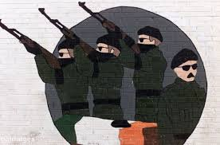
Irish Republican Terrorism
United Ireland
Hierarchal
Coded warnings
Non-suicidal
Infra structure
Targets and Collateral Death
Dialogue with HMG
Notes:
24
TIME SLOT 09.30am – 11.00am (DAY 1)
We can see here how the threat SB was countering, was changing over time and SB needed to evolve in its methods, practices and thinking to meet this new threat.
The UK was always considered as a safe haven due to its asylum and immigration policy.
In the aftermath of 9/11 and the UK’s involvement in military action in Afghanistan, it became clear that British interest were a priority target for AQ and associated networks:
A number of public statements by UBL, singled out Britain for criticism and encouraged attacks against UK
Disrupted plots overseas in 2001/2002 showed British targets being identified for attack especially Singapore and Gibraltar
The attacks in Istanbul in 2003 on HSBC and British Consulate which were the 1st successful attacks against British interest
Asylum dispersal post 2002 placed enclaves of asylum seekers into various pockets around the country.
USA very tight security especially at border control. UK is associate of the US and border control not as tight due to asylum and immigration laws and can therefore be more easily targeted and still harm western interests extending to USA.
It quickly became clear from emerging intelligence that the UK itself was a target and a growing number of plots were revealed between 2002 and 2004. By summer 2002 there were clear signs that Algerian Extremists Networks that had previously used the UK as a safe haven, were now planning attacks here!!!! ( (THE THREAT HAS CHANGED AGAIN!)

Slide 25
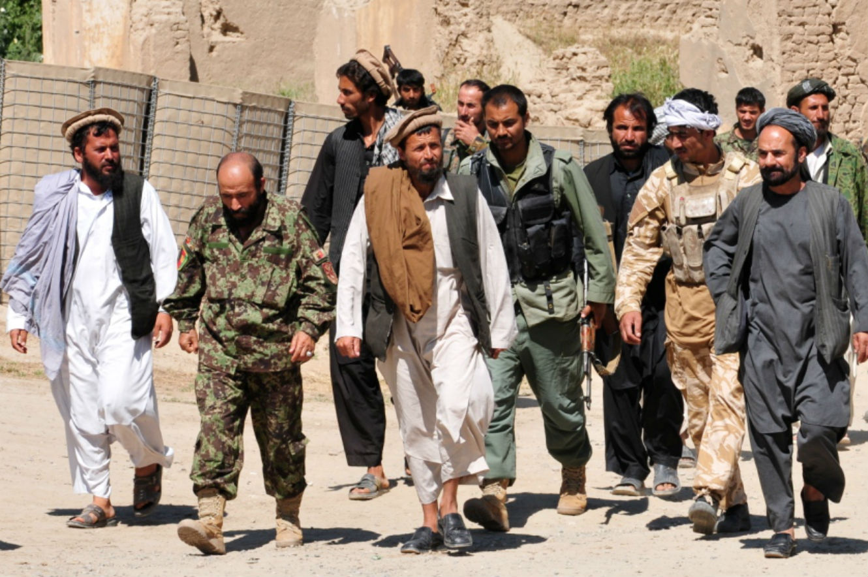
International Terrorism
An Interpretation of Islam
Disparate groups / individuals
Suicide
High collateral deaths
Vengeance
No dialogue with HMG
Recruited locally
Single Narrative
Notes:
25
TIME SLOT 09.30am – 11.00am (DAY 1)
We can see here how the threat SB was countering, was changing over time and SB needed to evolve in its methods, practices and thinking to meet this new threat.
The UK was always considered as a safe haven due to its asylum and immigration policy.
In the aftermath of 9/11 and the UK’s involvement in military action in Afghanistan, it became clear that British interest were a priority target for AQ and associated networks:
A number of public statements by UBL, singled out Britain for criticism and encouraged attacks against UK
Disrupted plots overseas in 2001/2002 showed British targets being identified for attack especially Singapore and Gibraltar
The attacks in Istanbul in 2003 on HSBC and British Consulate which were the 1st successful attacks against British interest
Asylum dispersal post 2002 placed enclaves of asylum seekers into various pockets around the country.
USA very tight security especially at border control. UK is associate of the US and border control not as tight due to asylum and immigration laws and can therefore be more easily targeted and still harm western interests extending to USA.
It quickly became clear from emerging intelligence that the UK itself was a target and a growing number of plots were revealed between 2002 and 2004. By summer 2002 there were clear signs that Algerian Extremists Networks that had previously used the UK as a safe haven, were now planning attacks here!!!! ( (THE THREAT HAS CHANGED AGAIN!)

Slide 26
Change of Intelligence Function
Following the Cold War MI5 were handed the intelligence function for Countering the PIRA on the UK mainland previously the responsibility of the Metropolitan Police Special Branch (MPSB)
They quickly Identified significant Intelligence ‘gaps’ and working in partnership with the Metropolitan Police’s Anti Terrorist Branch had substantial successes in capturing key PIRA suspects planning terrorist attacks.
Arguably these successes led to the PIRA ceasefire of 1994 and paved the way for the ‘Peace Process’.

Slide 27
11th September 2001
The invasion of Afghanistan that followed the Twin Towers attacks forced AQ to alter its hierarchical structure into a movement that comprised of loosely affiliated or ‘localised groups and in order to continue to spread it’s ideology to resort to intensive networking.

Slide 28
The Threat to the UK
As early as 2003 the Head of MI5 and the Commissioner of Police for London had expressed the view that it was not ‘if’ but ‘when’ the UK would be attacked by Islamist extremists associated with AQ.
The attacks that took place on the 7th July 2005 bore all the hallmarks of such an attack (no warning, mass casualties, maximise publicity)

Slide 29
CTU's and CTIU's
HMIC recommended regionalisation of CT activity to provide coordination of intelligence gathering activity
Intel gathering and handling in accordance with NIM
Through Tasking and coordination process they provide regional strategic assessments of terrorism and other threats
Standardisation of Special Branch procedures
Notes:
29
TIME SLOT 1.00pm till 2.00pm (DAY 1)
Bullet 1: this is in support of the identification and prioritisation of business
Bullet 4

Slide 30
Policing Terrorism – Government Responses

Slide 31
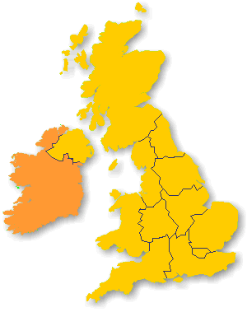
National Counter Terrorism Police Structure
  CTC
  North East CTU
  North West CTU
  Midlands CTU
  South East (2 units)
Northern
Grampian
  Scotland
  PSNI
  Wales (WECTU)
  East Midlands
  East
  South West
  + Force Special Branches
Central
Tayside
Scotland
Fife
Strathclyde
Lothian
&
Borders
Dumfries
Northumberland
&
P.S.N.I.
Galloway
Durham
Cumbria
North
Lancs
Yorks
West
Humberside
Merseyside
G.M.P.
Yorks
South
Cheshire
Yorks
North
Derbys
Notts
Lin
cs
Wales
Staffs
Norfolk
West
Leics
Cambs
West
Mids
Northants
Dyfed
Mercia
Warks
Beds
Suffolk
Powys
Gloucs
Herts
South Wales
Gwent
Thames
MET
Essex
Avon
Wiltshire
Valley
&
Surrey
Kent
Somerset
Hampshire
Sussex
Devon
Dorset
&
Cornwall
Notes:
31
CT units in and around the UK plus those in Scotland & NI
CTU’s counter terrorism units – explain location an set up – e.g intelligence and investigation
CTIU’s - explain the difference
CTIUs support the coordination of activity on a regional basis in accordance with the principles of the NIM. They develop regional strategic & tactical assessments on terrorism and other threats & coordinate regional responses. The CTIU manager is responsible for the running of the CTIU and for implementation of systems to ensure operational delivery throughout the region including operating standards, skills spread, training and operations preparedness and testing.
The work of the CTIU is divided into 3 areas:
Coordination such as operational standards (capacities databases) and training
Analysis
Intelligence cell work. (producing regional level 2 products)
The CTIU is effectively the regional SB office around which regional operational resources will be built.
National Special Branch Priorities – National Police CT and DE Strategic Assessment and Control Strategy
Implementation and development of the N.I.M within the Region Special Branches
Standardisation of Special Branch procedures
EXPLAIN SECURITY SERVICE ARE ALSO CO LOCATED IN ALL REGIONAL OFFICES – WHICH SUPPORTS GREATER PARTNERSHIP WORKING
REMEMBER TERRORIST ACTS AND INVESTIGATIONS OF THE TYPE SEEEN IN RECENT YEARS – ARE NO LONGER CONFINED TO SINGLE COUNTIES AND ARE MOSTLY CROSS BORDER AND INTERNATIONAL INVESTIGATIONS – THEREFORE A JOINED UP AND CONSISTENT APPROACH IS ESSENTIAL.
SO LETS DEMONSTRATE THIS BY GIVING YOU A CASE STUDY WHICH WAS BOTH A LOCAL. REGIONAL, NATIONAL AND INTERNATIONAL INVESTIGATION
CLICK
SB continues to develop! In 2006, TAM commissioned a review of CT structures and the recommendation was the creation of 4 CTUS. This is currently live and ongoing.

Slide 32
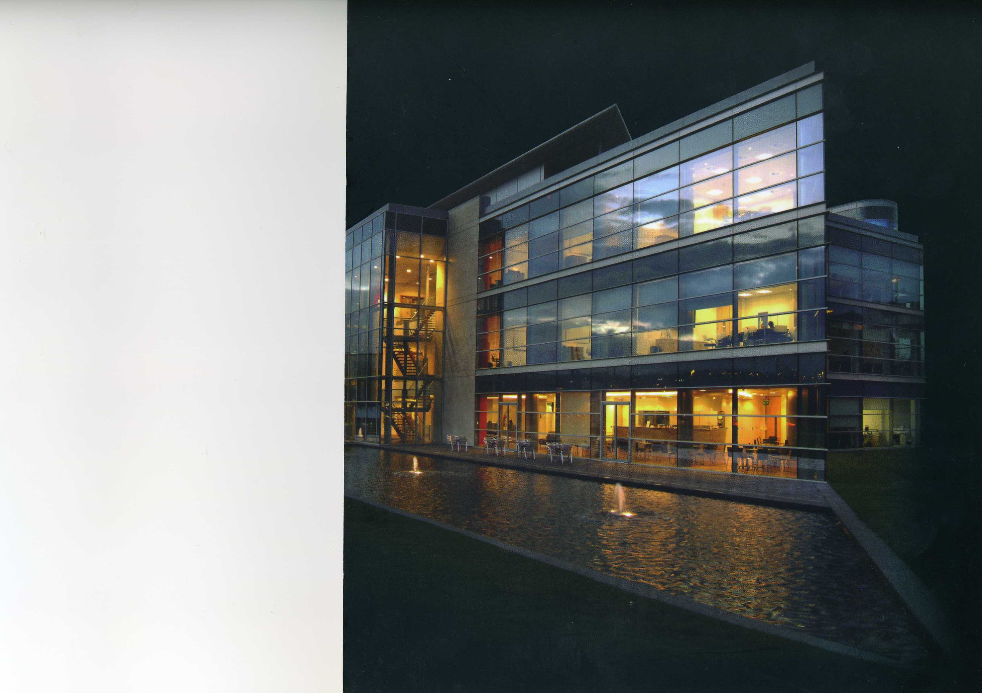
Head Of CTU
Detective Chief Superintendent
Business Support
Head Of Investigation
Detective Superintendent
Head Of Ops Support & Surveillance
Detective Superintendent
Head Of Intelligence
Detective Superintendent

Slide 33
Head Of Intelligence
Deputy Head Of Intelligence
Intelligence Manager
Office Manager & Admin Support
Source Controller
Domestic Extremism
Intelligence Development
Source Unit
Covert Operations
Field Intel Officers
Indexers & Researchers
Analysts

Slide 34
Head Of Ops Support & Surveillance
Deputy Head Of Surveillance
Surveillance Team Leader
Surveillance Team I
Surveillance Team II
Surveillance Team III
Community Intelligence Unit
Ports
Protective Security
Training & Development

Slide 35
Counter
Terrorism Ingtelligence
Unit
A typical structure
Notes:
CTIUs support the coordination of activity on a regional basis in accordance with the principles of the NIM. They develop regional strategic & tactical assessments on terrorism and other threats & coordinate regional responses. The CTIU manager is responsible for the running of the CTIU and for implementation of systems to ensure operational delivery throughout the region including operating standards, skills spread, training and operations preparedness and testing.
The work of the CTIU is divided into 3 areas:
Coordination such as operational standards (capacities databases) and training
Analysis
Intelligence cell work. (producing regional level 2 products)
The CTIU is effectively the regional SB office around which regional operational resources will be built.
35

Slide 36
Head Of CTIU
Detective Superintendent
Head Of Intelligence
DSU Controller
Ports
Intelligence Manager
Prevent
Intelligence Development
DSU
Protect and Prepare
Covert Operations
Field Intel Officers
Indexers & Researchers
Analysts

Slide 37
Force Special Branch
Roles and Responsibilities
Notes:
CTIUs support the coordination of activity on a regional basis in accordance with the principles of the NIM. They develop regional strategic & tactical assessments on terrorism and other threats & coordinate regional responses. The CTIU manager is responsible for the running of the CTIU and for implementation of systems to ensure operational delivery throughout the region including operating standards, skills spread, training and operations preparedness and testing.
The work of the CTIU is divided into 3 areas:
Coordination such as operational standards (capacities databases) and training
Analysis
Intelligence cell work. (producing regional level 2 products)
The CTIU is effectively the regional SB office around which regional operational resources will be built.
37

Slide 38
Role of Special Branch
Security Service Act 1989
Espionage
Sabotage
Terrorism
Counter Proliferation
Against WMD
Undermine or overthrow parliamentary democracy
Notes:
38
All intelligence about national security obtained by Special Branch is provided to the Security Service, which is the lead agency for the gathering; assessment; development/exploitation and dissemination of national security intelligence in the United Kingdom.
SBs are the link between the police service and the Security Service.
SBs assist the SyS in carrying out its duties under the Security Service Act 1989. This requires the SyS to protect national security and, in particular, protect against threats from:
Terrorism. We will be looking at a definition of terrorism later in the course.
Counter the proliferation of Weapons of Mass Destruction. This is the manufacture, distribution or acquisition of any Chemical, Biological Radiological or Nuclear WMD.
Foreign powers, politically or racially motivated groups may try to gain knowledge or the raw materials in order to develop WMD. Foreign powers may sponsor their nationals to acquire the necessary skills from British Universities or companies and feedback the intelligence. Espionage aka spying. We will again look at the current threats in more detail later in this course but foreign countries and states may wish to gain an advantage over the UK for financial, research, military or political aims. In order to gain this advantage they will task and recruit individuals, whether willing or by exploiting vulnerabilities, in identified posts to gain maximum access to sensitive materials. This could include you
Sabotage
And from actions intended to overthrow or undermine Parliamentary democracy by political, industrial or violent means.
These functions extend throughout the UK save that in NI the lead responsibility for investigating the threat from terrorism related to the affairs of NI lies with the PSNI
Combating terrorism is recognised as a key area for policing within the National Policing Plan for England and Wales and the Policing Plan for Northern Ireland and also a key policing priority for the Scottish Police Service. It is therefore the key function of SBs.

Slide 39
Role of Special Branch
Open sources of Intelligence
Crime
stoppers
Letters
Environmental scanning
Force control room
Other agencies
Notes:
39
Up until now an open source has been one that anyone has access to without using police powers.
Now a further consideration could be that you may be revealing the fact that you are a police officer but do not want to reveal that there is a National Security or CT involvement.
Therefore there may occasions when you will reveal a police interest but not the real reason behind the need for the information.
As can be seen many of these sources may be familiar to you from dealing with criminals but what may not be so familiar is the greater need to do so discreetly without leaving any trace at all that you were interested in a particular piece of information and we will look at this in a little more detail later.

Slide 40
Role of Special Branch
Other sources of Intelligence
CHIS
Crime recording
Intrusive or directed surveillance
SYS/SIS
Other National Units
Other agencies
e.g. UKIS
Field enquiries
Notes:
40
Up until now an open source has been one that anyone has access to without using police powers.
Now a further consideration could be that you may be revealing the fact that you are a police officer but do not want to reveal that there is a National Security or CT involvement.
Therefore there may occasions when you will reveal a police interest but not the real reason behind the need for the information.
As can be seen many of these sources may be familiar to you from dealing with criminals but what may not be so familiar is the greater need to do so discreetly without leaving any trace at all that you were interested in a particular piece of information and we will look at this in a little more detail later.
It might be possible or necessary to reveal a CT involvement when obtaining information from these sources but each case must be carefully considered before doing so.

Slide 41
Acquisition of Intelligence
What do we want to know
  Subject organisations
  Their key personalities/non-affiliates
  Infrastructure
  Plans
  Capabilities
Knowledge gained used to counter their activities
Notes:
41
So what do SBs want to know?
SB use a combination of intelligence gathering techniques in seeking to obtain a detailed knowledge of subject organisations, their key personalities, infrastructure, plans and capabilities. This knowledge assists in making intelligent decisions to counter the activities of terrorists and extremists. However, if details of the operational activity, or the identity of the individuals engaged in the activities were divulge, it would educate the subjects on tactical methods employed during an intelligence gathering operation or investigation. Many investigative techniques will require the application of operational security measures to protect sources and methods.

Slide 42

Policing Terrorism and human rights

Slide 43
Muslims in Britain today
The 2001 Census revealed there to be 1.6M Muslims living in Britain, by 2030 this number is estimated to grow to 5.5M,
In 2011 a study conducted at Durham University on behalf of the Equality and Human Rights Commission by Choudhury and Fenwick revealed that:

Slide 44
Demographics
60% of Muslims are under 34,
In 2010 87% of terrorist prisoners were Muslim,
There appeared a disconnect between what the Government described as the major threat to communities (CT) and what the communities believed were the major threats (Criminality).

Slide 45

But who are the Terrorists?
Whilst the UK Muslim population is acknowledged as being law abiding and peaceful research conducted post 7/7 indicated some support for the bombings one MP commented:
“Few terrorist movements have lasted for long without a ‘supportive community’.

Slide 46
But who are the Terrorists?
A supportive community does not condone violence, and certainly, most people in it would not want to become personally involved...whether or not they condone violence they see terrorists are sharing their world view, part of the struggle to which they belong.” (McGhee 2008:69).

Slide 47
So who are the Terrorists?
The suggestion of a ‘supportive’ rather than suspect community is a key point in the discourse surrounding the way in which Muslim communities are viewed as it implicates a far greater percentage of the Muslim population and it is this community support, sympathy or merely ‘seeing no evil’ which provides terrorists with the ability to plan and carry out their attacks (Lambert 2008).

Slide 48
UK Govt Responses to Terrorism
Body Scanners,
Section 44 Terrorism Act,
Schedule 7 Terrorism Act,
CONTEST (PREVENT),
CT Network,
ANPR
CCTV

Slide 49
Muslims in Britain Today
The new Suspect Community?
Many Muslims believe that they are treated as the new ‘suspect community’ and question the Governments stance that International Terrorism is the greatest threat to communities.
Many believe that the threat from drugs, gangs, unemployment and racist violence is greater than that of terrorism.

Slide 50
Muslims in Britain Today
The new Suspect Community?
Since 9/11 and 7/7 the overwhelming focus of CT work has been toward Muslim Communities,
The words “Muslim” and “terrorist” have become almost synonymous,
Concerns about the compliance of CT laws and policies with Human Rights (Section 44),

Slide 51
Remember Wilkinson
Overreaction?
Curtailment of democracy,
Human rights, and
The Rule of law?

Slide 52
Terrorism Legislation

Slide 53
Why Do we need Terrorism Legislation
To Provide the Police with Powers
To authorise Action to be taken
To Regulate Police Action

Slide 54
Why Do the Police need Powers
Need to Question People
Need to Search People and Premises
Need to Arrest People
Need to Seize and detain Property

Slide 55
The Terrorism Act 2000
Defined Terrorism *
Outlawed ‘Proscribed Organisations’
Provided new Stop and Search Powers
Provided new Border Powers
Provided new offences of Weapons handling/Training
Introduced new ‘fund raising’ offences
Introduced 'snooping charter re mobile telephone data

Slide 56
Terrorism Act 2000
Problems with Police Powers
Allegations that Police Officers abused this power as it required no ‘Reasonable Suspicion’
Less than 1% of stops under this power resulted in arrest
Many Photographers, tourists and train-spotters were stopped

Slide 57
Stop and Search
Section 44 of the Terrorism Act allowed Police officers to Stop and Search people without Reasonable Suspicion if a Senior Police Officer Considered it Advantageous to Prevent Terrorism.
A Ruling by the European Court of Human Rights declared this power to be unlawful and it has since been repealed.

Slide 58
Stop and Search
Section 44 was Replaced via a Parliamentary Remedial Order.
It States that:
"Authorising Officers should only use the power when they reasonably suspect that an act of terrorism will take place, and he / she considers it necessary to prevent such an act".

Slide 59
Stop and Search at Ports
The Guardian 2011 Reported:
“Asian people 42 times more likely to be held under terror law
People from ethnic minorities more likely than white people to be stopped under schedule 7 of the Terrorism Act”

Slide 60
Additional Legislation
Even though Lord Lloyds review of Terrorism Legislation and the Introduction of the Terrorism Act 2000 was supposed to bring terrorism legislation together more legislation was introduced following the 9/11 attacks most notably:
The Anti Terrorism Crime and Security Act 2001

Slide 61
The Anti - Terrorism Crime and Security Act 2001
This Act permitted the Home Secretary to indefinitely detain without charge or trial foreign nationals suspected of terrorism.
The Tory/Lib Dem Coalition scrapped Control Orders which had been ruled unlawful by the House of Lords and replaced them with Terrorism Prevention and Investigation Measures (TPIM’s)

Slide 62
Terrorism Prevention and Investigation Measures
If you are subject to the TPIM’s regime, you might not be able to:
Leave your house overnight, Go beyond the geographical boundaries decided by the Home Office
Take off your electronic monitoring tag, Talk to or meet with whoever you wanted
Stop the police or staff from the monitoring company entering and searching your home without a warrant
Have friends or family to your home unless approved by the Home Office, approval which can be removed at any time, Travel overseas
If you did any of these things in breach of the TPIM’s notice you could be put in jail for up to five years.

Slide 63
Investigatory Powers Act 2016
The so called 'Snoopers Charter' which allows the authorities 'hack' thousands of devices en masse,
Requires internet providers to collect browsing histories and make them available to public bodies,
Permits the mass collection of data .
Liberty (2019)

Slide 64
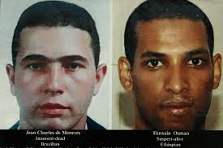
Policing Terrorism – some uk statistics
Since 9/11 over 300 people convicted on terrorism related charges
Over 70 people murdered including three police officers
Innocent member of public mistakenly shot

Slide 65
Grieve 2014 – advice to those concerned in CJS
'Do not overreact that is what the terrorists want you to do'
'Do not leave a festering mess for your successors'
'Try not to do anything stupid'
Contribute toward finding a balance between protecting a community and keeping its confidence'

Slide 66

Dilemma
Striking the balance between maintaining community trust and confidence without compromising secret intelligence operations

Slide 67
https://youtu.be/RX6x1HuOWeU

Slide 68
The Future? - English (2009)
Learn to live with some aspects and incidents of terrorism
Address the underlying causes
Avoid over militarisation
Follow Rule of Law
Recognise central role of intelligence
Coordinate all easures e.g. finance, technology, forensic
Counter narrative against terrorist rhetoric to undermine credibility

Slide 69
References
http://www.liberty-human-rights.org.uk/human-rights/terrorism/control-orders/index.php
http://www.guardian.co.uk/uk/2011/may/23/counter-terror-stop-search-minorities
http://www.guardian.co.uk/commentisfree/libertycentral/2009/jan/22/explainer-terrorism-legislation
http://www.independent.co.uk/news/uk/home-news/photographers-snap-over-use-of-section-44-by-police-officers-1833839.html
http://www.homeoffice.gov.uk/publications/counter-terrorism/terrorism-act-remedial-order/

