Slide 1
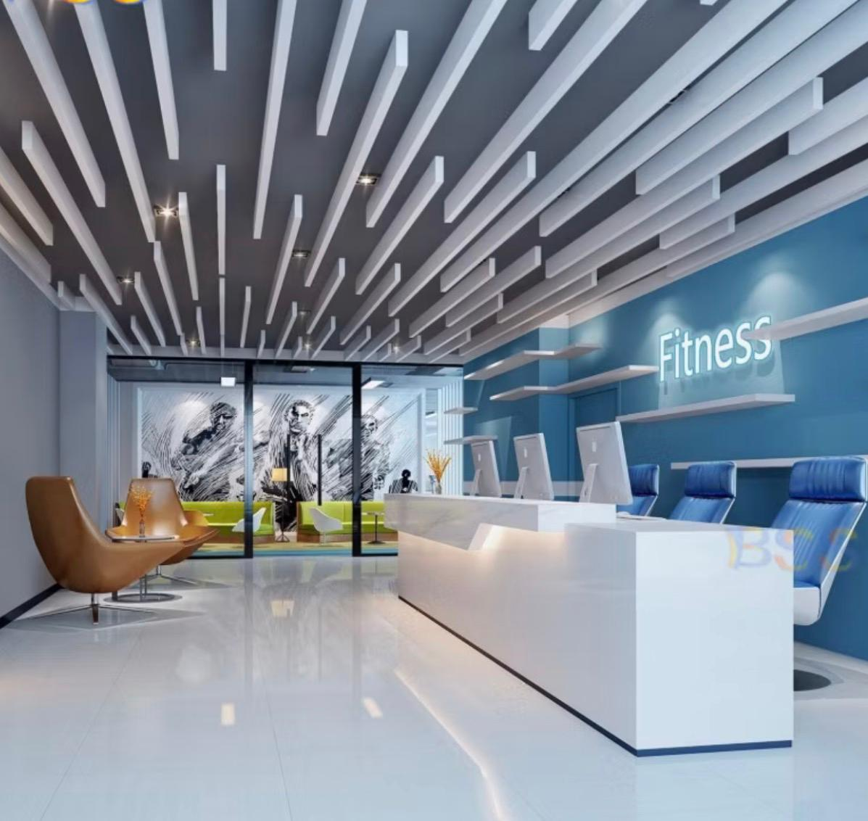
STUDENT NAME : SABIN GHEORGHE
STUDENT ID : 2213752
MODULE CODE : LCBB5012
LECTURE NAME : LIYANAGE RODRIGO
FITNESS & GYM RECEPTIONIST

Slide 2
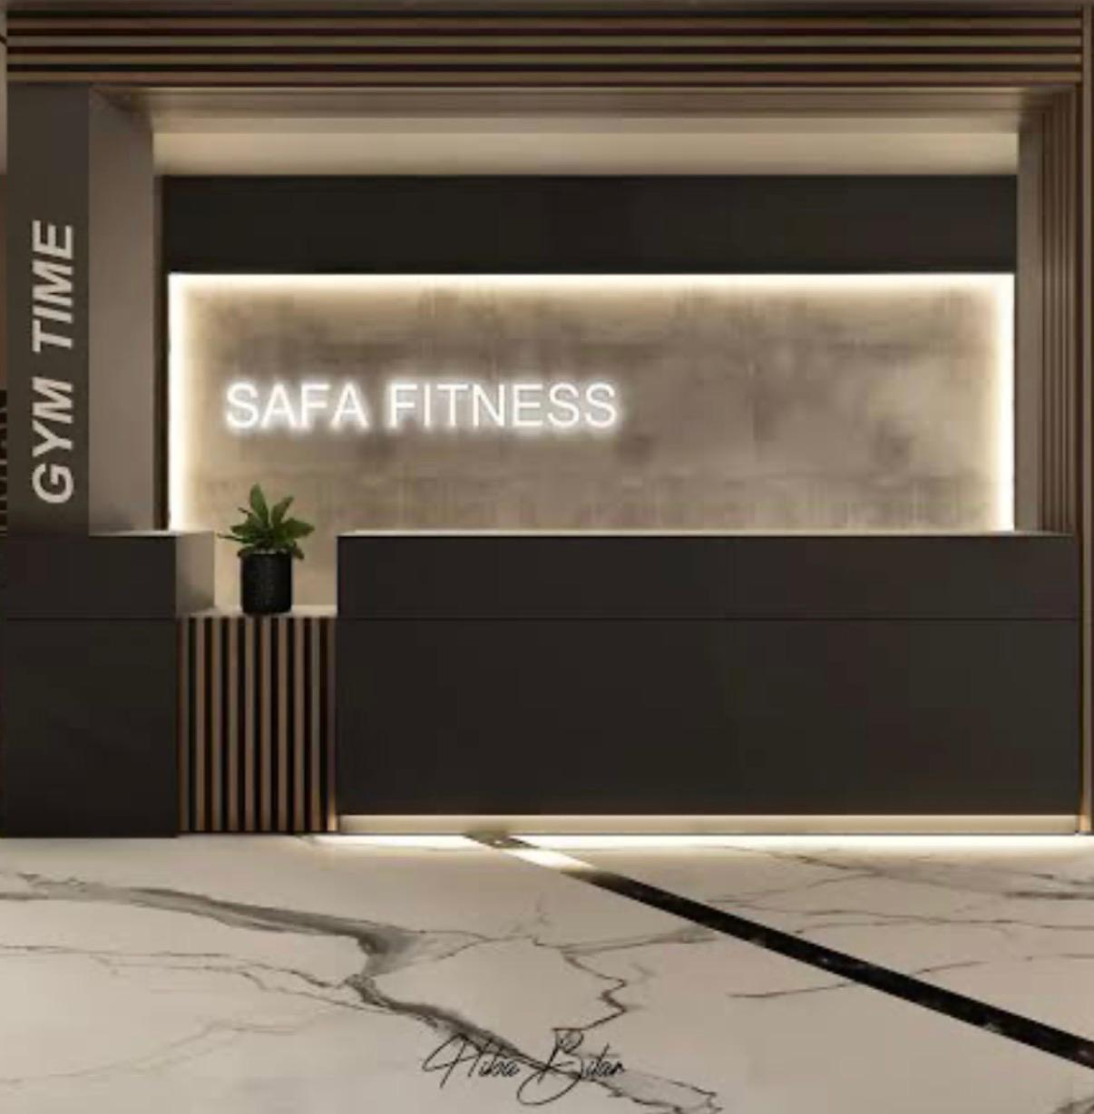
RECEPTIONIST ROLE OF FITNESS & GYM
The role of a gym receptionist is central to member engagement and operational efficiency. Receptionists serve as the first point of contact, responsible for greeting members, managing check-ins, scheduling classes, and processing memberships or payments. They also handle inquiries regarding fitness services, ensuring clear communication between clients and staff (Chelladurai & kerwin, 2018).
Beyond administrative duties, receptionists contribute to customer satisfaction by fostering a welcoming environment that promotes member retention (Zeithaml, Bitner, & Gremler, 2018). Effective performance requires strong interpersonal skills, organizational ability, and familiarity with fitness management systems (Pedersen & Thibault, 2014).

Slide 3

JOB DESCRIPTION
Gym receptionist
The gym receptionist fulfil a pivotal role in the daily operations of fitness center serving as the first point of contact for members and visitors. Primary responsibilities include greeting clients, managing check-ins, coordinating class schedules, and processing membership transactions. The role also encompasses handling inquiries, maintaining accurate records, and ensuring smooth communication between clients and staff.
Beyond administrative functions, the receptionist contributes to customer satisfaction by creating a welcoming environment, which is essential for member retention and organizational success (zeithaml, bitner, & gremler, 2018). Competence in interpersonal communication, organizational tasks, and management software is therefore critical (pedersen & thibault, 2014).

Slide 4
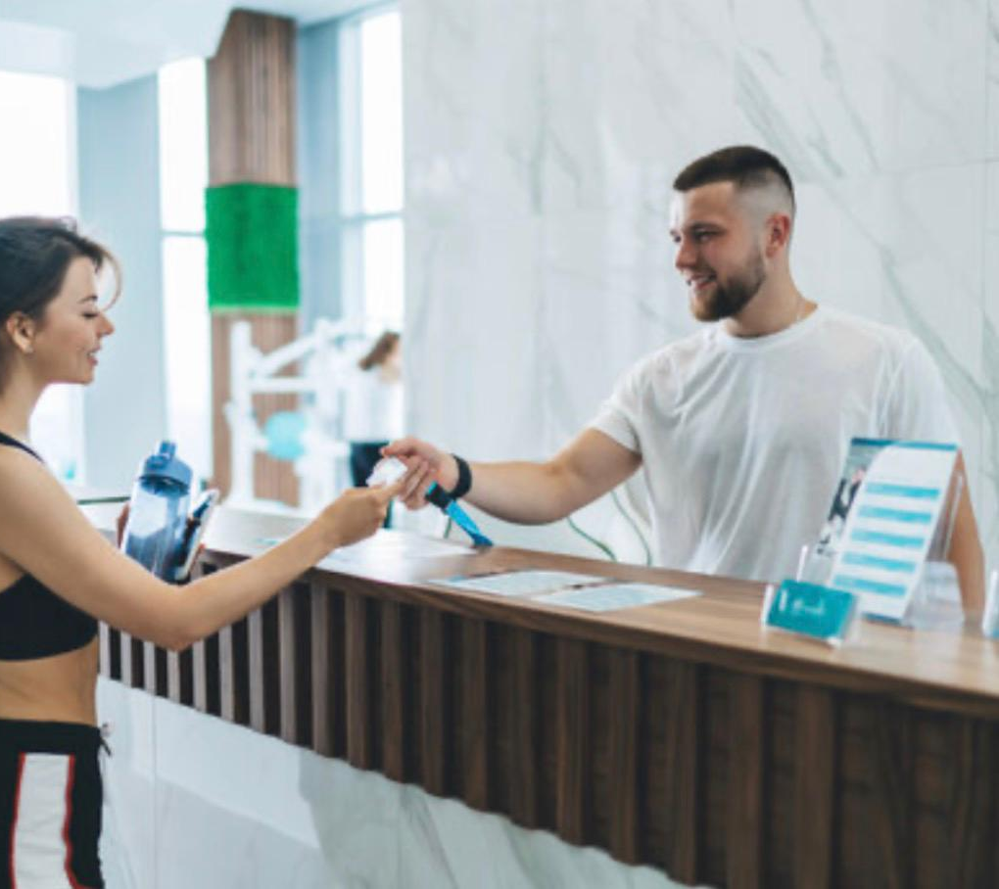
PERFORMANCE MANAGEMENT
The performance management process for a gym receptionist involves establishing clear performance expectations, continuous monitoring, and periodic evaluation. Initially, performance goals are set in alignment with organizational objectives, such as enhancing customer satisfaction, ensuring efficient member check-ins, and promoting retention (Aguinis, 2019). Supervisors regularly monitor progress through observation and feedback, emphasizing service quality, communication, and administrative accuracy.

Slide 5

Mid-cycle reviews allow for developmental feedback, identifying training needs in areas such as fitness software use, conflict resolution, or sales skills (Armstrong & Taylor, 2020). At the end of the appraisal cycle, performance is formally evaluated against predefined criteria, including customer feedback, error rates in record management, and responsiveness to member inquiries. High-performing receptionists may be rewarded through recognition or incentives, while performance gaps are addressed through coaching or additional training. This structured process supports individual development while contributing to organizational effectiveness.

Slide 6

RESPONSIBILITY OF RECEPTIONIST JOB
Greet members and visitors, ensure smooth check-in and check-out processes, and provide general information about the facility.
Customer service
respond to inquiries regarding memberships, schedules, promotions, and services, while maintaining a professional and welcoming environment.
Scheduling and bookings
Manage appointments for classes, training sessions, and consultations using fitness management software.
Membership administration
Assist with new member registration, process renewals, handle payments, and maintain accurate member records.
Communication
serve as a liaison between members and staff, ensuring timely and effective information flow.
Administrative support
answer phone calls, manage emails, and maintain the reception area’s cleanliness and organization.
Team collaboration
Gym staff in coordinating events, resolving issues, and ensuring a positive member experience.

Slide 7
Fitness gym receptionist performance appraisal
PERFORMANCE FACTORS | RATING (1-5)
CUSTOMER GREETING & CARE | 5
COMMUNICATION SKILLS | 4
APPOIMENT & CLASS BOKING | 5
MEMBERSCHIP PROCESING | 4
TEAMWORK COLLABORATION PROFESONALISM & RELIABILITY | 5 5
The receptionist demonstrates strong performance across all evaluated areas, with particularly high ratings in customer greeting & care (5), appointment & class booking (5), teamwork & collaboration (5), and professionalism & reliability (5). These results highlight consistent strengths in interpersonal interaction, reliability, and operational support, all of which contribute positively to member satisfaction and retention.
Slightly lower scores in communication skills (4) and membership processing (4) suggest areas for potential development, such as refining clarity in communication and improving efficiency with administrative software. Despite these, overall performance meets and, in several areas, exceeds expectations.

Slide 8
FRAMEWORK FOR GYM RECEPTIONIST
Performance indicators
customer satisfaction ratings
Accuracy of records and transactions.
Efficiency of appointment and membership processing.
Responsiveness to member inquiries.
Contribution to member retention and engagement.
Development pathways
training in advanced customer service techniques.
Upskilling in digital systems and booking software.
Opportunities for progression into supervisory or managerial roles.
Core responsibilities
greet and assist members/visitors. Manage check-ins, class bookings, and appointments. Handle memberships, renewals, and payments.
Maintain accurate records and documentation.
Provide information on gym services, policies, and promotions.
Support staff with communication and scheduling.
Key skills & competencies
strong interpersonal and communication skills.
Customer service orientation and problem-solving ability.
Organizational and multitasking skills.
Proficiency with gym/fitness management software.
Professionalism, confidentiality, and teamwork.

Slide 9

Questions ?
1. Do you feel comfortable greeting and helping members when they arrive?
2. Are you able to manage check-ins and bookings without difficulty?
3. How easy is it for you to use the computer/software at the front desk?
4. Do you feel confident answering members’ questions?
5. What could we do to make your job easier?

Slide 10

References :
Pedersen, P. M., & Thibault, L. (2014). Contemporary sport management. Human kinetics.
Zeithaml, v. A., Bitner, M. J., & Gremler, D. D. (2018). Services marketing: integrating customer focus across the firm. Mcgraw-hill education.
Aguinis,h. (2019). Performance management (4th ed.). Chicago business press.
Armstrong, m., & Taylor, S. (2020). Armstrong’s handbook of human resource management practice. Kogan page.

