Slide 1

New L5 Online Learning module. Enhancing Creativity & Innovation in the 21st Century.
L5: Changemakers: Creativity & Value Creation
Support Tutorial 1.
This Photo by Unknown Author is licensed under CC BY-SA-NC

Slide 2
Reminders
Replaced: Problems opening the ‘Students Guides’ (Moodle: Additional resources).
Location of ‘Weekly Support slides’ (Moodle: Additional resources).
Recommend Module document (Save all notes and activity answers for Assignment).
Possibility of working in a Team. But be careful your work is not dependant on another in case any circumstances prevent course continuation.

Slide 3
Last week’s - Moodle Activities & Assignment task
Unit 1: Ideas and Values
Topic 1 - How Innovation Changes the World
Topic 2 - Who Am I? My Sense of Self
Start Task 1 - Assignment 1.

Slide 4
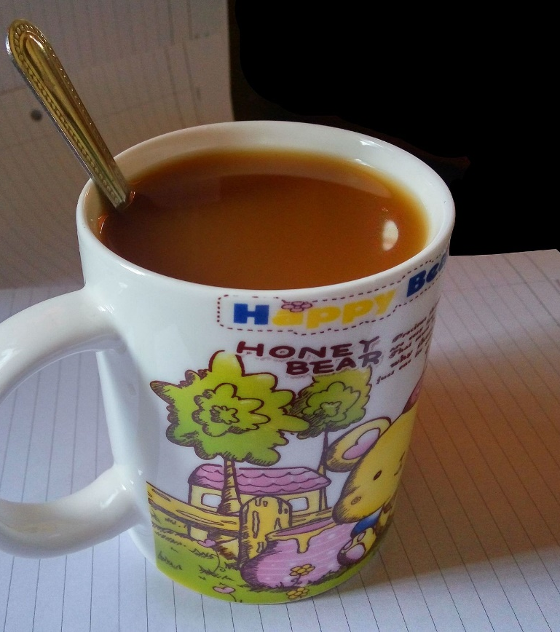


Enjoyed Fav. Drinks & Snacks
This Photo by Unknown Author is licensed under CC BY-SA
This Photo by Unknown Author is licensed under CC BY-SA
This Photo by Unknown Author is licensed under CC BY-SA

Slide 5
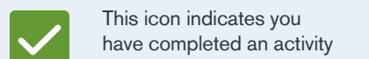
Reminder: Progressing through the Module
COMPLETION OF ACTIVITIES will EARN YOU MARKS AND BADGES towards the participation assessment element of the module.

Slide 6
This week’s - Moodle Activities & Assignment task
Unit 1: Ideas and Values
Topic 3 - Addressing Sustainability
Topic 4 - Making Statements.
Task 1 - Assignment 1.

Slide 7

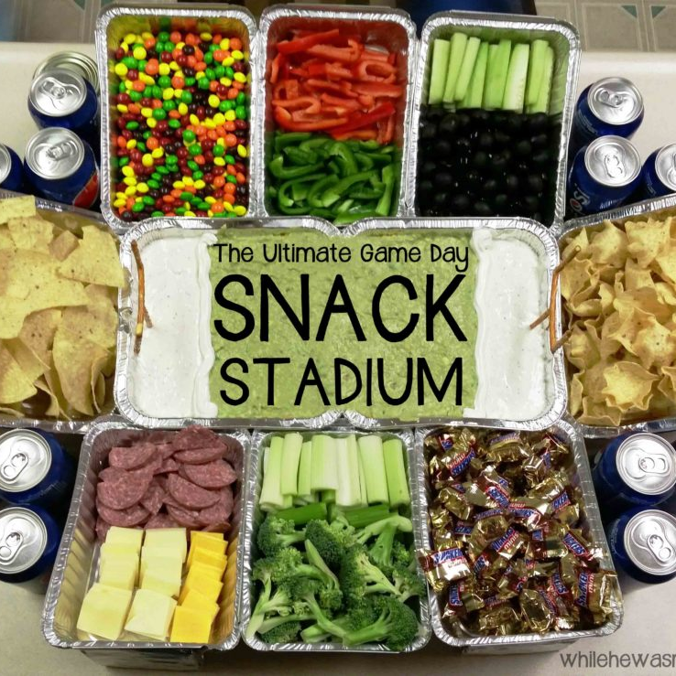
Don’t forget:
This Photo by Unknown Author is licensed under CC BY
This Photo by Unknown Author is licensed under CC BY-NC-ND
Fav. Drink & Snacks.
This Photo by Unknown Author is licensed under CC BY-SA

Slide 8

The Key to Success
THE KEY TO SUCCESS FOR THIS MODULE IS TO MAKE WEEKLY PROGRESS.
You will not be able to leave it until the end.

Slide 9

Assignment 1: Task 1
Unit 1 - Mind Map (15 marks):
Create a mind map that refers to some of the concepts & some of your answers to activities in Unit 1. You can decide which concepts & answers to include.
The development of your project idea.
Your mind map should be no more than 250 words, with supporting imagery, and produced using freely available Online Mapping tech of your choice.
The mind map should include citations and a reference list node (using the appropriate referencing standard).
Tip: The centre node could start with a single word, title or your idea.

Slide 10
Next: Go to Moodle and complete the following
Unit 1: Ideas and Values
Topic 3: Addressing Sustainability (a.2hrs).
Topic 4: Making Statements (a.3hrs).
  + Task 1 of Assignment 1.
Schedule in your diary /\

Slide 11

Personal Project - Recommended timeline
You will need to make progress on your personal project throughout the module.
October: Ideation & Start Design work.
Come up with and refine your idea.
November: Design & Start Dev. work.
December: Development work.
January wk 1: Create Project Video presentation.
In PowerPoint or alternative and submit.

Slide 12
Register.
Save / Download participant list from teams.

Slide 13

Questions.
Note: For more information about the module please read the ‘Module introduction’ document in the ‘Welcome and Information’ section on Moodle.

Slide 14

Socialization: Breakout rooms
(Compare ideas, Chat & Support each other)

Slide 15
The End.

