Slide 1
A child’s experience between the ages of 0-5 years
Student Name | Lijun Wu
Student number | 2014395

Slide 2

Introduction
Vygotsky’s theory of social construction
Zone of Proximal Development
Bandura’s Social learning theory
Mediational process step
Two examples relevant theory

Slide 3
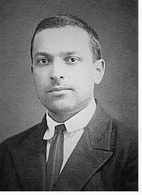
Vygotsky’s theory of social construction
Russian Psychologist
Social interaction among children are critical to both cognitive and social development.
Believed children’s development is the result of culture, think and language.
Believed language is an most important psychological tool.
Developed the Zone of Proximal Development.

Slide 4
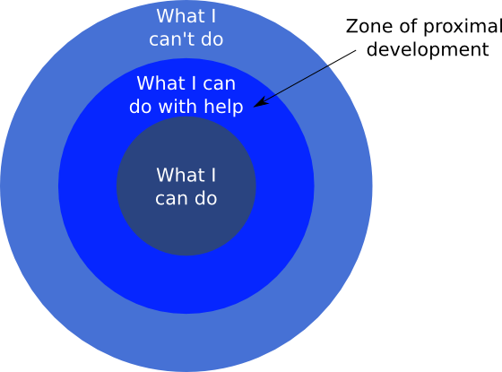
Zone of Proximal Development
The Zone of Proximal Development is an area of learning that happens when a person is assisted by a teacher or peer with a higher skill set.
It is important for educational application

Slide 5

Examples of Vygotsky’s of social construction
Teeth brushing
Children need assisting to help to brush teeth until they understand the routines.
As parent we need show the children how to brush, also can find some picture or songs show them.

Slide 6
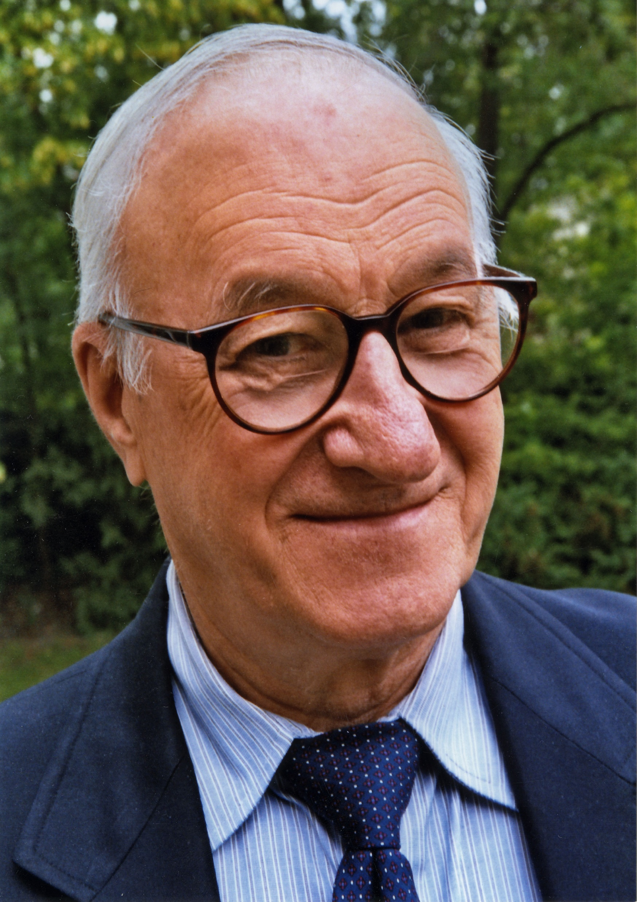
Bandura’s Social learning theory
Albert Bandura (1977) agrees with classical conditioning and operant conditioning
Add two important ideas :
1. Mediating processes happen between stimuli and responses
2.Behavior is learned from the environment

Slide 7
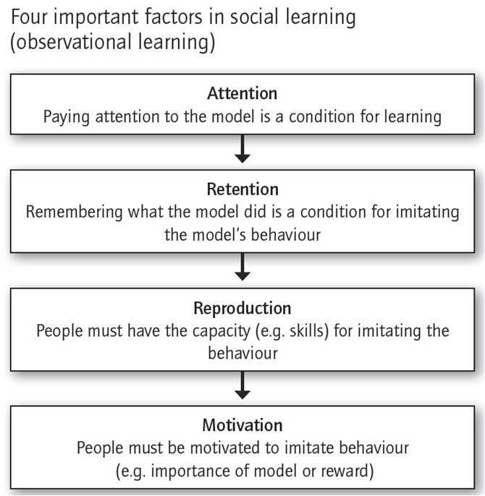
Mediational process step

Slide 8

Example of Bandura’s Social learning theory
Bandura’s Social learning theory
When my older daughter was 4 years old.
She speak dirty words to her grandma.
We find out she learn form her Dad.
After that we always pay attention for our ways of speak.

Slide 9
Reference
Sasso, B. and de Marais, A. (2014) Egocentric Speech in the Works of Vygotsky and Piaget: Educational Implications and Representations by Teachers, International Journal of Humanities and Social Science Vol. 4, (8) http://www.ijhssnet.com/journals/Vol_4_No_8_June_2014/14.pdf [Accessed 23/10/2021]
Wikipedia, Zone of proximal development, online available at: Zone of proximal development – Wikipedia [Accessed 23/10/2021]
Denise,Boyd & Helen, Bee.(2012). Lifespan Development,(6th E),pp 23-47, Pearson,Education,Inc(Original work published 2006)
Saul Mcleod, (2016) Albert Bandura’s Social Learning Theory, (online) available at:Albert Bandura's Social Learning Theory | Simply Psychology [Accessed 23/10/2021]
Image of four important factors in social learning a50b8d16c5803cf6550009bc8d010723--social-learning-theory-scenery-photography.jpg (670×686) (pinimg.com) [Accessed 23/10/2021]
Dealing with child behaviour problems, NHS, available at: Dealing with child behaviour problems - NHS (www.nhs.uk), [Accessed 24/10/2021]
Looking after my baby, NHS Greater Glasgow and Clyde, available at: Looking After My Body | NHS GGC [Accessed 23/10/2021]
Image of Albert Bandura, Albert_Bandura_Psychologist.jpg (2982×4223) (wikimedia.org) [Accessed 23/10/2021]
Image of the Zone of Proximal Development ,Zone https://i0.wp.com/forestschoolportfolio.com/wp-content/uploads/2015/08/Zone-of-Proximal-Development.png [Accessed 23/10/2021]
Image of Vygotsky, https://en.wikipedia.org/wiki/Lev_Vygotsky [Accessed 23/10/2021]

