Slide 1
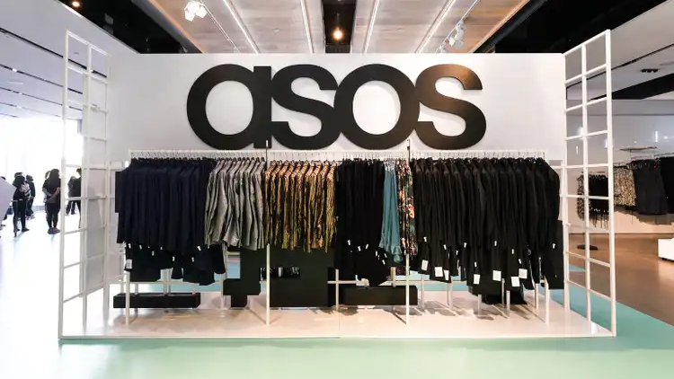

Module: Introducing the Modern Workplace
Code: LCBB4003
Lecturer: Dr Hoang Dang Nguyen
Group Presentation
Radu Maimescu:2131119
Marian Busca:2125297
Stefan Valentinov Baev:1905214
Nicola De Lisi:2131183

Slide 2


Introduction
This study represents the organizational profile of an organization.
The chosen organization for this study is one of the reputable fashion retailers in the UK, ASOS
This study shows how the structure of an organization has an impact on its performance of the organisation.
Notes:
The purpose of the study is to present an elaborative discussion that can help in understanding the organisational profile of the chosen company ASOS. This study will meet all the important aspects that can help in understanding the organisation's performance of ASOS and how the structure of this organisation has an impact on the performance of this organisation as well as the employees and workers. Organisation's profile: Background

Slide 3

Organization's profile: Background
ASOS is one of the United kingdom's reputable online fashion and cosmetic organizations (ASOS, 2022).
The term ASOS stands for "As Seen On Screen" (Heart, 2022).
This online retailer organization not only sells its own branded fashionable clothes and cosmetics, but it has other 850 brands
ASOS has stores in 196 countries.
Notes:
ASOS is one of the most famous and reputable e-commerce platforms in the United Kingdom and the term "ASOS" stands for "As Seen On Screen" which reflects the fact that they are committed to their customers and they will provide exactly the same product they display on their screen. Its popularity can be determined from this factor that ASOS has spread its online stores in almost 196 countries. ASOS is not only responsible for offering its branded clothes and accessories to the customers but there are several other almost 850 brands that can be observed in this online platform.

Slide 4

Organisation’s profile: Structure
Focusing on the structure of ASOS it has been observed that it has a Flat Structure (Previdi et al., 2017).
In this organisation, no hierarchy system is followed.
The organisation always asks its employees and customers to enhance the open communication system.
Notes:
Considering the structure of disorganization it has been observed that this organisation followed a flat structure as a result of which no hierarchy system is allowed in this organisation. As it is common that internal conflict can cause the decline of the organisation this structure always allows open communication among the organisation members and keeps the conflict away from this organisation.

Slide 5
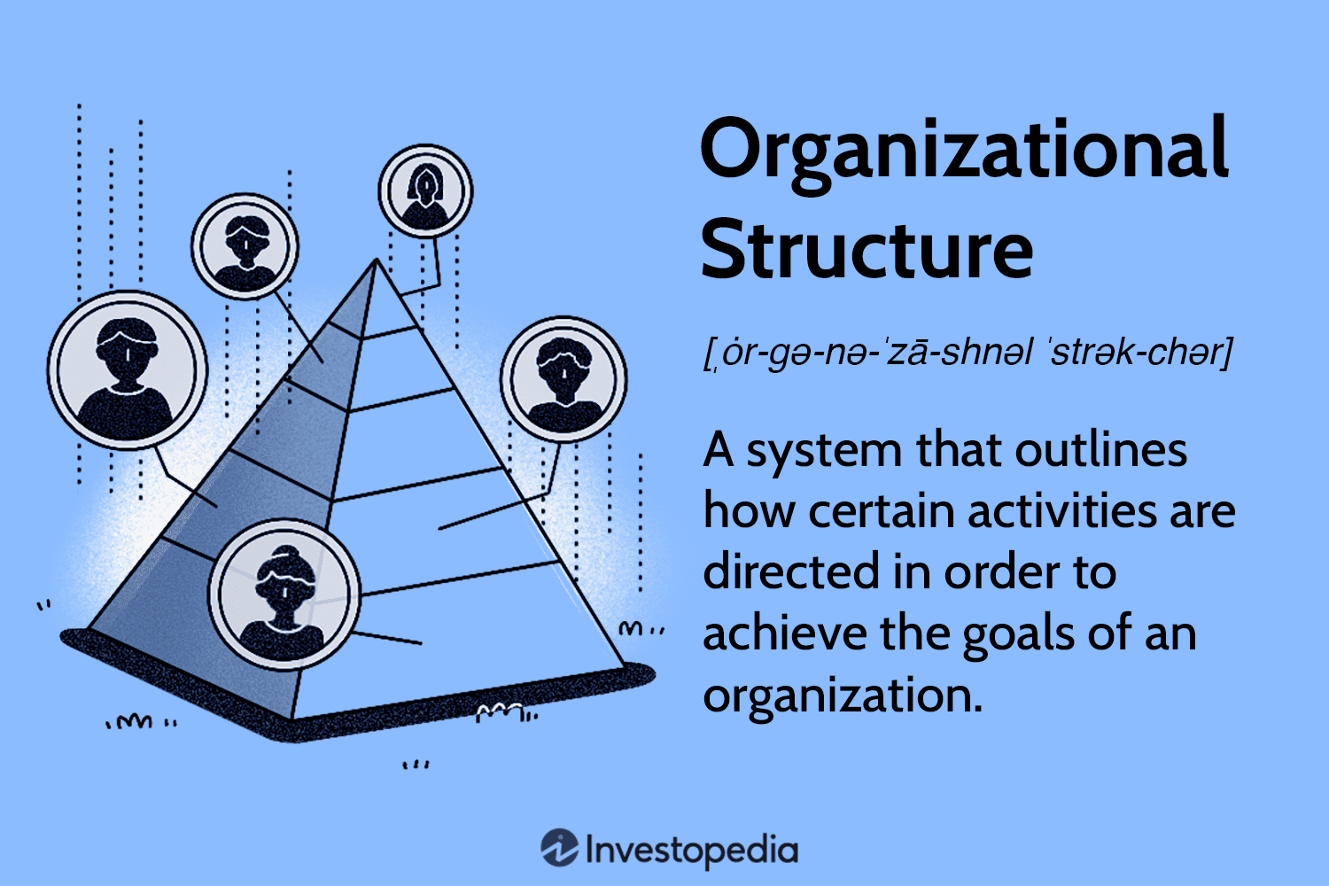
Organisation’s profile: Structure
The organisation always has the initiative to empower its team members so they can perform with authority (ASOS, 2022).
A feeling of equality has been promoted in this organisation
Employees are always allowed to show their authority and interest in their work.
Notes:
ASOS enables the organisation to empower each and every member of the organisation with equal respect and authority. This respect and authority allows employees to feel themselves part of the organisation and also important for the organisation.

Slide 6

Organization's profile: Performance
Organizational performance of the organisation is one of the key influential factors (Researchgate, 2022)
The organisation is both internally as well as externally driven.
They are committed and respectful towards their customers.
Employees and other members are responsible and reliable towards ASOS.
Labour productivity helps the organisation in generating huge amounts of revenue.
Notes:
The organisational performance of ASOS is one of the key factors and it is somehow influenced by the structure of this organisation. It has been observed that this organisation is both internally and externally given and the reason behind it is its responsibility towards each other. The point to be noted is that the employees are well responsible towards the organisation and the organisation is well committed towards their customers. As a result of this responsibility, the employees and workers are always approached to help organisations in increasing the GDP through enhancing productivity and sales.

Slide 7

Organisation’s profile: Competitors
ASOS has many competitors in the present digital competitive market of the United Kingdom.
Zara is one of the competitors of ASOS (Habig, 2021).
Innovation and creativity are one of the factors that are responsible for this competition.
Notes:
ASOS is an online platform and because of the advanced technology, there are several other online and traditional fashion retailers in the United Kingdom which stand as the tough competitors of ASOS. Zara is one of the competitors of this organisation because of the available fashion products and cosmetics that this organisation provides to its customers and its fame in the United Kingdom.

Slide 8

Relationship between the organisation structure and its performance
The organisation structure of ASOS enables its employees to show their reliability towards the organisation.
As the organisation empowers its employees, they enhance the productivity of the organisation (Rehman et al. 2019).
All the employees work with an authority that creates a sense of belonging.
Notes:
As it has been observed that ASOS focuses on the empowerment of their organisation which is connected to their flag structure the employees are able to show their reliability towards their organisation as well as their respect. This not only helps the organisation to get respect from their employees as there is a situation which helps in creating the essence of belonging within the employees but because of this they always try to enhance the productivity of the organisation.

Slide 9

Relationship between the organisation structure and its performance
This structure helps in creating open communication.
Because of open communication, the employees are rarely involved in any conflict.
The less conflict there is in the organisation the higher possibility can be observed in employee performance (Rehman et al. 2019).
Notes:
Conflict is one of the negative factors that hamper the peaceful and harmonious environment of an organisation and to avoid these issues the organisation with its structure creates an open communication system within the organisation. This open communication system enables the present member of the organisation to put their issues and problems in front of everyone and to solve them so no conflict can be raised in the organisation

Slide 10
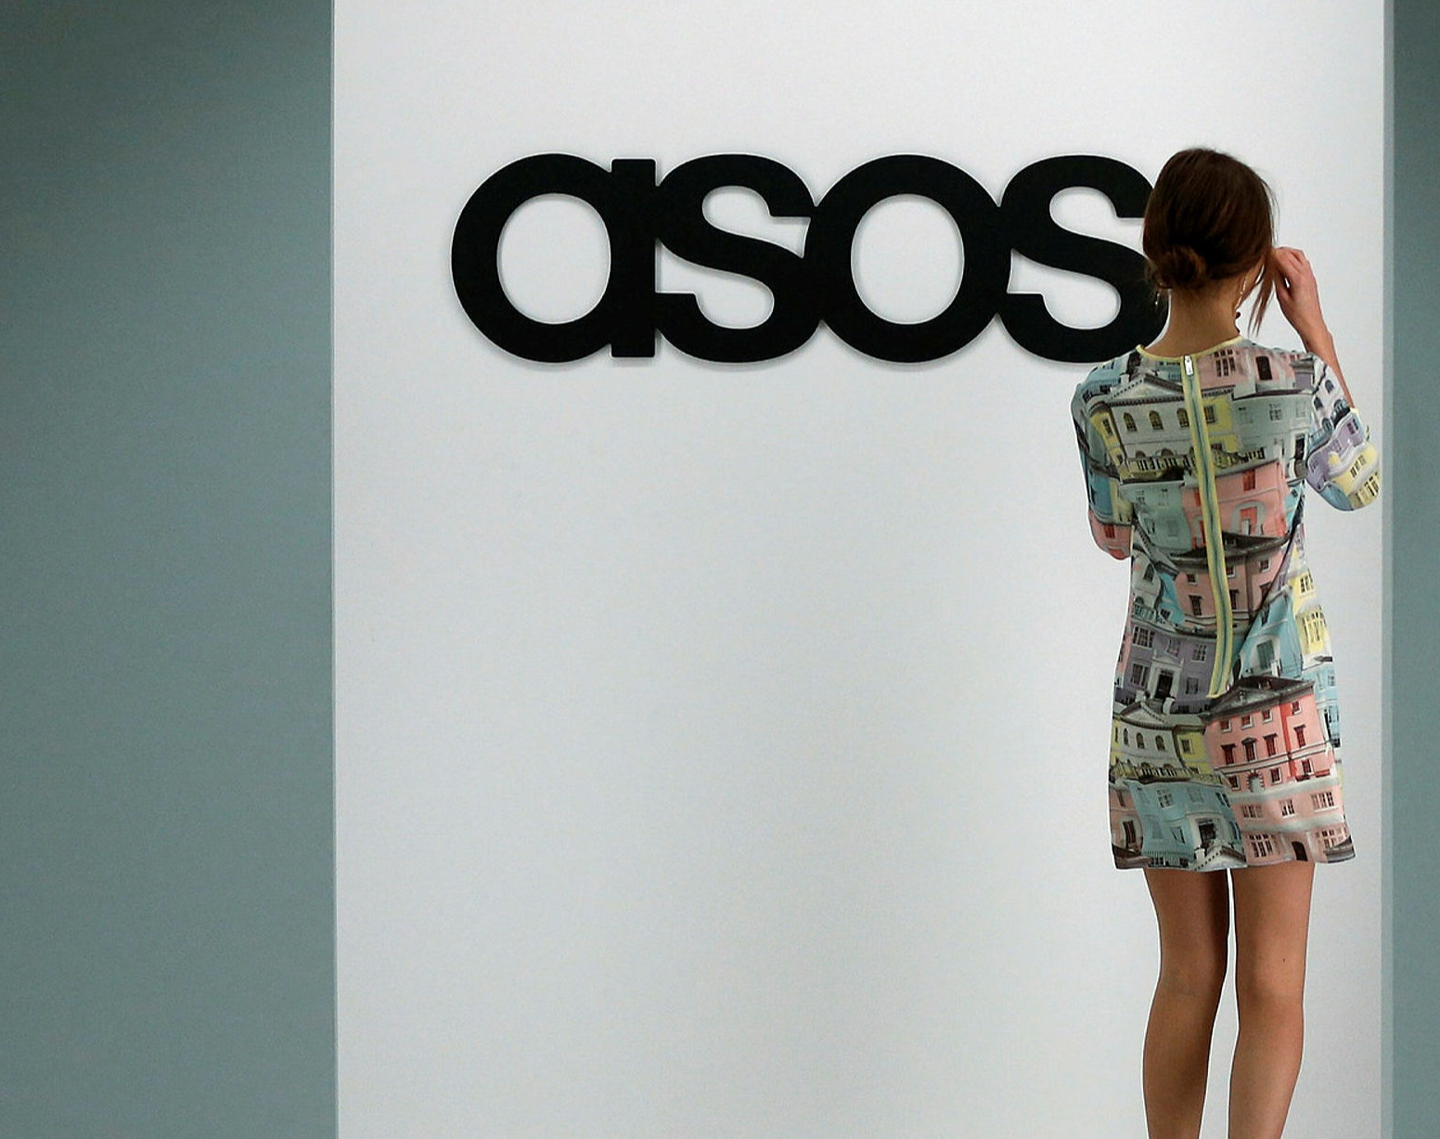
Tasks and skills that a manager uses to run ASOS
The leader is responsible for making effective marketing campaign strategies for brand awareness (Ziginov, 2021).
A leader is responsible for reaching the information regarding the organisation to the customer's touch point using social media.
Problem-solving and decision-making skills are necessary
Notes:
There are several management skills and tasks that need to be performed by a manager of the organisation to lead the organisation towards achieving its goal and success. With the help of problem solving skills and decision-making skills the manager is able to solve all the issues and adopt the changes in the organisation. The manager of ASOS takes the responsibility to make an effective campaign strategy for the organization and reach information to their customers through social media.

Slide 11

Tasks and skills that a manager uses to run ASOS
Communication and motivation skills help in increasing connection with employees (Prospect, 2022)
Interpersonal skills help managers to understand the expectations of their customers.
Commercial awareness is another skill that can help in making the manager ever of the competitive market and its strategies.
Notes:
Communication and motivation skills have the manager to motivate and appreciate their employees and also resolve all the issues faced by the employees in the organisation. With the help of interpersonal skills the manager of this organisation will be able to understand the demand and expectations of their customers as well as employees and depending on which they can make effective solution and strategies to satisfy their expectations and increase the brand awareness of the organisation.

Slide 12

The way Behavioral Theory of leadership can be applied to ASOS
Behavioral Theory points towards the specific behaviour of the leader.
It concentrates on the technical skill of the leader that enables him to tackle the technical aspects (Surdu et al., 2021)
Human skills enable the manager to interact with every individual in the organisation.
Notes:
Behaviour theory is one of the leadership theories that deal with the specific behaviour of a leader in an organisation. The theory includes several leadership skills such as technical skills and human skills. As a result of these two skills, the leader is able to interact with every individual properly and run the business fluently.

Slide 13

The way the Relationship Theory of leadership can be applied to ASOS
Relationship theory deals with the relationship of the Employees with their leader.
A positive relationship helps the leader to make his employees respectful and obedient toward him (Rastogi et al., 2019)
A good relationship between the employees and the manager helps in creating a peaceful environment and increase productivity.
Notes:
Relationship theory is another effective leadership Theory that points towards the positive behaviour of the employees which comes from the good and understandable relationship between the employees and the manager. Peaceful relationships among these two personalities help the organisation to create a peaceful environment and make the employees respectful and obedient towards their leader.

Slide 14
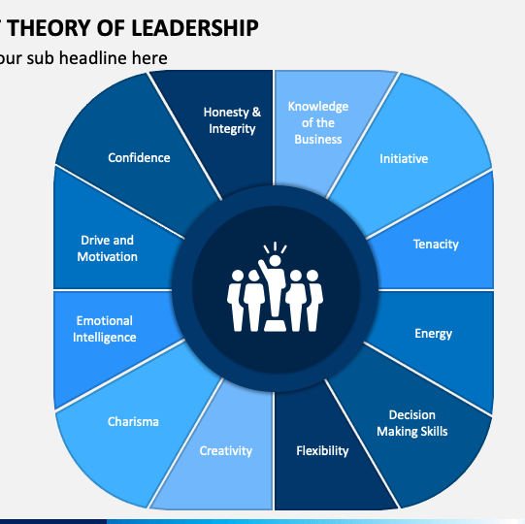
The way the Trait Theory of leadership can be applied to ASOS
Trait theory focuses on the several traits and characteristics of a leader.
It shows how the personality of a leader has a positive influence on the behaviour of the employees (Wyatt and Silvester, 2018).
The friendly and collaborative trait of a leader helps in increasing the productivity of an organisation.
Notes:
Trait theory is one of the important leadership theories that point towards the behaviour of a leader in an organisation. With the help of a good personality, friendly, and collaborative trade or behaviour the leader or manager of the organisation ASOS is able to motivate and drive the employees to give their best performance.

Slide 15

Factors influencing group and team behaviours
In an organisation There are several factors that can be observed to influence group and team behaviors.
Interdependence points toward the fact employees depend on each other (Aktipis et al., 2018).
Social interaction shows how interaction can help in increasing efficiency.
Notes:
In an organisation behaviour and performance of employees are influenced positively and negatively by several factors. Interdependence is one of the factors that show each and every employee is dependent on each other to successfully accomplish their work. Social interaction is part of it as with the interaction they can help each other and understand each other's problems and necessities.

Slide 16
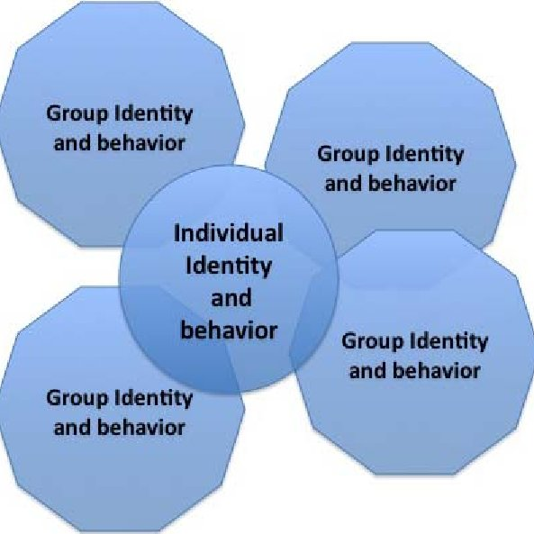
Factors that influences group and team behaviours
Perception of a group is a huge influential factor.
The commonality of purpose among the employees makes them collaborative with each other (Goldenberg et al., 2020).
Favoritism needs to be avoided in an organisation.
Notes:
The perception of a group has huge significance because the outcome of a work depends on the perception that each and every employee possesses. It is necessary for a group to work with a common goal or purpose only then they can work collaboratively and come up with an effective consequence otherwise it can lead to conflict that can cause the decline of the organisation. Favouritism is a factor often observed in several organisations that cause a negative impact on the workplace.

Slide 17

Conclusion
It reflects on the leadership theories that are used in this organisation
It also reflects on the appropriate leadership theories that can help in increasing the performance of this organisation.
All the influential factors discussed in the study that influences the team behaviour of this organisation
Notes:
This entire presentation shows that an organisation can lead successfully by a leader and this success depends on the proper and appropriate leadership quality regarding the structure of an organisation. For this reason, the study also focuses on the leadership qualities and the skills of the leader that have an influence on the performance of this organisation.

Slide 18
References
Aktipis, A., Cronk, L., Alcock, J., Ayers, J.D., Baciu, C., Balliet, D., Boddy, A.M., Curry, O.S., Krems, J.A., Muñoz, A. and Sullivan, D., 2018. Understanding cooperation through fitness interdependence. Nature Human Behaviour, 2(7), pp.429-431.
ASOS. (2022). ASOS. Available in. https://www.asos.com/ (Accessed 20 June 2022)
Goldenberg, A., Garcia, D., Halperin, E., Zaki, J., Kong, D., Golarai, G. and Gross, J.J., 2020. Beyond emotional similarity: The role of situation-specific motives. Journal of Experimental Psychology: General, 149(1), p.138.
Habig, S., 2021. Inditex's ESG Performance in a Global Financial Market.
Heart. (2022). What does ASOS stand for? Available at. https://www.heart.co.uk/news/who-owns-asos-stand-for-topshop/#:~:text=What%20does%20ASOS%20stand%20for,a%20celebrity%2Dlinked%20clothing%20website. (Accessed 20 June 2022)
Previdi, M.C., Carotenuto, P., Zito, D., Pandolfo, R. and Braconi, C., 2017. Noncoding RNAs as novel biomarkers in pancreatic cancer: what do we know?. Future oncology, 13(5), pp.443-453.
Prospect. (2022). Skills and tasks of a manager. Available in. https://www.prospects.ac.uk/jobs-and-work-experience/job-sectors/business-consulting-and-management/7-skills-for-a-successful-management-career (Accessed 20 June 2022)
Rastogi, L., Yazdifar, H., Alam, A., Eskandari, R. and Bahloul, M.A., 2019. A review of the relationship between leadership style and innovation: insights and directions for future research. Journal for Global Business Advancement, 12(5), pp.625-647.
Researchgate. (2022). Key Success Factors Positively Affecting Organizational performance. Available at. https://www.researchgate.net/publication/316932735_Key_Success_Factors_Positively_Affecting_Organizational_Performance_of_Academic_Spin-Offs (Accessed 20 June 2022)
Surdu, I., Greve, H.R. and Benito, G.R., 2021. Back to basics: Behavioral theory and internationalization. Journal of International Business Studies, 52(6), pp.1047-1068.
Wyatt, M. and Silvester, J., 2018. Do voters get it right? A test of the ascription-actuality trait theory of leadership with political elites. The Leadership Quarterly, 29(5), pp.609-621.
Ziginov, S., 2021. CUSTOMER ENGAGEMENT VIA SOCIAL MEDIA. HOW DOES SOCIAL MEDIA MARKETING AFFECT CONSUMER DECISION-MAKING PROCESS AND SALES? CASE: ASOS.
Rehman, S.U., Mohamed, R. and Ayoup, H., 2019. The mediating role of organizational capabilities between organizational performance and its determinants. Journal of Global Entrepreneurship Research, 9(1), pp.1-23.

Slide 19
  THANK YOU!
y

