Slide 1
International Human Rights Intervention: a realist and liberal perspective

Slide 2
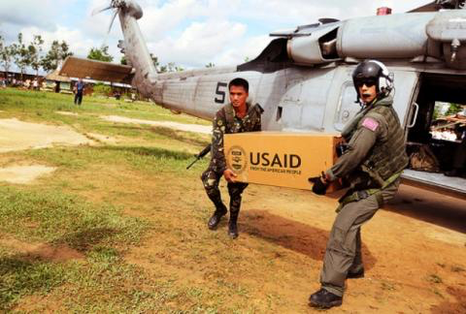
Humanitarian Intervention is undertaken to prevent horrendous crimes such as widespread slaughter and other serious vicious acts that put citizens of a given state at risk.
Good to note
Some accountability should be rendered during and after the intervention
Interventions should, where possible, attempt to stop the government from committing atrocities but should simultaneously minimize destabilizing effects on the country's fundamental political structures.

Slide 3
What is liberalism and Realism ?
Realism
Liberalism
A paradigm based on the premise that world politics is essentially and unchangeably a struggle among self- interested states for power and position under anarchy with each competing state pursuing its own interest
Emphasizes the interdependence between states and sub-state actors as the key characteristic of the international system. That can lead to more orderly ,just and cooperative world.
POWER + CONFLICT
COOPERATION+ INTERDEPENDENCE

Slide 4
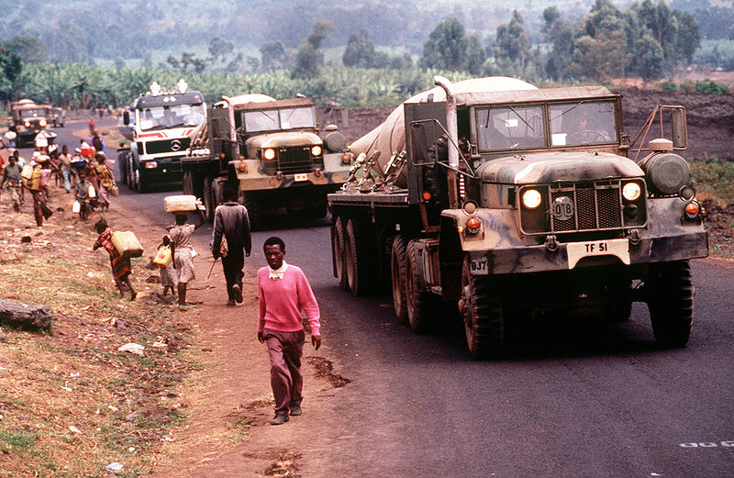
CASE STUDY : The Rwandan Genocide 1994
Genocide – a systematic eradication or mass killing of a group or large populations identified by the perpetrators . Large scale violation of human rights .
Background
Colonial hand in ethnic tension
Power handed over to the Hutu
Economic downturn and rise of the RPF
Shooting down of the presidents plane
Radio broadcasts and mass killings

Slide 5
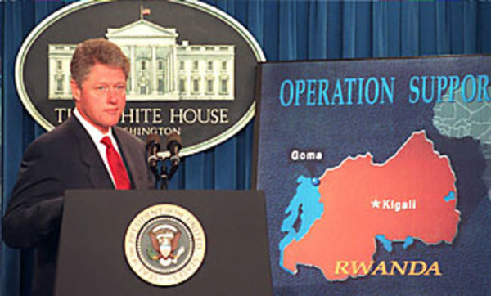
Actors
France – Before and after the death of the Rwandan president France maintained very close relations with Rwanda as part of their policy of Françafrique
United States of America – Following the plane crash US intelligence warned US deputy secretary of state that “there was a strong like hood that violence could break-out.”
https://youtu.be/RpKV8psvnaQ (President Clinton comments)

Slide 6
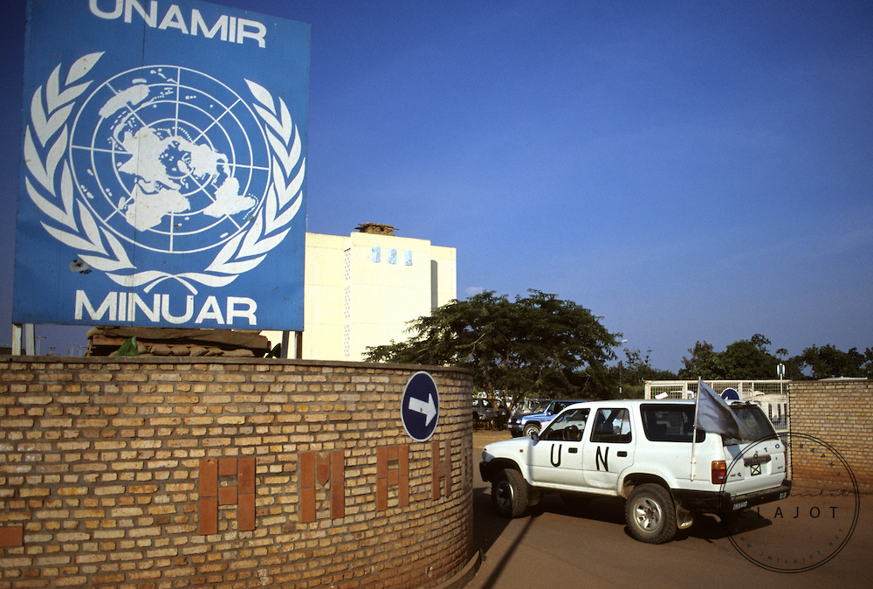
UNAMIR (the United Nations Assistance for Rwanda)- had been Rwanda since October 1993 overseeing the implementation of the Arusha Accords .
The OAU( Organization of African Unity ) – Sent a neutral military observation group . Criticism of the OAU lack of intervention as crisis unfolded in Rwanda .
"The OAU [Organisation of African Unity] was nowhere to be found … during the 1994 Rwandan genocide against the Tutsis, the OAU was furiously doing the watutsi* in Addis Ababa [Ethiopia]."

Slide 7
References
Fred Aja Agwu. (2014). The Challenge of Humanitarian Intervention Since Rwanda. Available: https://www.cfr.org/councilofcouncils/global_memos/p33324. Last accessed 15th Jan 2018.
Dawit@justiceforafrica.org. (2012). Why the African Union Needs a Human Rights Memorial. Available: https://sites.tufts.edu/reinventingpeace/2012/04/30/why-the-african-union-needs-a-human-rights-memorial/. Last accessed 15th Jan 2018.
(2016). The Rwandan Genocide. Available: http://endgenocide.org/learn/past-genocides/the-rwandan-genocide/. Last accessed 15th Jan 2018.
Hotel Rwanda Movie (2014)
Prunier, Gérard (1999) The Rwanda Crisis: History of a Genocide (2nd ed.). Kampala: Fountain Publishers Limited.

