Slide 1
Certificate of Higher Education in Skills for the Workplace
Professional Career Development
(BMSW 4005)
Session 3
Exploring employment opportunities

Slide 2
Activity 5 minutes
What did we do last week?

Slide 3
Previously…
We have;
Overviewed the module
Tested existing knowledge
Discussed self-awareness

Slide 4
In this session…..
We will;
Discuss the key points to consider when exploring employment opportunities.
Consider appropriate strategies to be used in exploring employment opportunities.

Slide 5

Finding employment opportunities – Steps to follow
Know yourself
Keep your options open
Do your research
Look for emerging trends

Slide 6

Google internships

Slide 7
When exploring employment opportunities…
Know your-self
Some of the key points that you may want to consider would be;
What motivates you?
What are your career aspirations?
What are your strengths and weaknesses?
What's your personality type

Slide 8

When exploring employment opportunities 30 minutes
Activity 3.1
Complete the ‘’Career motivation Test” on Moodle.
See you at 11.35am

Slide 9
When exploring employment opportunities…
DON’T LIMIT YOURSELF TO ONE OPTION
Making a shortlist of preferred options can be a useful strategy.
Transferable skills can be gained from any type of work experience, so even if your work experience relates to one area, that won’t restrict you from moving into a different one.

Slide 10
Activity 3.2 – Your career option
Considering your knowledge of yourself, your motivations, and aspiration, prepare a list (3-5) of career options that you would consider for your self.
Briefly explain why you consider each option and rank them in your preference.
Enter your detail in your learning log
(5 Minutes).

Slide 11
When exploring employment opportunities…
RESEARCH OPTIONS RELATED TO YOUR DEGREE
Read what graduates do – an in-depth look at Higher Education Statistics Agency’s latest survey to see where graduates have ended up after finishing university.
Some external websites have useful guides on options related to specific degree subjects, such as:
  Prospects: What can I do with my degree?
  Targetjobs: Degree subjects: your career options

Slide 12
When exploring employment opportunities…
DISCOVER EMERGING CAREER OPTIONS
Things change so quickly, the tools and career information cover every possible career option.
A good way to find out about other options is to look at job websites and speak to employers.

Slide 13
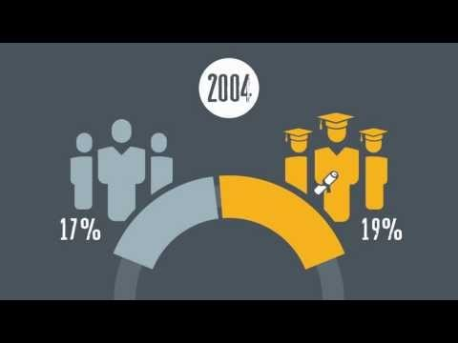
Activity 3.3 – Future Trends

Slide 14
Activity 3.4 – The future of work
Read the article on Moodle about ‘The future of work’ and answer the questions on Moodle
(1 Hour)

Slide 15
Summary of The Future of Work
The study looks ahead to the labour market of 2030.
Analyses the stable trends of future UK labour market.
Identifies the plausible disruptions of those trends.
Suggests potential actions for future skills for 4 scenarios; employers, individuals, education and training providers, and policy makers.

Slide 16
Topics
What are the trends shaping the future of UK jobs and skills up to 2030?
What are the potential disruption that could change the future of work in the UK?
What are the potential actions to meet the individual focused future skills for tomorrow’s world of work?

Slide 17
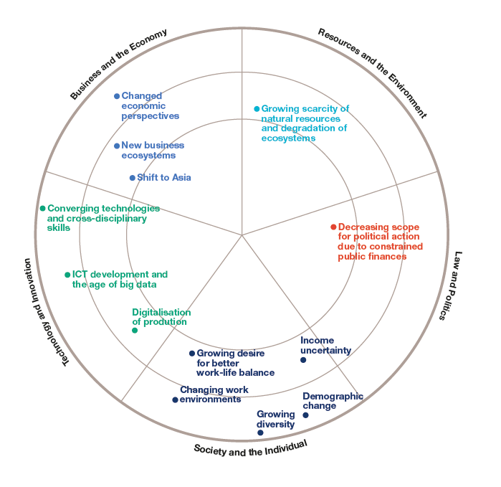
Trends Shaping the Future of UK Jobs and Skills

Slide 18
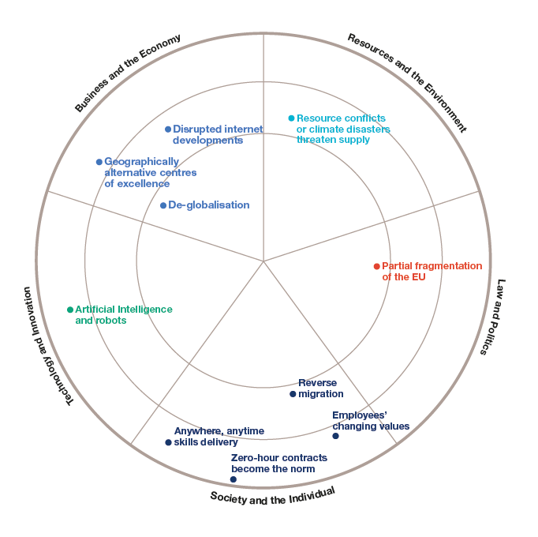
Disruptions that could Radically Change the Future of Work

Slide 19
Strategies for finding employment
GRADUATE SCHEMES
    MyFuture
    Prospects
    TargetJobs
    Milkround
INTERNSHIPS
    Graduate Talent Pool - Internship opportunities for graduates - mainly based in England
    Knowledge Transfer Partnerships– UK-wide programme with projects involving a partnership between a graduate, organisation and university or research organisation
    Step - Internship opportunities for students and graduates - mainly based in England
CHAT TO EMPLOYERS

Slide 20

Summary
What are the steps that you should follow in finding employment opportunities?

Slide 21
Get ready for your assessment for week 4
Read your case study

Slide 22

After your assessment…. We will explore
Selection Process

