Slide 1

what is Speciesism?
And is it justified?

Slide 2
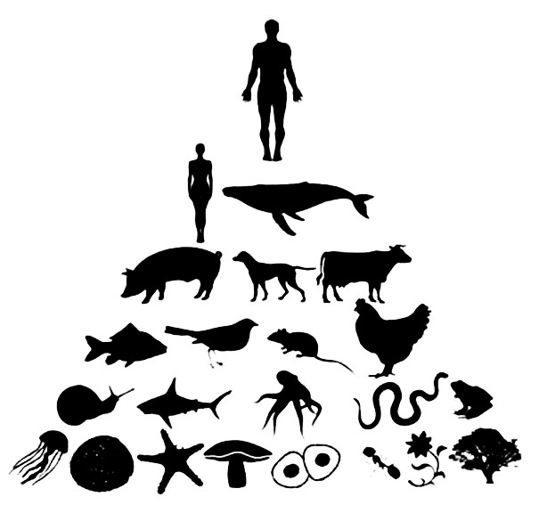
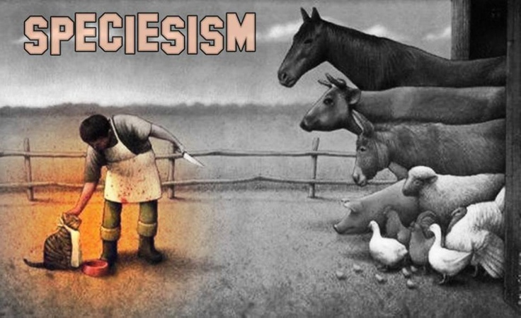
The two types of Speciesism :

Slide 3
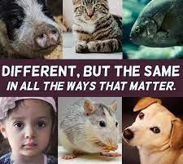
Anthropocentric Speciesism

Slide 4
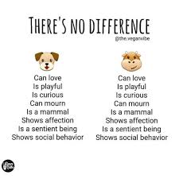

Pet Speciesism

Slide 5
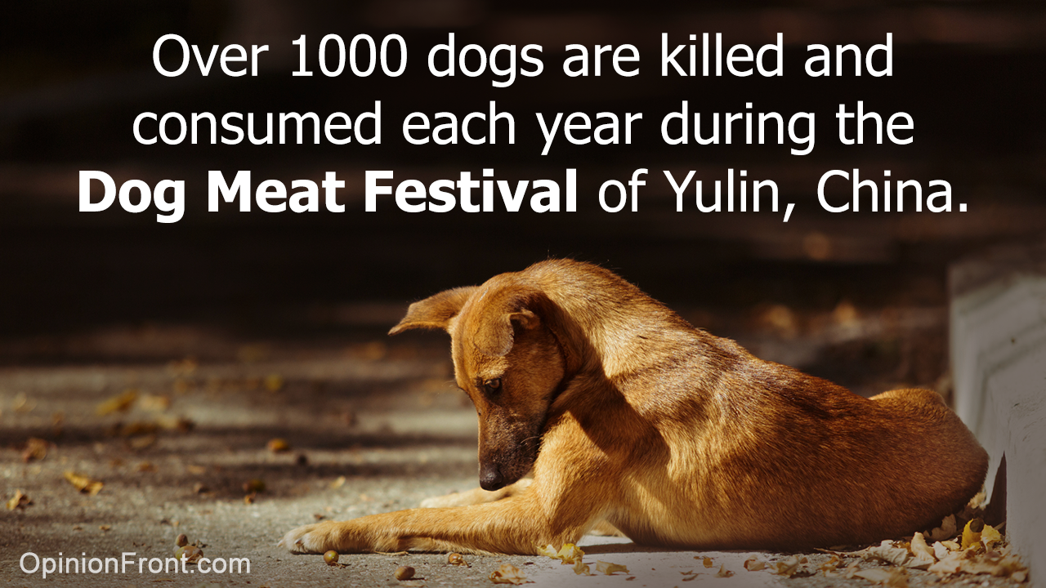
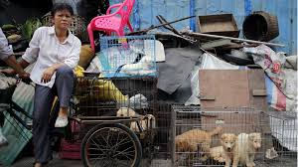
Yulin dog meat festival

Slide 6
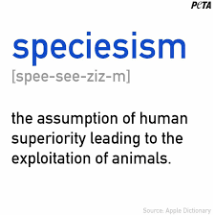
In conclusion...

