Slide 1
Independent Project

Slide 2
Part One
5000 word Essay
Part Two
Practical
Part Three
Presentation

Slide 3
Part One
5000 Word Essay
This is due
1pm on Thursday 10 December 2026
.
Upload on Turnitin by 1pm
Please remember that it can sometimes take a while to upload.
We would recommend uploading earlier than the final deadline time.

Slide 4
Part Two Practical
How to submit your Practical
(Research, Development and Final)
Uploaded on OneDrive by 1pm on Thursday 10 December 2026

Slide 5
Part Three
Presentation
Please imagine that you are delivering a presentation at a conference. Please do not assume that your audience is familiar
with your project.
During your presentation, you will have 10 minutes to present your Independent Project. It is crucial to clearly explain the connections between your written work and the project you have put into practice. Additionally, it is essential to introduce your project, as many individuals tend to overlook this step. It would be helpful to share your thought process, research links, and highlight only pertinent information.
As you communicate the key points of your outcome, it is important to be clear and concise for both specialists and non-specialists in the audience. Please consider how effectively you have engaged your audience through your presentation style and how to connect to the audience, providing enlightenment, and, if appropriate, showing empathy.
-Create a maximum 10-minute recorded presentation on Teams, you are allowed (10% either way with the time)
ensuring that your face image is visible as this helps with the presentation.
This recording will enable external examiners and second markers to review and evaluate your presentation.

Slide 6
Part Three
Presentation
Speak Clearly.
Don’t rush your words.
Pause
What is the most important parts of a presentation?

Slide 7
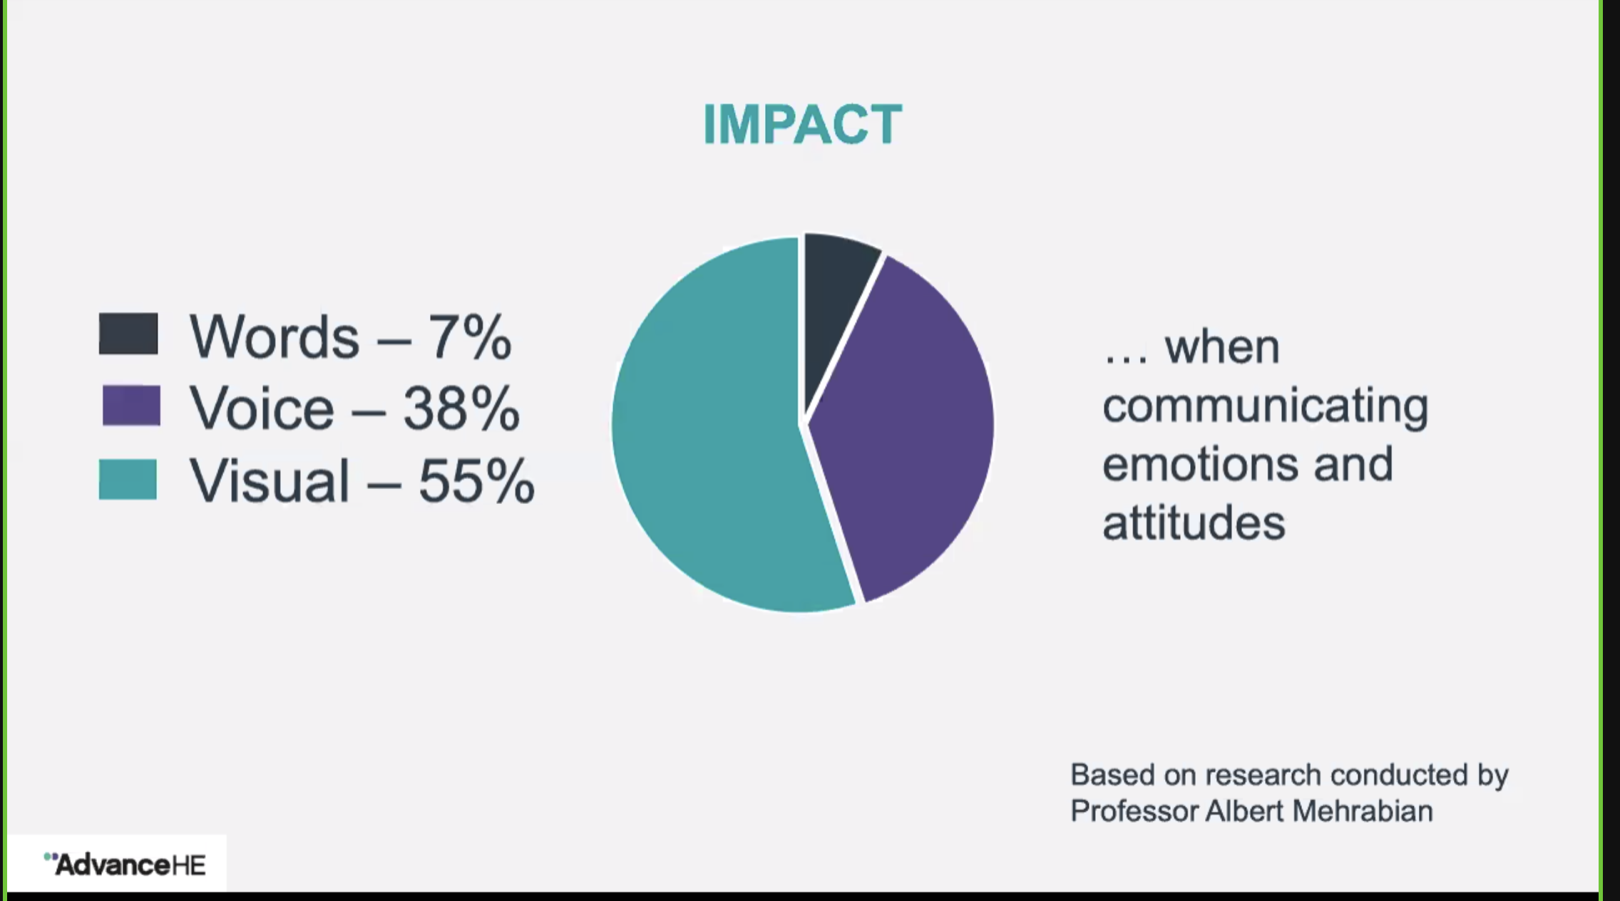
Part Three
Presentation

Slide 8
In a nutshell
If you missed this….
All three parts
uploaded by
1pm on Thursday 10 December 2026

