Slide 1



Hospitality and Guest Services for the Hotel Industry

Slide 2

Table Of Contents
Introduction………………………………………………………………………………..3
Overview of Banyan Tree……………………………………………..4
Identification of the hotel’s prime consumers………………………..5
The nature, scope and role of guest services and facilities in Banyan Tree……………………………………………………………………………….7
Importance of Hospitality………………………………………………………..8
Conclusion………………………………………………………………………………..9
References………………………………………………………………………………..10

Slide 3



Introduction
This presentation will examine the future of the hospitality sector, with an emphasis on the anticipated development that hotels are ready to implement to meet and exceed visitor expectations.
This investigation will provide information on the approaches and developments anticipated to revolutionise the visitor experience, providing a seamless fusion of customisation, first-rate service, and cutting-edge technology.
Source: (Ford, 2020)
Furthermore, this presentation will showcase the future of the hospitality industry, and cutting-edge amenities come together to create stays that will never be forgotten by guests.
Source: (Ford, 2020)
Notes:
This presentation will examine the future of the hospitality sector, with an emphasis on the anticipated development that hotels are ready to implement to meet and exceed visitor expectations. This investigation will provide information on the approaches and developments anticipated to revolutionise the visitor experience, providing a seamless fusion of customisation, first-rate service, and cutting-edge technology. Furthermore, this presentation will showcase the future of the hospitality industry, and cutting-edge amenities come together to create stays that will never be forgotten by guests.

Slide 4
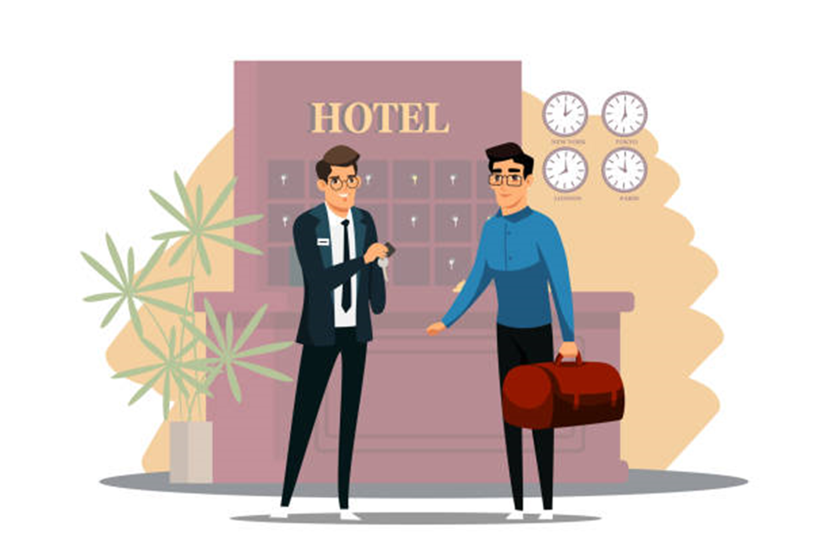


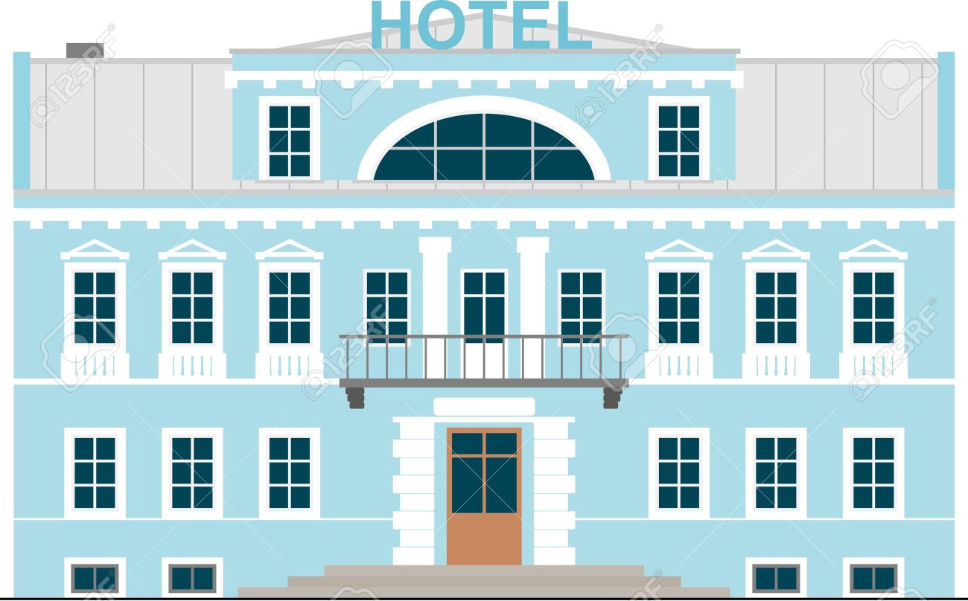
Overview of Banyan Tree
Ho Kwon Ping, a revolutionary businessman and former Singaporean journalist, launched Banyan Tree Hotel and Resorts in 1994, establishing it as a renowned name in the luxury hotel industry.
Ho Kwon Ping aimed to develop a brand that expressed these characteristics in the hotel industry by gaining inspiration from the mighty banyan tree that is renowned for its wide-ranging branches and profound significance in Asian culture.
Source: (Meirovich, 2020)
Source: (Meirovich, 2020)
The exquisite lodgings provided by Banyan Tree, that include tastefully designed villas and suites that provide tourists with a combination of contemporary comfort and classic elegance, are the company’s trademark
Notes:
Ho Kwon Ping, a revolutionary businessman and former Singaporean journalist, launched Banyan Tree Hotel and Resorts in 1994, establishing it as a renowned name in the luxury hotel industry. Ho Kwon Ping aimed to develop a brand that expressed these characteristics in the hotel industry by gaining inspiration from the mighty banyan tree that is renowned for its wide-ranging branches and profound significance in Asian culture.
The exquisite lodgings provided by Banyan Tree, that include tastefully designed villas and suites that provide tourists with a combination of contemporary comfort and classic elegance, are the company’s trademark. The award-winning Banyan Tree Spa offers restoring treatments and therapies in serene surroundings and displays its commitment to wellness (banyantree, 2023).

Slide 5




Identification of the hotel’s prime consumers
The main points of summarising the reasons Banyan Tree Hotel and Resorts appeals to their primary consumer groups are the following:
Affluent Travelers:
Affluent people seeking luxurious experiences are catered to by Banyan Tree’s emphasis on luxury and individualised attention.
Couples and honeymooners:
Banyan Tree is a great place for honeymooners and couples for the reason of its isolated villas, intimate settings, and romantic environment. Romantic gateways, private pools and beautiful vistas make the ideal visionary, developing priceless memories.
Source: (Nica, 2022)
Source: (Nica, 2022)
Source: (Nica, 2022)
Well-Travelled Adventures:
Well-travelled and culture enthusiasts are attracted to Banyan Tree as it is dedicated to authenticity and local experiences. It appeals to travellers looking for a deeper connection to the places they travel by incorporating local culture, traditions, and environment into services and giving guests a genuine sense of the area.

Slide 6


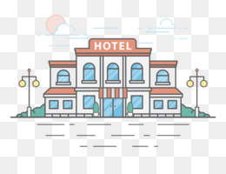
Contd…
Immersive and Tailor-Made Experiences:
The brand’s capacity to provide custom experiences fits with the taste of discriminating customers, enabling them to customise their stay in accordance with their preferences. Whether the tourists seeking relaxation, adventure, or cultural exploration, Banyan Tree has a variety of experiences to suit every individual's choices.
Source: (Ford, 2020)
Immersive and Tailor-Made Experiences:
The brand’s capacity to provide custom experiences fits with the taste of discriminating customers, enabling them to customise their stay in accordance with their preferences. Whether the tourists seeking relaxation, adventure, or cultural exploration, Banyan Tree has a variety of experiences to suit every individual's choices.
Source: (Ford, 2020)

Slide 7

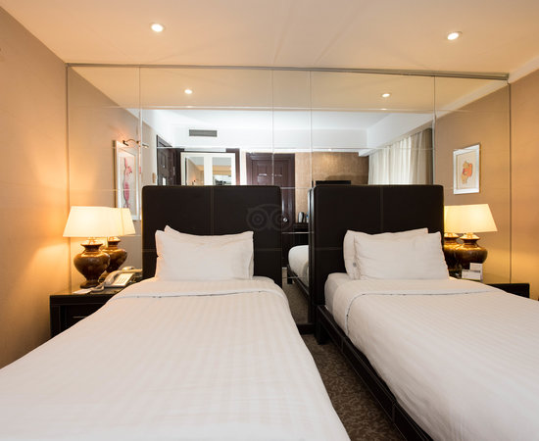
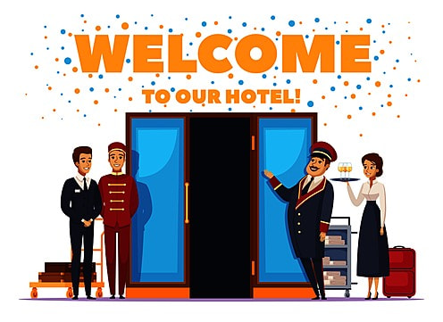
The nature, scope and role of guest services and facilities in Banyan Tree
Nature:
In the Hospitality sector, guest services and facilities refer to all the components intended to optimise a visitor’s stay and entire experience.
Role:
The primary purpose of the amenities and services for guests is to surpass their expectations and ensure that they have a wonderful and hassle-free stay.
Scope:
A huge range of amenities and services are offered to guests, all of that are designed for their stay memorable and rewarding.
Source: (Meirovich, 2020)
Source: (Meirovich, 2020)
Notes:
Nature:
In the Hospitality sector, guest services and facilities refer to all the components intended to optimise a visitor’s stay and entire experience. They include everything from lodging, food, entertainment, and wellness amenities as well as customised services. These components have been carefully structured to satisfy the requirements, tastes, and standards of a wide range of consumers. Private villas with opulent amenities in a tranquil, natural setting are offered by Banyan Tree as opulent lodging options. Traditional therapeutic methods are incorporated into the nature-inspired spa and wellness facilities that empower rest and renewal amidst beautiful surroundings.
Scope:
A huge range of amenities and services are offered to guests, all of that are designed for their stay memorable and rewarding. This comprises tastefully decorated accommodations, upscale dining selections or a variety of cuisines, spa and exercise facilities, leisure pursuits, concierge services, transportation, and individualised help (Nica, 2022). The focus contains smooth check-in and check-out procedures, visitor safety, and top-notch customer service. Private pools, thorough housekeeping, individualised butler service, and in-villa dining are just a few of the amenities that Banyan Tree offers to its guests. At the organisation, exquisite cuisine is an essential component (Herpell, 2015). A wide variety of cuisines produced by talented chefs are offered, allowing guests to engage in a gourmet adventure.
Role:
The primary purpose of the amenities and services for guests is to surpass their expectations and ensure that they have a wonderful and hassle-free stay. They support satisfied consumers, repeat business, and effective word-of-mouth advertising (Wood, 2015). Businesses can stand out in a crowded market by offering first-rate amenities and great services, enabling them to develop a loyal customer base. Through offering unparalleled solitude, individualised services, and a distinctive fusion of luxury with nature, Banyan Tree succeeds at exceeding guest's expectations. At Banyan Tree, the purpose of these guest services and amenities is to make each visit memorable so that visitors will want to revisit and tell their belongings about this resort.

Slide 8



Importance of Hospitality
Enhanced Guest Experience:
The core component of the hotel business is hospitality that elevates a standard visit to a memorable one. Building brand reputation:
The foundation of hospitality is the reputation of a hotel. Visitors share their encounters, both positive and negative, increasing the impact of each one.
Long-term business success:
In the hotel sector, hospitality is a vital factor in long-term company success. It encourages partnership fidelity and repeat business.
Source: (Nica, 2022)
Source: (Nica, 2022)
Notes:
Importance of Hospitality
Enhanced Guest Experience:
The core component of the hotel business is hospitality that elevates a standard visit to a memorable one. It consists of a kind of welcome, careful attention to detail and sincere concern for the guests (Minwer, 2019). This individualised approach makes sure that guests feel respected, at home and welcome, greatly improving their overall experience. By providing personalised experiences that speak to each visitor, hotels seek to go beyond simple lodging. A guest’s reservation triggers the start of personalisation. A smooth check-in process depends on knowing preferences for room type, bedding, amenities, or dietary requirements. Predicting and meeting guest's needs during their stay offers a personal touch.
Building brand reputation:
The foundation of hospitality is the reputation of a hotel. Visitors share their encounters, both positive and negative, increasing the impact of each one. Excellent service produces an indelible mark and inspires visitors to share stories about their trips with their friends, family, and online communities (Panchapakesan, 2020). The key to exceeding expectations is to provide flawless service. Hotels make significant investments in training programs to give staff members excellent communication and problem-solving skills, as well as an inherent grasp of consumer requirements (Soloman, 2018).
Long-term business success:
In the hotel sector, hospitality is a vital factor in long-term company success. It encourages partnership fidelity and repeat business. A satisfied customer is more than simply a one-time purchase, they become a source of ongoing income through repeat business and recommendations. Nowadays hotels are using technologies to redefine their guest's experience. Technology improves ease and efficiency, from faster booking procedures and pre-arrival communication to in-room tablets for guest requests.

Slide 9



Conclusion
The future of the hospitality sector was examined in this presentation, with an emphasis on the anticipated improvements that hotels were ready to execute to meet and exceed visitor expectations.
Source: (Meirovich, 2020)
Source: (Meirovich, 2020)
The investigation provided insight into the approaches and developments anticipated to transform the visitor experience, providing a smooth fusion of customisation, first-rate service, and cutting-edge technology.
Notes:
Conclusion
The future of the hospitality sector was examined in this presentation, with an emphasis on the anticipated improvements that hotels were ready to execute to meet and exceed visitor expectations. The investigation provided insight into the approaches and developments anticipated to transform the visitor experience, providing a smooth fusion of customisation, first-rate service, and cutting-edge technology. Moreover, this presentation depicted the future of hospitality, with personalised interactions and cutting-edge amenities coming together to create stays that will be remembered by every visitor.

Slide 10
References:
Ford, R.C (2020) Managing hospitality organizations: achieving excellence in the guest experience, SAGE
Herpell M. (2015) Five Star Service: How to deliver Exceptional Customer Service, Pearson, London
Meirovich, G., Jeon, M.M. and Coleman, L.J., (2020). Interaction of normative and predictive expectations in customer satisfaction and emotions. Journal of Marketing Analytics, 8, pp.69-84.
Minwer. L. Seenieena. L, Yoon, K. (2019) Multisensory experience for enhancing hotel guest experiences: Empirical evidence form big data analytics
Nica, E., Poliak, M., Popescu, G.H. and Pârvu, I.A., (2022). Decision intelligence and modeling, multisensory customer experiences, and socially interconnected virtual services across the metaverse ecosystem. Linguistic and Philosophical Investigations, 21, pp.137-153.
on service recovery in the hotel industry
Panchapakesan, P, Jisea A (2020) Guest satisfaction & dissatisfaction in luxury hotels: An application on big data

