Slide 1



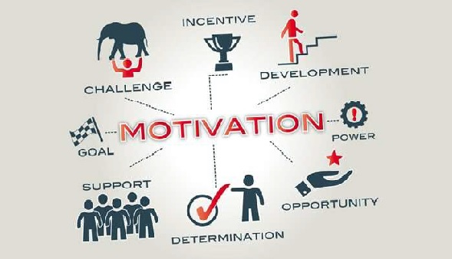
presentation
Module Code: BMSW 5102
Module: Developing Relationship and Workplace Achievement
Assignment Title: Developing Relationship and Workplace
Achievement
Lecturer: Dr. Doreen Nyaa Amundam
Name: Nicoleta Mocanu
Student ID: 2118432
Developing relationships & work placement achievement

Slide 2

INTRODUCTION
Employee motivation is the urge, zeal, and excitement that people have to carry out their duties and accomplish their objectives inside a company. Employee productivity, work happiness, and overall organisational performance all depend on it.
Extrinsic motivation is the external incentive that results from things like prizes, recognition, promotions, or pay raises. The source of intrinsic motivation, on the other hand, is internal and includes things like personal fulfilment, satisfaction, and a sense of achievement from completing the activity.
Notes:
Employee motivation is the urge, zeal, and excitement that people have to carry out their duties and accomplish their objectives inside a company. Employee productivity, work happiness, and overall organisational performance all depend on it.
Extrinsic motivation is the external incentive that results from things like prizes, recognition, promotions, or pay raises. The source of intrinsic motivation, on the other hand, is internal and includes things like personal fulfilment, satisfaction, and a sense of achievement from completing the activity.

Slide 3
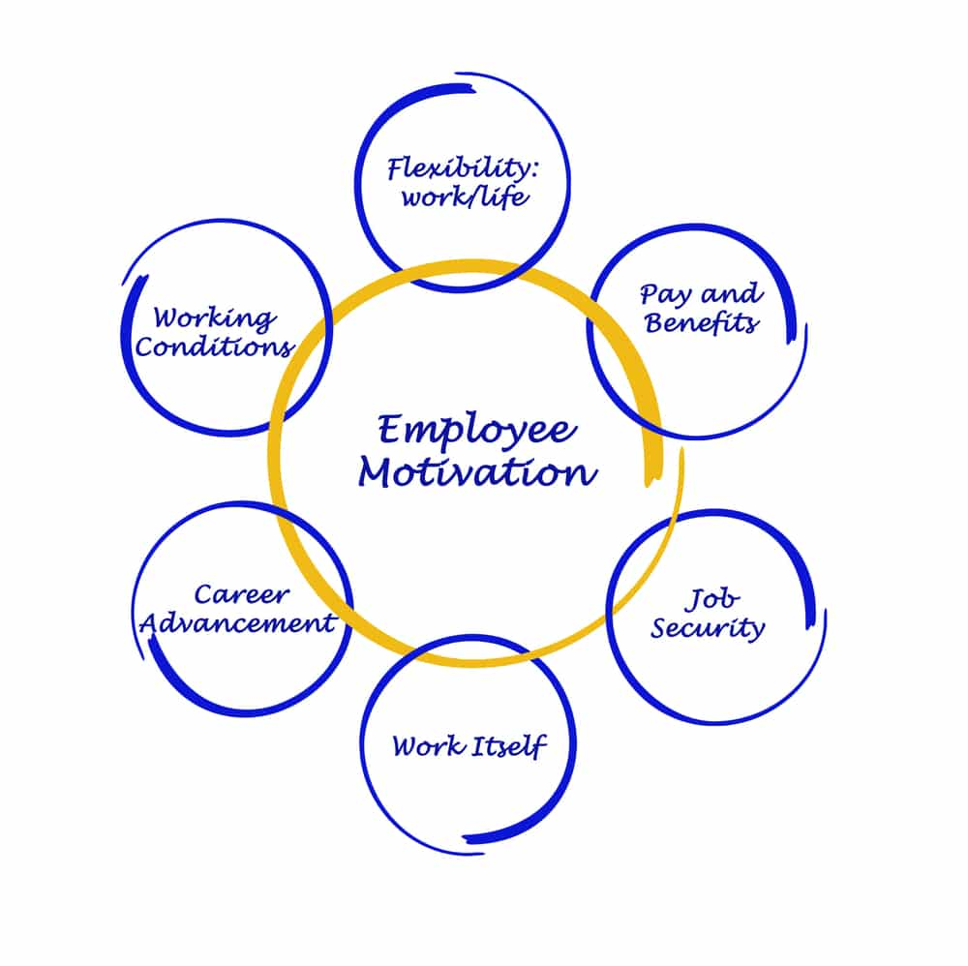
Employee motivation
Employee motivation is the collective term for the internal and external forces that push workers to properly carry out their duties and accomplish their organisational goals. It is the collection of psychological influences or incentives that influence how people behave, exert effort, and adhere to their professional tasks and obligations (Paais et al., 2020).
Employees that are motivated are more devoted, engaged, and productive at work. They go above and above what is necessary to do their jobs and proactively work to make the organisation successful. Employee motivation is crucial for a company's overall performance and has a big influence on productivity, employee happiness, retention rates, and ultimately, the bottom line.
Notes:
Employee motivation is the collective term for the internal and external forces that push workers to properly carry out their duties and accomplish their organisational goals. It is the collection of psychological influences or incentives that influence how people behave, exert effort, and adhere to their professional tasks and obligations (Paais et al., 2020).
Employees that are motivated are more devoted, engaged, and productive at work. They go above and above what is necessary to do their jobs and proactively work to make the organisation successful. Employee motivation is crucial for a company's overall performance and has a big influence on productivity, employee happiness, retention rates, and ultimately, the bottom line.

Slide 4
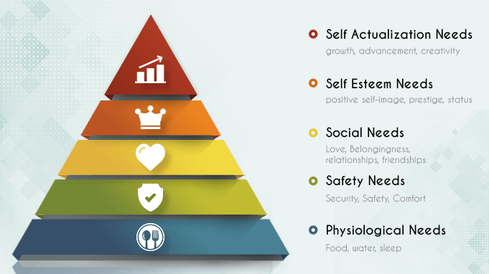

Motivation can arise from
various sources
Intrinsic Motivation: Internal elements such as self-satisfaction, a sense of accomplishment, or enjoyment from the activity itself serve as sources of intrinsic motivation.
Extrinsic motivation: This is fueled by outside sources like monetary incentives, accolades, promotions, or other palpable advantages provided by the company.
Work Design: The way a work is created might affect how motivated employees are. Employees are more likely to be motivated by jobs that offer autonomy, variety, difficulties, and opportunity for growth and development.
Organisational Culture: An organization's culture and values have a big impact on how motivated its employees are.
Leadership and Management: Motivating employees depends heavily on effective leadership and management.
Notes:
Intrinsic Motivation: Internal elements such as self-satisfaction, a sense of accomplishment, or enjoyment from the activity itself serve as sources of intrinsic motivation.
Extrinsic motivation: This is fueled by outside sources like monetary incentives, accolades, promotions, or other palpable advantages provided by the company.
Work Design: The way a work is created might affect how motivated employees are. Employees are more likely to be motivated by jobs that offer autonomy, variety, difficulties, and opportunity for growth and development.
Organisational Culture: An organization's culture and values have a big impact on how motivated its employees are.
Leadership and Management: Motivating employees depends heavily on effective leadership and management.

Slide 5
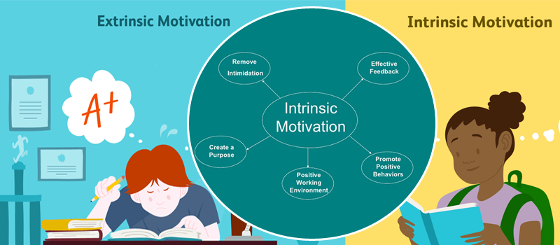
extrinsic and intrinsic motivation
External motivation or penalties serve as the basis for extrinsic motivation. In the short term, this kind of motivation may be successful, but over time, it may also cause a decline in the intrinsic drive.
Intrinsic motivation, such as the delight of learning something new or the difficulty of completing a task, is what fuels intrinsic motivation.
Notes:
External motivation or penalties serve as the basis for extrinsic motivation. In the short term, this kind of motivation may be successful, but over time, it may also cause a decline in the intrinsic drive.
Intrinsic motivation, such as the delight of learning something new or the difficulty of completing a task, is what fuels intrinsic motivation.

Slide 6


Which motivation type motivates mostly at work?
Due to its greater alignment with people's innate desire to learn and advance, intrinsic motivation is more likely to inspire individuals at work. Extrinsic motivation, however, may also be productive in the job, particularly when combined with intrinsic motivation. For instance, management might acknowledge the efforts and accomplishments of their staff members by giving them extrinsic rewards like bonuses or promotions (Nehra and N.S., 2023). By giving staff members a feeling of achievement and acknowledgment, this can aid in increasing intrinsic drive.
Notes:
Due to its greater alignment with people's innate desire to learn and advance, intrinsic motivation is more likely to inspire individuals at work. Extrinsic motivation, however, may also be productive in the job, particularly when combined with intrinsic motivation. For instance, management might acknowledge the efforts and accomplishments of their staff members by giving them extrinsic rewards like bonuses or promotions (Nehra and N.S., 2023). By giving staff members a feeling of achievement and acknowledgment, this can aid in increasing intrinsic drive.

Slide 7
Advantages and disadvantages of each motivation type
Extrinsic motivation
Advantages | Disadvantages
Can be effective in the short-term | Can lead to decreased intrinsic motivation over time
Can help to achieve specific goals | Can be seen as manipulative or controlling
Can be used to motivate people who are not intrinsically motivated | Can be ineffective if the rewards are not seen as valuable
Notes:
The short-term effectiveness of extrinsic motivation can be attributed to the fact that it offers a distinct and immediate objective. If individuals, however, fixate too much on the external benefits, it may eventually result in decreasing intrinsic drive. If a student is just driven to prepare for a test in order to achieve a good mark, for instance, they might not be as motivated to understand the content if they don't get a good grade.

Slide 8
Advantages and disadvantages of each motivation type intrinsic motivation
Advantages | Disadvantages
More sustainable in the long-term | Can be difficult to motivate people who are not intrinsically motivated
Leads to greater satisfaction and engagement | Can be time-consuming to develop
Is more likely to lead to creativity and innovation | Can be difficult to measure
Notes:
Because intrinsic motivation is fueled by internal variables like the joy of learning something new or the challenge of mastering a task, it is more long-lasting. People who are not inherently motivated, however, might be challenging to inspire.

Slide 9
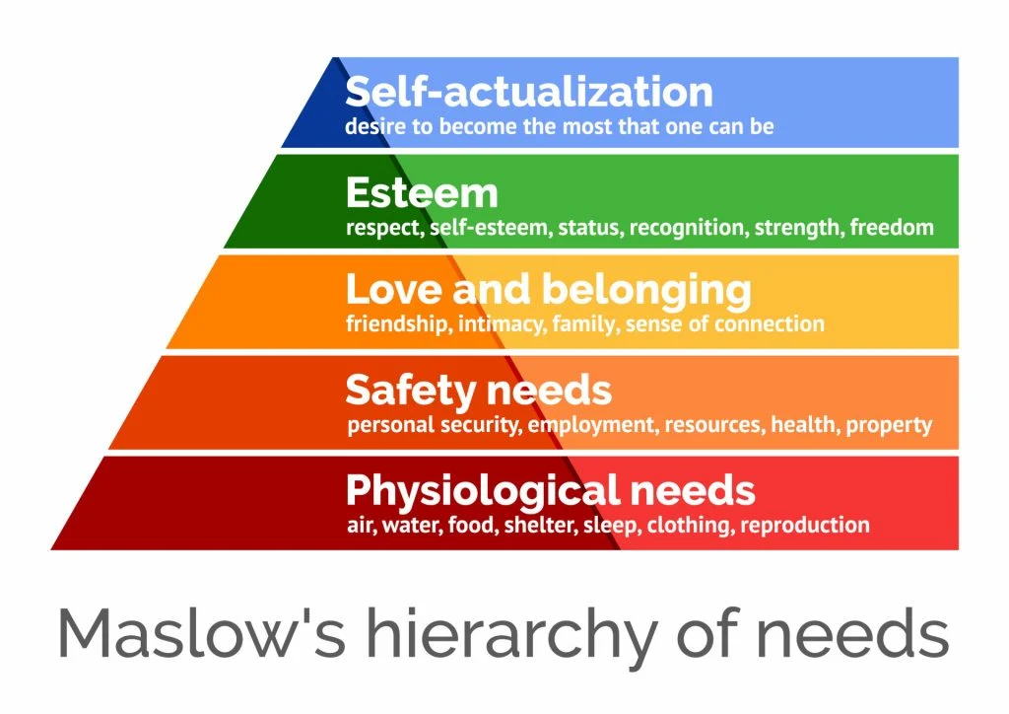
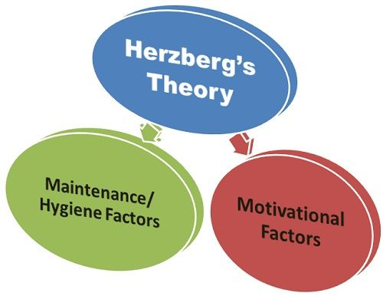
Key motivation theories
There are many various theories of motivation, but a few of the more important ones are as follows:
Maslow's hierarchy of needs: According to this idea, there is a hierarchy of wants that humans must fulfil in order to reach a level of self-actualization. The hierarchy of needs includes needs for physiology, safety, love and belonging, esteem, and self-actualization (Yurdakul et al., 2023).
Herzberg's idea of motivation and hygiene: Motivators and hygiene elements are the two categories of motivators that are distinguished by this approach. Occupational considerations including accomplishment, acclaim, and responsibility are examples of motivators. Factors that affect workplace hygiene include things like compensation, working conditions, and corporate rules.
Notes:
Maslow's hierarchy of needs: According to this idea, there is a hierarchy of wants that humans must fulfil in order to reach a level of self-actualization. The hierarchy of needs includes needs for physiology, safety, love and belonging, esteem, and self-actualization (Yurdakul et al., 2023).
Herzberg's idea of motivation and hygiene: Motivators and hygiene elements are the two categories of motivators that are distinguished by this approach. Occupational considerations including accomplishment, acclaim, and responsibility are examples of motivators. Factors that affect workplace hygiene include things like compensation, working conditions, and corporate rules.

Slide 10
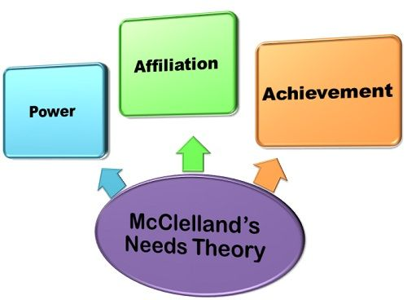
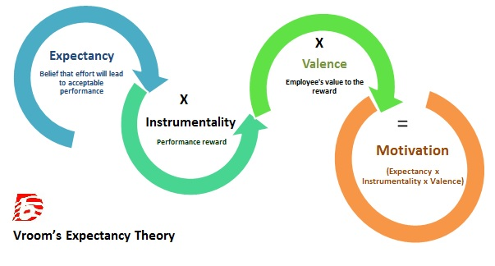
Key motivation theories
There are many various theories of motivation, but a few of the more important ones are as follows:
McClelland's need theory of motivation: According to this idea, humans are motivated by three primary needs: a want for success, a desire for power, and a need for connection. Success and the difficulty of completing a task inspire those with strong needs for accomplishment (Siok et al., 2023). The urge to exert control over others or have an impact on their surroundings drives those with a strong demand for power. driven by the need to be liked and accepted by others, people with a high need for connection are driven (Herlina et al., 2023).
Vroom's expectancy theory: According to this idea, people are driven to take specific behaviours if they think doing so would result in the desired result. According to the idea, three things affect how motivated someone is: the result's importance, their expectation that it will happen, and how directly the action would affect the outcome (Daouk-Öyry et al., 2023).
Notes:
McClelland's need theory of motivation: According to this idea, humans are motivated by three primary needs: a want for success, a desire for power, and a need for connection. Success and the difficulty of completing a task inspire those with strong needs for accomplishment (Siok et al., 2023). The urge to exert control over others or have an impact on their surroundings drives those with a strong demand for power. driven by the need to be liked and accepted by others, people with a high need for connection are driven (Herlina et al., 2023).
Vroom's expectancy theory: According to this idea, people are driven to take specific behaviours if they think doing so would result in the desired result. According to the idea, three things affect how motivated someone is: the result's importance, their expectation that it will happen, and how directly the action would affect the outcome (Daouk-Öyry et al., 2023).

Slide 11

Conclusion
Employee motivation is the urge, zeal, and excitement that people have to carry out their duties and accomplish their objectives inside a company. Extrinsic motivation is the external incentive that results from things like prizes, recognition, promotions, or pay raises(Ausat et al., 2023). The source of intrinsic motivation, on the other hand, is internal and includes things like personal fulfilment, satisfaction, and a sense of achievement from completing the activity. Extrinsic and internal motivation are both significant in the job. In order to encourage people to find purpose, fulfilment, and happiness in their job, organisations should try to establish a work environment that fosters both forms of motivation (Xing et al., 2023).
Notes:
Employee motivation is the urge, zeal, and excitement that people have to carry out their duties and accomplish their objectives inside a company. Extrinsic motivation is the external incentive that results from things like prizes, recognition, promotions, or pay raises(Ausat et al., 2023). The source of intrinsic motivation, on the other hand, is internal and includes things like personal fulfilment, satisfaction, and a sense of achievement from completing the activity. Extrinsic and internal motivation are both significant in the job. In order to encourage people to find purpose, fulfilment, and happiness in their job, organisations should try to establish a work environment that fosters both forms of motivation (Xing et al., 2023).

Slide 12
References
Xing, L., Sun, J.M., Jepsen, D. and Zhang, Y., 2023. Supervisor negative feedback and employee motivation to learn: An attribution perspective. human relations, 76(2), pp.310-340.
Ausat, A.M.A., Purnomo, Y.J., Munir, A.R. and Suherlan, S., 2023. Do Motivation, Compensation, and Work Environment Improve Employee Performance: A Literature Review. International Journal Of Artificial Intelligence Research, 6(1.2).
Daouk-Öyry, L. and El-Farr, H., 2023. Vroom’s Expectancy Theory.
Herlina, M.G., Hadipoespito, R. and Harlianto, J., Empowering Innovative Team Among Knowledge Workers: McClelland's Needs Theory with Rasch Model Analysis.
Siok, T.H., Sim, M.S. and Rahmat, N.H., 2023. Motivation to learn online: an analysis from Mcclelland’s theory of needs. International Journal of Academic Research in Business and Social Sciences, 13(3), pp.215-234.
Yurdakul, G. and Arar, T., 2023. Revisiting Maslow’s hierarchy of needs: Is it still universal content?. Journal of human behavior in the social environment, pp.1-28.
Nehra, N.S., 2023. Can employee engagement be attained through psychological detachment and job crafting: the mediating role of spirituality and intrinsic motivation. Journal of Organizational Effectiveness: People and Performance, (ahead-of-print).
Paais, M. and Pattiruhu, J.R., 2020. Effect of motivation, leadership, and organizational culture on satisfaction and employee performance. The Journal of Asian Finance, Economics and Business, 7(8), pp.577-588.
Notes:
Xing, L., Sun, J.M., Jepsen, D. and Zhang, Y., 2023. Supervisor negative feedback and employee motivation to learn: An attribution perspective. human relations, 76(2), pp.310-340.
Ausat, A.M.A., Purnomo, Y.J., Munir, A.R. and Suherlan, S., 2023. Do Motivation, Compensation, and Work Environment Improve Employee Performance: A Literature Review. International Journal Of Artificial Intelligence Research, 6(1.2).
Daouk-Öyry, L. and El-Farr, H., 2023. Vroom’s Expectancy Theory.
Herlina, M.G., Hadipoespito, R. and Harlianto, J., Empowering Innovative Team Among Knowledge Workers: McClelland's Needs Theory with Rasch Model Analysis.
Siok, T.H., Sim, M.S. and Rahmat, N.H., 2023. Motivation to learn online: an analysis from Mcclelland’s theory of needs. International Journal of Academic Research in Business and Social Sciences, 13(3), pp.215-234.
Yurdakul, G. and Arar, T., 2023. Revisiting Maslow’s hierarchy of needs: Is it still universal content?. Journal of human behavior in the social environment, pp.1-28.
Nehra, N.S., 2023. Can employee engagement be attained through psychological detachment and job crafting: the mediating role of spirituality and intrinsic motivation. Journal of Organizational Effectiveness: People and Performance, (ahead-of-print).
Paais, M. and Pattiruhu, J.R., 2020. Effect of motivation, leadership, and organizational culture on satisfaction and employee performance. The Journal of Asian Finance, Economics and Business, 7(8), pp.577-588.

Slide 13



THANK YOU
THANK YOU
+1 (589) 555-0199
victoria@fabrikam.com

