Slide 1


How do students use technology to collaborate at UWTSD?
2212092 GODFRED MINNOW YANKEY
2211604 LEONARD DOROFTEI

Slide 2

Digital Skills and Research Methods
LCHS4002
Rebecca Stewart (Module Lead)
Chuen Leung
Matthew Brian
Julius Azasoo
Lecturers name :
Leonard Doroftei

Slide 3

Introduction
The focus of this presentation it is to show how students at UWTSD are using digital skills and help them understand few of the most used among us.
Some digital tool developers and software companies provide free access to educators and students who are willing to teach or learn with them.
Leonard Doroftei

Slide 4

Which digital tool is most used by students at UWTSD to collaborate together?
What is the most common tool students use?
Why they using it for ?
How often do you use it ?
When do you use it ?
Are you satisfied with the tool?
Leonard Doroftei

Slide 5

What is the most common tool students use?
MS Teams
OneDrive
MS Word
WhatsApp
Moodle
Leonard Doroftei

Slide 6
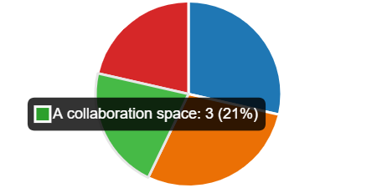
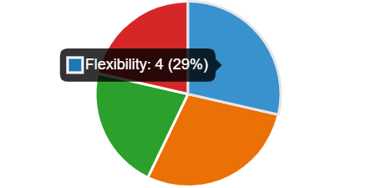
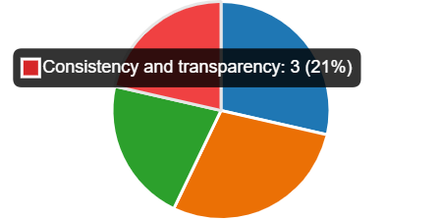
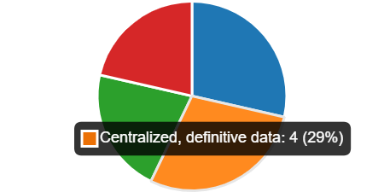
Why they using it for ?
A collaboration space
Flexibility
Consistency and transparency
Centralized, definitive data
Leonard Doroftei

Slide 7

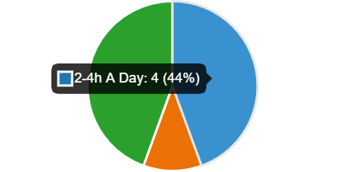
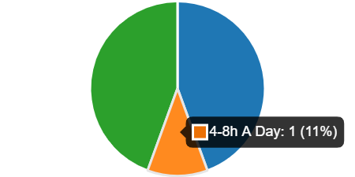
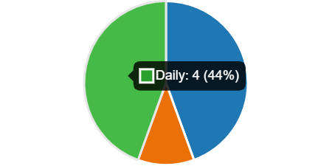
How often do you use it ?
A research made by us leading us to the next numbers :
Leonard Doroftei

Slide 8
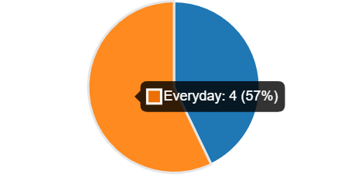
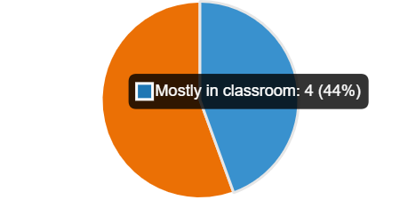
When do you use it ?
In a survey made by us we discovered the next statistics :
More than 50 % of the UWTSD students are using digital tools everyday.
Most of the students at UWTSD using digital tools only in their classrooms.
Leonard Doroftei

Slide 9
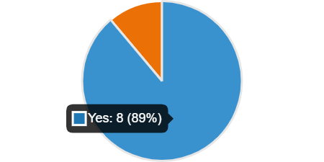
Are you satisfied with the tool?
More than 89 Percent of the students are satisfied with the digital tools the University Of Wales Trinity Saint David are providing.
There's also 11 Percent of the students which are not quite happy and they think the Univerisity can do better.
GODFRED MINNOW YANKEY

Slide 10

Let's see the Most common tools Students use at UWTSD
We are going to show everyone the basics of the digital tools and the most digital tools used by UWTSD students
GODFRED MINNOW YANKEY

Slide 11

What is Microsoft team used for?
How do Microsoft team Teams work?
Who can use Microsoft Teams?
GODFRED MINNOW YANKEY

Slide 12

What is Microsoft Teams used for ?
Microsoft Teams is a persistent chat-based platform.
Microsoft Teams features make it stand out from other collaboration software:
Online meetings.
Audio conferencing
Screen sharing
A chat function
GODFRED MINNOW YANKEY

Slide 13
How do Microsoft team Teams work?
In Microsoft Teams, teams are groups of people brought together for work, projects, or common interests.
Teams are made up of two types of channels :
standard (available and visible to everyone)
private (focused, private conversations with a specific audience)
GODFRED MINNOW YANKEY

Slide 14
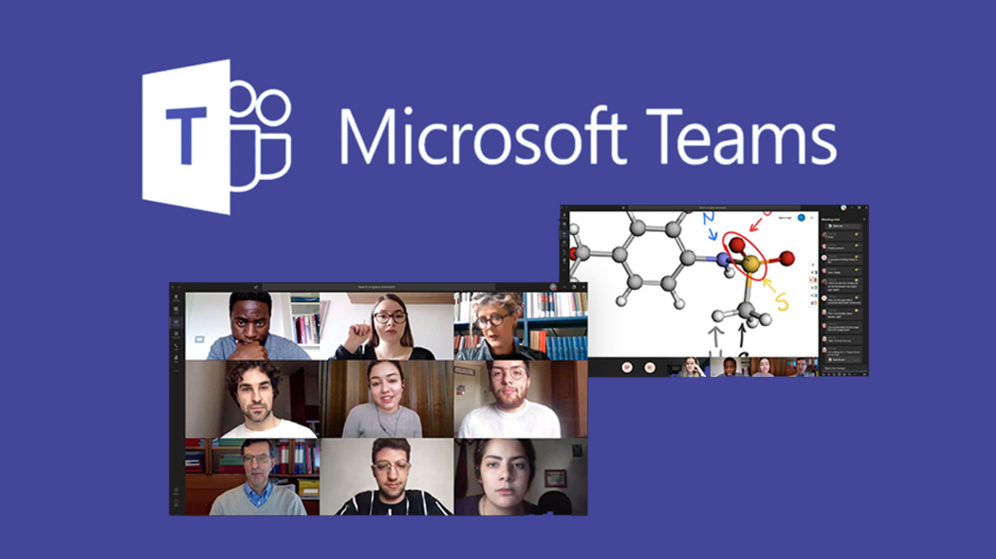
WHO CAN USE MICROSOFT TEAMS?
Microsoft Teams it's free to use and can be use by all students
GODFRED MINNOW YANKEY

Slide 15
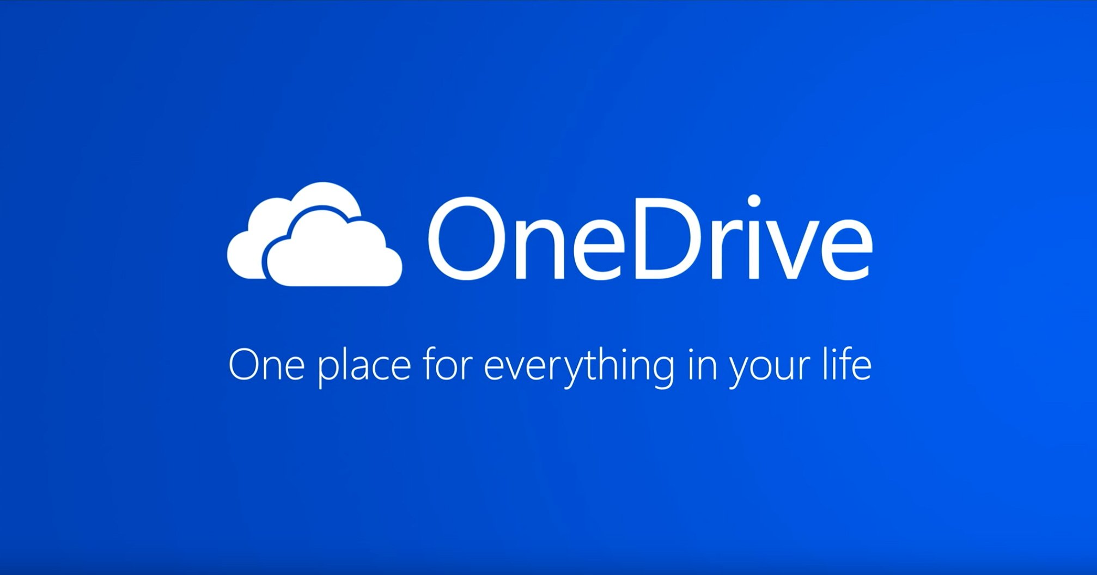
Onedrive and how can be use
OneDrive is a cloud storage service from Microsoft where you can save your files and then access them. It is a service similar to Google Drive, Dropbox, etc. You can store any file in OneDrive.
GODFRED MINNOW YANKEY

Slide 16

Microsoft Word
Create and edit documents together
Access your documents anywhere
Translate documents in your non-native language
GODFRED MINNOW YANKEY

Slide 17

Whatsapp
More than 2 billion people in over 180 countries use WhatsApp to stay in touch with friends and family, anytime and anywhere.
WhatsApp from Facebook is a FREE messaging and video calling app
Reliable. Private
GODFRED MINNOW YANKEY

Slide 18

Moodle
Moodle is the world’s most customisable and trusted eLearning solution that empowers educators to improve our world.
Moodle was born from a desire to give educators a way to create quality education experiences over the internet.
1. 316,000,000+
Users worldwide
2. 1.8 Billion+
Course enrolments
3. 41,000,000+
Courses in 42 languages
4. 179,000+
Moodle sites
GODFRED MINNOW YANKEY

Slide 19

hypothesis
"Our hypothesis is most of the students at UWTSD are using digital tools every day, not only when they inside the campus and they still learning and trying to work on their skills to become better in their classes, but also to improve themself outside the univerisity .
GODFRED MINNOW YANKEY

Slide 20
Reference list
docs.moodle.org. (n.d.). About Moodle - MoodleDocs. [online] Available at: https://docs.moodle.org/400/en/About_Moodle.
WhatsApp.com. (n.d.). Features. [online] Available at: https://www.whatsapp.com/features.
www.microsoft.com. (n.d.). Microsoft 365 | Secure, Integrated Office 365 Apps + Teams. [online] Available at: https://www.microsoft.com/en-gb/microsoft-365?rtc=1.
‌www.microsoft.com. (n.d.). Free Cloud Storage - Share Files Online | Microsoft OneDrive. [online] Available at: https://www.microsoft.com/en-gb/microsoft-365/onedrive/online-cloud-storage/ [Accessed 14 Oct. 2022].
‌www.microsoft.com. (n.d.). Create & Edit Word Docs with Microsoft 365 | Microsoft Word. [online] Available at: https://www.microsoft.com/en-gb/microsoft-365/word?activetab=tabs%3afaqheaderregion3 [Accessed 14 Oct. 2022].

