Slide 1


Course: Business management
Module name: Managing people
Module code: LCBB5004
Lecturer: Mushfiqur Rahman
Title of report: Presentation
Student: Stanimira Nikolova
ID Number: 2118452

Slide 2
Table of content
1. Introduction
2. UK Hospitality and its importance to the UK
3. Premier Inn
4. Talent management and its importance in the organization
5. Talent Management concept
6. Talent acquisition strategies
7. Short-term
8. Long-term
9. Different incentive methods
10. Monetary methods
11. Non-monetary methods
12. Herzberg’s theory
13. Premier Inn
14. Conclusion
14. Reference list

Slide 3
Introduction
UK Hospitality
Premier Inn
The most important instruments to find top talent
Top talent is vital for every successful, sustainable, and competitive organization
Premier Inn and it’s best working environment that allows everyone’s talent to grow

Slide 4

UK HOSPITALITY
UK Hospitality
UK Hospitality is under pressure due to Covid 19
Government support is required
A healthy hospital sector is vital to the UK economy
UK Hospitality

Slide 5


About Premier INN
Premier INN suffers from staff shortage due to health crisis
Premier Inn Mission, Vision & Values
Diversity team making winning teams
Premier Inn

Slide 6
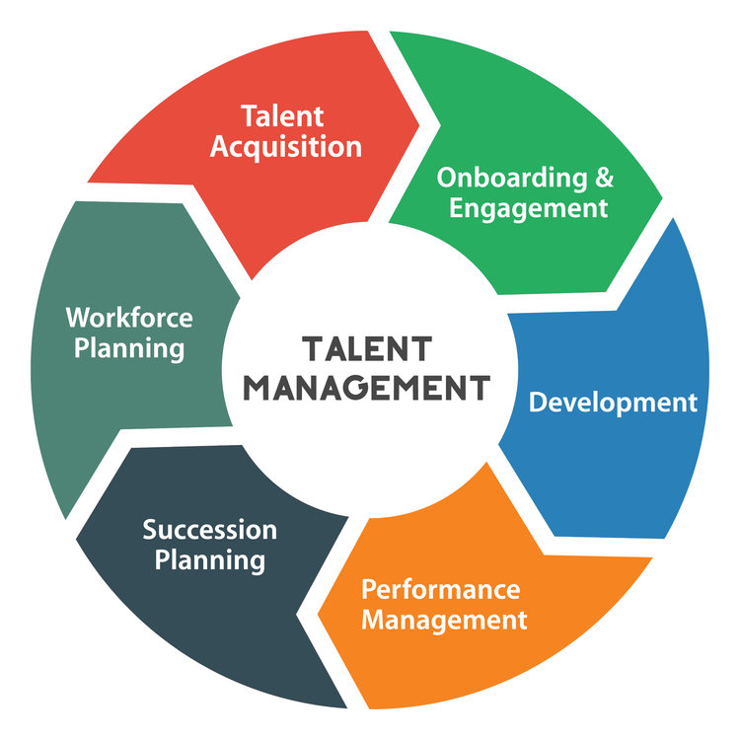
Talent Management Concept
Talent management
The importance of talent management
Talent management and its benefit
Successful organization required the right people
Talent management strategy
Planning and best practices for talent management
Talent Management

Slide 7
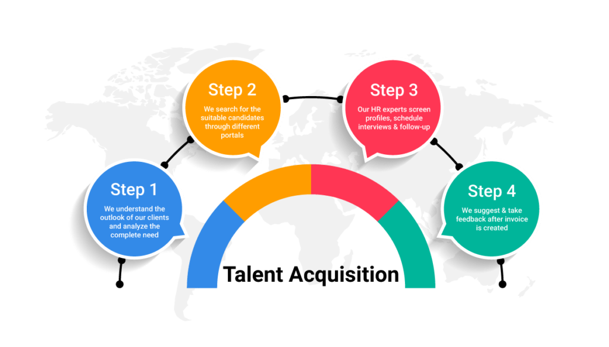
Talent Acquisition strategy
Help organisations recruit top talent
Convincing them to bring their unique skills
Talent Acquisition

Slide 8

Talent Acquisition strategies
Short–term talent acquisition strategies
Long-term talent acquisition strategies
Short and long term

Slide 9


Talent acquisition strategies-short and long-term
Short-term talent acquisition strategies
Examine the hiring requirements in terms of time and skills
Create a precise job description
Suitable technology for immediate recruitment
Check the quality of cost, and employment before the final selection
Short-Term

Slide 10

Long-term
Create a recruitment calendar and long-term hiring plan
Concentrate on improving employer branding
Use the internet job portal to scale the hiring process
Promote employee referral to attract candidates
Long-Term

Slide 11

Different incentive methods
Monetary methods
Non-monetary methods
Incentives methods

Slide 12

Monetary methods
40% of job seekers rank salary as the top factor.
Benefits are also one of the most important factors
Monetary methods

Slide 13
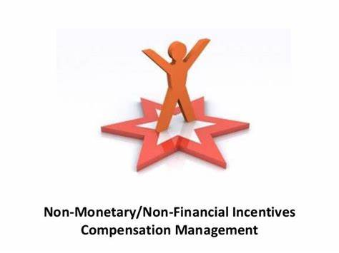
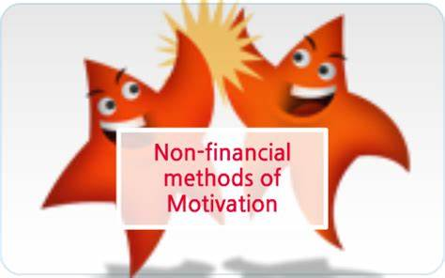
Non-monetary methods
Flexible working hours
Good working environment
Non-monetary methods

Slide 14
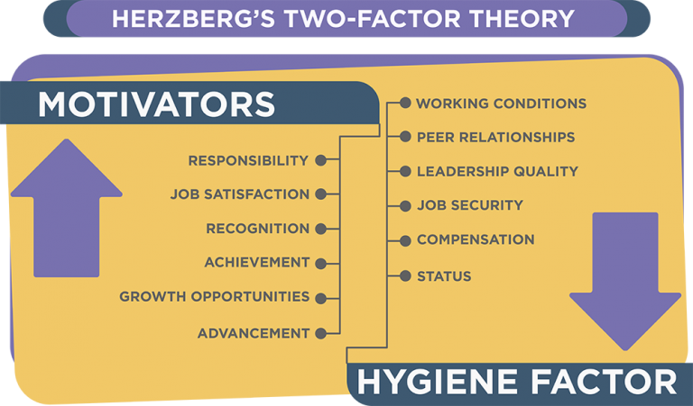
Herzberg theory
Herzberg Theory

Slide 15


Plans to spend about 23 million pounds on salary increase and one-off bonuses
Wants to deal with a material number of vacancies
Provide growth opportunity
Great way to attract potential candidates
Premier Inn has been named the Top employer in 2022
Best working environment, care about their team reaching their full potential
Great service, quality, and value
Premier Inn

Slide 16
Conclusion
Good motivation, respecting people, and value for diversity is one of the most important things to a successful and sustainable hospitality.
Hospitality really matters as it feeds the most basic human need that everyone has, to feel loved and accepted.
Excellent hospitality means excellent growth.

Slide 17
Reference list:
Smith A (2023) Government release updated hospitality strategy [Online] Available at:
https://www.ncass.org.uk/government-releases-updated-hospitality-strategy/ (Accessed: 15 March 2023)
APD (2023) What is talent management? [Online] Available at:
https://www.adp.com/resources/articles-and-insights/articles/w/what-is-talent-management.aspx
(Accessed: 15 March 2023)
BBC (2021) Motivate and Leadership [Online] Available at:
https://www.bbc.co.uk/bitesize/guides/zkt8xyc/revision/3 ( Accessed: 15 March 2023)
Muvija M & Peters C (2021) Labour shortages cloud Premier Inn owner’s bullish outlook [Online] Available at:
https://www.reuters.com/world/uk/premier-inn-owner-eyes-full-uk-recovery-2022-losses-narrow-2021-10-26/ ( Accessed: 15 March 2023)
Gov. UK (2023) Hospitality strategy: reopening, recovery, resilience [Online] Available at:
https://www.gov.uk/government/publications/hospitality-strategy-reopening-recovery-resilience
(Accessed: 15 March 2023)

Slide 18
Guardians News (2023) Severe staff shortages hit UK Hospitality venues amid a huge rise in booking [Online] Available at:
https://www.theguardian.com/business/2021/may/31/severe-staff-shortages-hit-uk-hospitality-venues-amid-huge-rise-in-bookings ( Accessed: 15 March 2023)
Premier Inn (2023) Premier Inn Mission, Vision& Values, [Online] Available at:
https://www.comparably.com/companies/premier-inn/mission ( Accessed: 15 March 2023)
Premier Inn (2023) We are Force for Good, [Online] Available at:
https://www.premierinn.com/gb/en/why/force-for-good.html (Accessed: 15 March 2023)
Premier Inn (2023) We value differences at Premier Inn [Online] Available at:
https://www.premierinn.com/gb/en/terms/diversity-and-inclusion.html ( Accessed: 15 March 2023)
Premier Inn (2022) Top Employer [Online] Available at: https://www.premierinn.com/gb/en/news/2022/top-employer.html#:~:text=Premier%20Inn%20named%20Top%20Employer%20We%E2%80%99re%20proud%20to,create%20the%20best%20working%20environments%20for%20their%20employees. ( Accessed: 21 March 2023)

Slide 19
Reed. Co.uk (2023) How to attract the right candidate for your organization [Online] Available at:
https://www.reed.co.uk/recruiter-advice/how-to-attract-the-right-candidate-for-your-organisation/
(Accessed: 15 March 2023)
Ette S (2022) Third of businesses to reduce opening hours over Christmas due to staff shortage [Online] Available at:
https://www.ukhospitality.org.uk/news/625938/THIRD-OF-BUSINESSES-TO-REDUCE-OPENING-HOURS-OVER-CHRISTMAS-DUE-TO-STAFF-SHORTAGES.htmh
(Accessed:15 March 2023)
SAVIOM (2022) How to plan for short -term and long-term talent acquisition strategy [Online] Available at:
https://www.saviom.com/blog/how-to-plan-for-short-term-and-long-term-talent-acquisition-strategy/ (Accessed: 15 March 2023)

