Slide 1


LCBB4009 Business Management
Understanding Organisational Structure and Culture
Marks & Spencer Organizational Structure Presentation
Student Name: Carmen Ileana Niculae
Student ID: 2431195

Slide 2
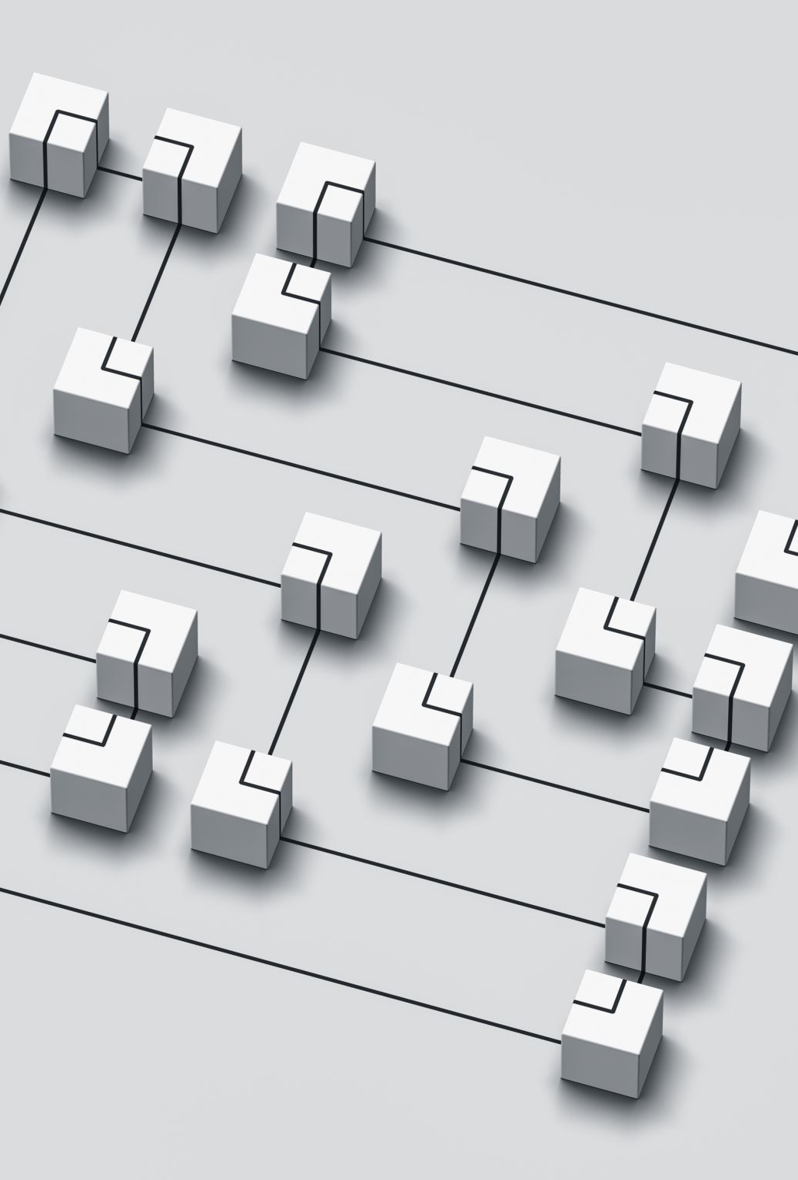
Presentation Outline
Definition and significance of the organisational structure in the current context of retailing
History of Marks and Spencer and how it has developed to be one of the largest retailers in the UK since 1884
Three structural methods of M&S: Flat/Hierarchical Structure, Divisional Structure, and Functional Structure
Comparison of both structures as to organizational structure analysis and practical applications of M&S software
Conclusion of how these structures can help M&S on its objectives and performance under strategies
Notes:
This presentation is organized in such a way as to develop a complete knowledge of this organizational design principles. First, we are going to start with the basics definition and theoretical significance, before moving on to the discussion of the background of M&S as leading retail company. The main emphasis discusses the three different structural designs namely hierarchical, divisional, and functional designs. Real M&S examples and organizational charts shall be used to analyze each structure. Lastly, we shall sum up by concluding on how the each of these structures aid together in the strategic objectives of M&S as well as how it positions itself competitively in contemporary markets of retail.

Slide 3
Organisational Structure Definition and Importance
Organisational structure is a formal structure that characterises the distribution, organization, and coordination that are used in an organisation (Daft, 2015)
Organisational charts give pictorial illustration of reporting lines, lines of authority and lines of communication among various levels of organisation and various departments (Handy, 1993)
A strategic value is in its ability to provide a platform through which effective communication, task coordination, and decision-making process can be achieved, which directly determines the organisational performance (Joseph & Sengul, 2025)
The adaption process in the environment necessitates organisations to match the structure to the environment and the relatively stable environments are best served under mechanistic structures and dynamically changed environments under organic structures (Burns & Stalker, 1961)
Under the performance impact, proper structural design is effective in motivating employees, cut expenditure incurred in operations and offer an efficient customer service delivery (Machova et al., 2022).
Notes:
The structure of an organization frames the spine of any successful company since it dictates the course of work and the approach of making decisions. It is a formal structure of activities separation and coordination s Daft puts it. As it relates to retailers such as M&S, structure has a direct relationship on customer service delivery and the efficiency of operations. The issue is that a decision in favor of either of the supposed to be contrary sides of the dichotomy of mechanistic and organic approaches is predetermined by environmental stability as illustrated by the Burns and Stalker on the choice of one of the two possible approaches. Structural fitment augments employee motivation, defrays costs and attains effective communication in the global operations of M&S comprising of more than 80,000 employees.

Slide 4
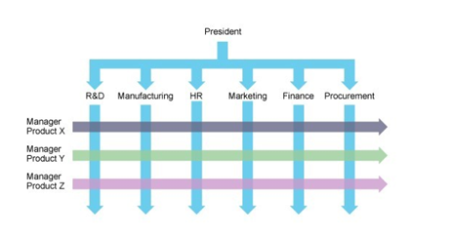
Flat/Hierarchical Structure at M&S
A definition of flat structure entails reduced intervening levels of management between the top executives and front-line workforce, expanded spans of control and more employee empowerment (Burns & Stalker, 1961)
The M&S execution is characterized by Executive Committee (ExCo) as the key leadership group to face strategical execution with fewer bureaucratic intermediaries to improve the decision-making pace (M&S, 2024)
Among the organisational advantages are improved and quicker flow of communication, decrease in costs of operation, and enhanced accountability among employees within M&S 80,000+ employees spread in various parts of the world (M&S, 2025)
Leadership style prioritises collaboration in governance, leadership, and employee consultation, which contributes to efficiency and innovation in the retail work (Nielsen et al., 2019)
The performance results stipulate a better sensitivity to market changes and increased contentment among the employees in a higher autonomy and responsibility (Sine et al., 2006)
Notes:
M&S use a top down structure where the lines of authority are clear between the Board level and to the front-line staff. This departmentalization model method of pyramid makes them accountable and have a handle of their complicated retail businesses. The strategic layer of leadership is the Executive Committee, and under it, independent areas are ran by the departmental directors. In responding to this accusation, even though M&S has reduced certain layers to enhance responsiveness, they utilize formal accounting relationships to allow effective governance. This design facilitates their requirements of having stable brand practices and operation systems in the international market.

Slide 5
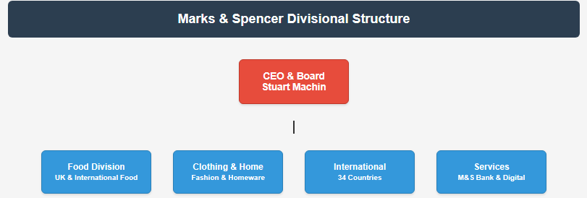
Divisional Structure at M&S
Definition of divisional structure Divisional structure groups the company into semi-autonomous units depending on products, markets, or geographic locations with separated resources and managers (Daft, 2015)
As M&S business operations, there are individual departments, i.e. Food, Clothing & Home, International operations and specialised services, i.e. M&S Bank and M&S Energy (M&S, 2025)
The geographic diversification is in 34 countries with wholly owned and franchise business operations in Europe, Asia, Middle East, and other international markets (www.annualreports.com, 2024)
The operational benefits allow concentrated specialisations on various customer groups, market specific approach and assigning resources that are counterpart to the distinct proprieties of each division (Joseph & Sengul, 2025)
The strategic flexibility enables each of the divisions to react freely to the market condition and yet have a corporate coherence and consistency of the brand (Kondalkar, 2007)
Notes:
M&S work based on different business divisions and each of these divisions targeting different markets and customer groups. Its grocery operations are done by the Food Division and fashion and housewares by the Clothing & Home. The company has internationally 34 country operations which are managed by International Division and the Services Division experienced M&S Bank and digital services. Within this divisional strategy, specialized management focus, specific strategies and response on market needs are enabled. The divisions are able to respond accordingly to the local situation but in general brand coherence of the M&S and convergence of the corporate strategy.

Slide 6
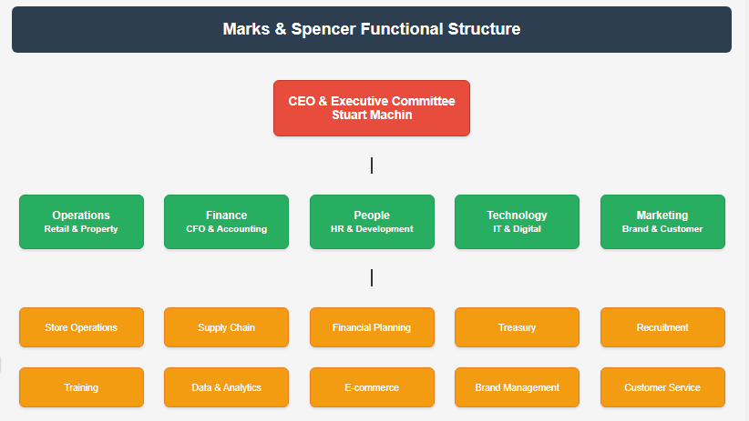
Functional Structure at M&S
The definition of functional structure puts the staff in different categories according to specialised activities and skills that include marketing, finance, human resources and operations in a hierarchical structure (Handy, 1993)
M&S operating businesses have specialised functions such as retail operations, supply chain management, technology, corporate affairs and people management within the executive departments (M&S, 2023)
The organization of governance with clear reporting lines of the Board of Directors is conducted with functional heads developing and ensuring specific areas of expertise and with cross-functional coordination (M&S, 2024)
Advancing expertise leads to high specialisation in the functionality and formal coordination of functions among the departments to make joint decisions (Daft, 2015)
Engagement in standardised operations, defined and clear roles that aid the complicated operation of M&S, and centralised control mechanisms (Nielsen et al., 2019)
Notes:
M&S has the specialized departments with expert directors in charge of specific core business functionalities. Each of the six functions, Operations, Finance, People, Technology, and Marketing, become highly competent and address the every-business-division in its task. The Technology drives digital transformation, with the People Director being in charge of the HR in global operations. Such functional differentiation means optimal deployment of resources and building the knowledge base. The executive committee does cross-functional coordination and it facilitates cross-functional decision-making, as well as retaining functional excellence and standardized processes across the organization.

Slide 7
Structural Evolution and Adaptation at M&S
The history change in traditional hierarchical bureaucracy into the modern hybrid relates to the M&S change of environment to the competitive retail demands and the shift in consumer demands (Burns & Stalker, 1961)
Implementation of delayering process by M&S has shortened the number of layers of management structure making them flatter than before to make decisions and communicate more effectively between top management and the front-line workers (Sine et al., 2006)
Environmental responsiveness shows the ability of M&S to transform its structures mechanistic to more organic to cope up with fluctuating market forces and the demand to innovate (Joseph & Sengul, 2025)
The development of leadership styles shifted towards moderation and consultation styles, and nowadays the main characteristic of executives is the collaborative governance and the inclusion of employees in influential decisions (Nielsen et al., 2019)
Structural flexibility guarantees M&S a competitive advantage because it enables it to stay on its operational efficiency and responsiveness in changing retailing markets through innovation (Daft, 2015)
Notes:
The M&S has unbelievably transformed passed the traditional bureaucratic hierarchical structure of operation into a more flexible hybrid structure. The delayering procedure minimized the level of management hence allowing speed in making decisions and enhanced communication circulation. This evolution is an indicator of the organic principles by Burns and Stalker, which is the transition of mechanical styles to flexible styles. The leadership patterns changed to consultative and this increased the staff involvement. These structural repositioning developed competitive advantages where M&S managed to step up operations efficiency as it enhanced the development of innovation and engagement of the market in break-neck trade areas.

Slide 8
Impact of Structure on Employee Performance and Satisfaction
Flatter structures with employee empowerment raise the level of job satisfaction and motivation because of the given rise in the degree of involvement and influence in their jobs (Machova et al., 2022)
The success of communication was enhanced because communication channels were less hierarchical and therefore information flow between the managerial and the workers was facilitated within M&S in its worldwide business (Handy, 1993)
The opportunities of career development that has been catalyzed by functional specialisation and divisional structure that offers clear career progression and skill acquisition on particular areas of specialisation (Kondalkar, 2007)
Strength of the organisational culture enhanced through the construction of the structure that facilitates collaboration, innovation, and shared responsibility across the various workforce of M&S (M&S, 2023)
Performance measurement shows that relevant structural compatibility with the needs of the staff and market requirements help to increase productivity and the level of customer satisfaction rates (M&S, 2025)
Notes:
The structure of M&S has a direct effect on the workforce efficiency and engagement rate. Employees have more decision-making powers because of flatter hierarchies which make them more satisfied and motivated in their job. An increase in better communication channels triggers the flow of information between the management and staff in global operations. Functional specialization gives definite career progression and skill development directions. The divisional structure provides various working places and exposure to the market. The whole of these structural features is a synthesis leading to a positive organizational culture, which means more productivity and satisfaction of the customers.

Slide 9
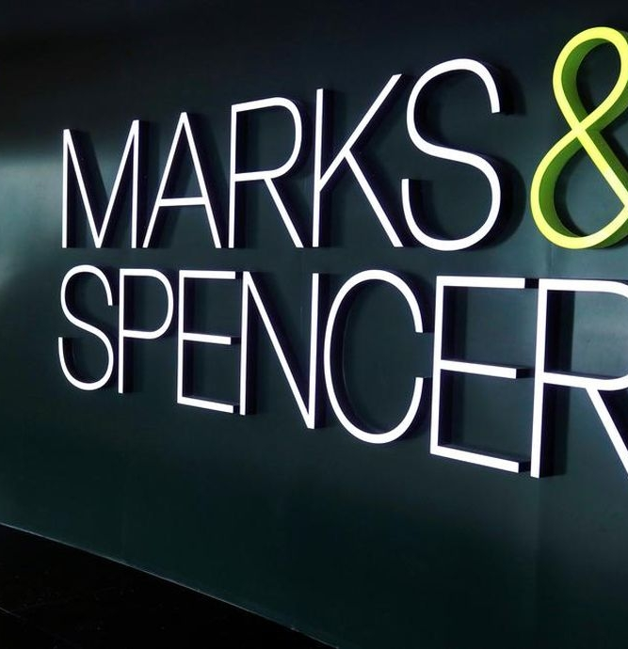
Conclusion
Integration of the structures at M&S illustrates the benefits of the blending between flat, divisional and functional structures to produce a hybrid form of structure, combining both operating efficiently and flexibility within competitive retailing environments (Joseph & Sengul, 2025)
Performance implication indicates that M&S structural change of its traditional hierarchal to more horizontal, responsive structure has improved the speed of decision-making and aggression of its employees (Sine et al., 2006)
Strategic fit of organisation structure and business goals helps M & S to sustain its leadership position in UK retail markets amid different changes in business environment (M&S 2025)
Considering the future in further details, it is predicted that further structural adaptation will be necessary to ensure that M&S is able to overcome digital transformation, sustainability challenges, and rising consumer expectations (Machova et al., 2022)
Through the dominant fact that an effective organisational design needs to align structural decisions based on the environmental requirements, the success of M&S shows how complex organisations involved in retailing can use different structural solutions concurrently (Burns & Stalker, 1961).
Notes:
Their balanced organizational design is contributed by their hybrid approach which is the mix of hierarchical authority, divisional specialization, and functional expertise. This structural integration has permitted the efficiency of processes and flexibility towards accepting the market. The examples demonstrate that the right structural decisions have a direct influence on performance, employee interest, and competitive advantages. M&S is the example of efficient organizational design, and its success shows that structural strategies in the retailing context are the key factors of its prosperity and sustainability.

Slide 10
References
Burns, T., & Stalker, G. M. (1961). The management of innovation. London. Tavistock Publishing. Cited in Hurley, RF and Hult, GTM (1998). Innovation, Market Orientation, and Organisational Learning: An Integration and Empirical Examination. Journal of Marketing, 62(4), 42-54.
Sine, W. D., Mitsuhashi, H., & Kirsch, D. A. (2006). Revisiting Burns and Stalker: Formal structure and new venture performance in emerging economic sectors. Academy of management journal, 49(1), 121-132.
Joseph, J., & Sengul, M. (2025). Organization design: Current insights and future research directions. Journal of Management, 51(1), 249-308.
Kondalkar, K. (2007). Organizational Behviour.
Marks & Spencer. (2025). 2025 Annual Report. [online] Available at: https://corporate.marksandspencer.com/2024-annual-report.
www.annualreports.com. (2024). Marks and Spencer Group PLC - AnnualReports.com. [online] Available at: https://www.annualreports.com/Company/marks-and-spencer-group-plc.
M&S (2024). Governance Framework. [online] Marks & Spencer. Available at: https://corporate.marksandspencer.com/about-us/corporate-governance/governance-framework.
M&S (2023). Our Leadership. [online] Marks & Spencer. Available at: https://corporate.marksandspencer.com/about-us/our-leadership.
Machova, R., Zsigmond, T., Zsigmondova, A., & Seben, Z. (2022). Employee satisfaction and motivation of retail store employees. Marketing i menedžment innovacij, (1), 67-83.
Nielsen, J. E., Babić, V., Stojanović-Aleksić, V., & Nikolić, J. (2019). Driving forces of employees’ entrepreneurial intentions-leadership style and organizational structure. Management: Journal of Sustainable Business and Management Solutions in Emerging Economies, 24(3), 59.‌
Daft, R. L. (2015). Organization theory and design. Cengage Learning Canada Inc.
Handy, C. (1993). Understanding organizations. Penguin Uk.
Notes:
Burns, T., & Stalker, G. M. (1961). The management of innovation. London. Tavistock Publishing. Cited in Hurley, RF and Hult, GTM (1998). Innovation, Market Orientation, and Organisational Learning: An Integration and Empirical Examination. Journal of Marketing, 62(4), 42-54.
Sine, W. D., Mitsuhashi, H., & Kirsch, D. A. (2006). Revisiting Burns and Stalker: Formal structure and new venture performance in emerging economic sectors. Academy of management journal, 49(1), 121-132.
Joseph, J., & Sengul, M. (2025). Organization design: Current insights and future research directions. Journal of Management, 51(1), 249-308.
Kondalkar, K. (2007). Organizational Behviour.
Marks & Spencer. (2025). 2025 Annual Report. [online] Available at: https://corporate.marksandspencer.com/2024-annual-report.
www.annualreports.com. (2024). Marks and Spencer Group PLC - AnnualReports.com. [online] Available at: https://www.annualreports.com/Company/marks-and-spencer-group-plc.
M&S (2024). Governance Framework. [online] Marks & Spencer. Available at: https://corporate.marksandspencer.com/about-us/corporate-governance/governance-framework.
M&S (2023). Our Leadership. [online] Marks & Spencer. Available at: https://corporate.marksandspencer.com/about-us/our-leadership.
Machova, R., Zsigmond, T., Zsigmondova, A., & Seben, Z. (2022). Employee satisfaction and motivation of retail store employees. Marketing i menedžment innovacij, (1), 67-83.
Nielsen, J. E., Babić, V., Stojanović-Aleksić, V., & Nikolić, J. (2019). Driving forces of employees’ entrepreneurial intentions-leadership style and organizational structure. Management: Journal of Sustainable Business and Management Solutions in Emerging Economies, 24(3), 59.‌
Daft, R. L. (2015). Organization theory and design. Cengage Learning Canada Inc.
Handy, C. (1993). Understanding organizations. Penguin Uk.

