Slide 1

Sioned Thompson
1801849
Young People in Focus
ECYW6003

Slide 2
Good Moring All
Identify a specific interest group of young people and critically explore their experiences of adolescence and ACEs. Propose interventions which have proven to enhance health and well-being and mitigate adversity. Your presentation should be supported by wider reading, and linked to the Youth Work National Occupational Standards (CLD Standards Council Scotland, 2019).

Slide 3



Thank you for attending my Presentation

Slide 4
NEET Young People
Homeless Young People
LGBTQ Young People
  My choice group of young people that I will be discussing through this presentation is the young people of LGBTQ community.

Slide 5
LGBTQ
>LESBIAN
>Gay
>Bisexual
>Transgender
>Queer (Questioning)

Slide 6

Definition of LGBTQ
LGBTQ is an acronym for lesbian, gay, bisexual, transgender and queer or questioning. These terms are used to describe a person’s sexual orientation or gender identity. (2021, Lesbian and Gay community service centre)

Slide 7
ACEs
NAOMIE
Sessions

Slide 8
ACEs affecting the young people of LGBTQ Community.
The Ryan, Family Acceptance project 2009, states
More families reject LGBTQ Young people
LGBTQ Young people are more at risk of participating in illegal drug use.
LGBTQ young people higher risk of catching HIV.

Slide 9
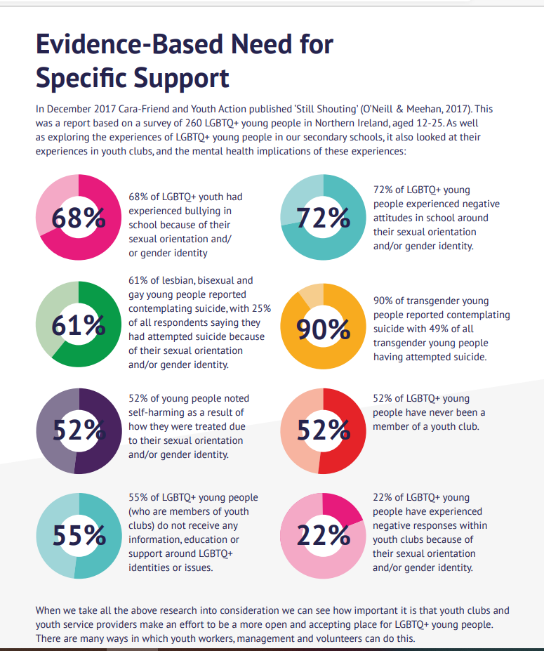

Slide 10
How do young people experience Adolescences.
X3 phases of transitions to adolescences
Physical Growth and Development
Mental and Emotional Development
Brain Development

Slide 11
Naomie
Needs
Implement
Aims
Objectives
Evaluate
Methods

Slide 12
Sessions
How do sessions support the young peoples Health and well-being.
Drugs & Alcohol
Safe Sex
Accepting owns individuality

Slide 13
Positive impact of Youth Work Intervention.
Safe Environment
Group Work
Go to person
Opportunity to be themselves.
Mixing with other young people. whom understand their choices.

Slide 14
Policies and Theory
National Occupational Standards.
Principles and purpose of Youth Work.
Five ways to well-being

Slide 15
Any questions?
Thank You

Slide 16
Information reference list
Defining LGBTQ (gaycenter.org) (Accessed on 18/02/21)
ACEs in the LGBTQ Community | ACEsConnection (Accessed on 18/02/21)
https://www.cwvys.org.uk/wp-content/uploads/2018/11/YOUTH-WORK-IN-WALES-PRINCIPLES-AND-PURPOSES.pdf#:~:text=Youth%20Work%20in%20Wales:%20Principles%20and%20Purposes%20has,designed%20primarily%20for%20young%20people,%20is%20available%20at (Accessed on 20/02/21)
https://cara-friend.org.uk/wp-content/uploads/2018/09/22307-CaraFriend-Youth-Worker-Booklet-LGBTQ-Final-screen.pdf (Accessed on 20/02/21)
https://www.nya.org.uk/wp-content/uploads/2014/06/National-Occupation-Standards-for-Youth-Work.pdf (Accessed on 20/02/21)

Slide 17
Picture reference list
youthDev.jpg (550×310) (wp.com) (Accessed on 17/02/21
cymru_introduction_to_supporting_lgbt_young_people_english.pdf (stonewall.org.uk) (Accessed on 18/02/21
lbgqt# - Bing images (Accessed on 18/02/21)

