Slide 1
Dream coffee
Program of Study: Business Management
Module Name and Code: Enterprise and Entrepreneurship (LCLM4006_LON)
Assignment Title: Business Plan for “Dream Coffee”
Student Name: Alexandru Dintiu 2513117
Date: 16.08.2026

Slide 2
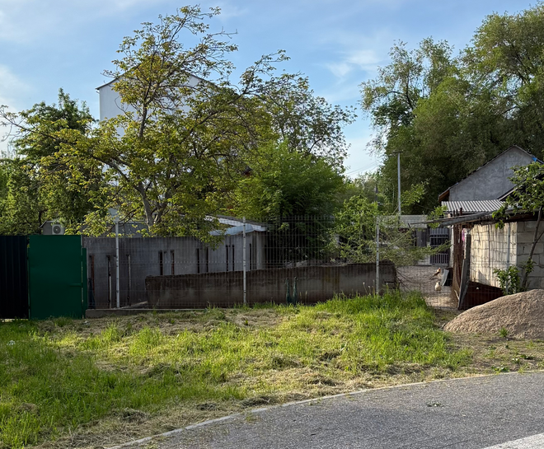
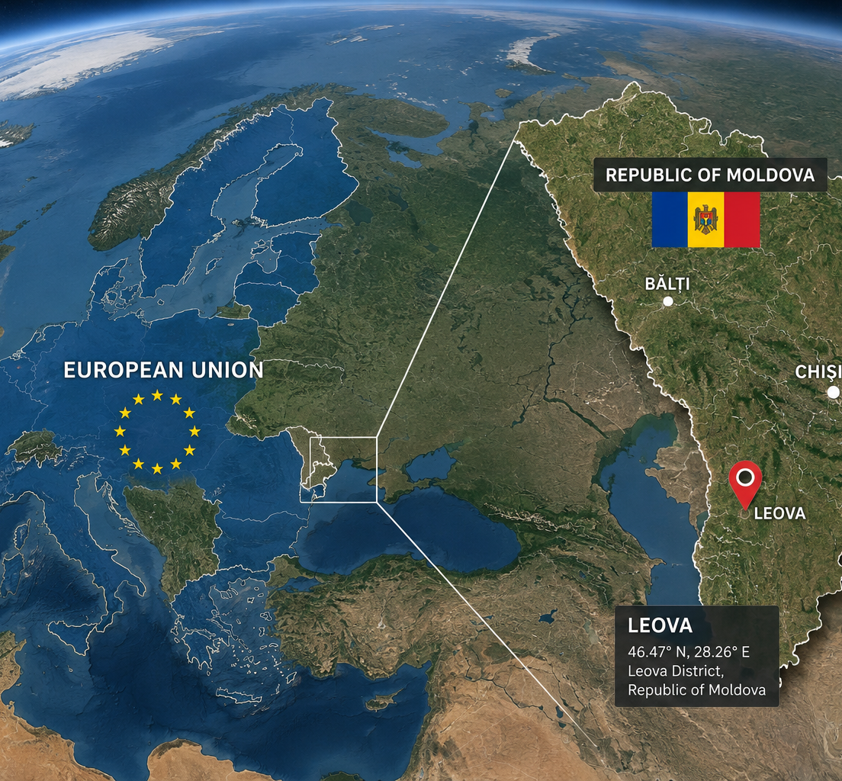
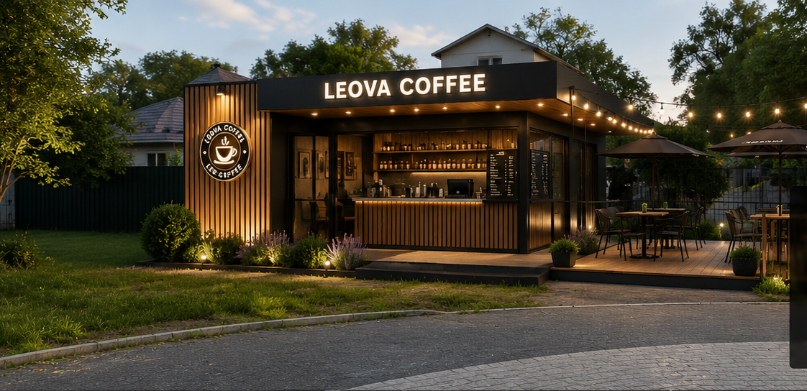
Executive summary
Dream coffee is a small coffee shop situated in town Leova republica of Moldova
15000 people
Operating like Privat Limited Company LTD
Costs ~ 20,000£ – 25,000£
-Equipment
-Renovation
- Inventory
-Licenses
-Operating expenses

Slide 3

Table of Contents
1.Executive Summary
2.Overview of the Business Idea
-Business concept
-Products and services
-Management structure
-Legal structure
3.Market Research
-PESTEL analysis
-Competition Analysis
4.Marketing Communications
5.Financials
6.Conclusion
7.References

Slide 4

2. Overview of the Business
Business concept
Dream coffee will be a modern coffee situated in Leova which will offer high quality coffee like espresso, cappuccino, latte, americano, tea, snacks, drinks and jus for kids, cakes, sandwiches. The objective is to bring more people together meeting with friends and family, remote work in good vibe in free air at table under trees.

Slide 5
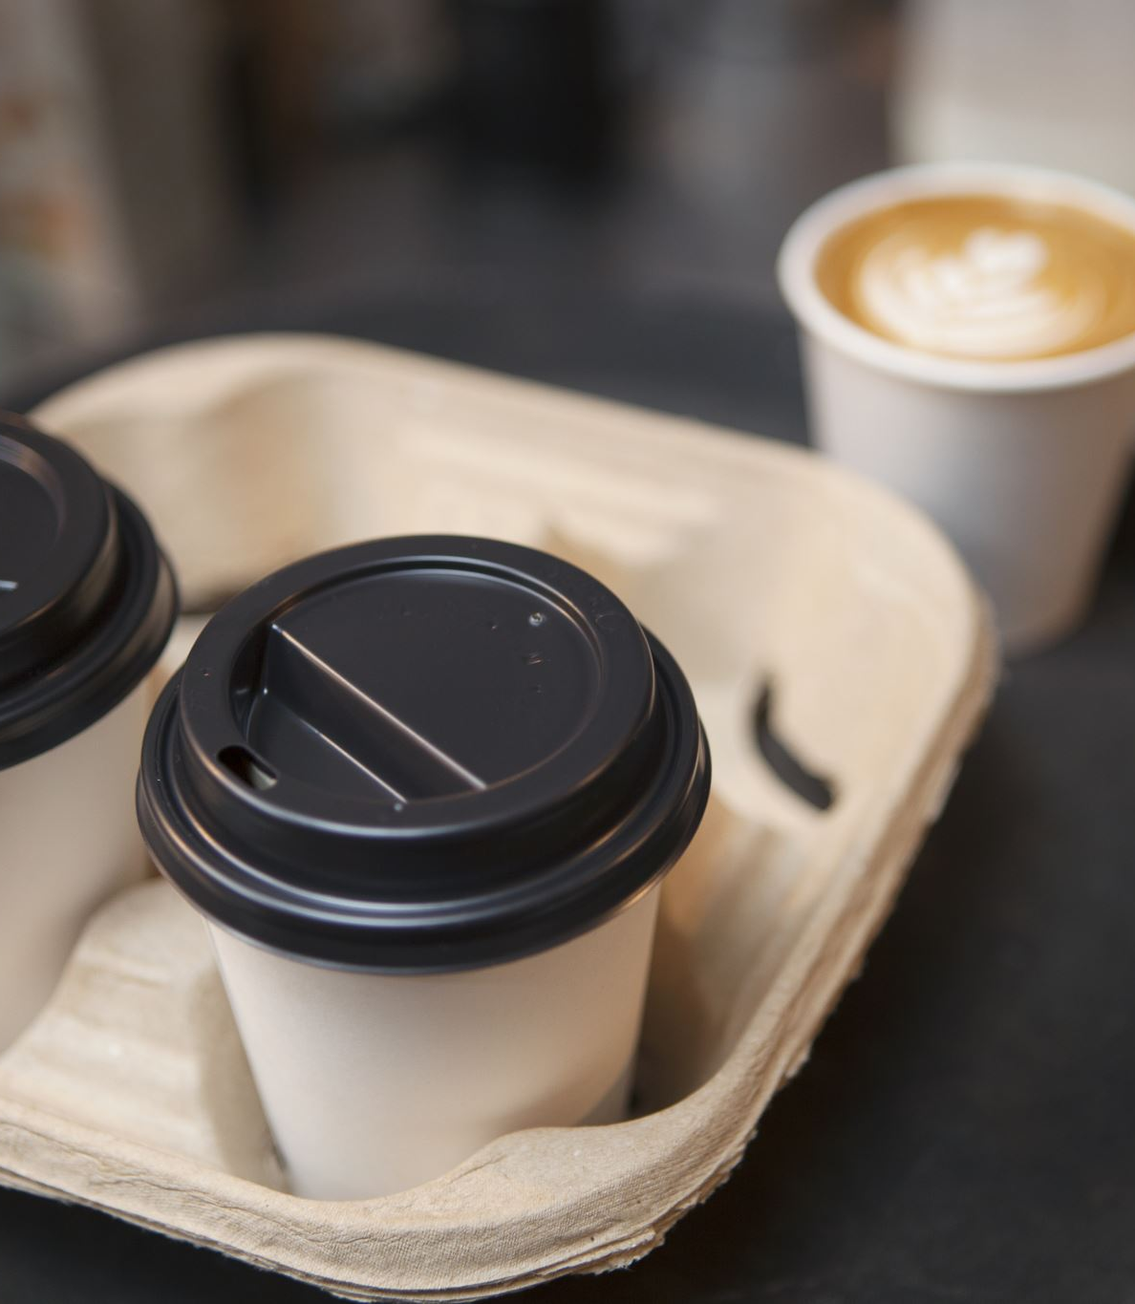
Products and Services
1 Tea and hot chocolate
2 Free Wi-Fi
3 Take away service
4 Traditional coffee drinks
5 Special Vouchers
6 Seasonal offers and many discounts

Slide 6
Management Structure
The business will employee:
Owner
Two baristas
Cleaner
One part time assistant
Owner (Manger )
Part time assistant
Baristas
Cleaner

Slide 7
Legal Structure
The business will be established as a Private Limited Company (LTD), because is suitable for limited liability protection for the owner while allowing flexibility in management and future business growth. An LTD structure also enhances the credibility of the business when dealing with suppliers, customers, financial institutions, and potential investors.

Slide 8
Marketing Research
PESTEL Analysis
-Political factor - The Republic of Moldova supports small and medium-sized and local government support and encourage entrepreneurs and local investment. However, changes in taxation or business regulations may affect operating costs.
-Economic factor - Leova is a relatively small town with moderate purchasing power. Although disposable income may be lower compared to larger cities such as Chișinău, consumers increasingly spend money on coffee and social experiences. Inflation and fluctuations in energy prices could impact operating expenses and product pricing.
-Social factor - Coffee culture has become increasingly popular among young people and professionals in Moldova. Customers are looking for places where they can socialize, study, and work. The growing demand for quality coffee and modern café environments creates an opportunity for Leova Coffee House to establish a strong customer base.
-Technological factor - Modern coffee equipment improves efficiency and product quality. Social media platforms such as Facebook, Instagram, and TikTok provide cost-effective marketing opportunities. Online ordering and digital payment methods can also improve customer convenience and business performance.
-Environmental factor - Consumers are becoming more environmentally conscious. The coffee shop can reduce environmental impact by using recyclable cups, minimizing waste, and sourcing products responsibly. Sustainable practices can enhance the company's reputation.
-Legal factor - The business must comply with food safety regulations, labor laws, licensing requirements, and taxation rules. Maintaining compliance will be essential to avoid penalties and ensure customer safety.

Slide 9
Direct competition
Direct competition are included local coffee shops, which they have limited variation of food and products, or inconsistent service quality. Their opportunity may keep good relationships with customers.
Indirect Competition
Indirect competitors include restaurants, supermarkets and bakeries which sell coffee products with cheap price. In generally do not offer the same atmosphere and customer experience as a dedicated coffee shop.
Competitive Advantage
“Dream coffee” will be different itself:
Premium coffee quality
Modern interior design
Comfortable seating areas
Free Wi-Fi
Consistent customer service
Loyalty programs
Seasonal menu innovations
This products will create different atmosphere than another shops and attract loyal customers.

Slide 10

Marketing Communications
Target Marketing
Students
Families
Kids
Young people
Tourists and visitors
Sportsmen
Branding strategy
The brand name “Dream Coffee” will represent comfort, quality. The visual identity will include a modern logo, warm colors, and professional packaging.

Slide 11

Social media marketing
The dream coffee will be promote by Instagram, Facebook, TikTok because there are many people spend more time and be easy to found it.
Content will be included:
-Photos of drinks and food
-Promotional offers
-Costumers testimonials
-Sessions designe of shop
Promotional activities
-Students discount
-Sports men discount
-Sessional promotions
-Social media vouchers
-Loyalti cards
-Grand opening discount
Local Partnerships
The coffee shop will collaborate with local schools, businesses, and community organizations. Such partnerships can increase visibility and attract new customers.

Slide 12
Financial
Funding Requirements
Our startup business to invest in “Dream Coffee” is approximately 20000£-25000£ .
The founding will be used
-Rent
-Building
-Coffee machine
-Fridge
-Furniture
-Designer
-Marketing
-Licenses and permits
Founding sources
From beginning we will need approximately 12000£ for rent building and buy any staff for startup and rest of all will be allocated for small things like license, marketing and designe.
This combination reduces financial risk while ensuring sufficient capital for startup operations.

Slide 13
Start-up costs
Rent | 800£
Building | 9000£
Coffee machine | 5000£
Furniture | 2500£
Fridge | 1000£
Design | 500£
Digital marketing | 800£
Licences and permits | 200£
Total | 19800£

Slide 14
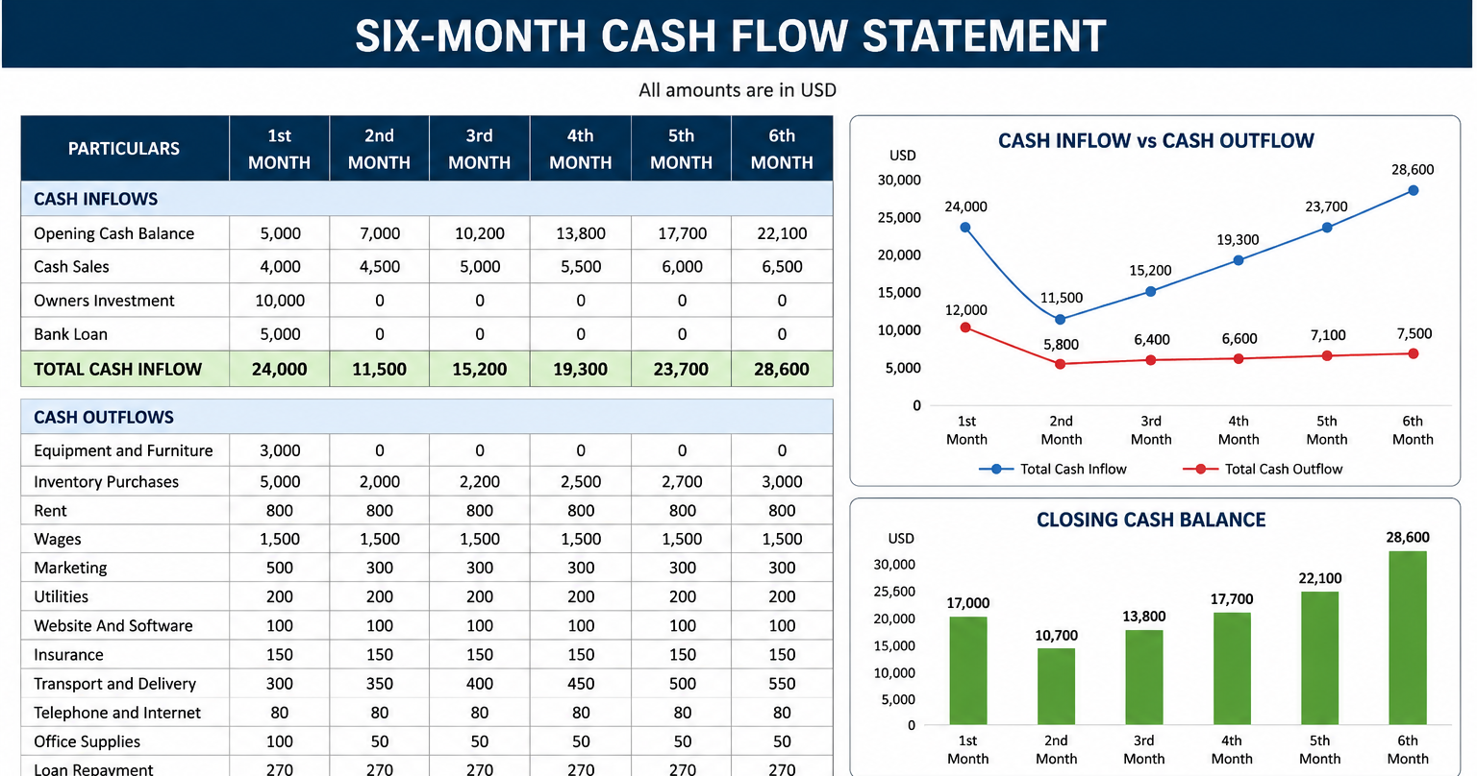

Slide 15

Revenue Expectations
The coffee shop expects an average of 40–60 customers per day during the first year. Assuming an average customer spend of €4, daily revenue could range from €160 to €240.
Monthly revenue is therefore expected to range between approximately €4,800 and €7,200, with growth anticipated as brand awareness increases and customer loyalty develops.
Financial Sustainability
Profitability will depend on maintaining efficient cost control, strong customer retention, and consistent product quality. By carefully managing expenses and implementing effective marketing strategies, the business should achieve financial stability within its first two years of operation.

Slide 16
Conclusion
The “Dream Coffee” is a very promising business in town Leova, Republic of Moldova because is a coffee shop for majority people from town where they can come and take them dream coffee. For increasing popularity of coffee culture, combined with out weather and quiet. With high-quality products, customer-focused services, effective marketing communications, and responsible financial management, the coffee shop can establish a strong competitive position and achieve long-term success. For this business is necessary to invest just 20,000£ for beginners and low risk to bring people together and live the dream with hot coffee or tea.

Slide 17
References
Baron, R. A. (2020). Entrepreneurship: An Evidence-Based Guide. Edward Elgar Publishing.
Blank, S., & Dorf, B. (2020). The Startup Owner's Manual. K&S Ranch.
Burns, P. (2021). Entrepreneurship and Small Business: Start-up, Growth and Maturity (5th ed.). Red Globe Press.
Bygrave, W. D., & Zacharakis, A. (2020). Entrepreneurship (5th ed.). Wiley.
Collins, J. (2001). Good to Great: Why Some Companies Make the Leap... and Others Don't. HarperBusiness.
Drucker, P. F. (1985). Innovation and Entrepreneurship. Harper & Row.
Gerber, M. E. (2001). The E-Myth Revisited: Why Most Small Businesses Don't Work and What to Do About It. HarperBusiness.
Hisrich, R. D., Peters, M. P., & Shepherd, D. A. (2020). Entrepreneurship (11th ed.). McGraw-Hill Education.
Kim, W. C., & Mauborgne, R. (2015). Blue Ocean Strategy (Expanded ed.). Harvard Business Review Press.

