Slide 1
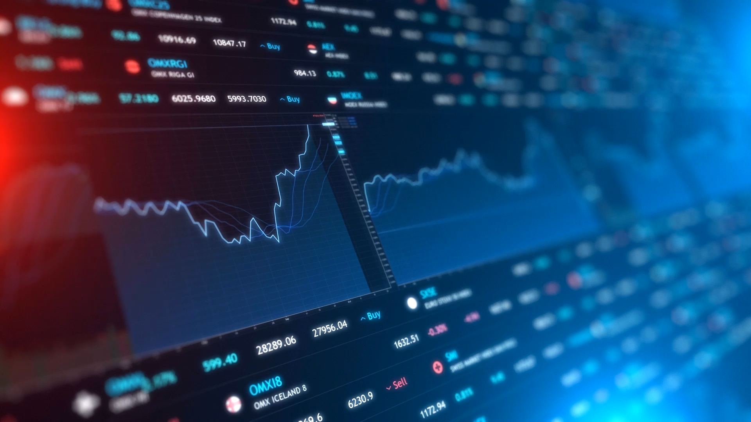
LCBB 5008 MGE
1
Inflation
Unemployment & the Phillips Curve

Slide 2
INFLATION
Definition: Inflation is a sustained increase in the general price level of goods and services in an economy . It is measured over a period of time.
It is measured by the Consumer Price Index (CPI)
The rate of increase in prices is called the rate of inflation.
Inflation causes a gradual or in some cases a rapid loss of purchasing power.
The Consumer Prices Index (CPI) rose by 2.3% in the 12 months to October 2024, up from 1.7% in September. (ONS,2024)
CPI is calculated by using the prices to a indexed set of goods and services to measure the change over a set time period.
The CPI is calculated based on a a large and a representative sample of over 700 goods and services which are commonly used by UK Households. The movement in the prices of these 700 goods are measured through 20000 outlets in the UK .
THE CPIH – is the CPI with the addition of owner occupied housing costs.
CPIH is more comprehensive as it includes costs of owning, maintaining and living in ones own home plus council tax. (ie., owner occupied costs)

Slide 3
CAUSES OF INFLATION
Too much demand in the economy ( DEMAND PULL INFLATION)
Demand pull inflation – demand increases within the economy and companies cannot produce enough output, then to allocate current output prices rise.
Cost Push Inflation : Higher costs of materials/imports etc., cause firms to increase prices.
https://www.bankofengland.co.uk/explainers/will-inflation-in-the-uk-keep-rising
Excessive growth in the money supply

Slide 4

TYPES OF INFLATION
Creeping Inflation : Rates of inflation increase slowly e.g. 4-5%
Strato –Inflation: High inflation -10% and over
Hyper Inflation – very high rates of inflation – in thousamd of percent . E.g.
https://www.forbes.com/advisor/au/personal-finance/countries-with-highest-interest-inflation-rates/

Slide 5
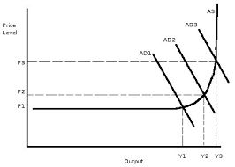
WHAT CASUES DEMAND PULL INFLATION
Government policies which are reflationary in nature
Where consumer confidence rises and consumer start to spend more

Slide 6
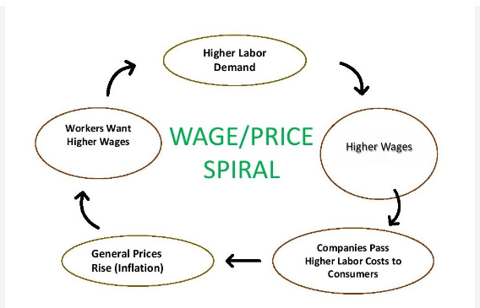
CAUSES OF COST PUSH INFLATION
Excessive wage and salary increases to employees – these wage increases are not linked to increased productivity
Increased cost of imported raw materials (Fall in value of pound)
Monopoly power of suppliers causes an increase in input prices( Raw materials, etc).

Slide 7
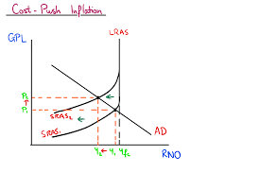
Cost Push Inflation

Slide 8
PROBLEMS OF INFLATION
Redistribution of income – groups of people/earners whose earnings are not linked to inflation suffer from a fall in purchasing power.
Borrower may gain against lenders unless the lenders index link the loans.
Planning Difficulties – firms will delay investment if there is uncertainty as to input prices and sales prices
Uncompetitive abroad – UK inflation affects exchange rates which rise making UK goods uncompetitive .
“With occasional exceptions such as in the 1930s, there has been a pronounced tendency for sterling to be too strong, with the consequence that our manufactured exports have tended to be uncompetitive and importing too attractive.”
(Civitas.org – accessed 20/11/24)

Slide 9
CURING INFLATION 1
DEMAND SIDE POLICIES
SUPPLY SIDE POLICIES
Reduce AD
Reduce by
Reducing govt expenditure
Increase taxes
Increasing interest rates
Increase Labour Market Productivity _ reduce power of trade unions , reduce unemployment benefits
Increase Competition
Privatization
Encourage SMEs’ and startups

Slide 10
CURING INFLATION 2
PRICES AND INCOME POLICIES
Govt tries to control increases in prices and incomes by passing regulation
But these
Stops the market mechanism from working properly – good workers cannot be attracted by higher wages
Cause industrial relation problems post legal restrictions – surge in wages and process as people play catch-up.
EXCHANGE RATE POLICIES Increase the value of the currency
- the effect is to reduce import prices
- to reduce the demand for exports

Slide 11

UNEMPLOYMENT
The Labour Force _ Reflects those in a job /employment and those who are unemployed
Unemployment – those people not employed who are seeking a job.
Unemployment refers to the share of the labour force that is without work but available for and seeking employment. (World Bank, 2024)
UNEMPLOYMENT RATE (%) = UNEMPLOYED X 100
                LABOUR FORCE

Slide 12
CLAIMANT COUNT
The actual number of people claiming unemployment related benefits (mainly Jobseeker’s Allowance (JSA)/UNIVERSAL CREDIT), also known as the ‘claimant count’.
The monthly total of those claiming benefit . They are officially registered an able to work but claim job seekers allowance or universal credit
Disadvantages - it generally underestimates the real number of unemployed people. This is because not everybody claims unemployment benefits. Disadvantage - because unemployment benefits are controlled by the government, the figures can be manipulated.
Advantages Easy to Collect

Slide 13
ILO- DEFINITION OF UNEMPLOYMENT
The International Labour Organisation (ILO) measure of unemployment from the Labour Force Survey (LFS), which essentially captures people who are currently not working, but are available for work
That is people without work who have actively sought work in the last four weeks or are waiting to take up a job in the next two weeks .
More comprehensive and allows for comparison between countries
Based on a quarterly survey of 60000 households (Labour Force Survey)
The Labour Force Survey is a continuous, large-scale survey, with a sample of around 60,000 households in each three-month period. These include around 150,000 people, of whom over 110,000 are aged 16 or over, in each three-month period. (ONS, 2024)
May contain sampling error as only a percentage of households are included

Slide 14
ILO differs from Claimant Count
Many female unemployed workers may be actively be looking for work. They may be excluded from the claimant count because their partners earn so much that they do not qualify for benefit.
Older workers may be collecting a pension and so they are not entitled to claim benefits. They maybe be looking for work.
Workers who are made redundant cannot claim for a set period , but they would have been included in the ILO survey.

Slide 15
TYPES OF Unemployment
Regional – this is associated with particular regions of the country . This is due to structural unemployment .
Structural : people made unemployed because of changes in the nature of the economy . In the UK, a decline in farming/mining /motorcycle industry
Frictional – this occurs where people are between jobs
Seasonal: this is where people are unemployed due to the seasonal nature of work – summer fruit picking /ice-cream sales
Classical_ unemployment occurs because real wages are too high due to union collective bargaining power.
Keynesian /Cyclical – this occurs due to a downturn or recession in the economy

Slide 16
The Natural Rate of Unemployment (NAIRU)
This is the rate of unemployment which is consistent with the correctly anticipated inflation rate.
Implication: The NAIRU occurs where the economy is at full employment
The level of the NAIRU depends on the supply side of the labour market. For example – the training , benefit levels , unions and information.

Slide 17
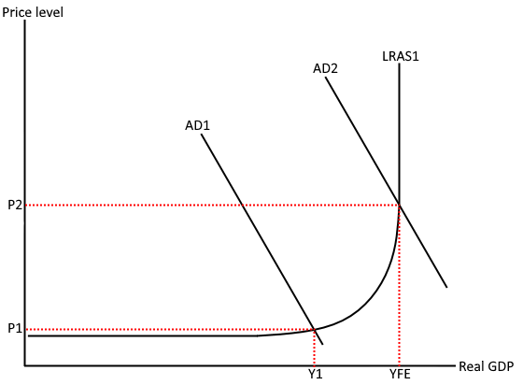
CURING UNEMPLOYMENT – DEMAND SIDE POLICIES
Lower taxation
Lower interest rates
Increase government spending
These boost aggregate demand

Slide 18
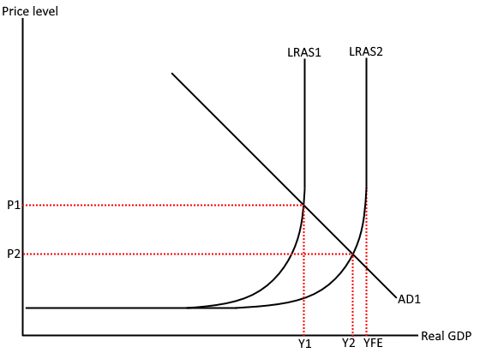
CURING UNEMPLOYMENT – SUPPLY SIDE POLICIES
Increase training opportunities
Increased education opportunities (University)
Reduce income tax
Reduce unemployment benefit
Improve information about vacancies – job centres

Slide 19
CONT’D
Supply side policies should improve the economy’s productive capacity from Y1 to YFE.
That is the maximum amount of products that can be produced using current factors of production should increase.
Thus the general price level should fall P1 to P2.
At Y1 , the company is operating at full capacity at AD - LRAS1 .
The increase in the LRAS to LRAS2 causes a new equilibrium less than FYE. That is Y2.
There is now spare capacity – Y2 – YFE

Slide 20
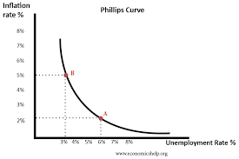
I and E– The PHILLIPS CURVE
The PC shows the relation between employment and inflation

Slide 21
THE BALANCE OF PAYMENTS (BOP)
The BOP is a record of a country, UK, transactions with the rest of the world ( Trading partners). It reflects the country’s payments and receipts from trade.
The BOP contains both the
Current Account
The Capital Account
https://www.ons.gov.uk/economy/nationalaccounts/balanceofpayments
Capital Account
Current Account

Slide 22
Balance Of Payments
CURRENT ACCOUNT
CAPITAL ACCOUNT
Visible Trade Account: difference between export revenue and import expenditure (physical goods)
Invisible Trade Account: this measures the difference between export revenue and import expenditure on
1) services – banking , insurance and tourism
2) interest, profits and dividends flowing in and out of the UK
Transfer payments – oversea aid
RECORDS THE INVESTMENTS AND FINANCIAL FLOWS
Financial flows are movements in money capital by firms and the Government .Example – invest in factories and in shares or EU Payments

Slide 23

BALANCE OF PAYMENTS & FLOATING EXCHANGE RATES
BOP AND FLOATING EXCHANGE RATES
The BOP automatically balances – the exchange rate will change until the supply of pounds equals the demand for pound

Slide 24
Current Account Deficit
The UK spends more on foreign goods and services ( Imports) then foreigners spend buying UK goods and services (Exports)
A deficit on the current account means that the value of imports is greater than the value of exports.
CAD could indicate competitive problems in industry and the economy of a country.
If the exchange rates floats lik e in the UK, then the CAD is removed as the external value of the currency will fall.
Exports become cheaper.

Slide 25
BOP Deficit – Treatment to Reduce the BOP Deficit
Set up import controls like tariffs
Devalue the currency
Devaluation is a downward adjustment to a country’s value of money relative to a foreign currency or standard.
Deflate the economy by reducing expenditure.
- Increase taxation
- Raise interest rates
This may reduce imports but may also affect domestic consumption

Slide 26
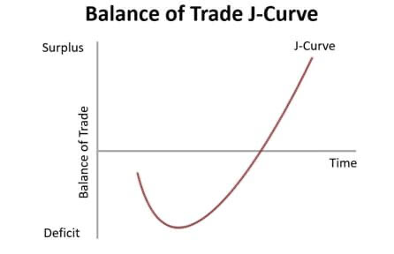
BOP & The J Curve Effect
Reduce the value of the pound
In the short run given inelasticity of Imports and exports the BOP position worsens before it gets better.

