Slide 1
Searching Persons
Wynne Jones

Slide 2
Stop and search
  Home Office 15 February 2019
Overall, there were 277,378 stop and search incidents in England and Wales in 2017/18, 5 per 1,000 people; down from 23 per 1,000 people in 2009/10
Rates of stop and search have fallen for every ethnic group since 2009/10 – however, they have fallen at different rates for different groups
In 2017/18, there were 3 stop and searches for every 1,000 White people, compared with 29 stop and searches for every 1,000 Black people

Slide 3
Stop and search
  Home Office 15 February 2019
Black people were 9 and a half times as likely to be stopped and searched as White people in 2017/18; the previous year they were just over 8 times as likely, and in 2014/15 they were just over 4 times as likely
Chinese and Mixed White/Asian groups have consistently had the lowest rates of stop and search since 2009/10
The MPS was the police force area with the highest rate of stop and search incidents in 2017/18, with 16 stop and searches for every 1,000 people

Slide 4

Sec 1(2) Police & Criminal Evidence Act 1984
A police constable may detain in order to search
any person or vehicle or anything which is in or on a vehicle,
in any place to which the public has access
Notes:
State:
Stop and search is frequently used by police officers and we will look at the power used most often, under the Police & Criminal Evidence Act 1984
This power is provided under Sec 1(2) PACE 1984
There are a number of important elements in this definition.
The first is detain. Detaining someone in law is not actually arresting them, but the outcome is the same, you prevent that person from moving until you have completed the search. The detention must be at or near where the person was first required to stop. So you cannot stop someone and then take them to a police station to carry out the search.
The power to stop and search only applies in a place where the public are or have access to, for instance any road or footpath or other public area, other areas where the public have express permission, for example a cinema or football ground, so even if the person has paid to enter it is still a public place.
Then there is the private place but where the public have access such as a private field that has a low wall around it.
You can search anyone in the garden of a house if that person is there without the owner’s permission.
The same principles apply to the search of a vehicle.
An officer can also search anything that the person has with them and anything within the vehicle, such as a bag.

Slide 5
Sec 1(2) Police & Criminal Evidence Act 1984
if he or she has
reasonable grounds for suspecting
that stolen or prohibited articles,
prohibited fireworks or
bladed or sharply pointed articles will be found.
Any such article found during a search may be seized.
Notes:
State:
The power is granted to an officer who already has reasonable grounds for suspecting that a person has one of the mentioned items on them.
The officer cannot stop a person to gather evidence that the person is carrying something.
We will now look at this definition in more detail.

Slide 6

Reasonable grounds to suspect
Notes:
Question to self: So what are these reasonable grounds to suspect?

Slide 7

Fair
Sensible
Notes:
State:
A dictionary definition of reasonable is ‘fair and sensible’

Slide 8

Suspicion/Suspect
A feeling or belief that someone is guilty of a crime or offence
Notes:
State:
Suspicion, then is :
‘A feeling or belief that someone is guilty of a crime/offence’

Slide 9

Levels
Know
Believe
Suspect
Notes:
State:
In law there are three levels of knowledge that an officer has to have before they can act in any given situation. The first is:
Q. Know - How would you know something has happened? You see it yourself – there is no doubt it has taken place. For example you are on patrol in the High Street when you see a person carrying a brick. You see this person bring their arm back and throw the brick. You see the brick make contact with and smash through the window of a shop. You know that this person has committed damage.
Q. Believe - What would make you believe that something has happened? In this instance you are on patrol on a side street of the main shopping area. You hear a smash of glass from around the corner. You turn the corner and see a man standing in front of a broken shop window. Inside the shop is a large brick.
Q. Suspect - What would make you suspect that something has happened?
You hear a smash of glass from around the corner. You turn the corner and see a man running away. You see a broken shop window and inside the shop is a large brick. You walk along the street and find the man you saw running away hiding behind some bins.
Where the incident fits on this scale will depend upon how much knowledge you have about the incident
Reasonable grounds for suspicion depend on the circumstances in each case. There must be some objective basis for that suspicion based on facts, information, and/or intelligence which are relevant to the likelihood of finding an article of a certain kind.
Code A of PACE states reasonable grounds for suspicion will depend on:
The nature of the article suspected of being carried.
The time & place where the person or vehicle is.
The behaviour of the person or those with him or her.
And that the suspicion is linked to accurate & current intelligence.

Slide 10

The following can be used
Behaviour
Location
Time/Place
Intelligence
Notes:
State:
The PACE codes of practice are very clear about what can and cannot be used when gathering the information necessary to carry out any power contained with PACE.
It states:
Reasonable suspicion can never be supported on the basis of personal factors alone without reliable supporting intelligence or information or some specific behaviour by the person concerned.
Suspicion cannot be founded on inappropriate generalisations or stereotypical images
Suspicion can be linked to accurate intelligence
Suspicion can be linked to specific crime problems
Therefore the things that CAN be used are:
Show slide
A person’s behaviour, for example trying to hide something or other suspicious act
The time, place and/or location etc. when linked to specific intelligence, for example an area where crime is taking place on a regular basis
Reliable information/intelligence from witnesses, for example a good description of a person who has just committed an assault.

Slide 11
The following cannot be used
Colour
Age
Hairstyle
Clothing
Previous convictions
Unless supported by intelligence
Notes:
State:
PACE states that certain things ALONE CANNOT be used as grounds to suspect a person of an offence.
Obviously, if you have a description of a person who has committed an offence and a number of these match that description, then it can be used, but ensure that the description you get is a good one.
You would not be entitled to search anyone on a description of a black man of average height and build.
Why not?
Trainer to discuss issues around stereotyping and prejudice
A good test of ‘reasonable grounds’ is to ask yourself the question:
‘Would an independent third person come to the same conclusion as me if they looked at the facts?’
If you suspect someone on a HUNCH you cannot explain, you would not have reasonable grounds, you would need to find or have the necessary information or intelligence to back this up.

Slide 12
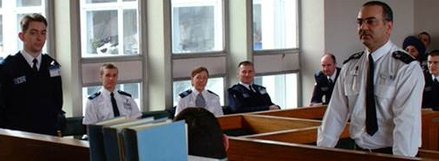
Remember -What can you give evidence of?
Seen
Heard
Actions
Conversations
Knowledge
Smell
Notes:
State:
As we have discussed, you cannot rely on – colour, age, hairstyle, clothing, pre cons alone.
An officer must gather as much available information as possible either from the witness or from our own experience of the incident they are attending.
For instance:-
What has the officer seen, including actions/behaviour?
What have you heard, conversation, alarms, breaking glass etc.?
Actions would include what you did, what the person did in response and so on. Did their actions increase or decrease your reasonable grounds to suspect?
Any conversation that takes place. What did you say to them? What did they say to you? Did their reply increase or decrease your grounds to suspect?
What is already known about the individual in terms of intelligence rather than previous convictions? What is the time/location?
Is the area a crime hot spot? Has the person been seen or pointed out by a witness?
And finally, any smells that might give rise suspicion for example, that drugs may be present?

Slide 13
if he or she has
reasonable grounds for suspecting
that stolen or prohibited articles,
prohibited fireworks or
bladed or sharply pointed articles will be found.
Any such article found during a search may be seized.
Notes:
State:
When an officer carries out a search it is for a particular item.
This should always be the case. Stop and search should not be used as a general ‘fishing expedition’.
First then is any stolen item which is simple enough.
You receive a report that a person has just stolen a DVD from a local store. That is the item for which you wish to search the person.
Then you have prohibited items which is a little more complex.

Slide 14
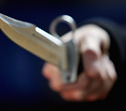
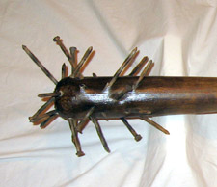
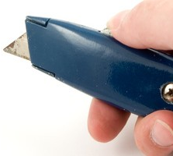
Prohibited articles
Any offensive weapon:
Sec 1 Prevention of Crime Act 1953
Made
Adapted
Intended
Notes:
State:
The term ‘prohibited articles’ covers a variety of things
There are many pieces of legislation which defines specific weapons as being prohibited such as the Fire arms Act 1968, which includes CS or pepper sprays and it is illegal to be in possession of these in a public place.
According to the British Crime Survey weapons are used in about one in five violent crime incidents. The most common types of weapon used are knives, hitting implements and glasses and bottles.
These are commonly known as ‘offensive weapons’
There are three categories of offensive weapon;
Those that were made for the purpose of causing injury, for instance a flick knife or a baton. These are offensive weapons per se; the courts need no proof of their intended use but will need some evidence that the defendant had no reasonable excuse for possessing such an item.
Then there are articles that on their own are not weapons but have been adapted to be used as weapons. It will be for a jury to decide if the article has been specifically adapted to be a weapon. An example could be a snooker ball inside a sock.
Finally there are articles which are not weapons, which have not been adapted but are intended to be used as a weapon. These items are more difficult to prove that they are weapons because it is what the person intends to use them for. This admission would need to be proven during an interview.

Slide 15


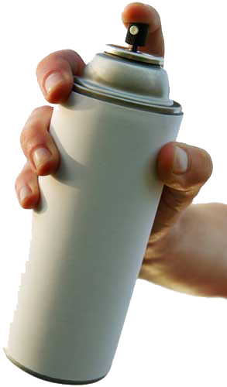
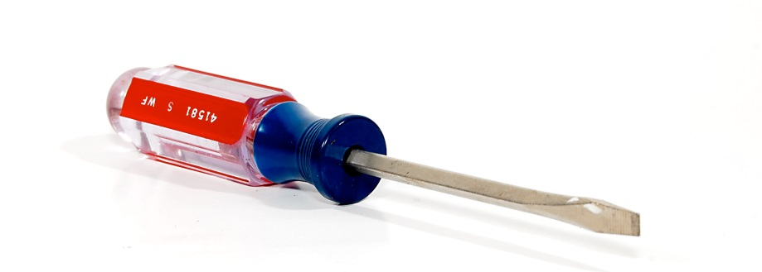
Prohibited articles
Any article used in connection with
Burglary, TWOC, Fraud, Criminal Damage
Notes:
State:
This section includes any article that may be used to assist the person to commit these offences.
They do not need to be offensive weapons but the investigating officer must be able to prove the connection between possession of the article and the offence.
There are other offences to do with being in possession of articles that you may wish to investigate such as the offence of going equipped to commit offences which is Section 25 of the Theft Act 1968.

Slide 16
if he or she has
reasonable grounds for suspecting
that stolen or prohibited article,
prohibited firework or
bladed or sharply pointed article will be found.
Any such article found during a search may be seized.
Notes:
State:
The next part then is the prohibited firework.
The relevant legislation which defines the term ‘firework’ and covers the offences relating to fireworks are:
The Explosives Act 1875
The Fireworks Act 2003
The Fireworks Regulations 2004
The Fireworks (Safety) Regulations 1997.
In simple terms ‘prohibited firework’ means any firework, with the exception of:
Indoor type fireworks
Caps
Party Poppers
Sparklers

Slide 17
if he or she has
reasonable grounds for suspecting
that stolen or prohibited article,
prohibited firework or
bladed or sharply pointed article will be found.
Any such article found during a search may be seized.
Notes:
State:
Sec 139 of the Criminal Justice Act 1988 makes it an offence to be in possession of a bladed (a knife) or sharply pointed article (something with a sharpened age) in a public place.
‘Bladed’ – includes any kind of bladed article, for example a kitchen knife, scissors, a craft knife, a pocket knife or any other article which has been given a cutting edge or blade.
Pocket knives with a blade less than 7.62cm (3 inches) long which cannot be locked in the open position are exempt from this legislation.
‘Sharply pointed’ – includes any kind of sharply pointed article, for example a needle, geometry compasses, or any other article which has been given a sharp point
A court must decide whether or not an article has a blade or is sharply pointed, and therefore the onus is on the prosecution to prove that the article fits the relevant description.
For example in R v Davis(1998) the suspect was carrying a screwdriver which the court was asked to consider as a ‘bladed article capable of causing injury’.
The court decided that it was more important to decide whether the screwdriver had a cutting edge or point than to consider whether it was capable of causing injury.
Therefore, unless a screwdriver has a pointed end or has been sharpened to make a blade, it is not an article for the purposes of this ACT
The legislation refers to the person ‘having it with them’ rather than in possession. This means that the instrument is ‘readily available’ and could mean that the person has it in a vehicle parked close by.
Section 139 (a) of the same legislation makes it an offence for someone to have a bladed or sharply pointed article on a school premises.

Slide 18
if he or she has
reasonable grounds for suspecting
that stolen or prohibited article,
prohibited firework or
bladed or sharply pointed article will be found.
Any such article found during a search may be seized.
Notes:
State:
Sec 139 of the Criminal Justice Act 1988 makes it an offence to be in possession of a bladed (a knife) or sharply pointed article (something with a sharpened age) in a public place without reasonable excuse.
The reasonable excuses are:
Lawful authority. This generally applies to an officer who seizes an article as evidence of an offence. It could also mean a member of the public, a school teacher for instance, who seizes an article from a child to hand it over to the police.
For use at work. Obviously, some people, carpet fitters for example, carry there articles with them as part of their job.
Religious reasons. Usually as a decorative item. Followers of the Sikh religion carry kirpans, a small rigid knife, and Scots carry a Sgian Dubhs (pronounced Skean Duhr) as part of their national costume.
There are also some articles listed in various acts that are classified as dangerous weapons.
For example, Butterfly knives, side handles or friction lock batons, knuckleduster
Ignorance of the item, forgetfulness or general self defence will never be a reasonable excuse, though this will be decided by the court not by an investigating officer.
Any item found during the search should be seized by the officer finding it as it is likely to become evidence.
Officers should ensure that the item is packaged correctly, labelled with an exhibit label and the information recorded in the officer’s PNB to ensure continuity of evidence.

Slide 19

Information to be given
G – grounds for search
O – object or purpose of search
W – warrant card (if in plain clothes)
I – identity of officer
S – station to which attached
E – entitlement to copy of record
L – legal power used
Y – you are detained for purpose of search
Notes:
State:
The Police and Criminal Evidence Act and PACE Codes of Practice (Code A) provide guidance rules for how an officer conducts a search and in particular the information to be given to the suspect before carrying out the search.
This ensures that any search carried out is done so ethically and in line with legislation
This is brought together in the mnemonic GO WISELY
Show slide
It is important that police officers comply with all aspects of GO WISELY as any breach of the Police & Criminal Evidence Act would render a search (and probably any later arrest and detention) unlawful.
This was confirmed in R v Bristol(2007), a case that involved a search carried out under Section 23 Misuse of Drugs Act 1971.
The defendant was convicted of obstructing a police officer but the conviction was overturned on appeal because ‘GO WISELY’ under PACE had not been complied with during the search.
Remember – an unlawful search may constitute an assault and may also engage an individual’s human rights (Right to liberty) as they will be detained for the purpose of the search.

Slide 20
Searching Persons RECAP
Wynne Jones

Slide 21
Sec 1(2) Police & Criminal Evidence Act 1984
A police constable may detain in order to search
any person or vehicle or anything which is in or on a vehicle,
in any place to which the public has access
Notes:
State:
Stop and search is frequently used by police officers and we will look at the power used most often, under the Police & Criminal Evidence Act 1984
This power is provided under Sec 1(2) PACE 1984
There are a number of important elements in this definition.
The first is detain. Detaining someone in law is not actually arresting them, but the outcome is the same, you prevent that person from moving until you have completed the search. The detention must be at or near where the person was first required to stop. So you cannot stop someone and then take them to a police station to carry out the search.
The power to stop and search only applies in a place where the public are or have access to, for instance any road or footpath or other public area, other areas where the public have express permission, for example a cinema or football ground, so even if the person has paid to enter it is still a public place.
Then there is the private place but where the public have access such as a private field that has a low wall around it.
You can search anyone in the garden of a house if that person is there without the owner’s permission.
The same principles apply to the search of a vehicle.
An officer can also search anything that the person has with them and anything within the vehicle, such as a bag.

Slide 22
Sec 1(2) Police & Criminal Evidence Act 1984
if he or she has
reasonable grounds for suspecting
that stolen or prohibited articles,
prohibited fireworks or
bladed or sharply pointed articles will be found.
Any such article found during a search may be seized.
Notes:
State:
The power is granted to an officer who already has reasonable grounds for suspecting that a person has one of the mentioned items on them.
The officer cannot stop a person to gather evidence that the person is carrying something.
We will now look at this definition in more detail.

Slide 23
Levels
Know
Believe
Suspect
Notes:
State:
In law there are three levels of knowledge that an officer has to have before they can act in any given situation. The first is:
Q. Know - How would you know something has happened? You see it yourself – there is no doubt it has taken place. For example you are on patrol in the High Street when you see a person carrying a brick. You see this person bring their arm back and throw the brick. You see the brick make contact with and smash through the window of a shop. You know that this person has committed damage.
Q. Believe - What would make you believe that something has happened? In this instance you are on patrol on a side street of the main shopping area. You hear a smash of glass from around the corner. You turn the corner and see a man standing in front of a broken shop window. Inside the shop is a large brick.
Q. Suspect - What would make you suspect that something has happened?
You hear a smash of glass from around the corner. You turn the corner and see a man running away. You see a broken shop window and inside the shop is a large brick. You walk along the street and find the man you saw running away hiding behind some bins.
Where the incident fits on this scale will depend upon how much knowledge you have about the incident
Reasonable grounds for suspicion depend on the circumstances in each case. There must be some objective basis for that suspicion based on facts, information, and/or intelligence which are relevant to the likelihood of finding an article of a certain kind.
Code A of PACE states reasonable grounds for suspicion will depend on:
The nature of the article suspected of being carried.
The time & place where the person or vehicle is.
The behaviour of the person or those with him or her.
And that the suspicion is linked to accurate & current intelligence.

Slide 24
Information to be given
G – grounds for search
O – object or purpose of search
W – warrant card (if in plain clothes)
I – identity of officer
S – station to which attached
E – entitlement to copy of record
L – legal power used
Y – you are detained for purpose of search
Notes:
State:
The Police and Criminal Evidence Act and PACE Codes of Practice (Code A) provide guidance rules for how an officer conducts a search and in particular the information to be given to the suspect before carrying out the search.
This ensures that any search carried out is done so ethically and in line with legislation
This is brought together in the mnemonic GO WISELY
Show slide
It is important that police officers comply with all aspects of GO WISELY as any breach of the Police & Criminal Evidence Act would render a search (and probably any later arrest and detention) unlawful.
This was confirmed in R v Bristol(2007), a case that involved a search carried out under Section 23 Misuse of Drugs Act 1971.
The defendant was convicted of obstructing a police officer but the conviction was overturned on appeal because ‘GO WISELY’ under PACE had not been complied with during the search.
Remember – an unlawful search may constitute an assault and may also engage an individual’s human rights (Right to liberty) as they will be detained for the purpose of the search.

Slide 25
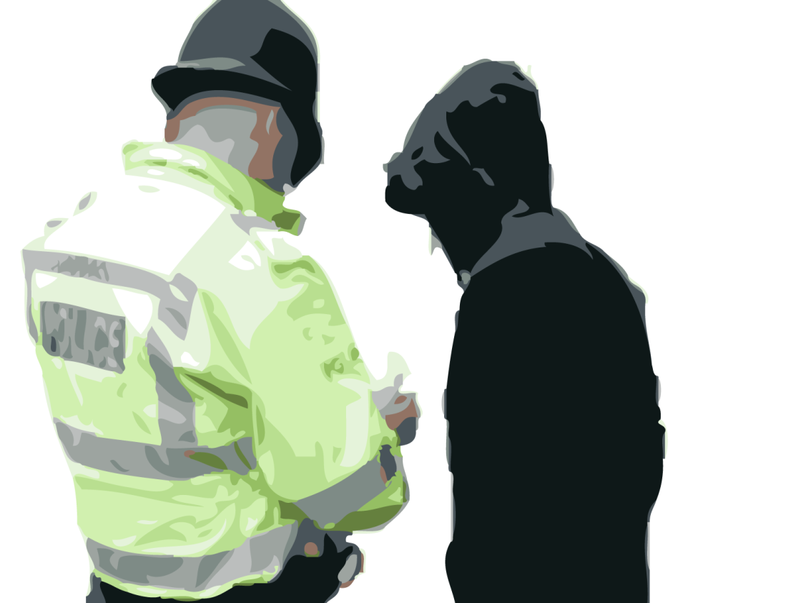
Conduct of the search
Co-operation
Relevant
Extent (J.O.G)
More thorough
Notes:
State:
Co-operation
Whilst there is no such thing as a voluntary search, you must try to get the co-operation of the person you intend to search. PACE allows you to use reasonable force but this should be as a last resort. A willing participant is much better than an unwilling one.
Relevant
The search must be kept to the places you might reasonably expect the item to be, e.g. If, because of the information you have, you expect to find the item in a particular pocket, then you should only search that pocket unless you can justify further searching. Or again, you wouldn’t search for a stolen DVD player in someone’s coat pocket, unless it was extremely large. Once you have found the item that you are looking for, the search, at least under Section 1 PACE, should stop.
Extent (J.O.G)
You are only allowed to require the person to remove their Jacket, Outer coat, which might include a hooded sweatshirt, and Gloves. You can ask them to remove other garments, their hat for example, but you cannot require it when you are in a public place.
More Thorough
You can carry out a more thorough search, for example the removal of a tee-shirt, but it must be done out of the view of the public, in the back of a police van or possibly in the changing room of a shop if it is nearby.

Slide 26
Conduct of the search
Same sex
Pockets, collars, socks & shoes
Hair
Notes:
State:
You cannot search or be present at the search a member of the opposite sex if more than JOG (plus headgear and footwear) are going to be removed.
Whilst there is nothing in PACE that states a search cannot be carried out by a member of the opposite sex, it is always best practice to have a an officer of the same sex to carry out the search. It reduces the chance of any complaint being made.
An officer can search the inside of pockets of outer clothing, and feel around the inside of collars, socks and shoes.
An officer can also search a person’s hair but only if it does not require the removal of headgear.

Slide 27

Risks
Injury to self
Injury to others
Violence
Allegations of misconduct
Notes:
Trainer to ask students for examples of risks posed by conducting searches.
Discuss any answers provided
Searching individuals carries a degree of risk. These can include:
Injury to yourself
Injury to others
Being subjected to violence from the individual being searched or others present.
Allegations of misconduct – importance of GO WISELY
As we have discussed building up communication with the individual will reduce any risk to yourself.
For example before you put your hands in their pockets, ask them if they have anything that is likely to harm you or them. An alternative to you searching their bag/pockets can be to ask them to empty them first.
Be aware of changing body language that may indicate an escalation in the individuals behaviour. If concerned ask for assistance before conducting the search.
Ensure that where possible another officer is present when a search is conducted to minimise the risk of allegations being made. Whilst this may not always be possible, the use of CCTV can assist you

Slide 28
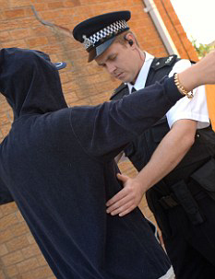
Section 32 (2) (b) PACE
Reasonable grounds for believing:
Danger
Implement
Evidence
Notes:
State:
The full definition of Section 32 of PACE talks about search of a person when arrested elsewhere than at a police station which will be dealt with in a later lesson.
The person can be searched if the officer has reasonable grounds for believing that the arrested person may present a danger to himself or others.
The officer can search the person for anything which the arrested person might use to assist him to escape from lawful custody; or which might be evidence relating to an offence
The power to search conferred is only a power to search to the extent that it is reasonably required for the purpose of discovering any implement of evidence
As with Section 1 of PACE this section to search a person does not authorise an officer to require a person to remove any of his clothing in public other than an outer coat, jacket or gloves.

Slide 29
Section 32 (2) (b) PACE
A constable may enter and search any premises in which a person was when arrested or immediately before he was arrested for evidence relating to the offence for which he was arrested.
Notes:
State:
The power to search a premises is for evidence relating to the offence for which he was arrested.
The power is only granted when a police officer has a genuine belief that there is evidence on the premises
When the premises is shared then the power to search is limited to:
Any dwelling in which the person was when or immediately before arrest and any part which had common use.

Slide 30
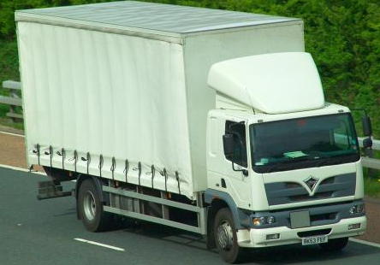
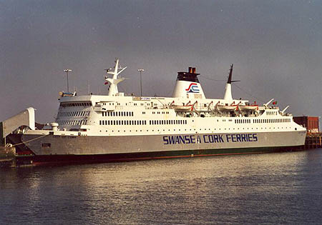


Premises
Vehicle
Vessel
Aircraft
Hovercraft
Notes:
State:
For the purpose of exercising these powers of entry the term ‘premises’ includes any place and, in particular, includes any:
vehicle, vessel, aircraft or hovercraft
NEXT SLIDE

Slide 31

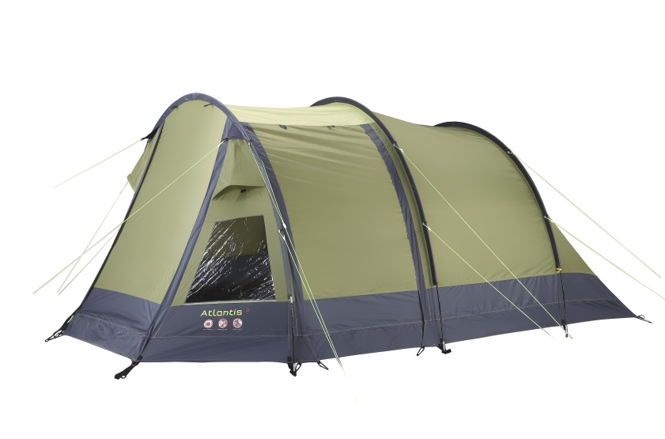
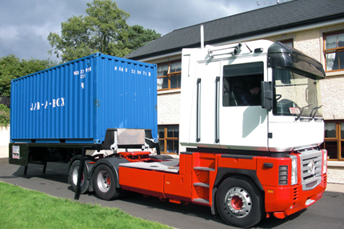
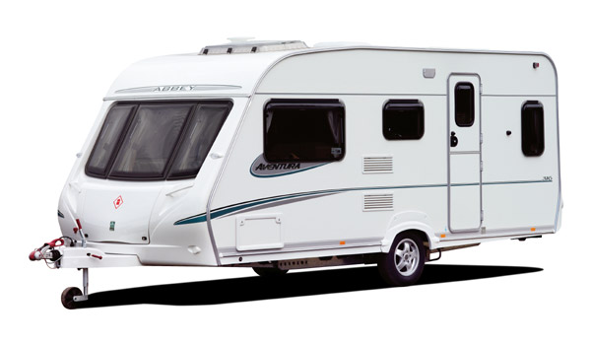
Premises
Offshore installation
Tent, or
Moveable structure
Notes:
State:
offshore installation tent or movable structure.

Slide 32

Section 17 PACE
Executing a warrant of arrest or commitment
Notes:
State:
Before you can use this power you have reasonable grounds for believing that the person you are seeking is on the premises, and in the case of premises which consist of two or more separate dwellings (e.g. bed sits) you enter and search only, parts of those premises which the person uses in common with other occupants, and any dwelling within those premises in which you have reasonable grounds for believing you will find the person you are seeking.
warrant of arrest issued in connection with or arising out of criminal proceedings, for example where an arrest warrant has been issued following the failure of a person to answer a summons
commitment warrant commitment - to a specific place - one of few occasions when prisoner not taken to a police station

Slide 33
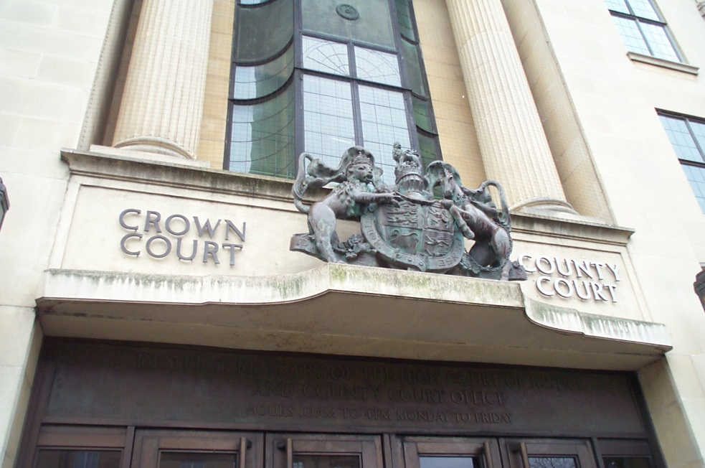


Section 17 PACE
An indictable offence
An offence under Section 1 POA 1936
Notes:
State:
An indictable offence is one that CAN be heard in Crown Court, so anything that is not a summary offence theft, burglary for example but not TWOC. (The law is an ass)
Section 1 Public Order Act 1936 (Prohibited Uniforms)
Oswald Mosley formed a new political party in 1932 called the British Union of Facists. They had found problems with disruption of New Party meetings, and instituted a corps of black-uniformed paramilitary stewards, nicknamed blackshirts. The party was frequently involved in violent confrontations, particularly with Communist and Jewish groups and especially in London. The government was sufficiently concerned by the organisation and its politics and policies that they passed the Public Order Act 1936, which, amongst other things, banned political uniforms and quasi-military style organisations.
There are no recent examples of the use of this piece of legislation.

Slide 34


Section 17 PACE
S 4 POA 1986
S 6 to 8 or 10 of the CLA 1977
S76 CJPO 1994
Notes:
State:
Many offences are summary offences therefore do not come under PACE so they were added specifically to the legislation.
Section 4 POA is about threatening violence.
Sections 6 to 8 or 10 Criminal Law Act 1977 are offences of entering or remaining on property, or squatting
Section 76 Criminal Justice and Public Order Act 1994
Relates to failure to comply with an interim possession order as a result of squatting

Slide 35
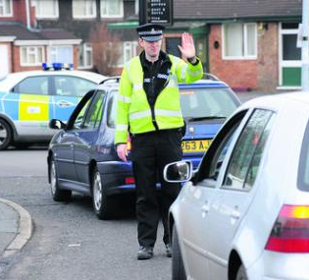
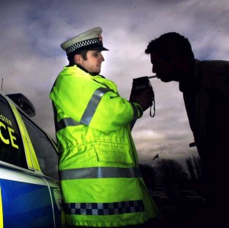
Section 17 PACE
S 163 RTA 1988
S 4 RTA 1988
S 27 Transport & Works Act 1992
Notes:
State:
Section 163 of the Road Traffic Act 1988 relates to failure to stop when required to do so by a constable in uniform
Section 4 Road Traffic Act 1988 relates to driving under the influence of drink or drugs. This has been put in because the breath test is not evidence of the offence only the results of the intoxiliser machine used in police stations will be evidence. Therefore the person has not committed an offence at this time but an officer needs to arrest to take the suspect to a police station.
Section 27 Transport & Works Act 1992 relates offences involving drink or drugs in relation to transport system workers
There are also offences relating to the prevention of harm to animals (Animal Welfare Act 2006 & Animal health Act 1981)

Slide 36
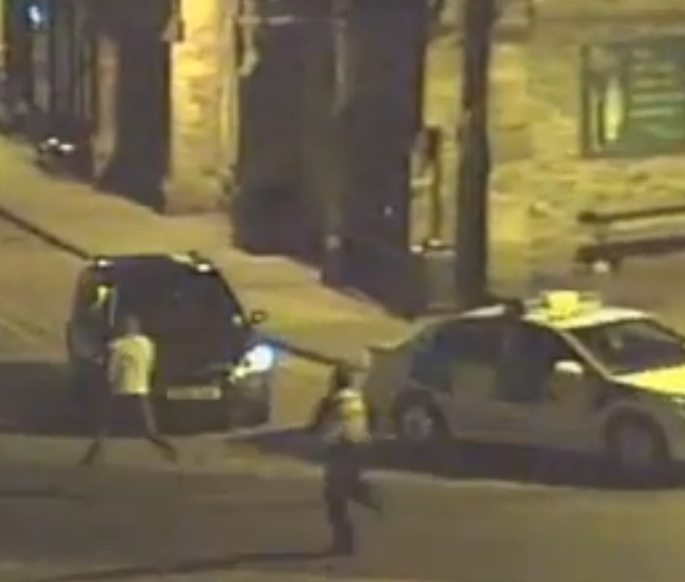
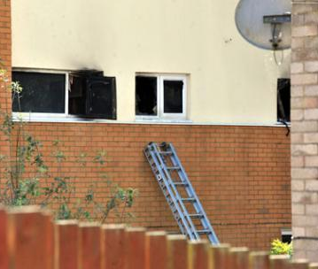
Section 17 PACE
Recapturing a person unlawfully at large and whom he is pursuing
Saving life and limb or prevent serious damage to property
Notes:
State:
Unlawfully at large does not have a particular statutory meaning it can apply to someone who is subject to an order under the mental health act or someone who has escaped from custody
The pursuit must be ‘fresh’ you must actually be pursuing, not when seen or from information given at a later time.
There are limitations to the use of this power with the exception of saving life & limb
You must:
have reasonable grounds for believing that the person in on the premises
only enter those areas where you reasonable suspect the person to be when searching shared accommodation
We spoke about reasonable grounds to suspect and reasonable grounds to believe and the amount of evidence available at the time.

Slide 37
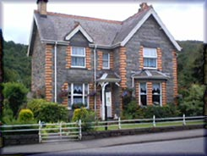
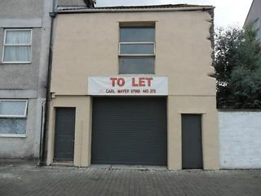
Section 18 (1) PACE
A constable may enter and search any premises occupied
or controlled by a person under arrest for an indictable offence
Notes:
State:
This power is to search any premises occupied or controlled and is usually used after a person has been arrested and taken to a police station for a variety of reasons, most of which require a person to have been arrested.
OCCUPIED
in this context refers to premises where the arrested person resides or works and may include occupancy as an owner, tenant or 'squatter‘.
CONTROLLED
in this context includes premises in which the arrested person holds some interest - ie: he owns, rents, leases or has use of the premises.
You should be in possession of the written authority unless it is impracticable, but you must state where the record is held.
The power only applies where a person has been arrested for an indictable offence.

Slide 38
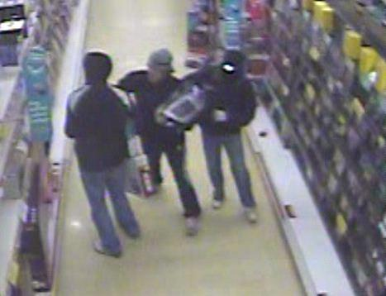

Section 18 (1) PACE
if he has reasonable grounds for suspecting that there is on the premises evidence relating to that offence
or another indictable offence which is connected with or similar to that offence
Notes:
State:
As well as only looking for evidence of that offence you are limited in conducting a search where you might find that evidence, for example
If you were searching for a stolen TV you would not be entitled to search drawers or small cupboards.
You would be able to if you were looking for packaging, receipts or other documents relating to the TV.
However if you find items indicating another offence the person may be arrested for that offence and another Section 18 search may begin for items relating to that or a similar offence

Slide 39
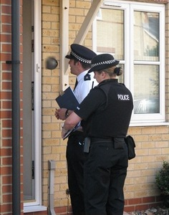
Section 18(5) PACE
A constable may conduct a search before taking the person to a police station without obtaining an authorisation from an inspector if the presence of that person is necessary for an effective investigation.
Notes:
State:
However, you may carry out a Section 18 search without prior authority if the presence of the person arrested at a place other than a police station is necessary for the effective investigation of an offence.
The authority of an Inspector does not constitute a lawful search.
If you do carry out the search before taking the person to a police station an inspector must be informed as soon as is practicable. My advice is check it out with your supervisor first.
If the premises is occupied the officer must explain to the occupiers the reason for the search, if you do not you may not be acting in the lawful execution of your duty.
The test in this case is: Is it NECESSARY for the person to be there for the EFFECTIVE investigation. This is what you must be able to justify.
You should always attempt to get voluntary agreement from the arrested person first.
This could be the occupier or a person entitled to grant entry. The consent must not be obtained under duress. The consent can be withdrawn. This is good practice not a requirement.
If the person is in custody a record must be made on the custody record of the facts concerning the search

Slide 40

Section 19(2) PACE
A Constable who is lawfully on any premises may seize anything which is on the premises if he has reasonable grounds for believing that it has been obtained in consequence of the commission of an offence
Notes:
State:
Section 19(1) of PACE states that a Constable who is lawfully on property may seize articles and can be listed as:
Anything –reasonable grounds for believing obtained by offence or necessary to prevent destruction / concealment s19(2) PACE
Anything if reasonable grounds for believing evidence of an offence –necessary to prevent concealment / destruction s19(3) PACE
Opening up computers
s19(4) PACE
Exception for privileged material
s19(5) PACE
The important word here is lawfully. If you have a warrant or authorisation then this is okay.
QTS: What about if you have been invited on to a premises, does section 19 still apply?
A: Yes as long as you have not been asked to leave, so once you have enough evidence get an arrest in quick!

Slide 41
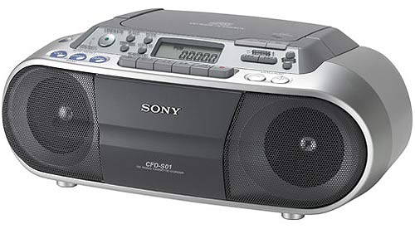
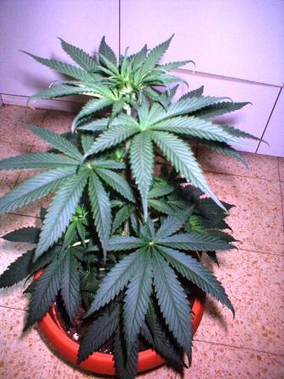
Section 19(2) PACE
or that it is evidence in relation to an offence which he is investigating
or any other offence and it is necessary to seize in order to prevent it being:
Notes:
State:
You can also seize any items that link to the offence you are investigating.
QTS: What level of evidence would help make your mind up about an item?
A: Whether the person had a receipt for the item in question
Stated cases
The following stated case illustrates that seizing items under Section 19 PACE 1984 allows the whole premises to be seized, where this is physically possible.
Cowen v Commissioner of the Police of the met [2000] 1 All ER 504
The case involved the seizure of a car belonging to the appellant, who had been arrested on suspicion of sexual offences involving children.
The police suspected that the offences had been committed within the vehicle, which therefore justified forensic examination.
The court held that the powers of seizure under PACE 1984 allowed the seizure of the whole premises, where this is physically possible.

Slide 42
CONCEALED
LOST
ALTERED
DAMAGED
DESTROYED
Items subject to legal privilege may not be seized
Notes:
State:
Items seized under Section 19 may be seized only where this is necessary to prevent their concealment, alteration, loss or damage or destruction.
Items may be photographed or copied.
No item may be seized which is subject to legal proceedings.
This relates to communications between the individual and any legal representative.

Slide 43
Premises occupied
You must:
Identify yourself any person accompanying and their role.
If not in uniform Show warrant card.
State the purpose and grounds for search.
Notes:
State:
Organised searches will usually have an officer in charge (drugs), then you may also have an exhibits officer but a lot of the time it will be only you.
You must always consider the following:
Complying with The Codes of Practice.
The search must be at a reasonable hour, unless frustrate purpose of the search.
Consideration for the property. You must treat the property with care and leave the premises as you found it.
Privacy of occupant. You must comply with the HRA and the DPA in relation to the person and any property found.
The search must only be to the extent necessary to achieve the object of search.
The occupier may have someone else present, Unless this would:
Hinder the investigation.
Cause unreasonable delay.
Before leaving premises entered by force, it must be secured. This can be achieved by:
Arranging for the occupier or agent to be present or any other appropriate means.

Slide 44
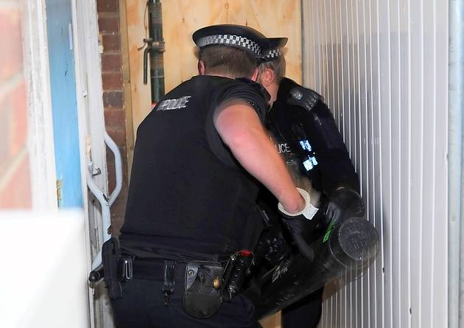
Section 117 PACE
Occupier has refused entry
It is impossible to communicate
premises are unoccupied or,
Occupier is known to be absent
Reasonable grounds to believe that:
frustrate the object of the search
Endanger officers or other persons
Notes:
State:
Reasonable force may be used when the occupier has refused entry, it is impossible to communicate with occupier, the premises are unoccupied or, the occupier is known to be absent or there are reasonable grounds to believe that it would frustrate the object of the search or endanger officers or other persons
The responsibility for the use of Force is an individual decision, which may have to be justified in legal / disciplinary proceedings.
The three core questions for police (as to when force may be used, and to what extent)
1. Would the use of force have a lawful objective (e.g. Effecting a lawful arrest) and, if so, how immediate and grave is the threat posed?
2. Are there any means, short of the use of force, capable of attaining the lawful objective identified?
3. Having regard to the nature and gravity of the threat, and the potential for adverse consequences to arise from the use of force, what is the minimum level of force required to attain the objective identified, and would the use of that level of force be proportionate or excessive?
An officer asking each of these three questions, and acting according to the answers, will be likely to identify the correct considerations governing the use of force, and therefore to be acting lawfully.

Slide 45

There are some exercises on this power point to reinforce your learning.

Slide 46
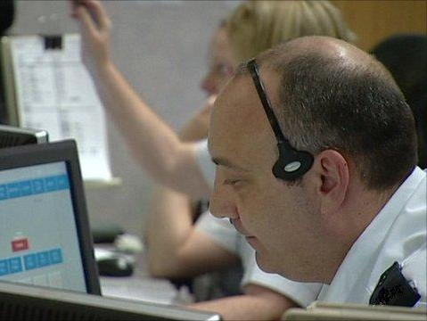
“Tony Donavan went out with another man about half an hour ago in a dark vehicle.
They have just returned in the vehicle and they are carrying black plastic bags into Tony’s house.
I don’t know what is in the bags but they appear to be full, but quite light.”
Notes:
State:
We will now work our way through an incident,
At 0330 one morning an anonymous telephone call is received by the control room. The caller says,
“Tony Donavan went out with another man about half an hour ago in a white van. They have just returned in the van and they are carrying black plastic bags into Tony’s house. I don’t know what is in the bags but they appear to be full, but quite light.”
When asked by the operator the caller says, he does not know the second man. He refuses to give his name because he describes Donavan as a nasty piece of work.
Tony Donavan is a well known local burglar and drug dealer. He is presently on bail to Crown Court for burglary offences, committed in local shops and garages. He is known to live at 32, Bradley Drive, Sandford, with his wife and one year old son. The house is a semi detached, built in the 1930s and owned by the local council.
The call was made from a telephone box on Bradley Drive.

Slide 47
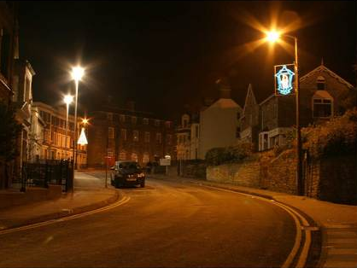
What are you thinking?
What options are available to you?
Notes:
State: The information is relayed to you because Bradley Drive is on your beat.
You are able to see from the end of Bradley Drive that there is a dark vehicle outside Tony Donavan’s house. The house is in darkness.
Possible options
Do nothing
Keep observations to see if anyone leaves with the suspect or leaves the property
Approach the house, inform the occupant of the allegation and ask for an explanation and for permission to search
Enter the premises using the power under Section 17(1)(b) PACE to arrest for an indictable offence
Apply to a magistrate for a warrant under Section 8 PACE to enter and search the premises

Slide 48

One of your colleagues has discovered a burglary at a petrol station on the Bradley estate, where large quantities of cigarettes were stolen.
What are you thinking?
What are you going to do?
Notes:
QTS: What does this piece of information mean?
A: It is likely that the plastic bags taken into Donavan’s house contained the cigarettes from this burglary.
QTS: What are you going to do with this information?
A: Using Section 17(1)(b) PACE power to enter the property and arrest Donavan and the other suspect.
QTS: Is there anything else you are considering?
A: Search the house for the cigarettes under Section 18 of PACE.

Slide 49
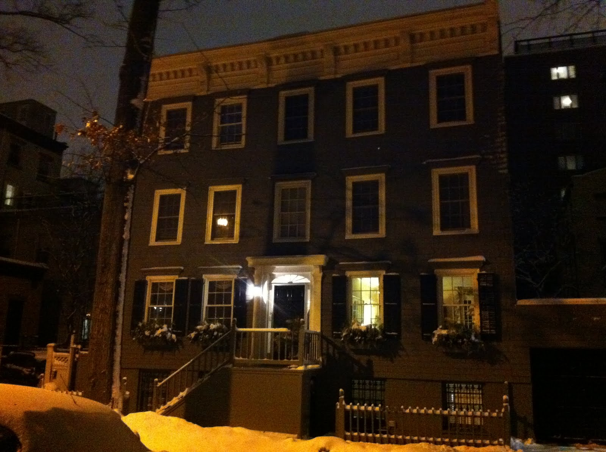
On arrival at Donavan’s house you can see that the house is in darkness
There is a short delay on gaining entry and you can hear movement in the front room
Notes:
QTS: How long would you wait at the door?
A: Long enough to satisfy yourself that no-one will answer.
State:
The question of waiting will depend upon the circumstances you face.
For example, if you we going to search a property for drugs you would not want to give the occupiers the opportunity to dispose of the evidence.

Slide 50

You arrest Donavan
Donavan denies that there is another man in the house.
He says the only other people in the house are his wife and a family friend
Notes:
State:
Donavan comes to the door and is arrested immediately
Donavan denies that there is another man in the house. He says the only other people in the house are his wife and a family friend.
QTS: What are you going to do with the information Donovan has given you? Do you have reasonable grounds to believe that the other suspect is still on the premises?
SEE NEXT SLIDE FOR ANSWERS

Slide 51
What do you want to do now?
Notes:
QTS: What will you do now?
A: Section 17 search for Drydale
Take Donovan to custody. If they choose this option:
QTS: What might happen if you leave the property?
A: If the stolen property is on the premises and might be CLADD.
A: Obtain warrant. If they choose this option
QTS: What might happen if you leave the property?
A: If the stolen property is on the premises and might be CLADD.
A: Section 18 search of the property. If they choose this option
QTS: Would you go for the Inspector’s authorisation
A: No same reason as above
DO THEY CONSIDER SEARCHING THE VEHICLE UNDER SECTION 18?
If they do State: A sealed carton of cigarettes is found
QTS: What will you do with the pack?
A: Seal if in some form of container to save any forensic evidence. The identifying number will be the finding officer’s and the number 1 (the first piece of evidence in the chain for that officer.

Slide 52

During the search you see two women sitting together on a sofa.
What are your thoughts?
Notes:
State:
You carry out a search but you do not find:
The male/the black plastic bin bags
Whether they choose S17 or S18Show slide
You recognise one of the women as Shirley Wilson, girlfriend of Simon Drydale, known associate of Donovan.
QTS: What do you want to do now?
A: Arrest the girls. If they choose this option
QTS: What grounds do you have? NONE
A: Search the two girls. If they choose this option
QTS: What power would you use? If they say Section 1 – no power as it is not a public place.

Slide 53
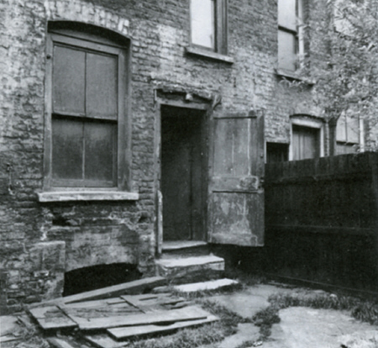
At the rear of the property and find the back door open.
You check Dryden’s current address. It’s shown as Room 3, Staymor Guest House, Queens Street on the other side of town.
What action will you take?
Notes:
State:
During your search you saw that the back door to the property is open.
You come to the conclusion that Drydale has escaped.
You arrange for Donovan to be taken to custody as you still need to investigate this incident further.
You check Drydale on PNC and the following information comes back
Show details
QTS: What are you going to do now?

Slide 54
What evidence do you draw your conclusions from?
Notes:
QTS: Using the NDM as your guide what has led you to the decision you just made?
A: Answers could include:
They are looking for another male accomplice
The evidence is not at the property
The girlfriend of a known associate of Donovan is at the property
The hour of the morning that these two girls are awake
QTS: What are you going to do now?
A: If students mention search Staymor for Drydale ask:
QTS: What do S17 say you need for this power to be used?
A: Reasonable grounds to BELIEVE person will be on the preimses

Slide 55
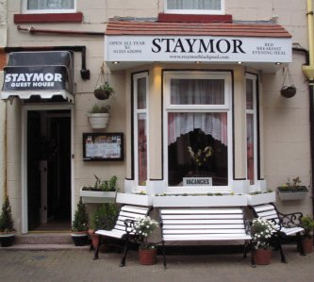
You arrive at the Staymor. It is now 0500 hrs.
Where, if anywhere, will you start your search?
Why?
Notes:
State:
You arrive at the Staymor and you are met by Mrs Porritt, the owner.
QTS: What do you tell her?
A: Due to the hour it will be necessary to explain why the search needs to be carried out at that hour. The student should consider the amount of information to be divulged, remembering that need to keep some information confidential.
State:
Remember at this stage you only have the suspicion of his involvement. He is still innocent!
Mrs Porritt tells you she has heard somebody go into Drydale’s bedsit.
The Staymor has nine bedsits on three floors. On each floor is a bathroom and a TV lounge that the occupants of the landing are expected to share.
QTS: What will you do now?
A: Search Dryden’s room and any rooms which are communal.

Slide 56
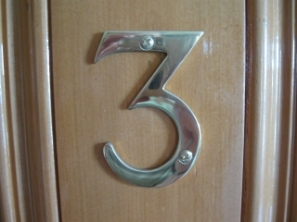
Drydale’s bedsit is on the first floor.
What will you do?
Why?
Notes:
State:
Drydale is not in his room.
QTS: What will you do now?
A: leave it. Section 17 only allows power to enter to arrest. All the other powers require an arrest to be made first. A warrant will have to be obtained to search further.
State:
As you are leaving Drydale’s room, Mrs Porritt tells you about another guest, David Mancrief, who has room number five.

Slide 57
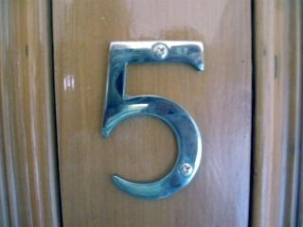
What powers do you have?
What will you do?
Notes:
State:
Mrs Porritt tells you that Drydale and Mancrief are always in each other’s rooms, but Mancrief is not in today - he is away on holiday.
Just as you are finishing in Drydale’s room you hear a loud thud from room five.
QTS: What are you going to do?
A: Search Mancrief’s room.
QTS: What power allows you to do this?
A: Section 17.

Slide 58
What powers do you have?
What will you do?
Notes:
State:
You knock on the door but there is no answer. Mrs Porritt lets you into Mancrief’s room where you find Drydale hiding in a closet.
QTS: What are you going to do now?
A: Arrest Dryden, possibly search him under S32 PACE
QTS: What else can you do?
A: Search Mancrief’s room.
QTS: Under what authority?
A: Section 32 PACE.
State:
You do not find the black bags in Mancrief’s room.
QTS: What will you do now?
A: Search Dryden’s room under S18.
QTS: What do you need for this search to take place?
A: Authority of an Inspector.
QTS: Can you justify not taking Dryden to custody first?
A: Only if his presence is necessary for the effective investigation of the offence. This should only be done in exceptional circumstances and the guidance of a supervisor should be sought. In this case, unless you believe that someone else might come and remove the evidence (does anyone but the Landlady have a key?) you may well take him to custody first.
On searching Dryden you find a set of Yale keys. None of them fit the door to Dryden’s room or the front door.

Slide 59
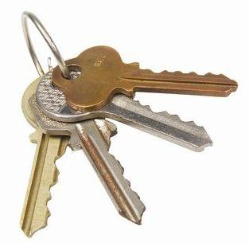
What will you do now?
Notes:
QTS: What are you going to do now?
If students say ‘ask about the key’ remind them that this will constitute an interview.
State:
You would need to take him to custody and ask the question under formal interview.
During interview Dryden says that he is a self-employed painter and decorator and that he keeps his ‘gear’ in a lock-up garage off Princess Street.
QTS: What are you going to do?
A: Get an inspector’s authority to search both room and lockup.

Slide 60
You arrive at the lockup
The lock-up is full of junk and painting equipment. You find the black bags full of packets of cigarettes, and you also find a Sony DVD recorder and a stack of DVDs hidden under sacking at the back of the garage.
What are you going to do?
Notes:
QTS: What are you going to do now?
A: Seize all the items
QTS: Bag and tag the items seized and make a full PNB entry of your actions.

Slide 61
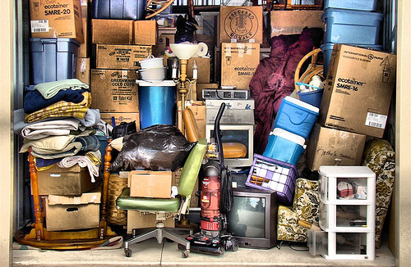
Criminal Justice and Police Act 2001
Sift and Seize
Notes:
State:
When the extent or complexity of a search mean it is likely to take a long time, the officer in charge of the search may consider using the seize and sift powers inserted into S & PACE by the CJPA 2001
This power can be used when it is not reasonably practical to do it any other way.
What is reasonably practicable will be different in each case but will include the time it would take to separate material and also the risk of accidentally altering or damaging anything.
Where legally privileged material forms part of the 'whole thing' then this too can be seized and section 19(6) of PACE does not apply.

Slide 62
Proceeds of Crime Act 2002
If a constable who is lawfully on any premises and has reasonable grounds for suspecting that there is on the premises cash -
which is intended by any person for use in unlawful conduct, and
the amount of which is not less than the minimum amount
he may search for the cash there.
Notes:
State:
Section 289 of the Proceeds of Crime Act 2002 provides a search power to seize cash that is the proceeds of unlawful conduct or intended for use in unlawful conduct.
The minimum amount is £1,000.
The law allows constable to seize cash exceeding £1,000 when found on premises when there are reasonable grounds for suspecting it is the proceeds of crime or is to be used for a criminal activity.
If the person is eventually convicted of an offence the courts can decide if the money found was as a result of a criminal activity or criminal lifestyle and can make an order to have that money confiscated.
If you find cash less than the value of £1000 and you can link it to the consequences of a crime then you can seize it.

Slide 63
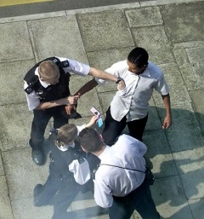
Needs of the individual
Respect and courtesy
Minimise embarrassment
Treat as individual
Aware of individual needs
Notes:
State:
Stop searches can become routine for an officer but you should always remember that it might be the first time for this person and remember ... all persons searched are innocent until proven guilty by a court, therefore you must ensure that all persons are:
treated with respect and dignity
treated in a manner that minimises embarrassment
treated as an individual and the officer should be aware of any individual needs.
All stops and searches must be carried out with courtesy, consideration and respect for the person concerned. This has a significant impact on public confidence in the police.
Every reasonable effort must be made to minimise the embarrassment that a person being searched may experience
Searches should ONLY be conducted using force where it is established that the person is unwilling to co-operate or resists.
Reasonable force may only be used as a last resort if necessary to conduct a search or to detain a person or vehicle for the purposes of a search

Slide 64
Needs of the individual
Respect and courtesy
Minimise embarrassment
Treat as individual
Aware of individual needs
Notes:
State:
As has previously been discussed, as with most things that police officers do, there is a significant amount of legislation that governs how individuals are dealt with.
This includes:
Equality Act 2010
European Convention of Human Rights 2003
Children Act 2004
Race Relations Amendment Act 2000
Health and Safety at Work Act 1974
Police and Criminal Evidence Act 1984

Slide 65

Any Questions?
Notes:
State:
You are now going to watch a DVD clip.
I want you to consider what your actions might be at the end of each section.
Remember you will have to justify every action that you intend to take.
Trainer play students the ‘Stop & Search – Car Park Scenario’ DVD
After each section, i.e. a, b, c & d,
QTS:
What are you thinking?
What would you do?
How can you justify this?
What powers are available to you?

