Slide 1
Atheism and non-Belief
The Enlightenment and the Nineteenth Century

Slide 2
Faith vs Reason
“As to the issue of the coming conflict, can any one doubt? Whatever is resting on fiction and fraud will be overthrown. Institutions that organize impostures and spread delusions must show what right they have to exist. Faith must render an account of herself to Reason. Mysteries must give place to facts. Religion must relinquish that imperious, that domineering position which she has so long maintained against Science. There must be absolute freedom for thought. The ecclesiastic must learn to keep himself within the domain he has chosen, and cease to tyrannize over the philosopher, who, conscious of his own strength and the purity of his motives, will bear such interference no longer. What was written by Esdras near the willow-fringed rivers of Babylon, more than twenty-three centuries ago, still holds good: ‘As for Truth it endureth and is always strong; it liveth and conquereth for evermore’.
John William Draper (1811-1882) History of the Conflict between Religion and Science, 1874

Slide 3
from Faith to Reason
“A rational account is broadly one which confines itself to reasons, evidence and arguments that are open to scrutiny, assessment, acceptance or rejection, on the basis of principles and facts which are available to all. An optimally rational account is one in which we don’t have to plug any gaps with speculation, opinion, or any other ungrounded beliefs” (Baggini, 2003, 76).
“Thus atheism can be seen as part of a wider, progressive study about the development of human intellect and understanding” (Baggini, 2003, 78)

Slide 4
‘Equality, liberty and tolerance’ came out of the Enlightenment. It was ‘central to our notion of what makes a good and fair society’ – from superstition to reason (Baggini, 2003, 79).
“…few seriously believe that we should go back to a time when office was inherited, when only the male middle classes were politically enfranchised, or when leading clerics wielded strong political power” (Baggini, 2003, 79).

Slide 5
“Atheism takes the Enlightenment rejection of superstition, hierarchy, and rationally ungrounded authority to what many would see as its logical conclusion. It certainly fits atheism’s self-image to say that, once we were prepared to look religion in the eye under the col light of reason, its untruth became self-evident. It just obviously was superstition and myth, grounded not in the divine but in particular, local human practices” (Baggini, 2003, 80).

Slide 6
Atheism battled against the odds (Baggini, 2003, 81) and explains why atheism was seen (and still is) as negative non-belief in God rather than positive naturalism. The backdrop was of religious belief. So, it has done well to expand so much in 200 years as a ‘credible alternative’ (Baggini, 2003, 81).

Slide 7
Baron d'Holbach (1723 – 1789) Wealthy Philosopher. Could entertain influential people. Baron d’Holbach was more than simply an academic; he strongly believed in the necessity of informing the public about atheism. Pamphlets.
The English Civil War (1642–1651): Parliamentarians (“Roundheads’) and Royalists (‘Cavaliers’). ‘Divine Right of Kings’.

Slide 8
Christianity Unveiled, 1767 - anti-religious stance. Religion is against human development
“Many men without morals have attacked religion because it was contrary to their inclinations. Many wise men have despised it because it seemed to them ridiculous. Many persons have regarded it with indifference, because they have never felt its true disadvantages. But it is as a citizen that I attack it, because it seems to me harmful to the happiness of the state, hostile to the march of the mind of man, and contrary to sound morality, from which the interests of state policy can never be separated” (HumanistsUK).

Slide 9
The System of Nature (1770). Outlined d’Holbach’s thinking as a materialist and an atheist. The only reality is in material things.
Baggini (2003, 80) ‘Atheism takes the Enlightenment rejetion of superstitution, hierarchy,, and rationally ungrounded authority to what many would see as its logical conclusion’. And ‘It certainly fits atheism’s self-image to say that, once we were prepared to look religion in the eye under the cool light of reason, its untruth became self-evident. It is just obviously superstitution and myth, grounded not in the divine but in particular, local human practices’.

Slide 10
It was a time of on-going progress of human society and intellect – even if the progress, says Baggini, was uneven and reversible (religion comes and goes). Late onset of Atheism as an actual belief was due to religion being so deeply embedded and assumed to be ubiquitous. Atheism was battling against the odds and seen as negative as it was against a set of beliefs believed to be universal. ‘…how little experience we have of living our lives and ordering our societies without the backdrop of religion’ (Baggini, 2003, 81).

Slide 11
Mass Atheism is young so can expect to see some immaturity (Baggini, 2003, 81).
Walter, (2010) notes that Deism was popular in the Enlightenment period as an alternative to ‘supernatural’ religion. Known as ‘rational religion’. God created the universe and the laws of nature, but no further involvement. Impersonal God easier to accept?

Slide 12
The Enlightenment
The Age of Reason
Politics, Philosophy, Science – questioning of traditional authority. Books, essays, scientific discoveries, laws, revolutions.
Humanity could be improved through rational thought and rational change.
The Renaissance – Classical Literature, Protestant Reformation, astronomy (Galileo, Copernicus).
‘Infallibility of the Pope’.

Slide 13
Nineteenth Century Developments
Max Muller (1823 - 1900) – explain sun, floods, etc
EB Tylor (1832 – 1917) – explain dead in dreams
James Frazer (1854 – 1941) – magic to religion
Anthropologists – religion is a normal historical attempt to make sense of the world. Experiences let to ideas and inferences (Walters, 2010, 97) and formed the basis of human reason. Religion was primitive and false, but not irrational.

Slide 14
August Comte (1798 – 1857)
Emile Durkheim (1858 – 1917)
Both saw religion as leading to social cohesion – functionalist approach. Story, myth, ritual, value.
Walters (2003, 98) says that Atheists see religion in the same way – the functionalist approach. As either a consolation (life/death, fear/suffering, hope, poverty, death) but itself causing fear, or as a part of natural selection – useful function during development. Biological not just socio/psycho.

Slide 15
God as Human Invention
Ludwig Feuerbach (1804 – 1872) – Projection. Help us deal with our fears and aspirations. But robs humans of sense of pride and also of control.
God is a human invention – society or psychology – Freud
At the end of the 19th century the philosopher Friedrich Nietzsche (1844-1900) announced that God was dead, and that humanity had killed him.

Slide 16
Biblical Criticism
Historical Criticism against the infallibility of the Bible.
Moral Criticism
Criticism from Science

Slide 17
Historical Criticism against the infallibility of the Bible.
Moral Criticism
Criticism from Science
1828 no-one could hold a public office without signing up to the beliefs of the Church.
1836 only Church of England ministers could conduct marriages.
1871 only members of the Church of England could teach at the universities of Oxford and Cambridge.

Slide 18
Industrial Revolution
Inequality
Poverty
Poor health and sanitation
Poor church-attendance
Alcohol

Slide 19
Historical Criticism
Literary criticism. Treat the Bible like any other book.
Thomas Hobbes (1588 – 1679) - 1651, Moses could not have written all the books attributed to him.
J G Eichhorn (1752 – 1827) 1779 the stories in Genesis were not actual history, but myths.
DF Strauss (1808 – 1874) – Life of Jesus, 1835 - New Testament stories about Christ should not be interpreted as literally true.
Historical method – author, place, time, translations, interventions.
Rowland Williams, 1860 Essays and Reviews, 1889 Lux Mundi

Slide 20
Moral Criticism
Original Sin
Doctrine of Hell
John Stuart Mill 1872, "I will call no being good, who is not what I mean when I apply that epithet to my fellow creatures, and if such a being can sentence me to hell for not so calling him, to hell I will go."
Exodus 21.20
Bishop William Colenso, Natal.

Slide 21
Criticism from Science
Archbishop Ussher (1581 – 21 1656) 4004BCE
Fosils were to test humanity
Noah’s flood really happened
Charles Lyell and William Buckland – 1830s
Darwin and Evolution.
Colenso – Mathematician, The Pentateuch and the Book of Joshua Critically Examined (1862)

Slide 22
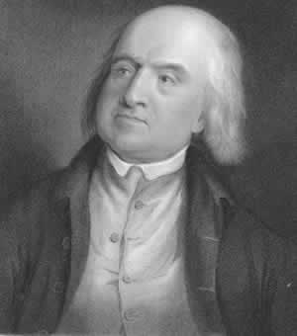
Jeremy Bentham
1748-1832
Polymath famous for campaigning for:
  Abolition of Slavery
  Women's Rights
  Decriminalization of Homosexuality
  Animal Rights
Founder of Utilitarian Philosophy
1822 – The Analysis of the Influence of Natural Religion on the Temporal Happiness of Mankind (with George Grote)
“Religious Beliefs are irrational as they are ‘extra-experimental’” (i.e. Non-Falsifiable)
Not openly atheist in his lifetime, but now considered as such by most academics.

Slide 23
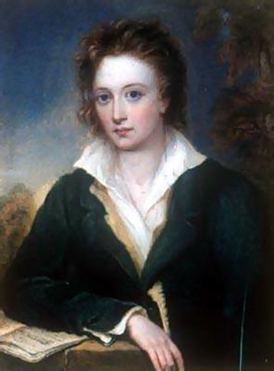
Percy Shelley
1792-1832
Romantic Poet – lived with Keats in Rome
Married to Mary Shelley (Frankenstein)
Expelled from Oxford in 1811 for writing The Necessity of Atheism
Argued that:
Empiricism denies the reality of God
Testimony must answer to reason, and irrational testimony rejected
Atheists should not be persecuted for their stance
Does not object to a ‘pervading spirit’ of the universe, though…
Was a Pantheist in later life
http://www.infidels.org/library/historical/percy_shelley/necessity_of_atheism.html

Slide 24
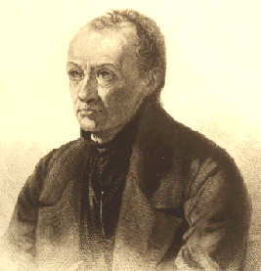
August Comte
1798-1857
French social philosopher
Founder of sociology as a discipline
Positivist Thinker – Empiricism & Logic are the foundations for true knowledge
Atheist
Desired social harmony after French Revolution – founded Religion of Humanity in 1849.
Months of the year named after great thinkers, festivals and ceremonies purely social.
Based on the three tenets of: Altruism, Order & Progress.
First real Humanist Social & Moral organisation

Slide 25
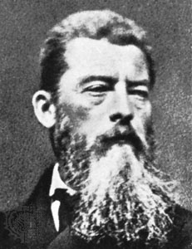
Ludwig Feuerbach (1804-1872)
The Essence of Christianity (1841)
Feuerbach argued that the empirical world must have precedence over claims to ‘spirit’.
Humanity’s ideals are: (1) Reason (2) Will and (3) Love. Humans do not live up to these ideals and feel alienation from them.
This alienation is projected into a metaphysical ideal (i.e. Divinity)
Thus ‘God’ is not the Ultimate Reality, but a human creation.

Slide 26
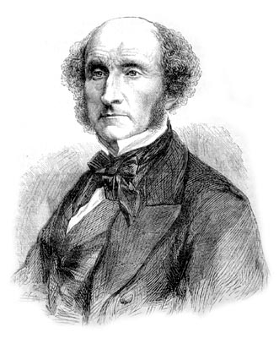
John Stuart Mill (1806-1873)
Student of Jeremy Bentham
Learnt Latin at four, Greek at eight
Pen-friend with Comte
Studied Zoology and Chemistry in France
Refused to study at Oxford or Cambridge as he would not take Anglican Orders
On Liberty (1859) primarily a social work, but massive amount on religion. Also, The Utility of Religion (1874).

Slide 27
What little recognition the idea of obligation to the public obtains in modern morality is derived from Greek and Roman sources, not from Christian; as, even in the morality of private life, whatever exists of magnanimity, high-mindedness, personal dignity, even the sense of honor, is derived from the purely human, not the religious part of our education, and never could have grown out of a standard of ethics in which the only worth, professedly recognized, is that of obedience.
-- John Stuart Mill, "Chapter II: Of the Liberty of Thought and Discussion“, On Liberty (1859)
The world would be astonished if it knew how great a proportion of its brightest ornaments, of those most distinguished even in popular estimation for wisdom and virtue, are complete skeptics in religion.
-- John Stuart Mill, Autobiography Of John Stuart Mill, "Chapter II Moral Influences in Early Youth. My Father's Character and Opinions" (1873)
Christian morality (so called) has all the characters of a reaction; it is, in great part, a protest against Paganism. Its ideal is negative rather than positive; passive rather than action; innocence rather than Nobleness; Abstinence from Evil, rather than energetic Pursuit of Good: in its precepts (as has been well said) "thou shalt not" predominates unduly over "thou shalt."
-- John Stuart Mill, On Liberty (1859)

Slide 28
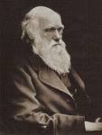
Charles Darwin
Origin of Species - 1859
Theorised that every generation of species includes small random differences between individuals.
Species are well adapted to their environment (and thus seem to be the products of intelligent design) because the less well-adapted individuals died out and did not reproduce.
This turns ‘creation’ and ‘androcentric’ cosmologies on their heads– it is not that the world is perfectly created for the species underneath it, it is that those species that were not perfectly suited did not survive.
Charles Darwin (1809-1882)

Slide 29
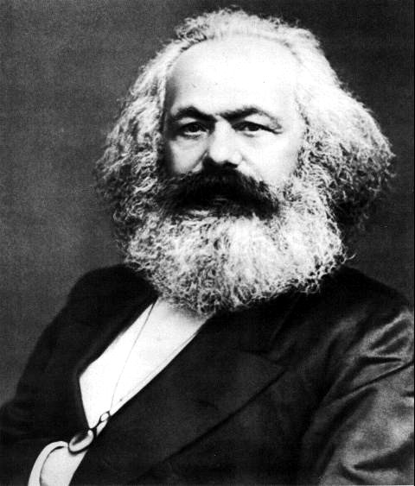
Karl Marx (1818-1883)
Marx saw Capitalism as a new form of social organisation – the exploitation of the workers by the owners of capital.
Capital owners = Bourgeois class
Workers = Proletarian class
Bourgeois extracted surplus value from the workers and expanded technologies of production to create a world-wide system of group dominance.
Marx argued that everything – law, politics, culture, religion – were based on the economic organisation of a society. This is a universal law, or meta-theory.
Religion was famously described as “the opium of the People” because it distracted from the here and now.

Slide 30
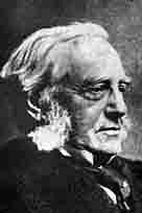
Friedrich Max Muller (1823-1900)
Overlooked for Boden Chair as friendly with editor of Essays and Reviews (Jowett 1860).
Oversaw translation of 50-volume Sacred Books of the East series still used today.
Used philology to understand development of religions.
Added depth to comparative narratives (Flood & matsya-avatara and Gilgamesh & Enkidu)

Slide 31
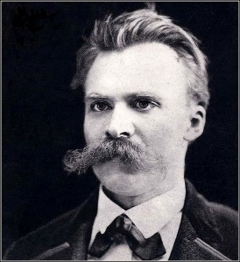
Friedrich Nietzsche (1844-1900)
‘God is Dead’
Nihilism – life is ultimately pointless and there are no substantive truths to existence beyond this.
Very different to later atheists who align atheism with humanism and morality.
Understood by his successor Heidegger as the ‘death of metaphysics’.
Nietzsche himself understood nihilism as something to be overcome – perhaps what other post-Heidegger atheist philosophers have tried to achieve (but note the criticisms of modern theologians – e.g. ‘without God what meaning do we have’?)

Slide 32
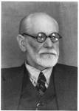
Sigmund Freud (1856-1939)
Defined religion as: “…illusions, fulfillments of the oldest, strongest, and most insistent wishes of mankind”
(The Future of Illusion 1927)
Religion as a ‘Mental Defence’ in life.
In a Judaeo-Christian sense, Freud believed this manifested itself in the ‘Father’ in Heaven as our protector.
Led Freud to describe religion as “…the universal obsessional neurosis of humanity.”
(The Future Illusion, 1927)
Linked religious ritual with obsessive behaviour – enacted for no obvious purpose. Religious acts become acts of deference for ancestors.

Slide 33

Emile Durkheim (1858-1917)
Mechanical & Organic Solidarity:
Durkheim grouped societies into different forms of solidarity – for Durkheim, this acted like a structure, a joining point of societies, such as the values, customs and beliefs of a given group. He called this the collective conscience.
Mechanical Solidarity – seen in primitive societies where social functions are close-knit affairs.
Organic Solidarity – in complex industrial societies the division of labour breaks mechanical solidarity down and produces organic solidarity – including economic interdependence between states.

