Slide 1
Introduction to health and social care
Module LCHS4003
Lecturer: Jolly Nwankwo
Student ID 2325666
Agnieszka Szalek

Slide 2
INDIVIDUAL PRESENTATION
DENTAL SERVICES
THROUGHOUT THE YEARS 1948 – 2024

Slide 3
Overview
Introduction
Past and Present
Conclusion
References

Slide 4
Introduction
The presentation will review the origin of dental care with the developments done over years. It will also be helpful to study the past and present of dental care operations.

Slide 5
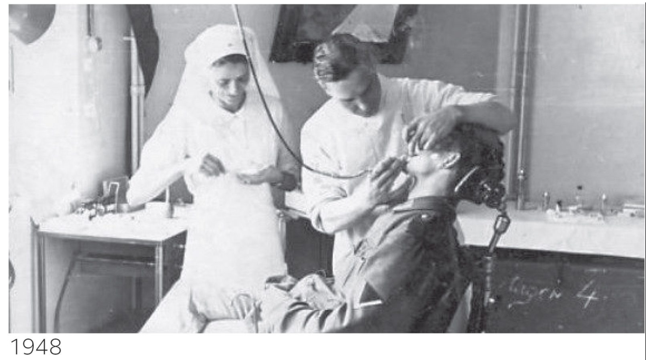
Dentistry Services Past
The National Health Service faced overwhelming demand for dental care in 1948
The “prevention-based dentistry” was also introduced in 1950s.
Education

Slide 6
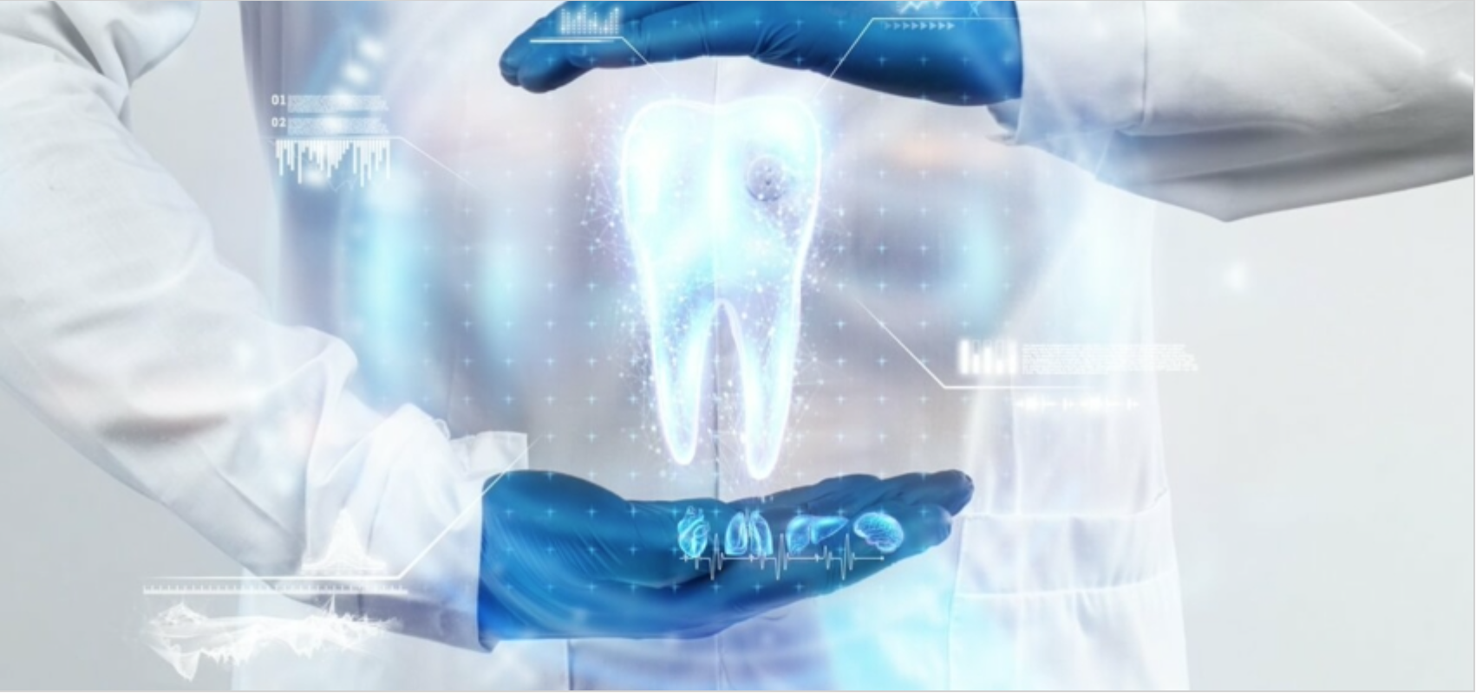
Dentistry Services Present
Dental care has a crucial role in protecting oral hygiene habits
Dentistry is a constantly developing field
Computerized imaging, 3D printing, and Artificial Intelligent (AI) driven diagnostics

Slide 7
Conclusion
It has been found that Dental Care Services are know to be one of the cruicial primary care
Today, the NHS actually wrestless with dificulties like significant delays and staffing deficences (O’Brien et al. 2022).

Slide 8
References
Ghoneim, A., Ebnahmady, A., D’Souza, V., Parbhakar, K.K., He, H., Gerbig, M., Singhal, S. and Quiñonez, C., (2022). The impact of dental care programs on healthcare system and societal outcomes: a scoping review. BMC Health Services Research, 22(1), p.1574.
İlgün, G., Konca, M., Yetim, B. and Şahin, B., (2022). Does efficiency of oral and dental health centers change by the development level of regions?. Value in Health Regional Issues, 31, pp.61-66.
O'Brien, K.J., Forde, V.M., Mulrooney, M.A., Purcell, E.C. and Flaherty, G.T., (2022). Global status of oral health provision: identifying the root of the problem. Public Health Challenges, 1(1), p.e6.
Spielman, A.I., (2024). Dental education and practice: past, present, and future trends. Frontiers in Oral Health, 5, p.1368121.

