Slide 1

Presentation
BMHP6030
Health, Wellbeing and Sustainable Development

Slide 2





Table of Contents
4.
In Health Policies and Sustainable Development Frameworks
2.
Key Concepts: Definitions and Discussion
3.
Holistic Health Approaches
5.
Theoretical Perspectives
1. Introduction
6.
Policy and Governance
7.
Service Delivery
9.
Equity and Access
10.
Conclusion
8.
Public Health Initiatives

Slide 3
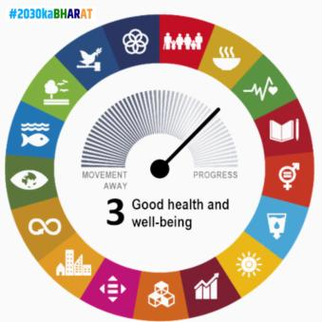
Introduction
Overview: Health, well-being, and sustainable development integration in the health and social care sector.
Importance: Key concepts in global healthcare challenges like COVID-19, environmental sustainability, and accessible healthcare.
Impact: Alignment with WHO’s SDGs for worldwide health goals.
(Weeks, Weinstein, and Lavista, 2023)
Notes:
1. Introduction
In this presentation, the incorporation of health, well-being and sustainable development into the health and social care sector was discussed. The three concepts are relevant in the modern direction of healthcare politics and practice, particularly in the global sphere of global concerns like the COVID-19 pandemic, environmental sustainability, and the growing desirability of accessible healthcare.
These ideas, when combined, will contribute significantly to the accomplishment of health goals worldwide and especially those which have been developed by the World Health Organisation (WHO) in the Sustainable Development Goals (SDGs) (Weeks, Weinstein, and Lavista, 2023).

Slide 4
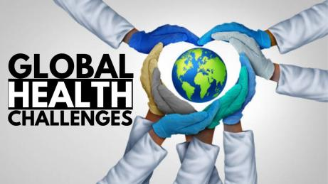
Key Concepts: Definitions and Discussion
Health (WHO, 2020): More than the absence of disease – physical, mental, and social well-being.
Example: A physically fit person may suffer from mental health issues, showing the connection.
Well-being (Keyes, 2002): Encompasses emotional, mental, physical, and social health.
Importance: Influences overall quality of life and emotional stability.
Sustainable Development (United Nations, 1987): Ensures future healthcare needs are met, with greener practices.
Example: Reducing healthcare system carbon footprint and waste.
(Keyes, 2002)
Notes:
2. Key Concepts: Definition and Discussion
Health, well-being and sustainable development have connections to one another and would be vital concepts used in current healthcare practices. These are vital ideas in enhancing the health of the people, providing and guaranteeing the well-being of the individuals and long-term health care system sustainability (Begum et al., 2021).
Health
According to the World Health Organisation (WHO, 2020), health is the lack of disease and, more so, full physical, mental, and social well-being. The extended definition provokes a more comprehensive understanding of health and promotes the conventional health care perspective to consider all aspects of a person's life. An example of someone being physically fit and yet experiencing low mental health might serve as evidence that mental and social health are part of the whole of health perception (WHO, 2020).
Wellbeing
Well-being is a comprehensive notion that encompasses both physical and mental, emotional and social health. Wellbeing aims to enhance a better life, emotional stability, and mental wellness. Well-being, according to WHO (2020), presupposes not only satisfaction with life but also positive emotional health as a factor reducing the risks of worsening health and improving the quality of life (Vittersø, 2025).

Slide 5


Health, Well-being, and Sustainable Development
Relevance in Healthcare Policies: WHO’s SDGs address global health and well-being, promoting equity and accessibility.
Integration: Leads to healthier populations, better mental health outcomes, and long-term healthcare system sustainability.
(Hasan, Jayasinghe, and Selvanathan, 2024).
Notes:
Sustainable Development
Healthcare sustainable development means a continuation of the current healthcare production such that the future population can continue meeting its requirements (United Nations, 1987). These involve being greener in the practices related to healthcare. They involve ensuring better utilisation of resources and resilient healthcare systems in the future. The latter method may emphasise the necessity of addressing the upcoming healthcare needs in the short term and long-term sustainability outcomes (WHO, 2020).
Healthcare Policies' Importance
These concepts have become incredibly critical in healthcare policies over the past years. The SDGs by WHO determine health and well-being as essential aspects of global sustainability, thus the necessity to narrow health disparities, enhance global health coverage, and enable equitable access to quality healthcare for everyone (WHO, 2020).
3. Health, Wellbeing and Sustainable Development.
The concepts of health, well-being and sustainable development entail the project of health care systems that are directed towards the treatment of not only diseases but also the health and sustainability of the whole health care system (Greeley, Shahan, and Barua, 2021). The application of holistic health methods and sustainable development systems would be instrumental in ensuring that the health care systems consider the three aspects of prevention, mental health, social determinants of health, and environmental influence (Hasan, Jayasinghe, and Selvanathan, 2024).

Slide 6
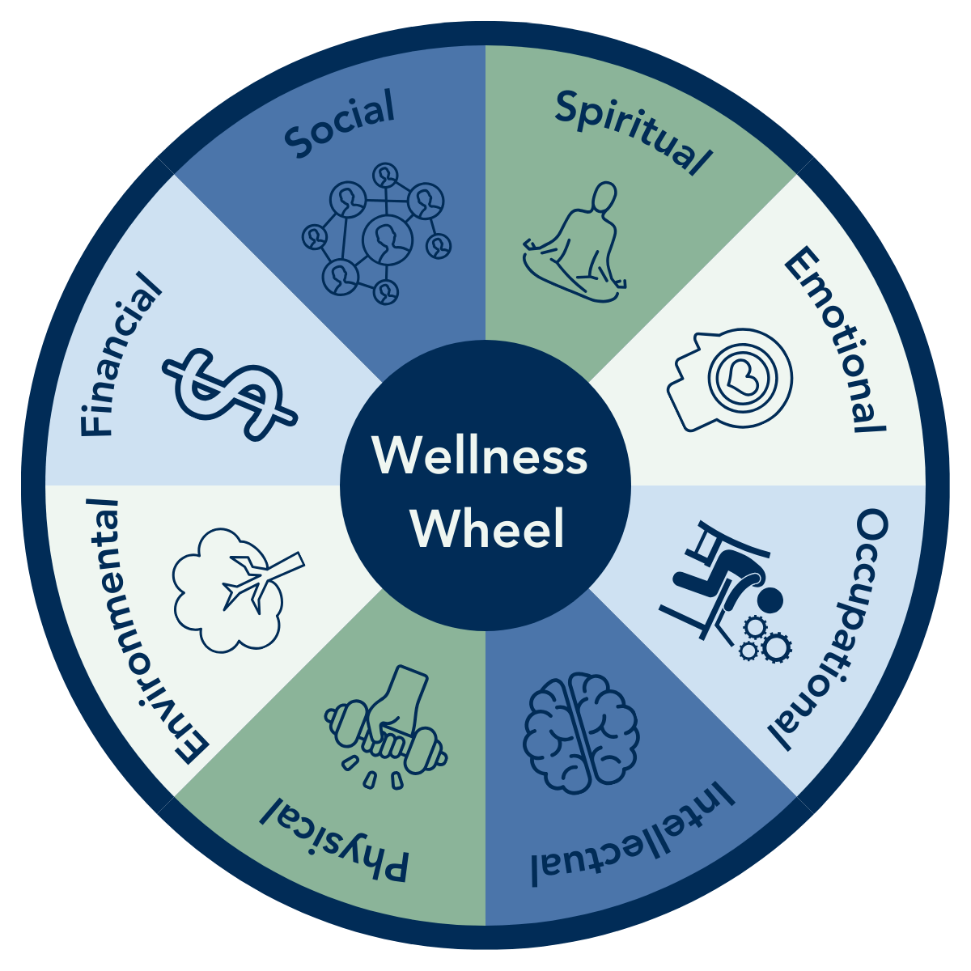
Holistic Health Approaches
Definition: Healthcare focusing on physical, mental, and social health.
Example: Patient-centred care emphasises emotional and mental needs along with physical health.
Benefits: Improves satisfaction, health outcomes, and patient care.
Example: NHS community health services that include both physical and mental health.
(Porter, 2020).
Notes:
Holistic Health Approaches
The holistic approaches to health involve the practices of health care that include the implementation of physical, mental, and social health in medical care. There is growing medical attention to patient-centred care that does not emphasise only the physical health of patients but also the emotional, social and mental needs. Such a strategy is essential in improving patient satisfaction and health outcomes. Presumably, wide-societal health needs could be served with the help of community health services targeting physical and mental health (Porter, 2020).

Slide 7
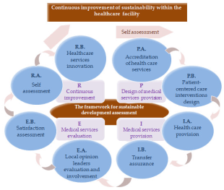
In Health Policies and Sustainable Development Frameworks
Health in All Policies (WHO, 2020): Integrates health into government policies across sectors.
Outcome: Encourages health promotion, disease control, and equitable resource distribution.
Benefits: Address long-term sustainability challenges in healthcare provision.
(WHO, 2020)
Notes:
In Health Policies, there are Sustainable Development Frameworks.
Through sustainable development projects like the Health in All Policies project by the WHO, all other sectors of government policy incorporate health issues in their policy frameworks. The integration fosters policies that encourage good health and disease control and equitable allocation of healthcare resources with due regard to long-term consequences of healthcare practice (WHO, 2020).

Slide 8
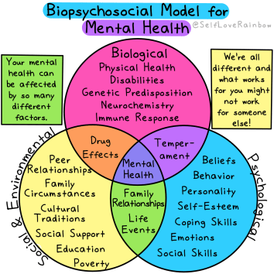

Theoretical Perspectives
Biopsychosocial Model (Engel, 1977): Health is the result of biological, psychological, and social factors.
Example: Holistic care addressing emotional, social, and physical needs.
Comparison with Medical & Social Models:
Medical Model: Focuses only on physical health.
Social Model: Focuses only on social aspects, excluding biological factors.
(Engel, 1977)
Notes:
Biopsychosocial Model
The biopsychosocial model brings together biological, psychological, and social elements in health (Nakao, Komaki, Yoshiuchi, 2020). It underlines that health should be treated as the outcome of genetics, individual behaviour, and societal enactments interactions. This paradigm has become a common approach in the healthcare sector to provide comprehensive care that extends to the well-being of the patient. This model was first conceived by Engel (1977) in his attempt to discuss the significance of viewing the care of the patient in the entirety and taking into account the emotional, social and physical aspects of health.
Comparison to the other Models
Although the Biopsychosocial Model is holistic in outlook on health, the Medical Model is concerned with the physical issues of health and only treats the symptoms of the disease. Instead, the Medical Model fails to address adequate psychological and social determinants of health. The Social Model of Health again focuses on the social influences of health, but excludes the biological influences fully, as the Biopsychosocial Model does.

Slide 9
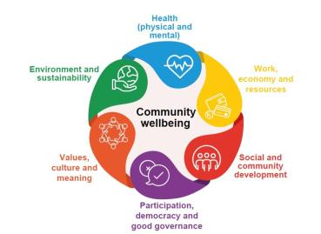
Policy and Governance
Relevant Policies
Policy and Governance Challenges
(Sulistiadi, Wasir, Thalib, 2024)
Notes:
Relevant Policies
The emphasis on preventive care policies, the use of mental health policies, and the restructuring of social care by the NHS are just some of the policies that are assisting in the incorporation of health and well-being into healthcare delivery (Sulistiadi, Wasir, Thalib, 2024). The associated policies focus on minimising health disparities, advancing physical and psychological well-being, and seeking ways to secure a sustainable and equitable provision of care to all.
Policy and Governance Challenges
Nonetheless, some issues hinder the implementation of the policies on health and well-being. These are government regulations, a lack of sufficient funds, and more seamless integrations within industries. These issues must be participative and inter-sectoral. Health inequity is not at all eliminated, and its solution might involve a combination of efforts involving healthcare, education, and social services.

Slide 10
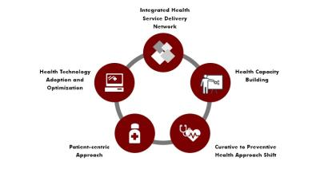
Service Delivery
Wellness and Telehealth Programmers: Healthcare systems are increasingly becoming dominated by wellness programs, which include workplace health programs, fitness and mental health programs, among others
Case Examples: Practical implementation of the holistic care model reflected in the NHS, aimed at delivering community-based health care, can lead to the achievement of better patient outcomes.
(WHO, 2020)
Notes:
6. Service Delivery
It is important to state that integration of health, well-being and sustainable development in the delivery of services would guarantee positive health outcomes and viability of health care systems in the long run. In this section, the author explains the integration of wellness programmers, telehealth, and community-based programmers into healthcare service delivery.

Slide 11
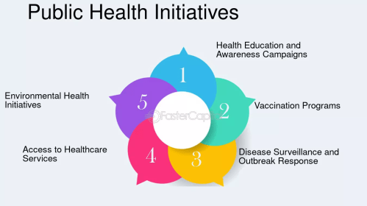
Public Health Initiatives
Social Determinants of Health: Focus on healthy lifestyles to improve public health.
Example: UK Change4Life campaign promoting healthy eating, exercise, and smoking cessation.
Impact: Positive changes in lifestyle, reduced chronic diseases, and improved public health.
(The importance of public health in times of crisis - FasterCapital, 2024)
Notes:
7. Public Health Initiatives
The social determinants of health are covered, and the enhancement of a healthy way of living is stated as the overall purpose of the public health programmes. We may call such efforts essential to the welfare of people as a whole and the prevention of health. Sales of Fitnessful Balanced Lifestyles. Some of these campaigns have encouraged healthy dieting, like the UK Change 4 Life campaign, in which physical exercise and quitting smoking are encouraged. The campaigns are aimed at changing the lifestyle to avoid getting chronic diseases like heart disease, obesity, etc., by influencing individuals to make more appropriate decisions.

Slide 12
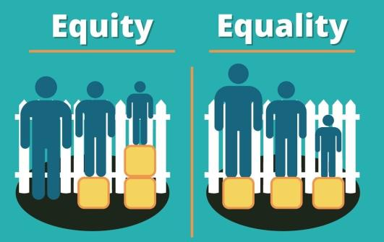
Equity and Access
Healthcare Disparities: Inequality in healthcare access and care has proven to be evident in the majority of areas across the world, particularly in rural and urban areas or different classes or religions.
Efforts To Dominate Inequalities: Universal health care, interventions focusing on marginalised population groups, and community-based solutions for health care demands that such inequalities in healthcare are reduced to a minimum.
(WHO, 2020)
Notes:
8. Equity and Access
Healthcare equity is one of the most significant concerns that influences the quality and access of care. Inequities in healthcare availability and care levels may be brought about by differences in socioeconomic status, location and race. To engender equity in healthcare systems, these inequalities need to be addressed.
Healthcare Disparities
Inequality in healthcare access and care has proven to be evident in the majority of areas across the world, particularly in rural and urban areas or different classes or religions. The inequities lead to poor health conditions and poorer lifestyles among the underserved population.
Efforts To Dominate Inequalities.
Universal health care, interventions focusing on marginalised population groups, and community-based solutions for health care demands that such inequalities in healthcare are reduced to a minimum. Such actions are a guarantee of social justice because these actions provide equal opportunities regarding access to good medical care that can promote the health of people (WHO, 2020).

Slide 13

Conclusion
Sustainable development, health and well-being are among the elements that must be assembled into a process that reacts to the realisation of a healthcare system centred on living and inert compliance to the future and present demands of particular healthcare.
Notes:
. Conclusion
Sustainable development, health and well-being are among the elements that must be assembled into a process that reacts to the realisation of a healthcare system centred on living and inert compliance to the future and present demands of particular healthcare. By undertaking the following strategies, a better and viable healthcare system that is sustainable, equitable, and is holistically guided in medical provisions can be achieved: staffing the better institutions with models of sustainable development, and improving equitable access. The rising concern of governments and delivery frameworks over the concept is a significant move in contributing to the welfare of the subjects.

Slide 14
References
Begum, H., Alam, A. S. A. F., Leal Filho, W., Awang, A. H., and Ghani, A. B. A. (2021). “The COVID-19 Pandemic: Are There Any Impacts on Sustainability?” Sustainability, 13(21), 11956. DOI: 10.3390/su132111956
Greeley, M., Shahan, A. M., and Barua, S. B. (2021). Sustainable Development, Human Dignity and Choice: Lessons from the ENRICH Programmer, Bangladesh. Springer Cham.
Hasan, M. R., Jayasinghe, M., and Selvanathan, E. A. (2024). “New Approach to Measure Wellbeing: A Case Study on Bangladesh.” Social Indicators Research, 172, 283 - 311. DOI: 10.1007/s11205 023 03305 4
Nakao, M., Komaki, G., and Yoshiuchi, K. (2020). “Biopsychosocial medicine research trends: connecting clinical medicine, psychology, and public health.” BioPsychoSocial Medicine, 14, Article 30. DOI: 10.1186/s13030 020 00204 9
Porter, R. J. (2020). “The biopsychosocial model in mental health.” Australian & New Zealand Journal of Psychiatry, 54(8). DOI: 10.1177/0004867420944464 SAGE Journals The use of a biopsychosocial model in the treatment of patients with chronic conditions. Patient Education and Counselling, 121 (April 2024), Article 108117. DOI: 10.1016/j.pec.2023.108117
Sulistiadi, W., Wasir, R., and Thalib, W. (2024). “Building health systems resilience: understanding the social, economic, and cultural impacts of climate change from stakeholders’ perspectives in Indonesia.” Archives of Public Health, 82, Article 168. DOI: 10.1186/s13690 024 01403 4
Vittersø, J. (2025). Humanistic Wellbeing: Toward a Value-Based Science of the Good Life. Springer Cham.
Weeks, W. B., Weinstein, J. N., and Lavista, J. M. (2023). “All Sustainable Development Goals Support Good Health and Well Being.” International Journal of Public Health, 68:1606901. DOI: 10.3389/ijph.2023.1606901
World Health Organisation (2020). World health statistics 2020: monitoring health for the SDGs, sustainable development goals. Geneva: WHO. Available at: https://apps.who.int/iris/handle/10665/332070 (Accessed: [24th September 2025]).
The importance of public health in times of crisis - FasterCapital (2024). https://fastercapital.com/topics/the-importance-of-public-health-in-times-of-crisis.html/1.
Notes:
Begum, H., Alam, A. S. A. F., Leal Filho, W., Awang, A. H., and Ghani, A. B. A. (2021). “The COVID-19 Pandemic: Are There Any Impacts on Sustainability?” Sustainability, 13(21), 11956. DOI: 10.3390/su132111956
Greeley, M., Shahan, A. M., and Barua, S. B. (2021). Sustainable Development, Human Dignity and Choice: Lessons from the ENRICH Programmer, Bangladesh. Springer Cham.
Hasan, M. R., Jayasinghe, M., and Selvanathan, E. A. (2024). “New Approach to Measure Wellbeing: A Case Study on Bangladesh.” Social Indicators Research, 172, 283‑- 311. DOI: 10.1007/s11205‑023‑03305‑4
Nakao, M., Komaki, G., Yoshiuchi, K. (2020). “Biopsychosocial medicine research trends: connecting clinical medicine, psychology, and public health.” BioPsychoSocial Medicine, 14, Article 30. DOI: 10.1186/s13030‑020‑00204‑9
Porter, R. J. (2020). “The biopsychosocial model in mental health.” Australian and New Zealand Journal of Psychiatry, 54(8). DOI: 10.1177/0004867420944464 SAGE Journals
Sulistiadi, W., Wasir, R., Thalib, W. (2024). “Building health systems resilience: understanding the social, economic, and cultural impacts of climate change from stakeholders’ perspectives in Indonesia.” Archives of Public Health, 82, Article 168. DOI: 10.1186/s13690‑024‑01403‑4
The use of a biopsychosocial model in the treatment of patients with chronic conditions. Patient Education and Counselling, 121 (April 2024), Article 108117. DOI: 10.1016/j.pec.2023.108117
Vittersø, J. (2025). Humanistic Wellbeing: Toward a Value-Based Science of the Good Life. Springer Cham.
Weeks, W. B., Weinstein, J. N., and Lavista, J. M. (2023). “All Sustainable Development Goals Support Good Health and Well‑Being.” International Journal of Public Health, 68:1606901. DOI: 10.3389/ijph.2023.1606901
World Health Organisation 2020. World health statistics 2020: monitoring health for the SDGs, sustainable development goals. Geneva: WHO. Available at: https://apps.who.int/iris/handle/10665/332070 (Accessed: [24th September 2025]).

