Slide 1

Employee Engagement needs of individuals

Slide 2
WHAT MEANS Employee Engagement?
MacLeod and Clarkes(2009) concept of Employee Engagement
Strategic narrative
“a strong, transparent and explicit organisational culture which gives employees a line of sight between their job and the vision and aims of the organisation” (MacLeod and Clarke 2009, 31).

Slide 3
Engaging managers
“Engaging managers who offer clarity, appreciation of employees’ effort
and contribution, who treat their people as individuals and who ensure
that work is organised efficiently and effectively so that employees feel
they are valued, and equipped and supported to do their job.” (MacLeod and Clarke 2009, 31)
Employee voice
“Employees’ views are sought out; they are listened to and see that their
opinions count and make a difference. They speak out and challenge when
appropriate. A strong sense of listening and responsiveness permeates the
organisation, enabled by effective communication.” (MacLeod and Clarke 2009, 75)
Example is Vergin the company claimes to listin to the employees voice

Slide 4
Integrity
“A belief among employees that the organisation lives its values, and that espoused
behavioural norms are adhered to, resulting in trust and a sense of integrity” (MacLeod and Clarke 2009, 33)
American Express – Focus On Behaviours

Slide 5
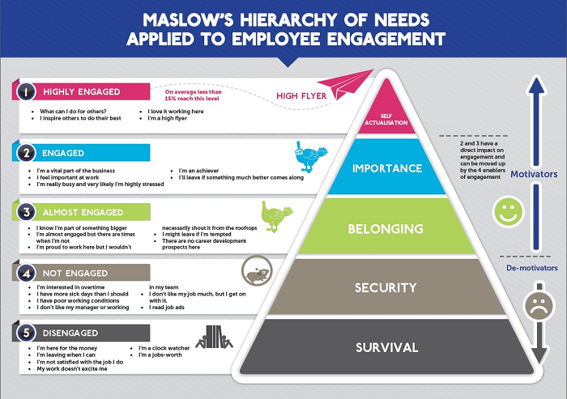
Employee Engagement and Maslow hierarchy of needs motivated employees engaged more
https://www.servicefutures.com/can-maslows-hierarchy-needs-help-understand-employee-engagement

Slide 6
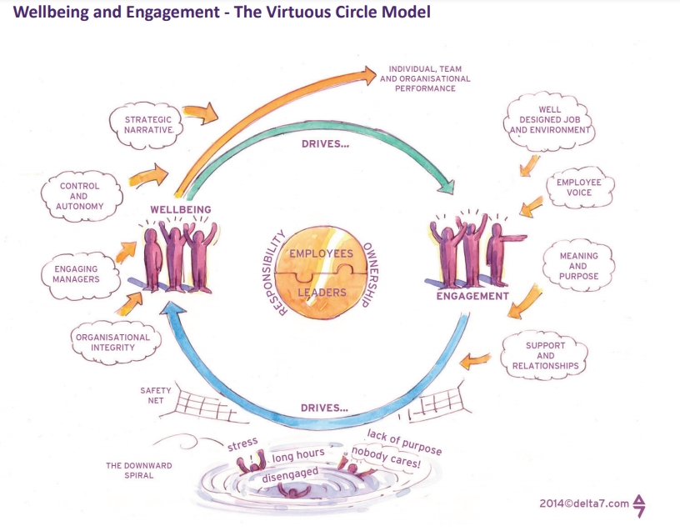
“A workplace approach designed to ensure that employees are committed to their organisation’s goals and values, motivated to contribute to organisational success, and are able at the same time to enhance their own sense of well-being.” (MacLeod and Clarke, 2009, 9)
THE EVIDENCE Wellbeing and Employee Engagement (May 2014)

Slide 7
Different companies different approaches to employee engagment strategy
Vergin- listining to the voice of employees
Sephora-training and development
Google-Transparacny
John Lewis-Empowering, partnership
Full Contact -wellbeing
https://www.entrepreneur.com/article/285052
https://www.managers.org.uk/knowledge-and-insights/case-study/6-companies-that-get-employee-engagement-and-what-they-do-right/
https://www.johnlewispartnership.co.uk/work/employee-ownership.html

Slide 8
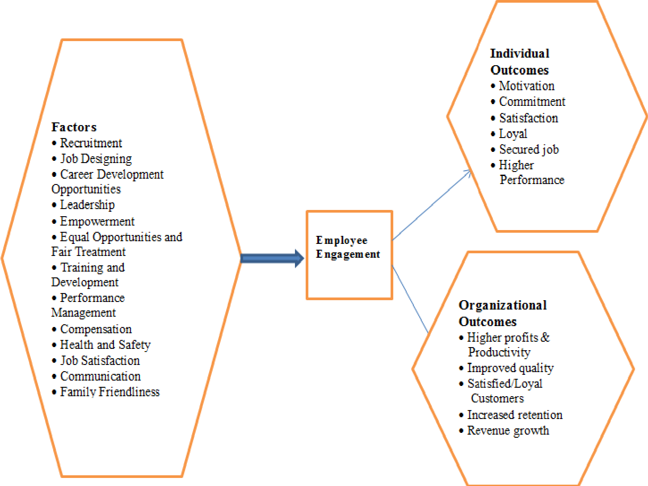
efecting employee engagment factors, k. Mysore(2013)

